Slide 1
PHASE 1
PHASE 2
Generate Distill Data
Secret Sharing
Private Dataset A
Private Dataset A
Private Dataset B
Private Dataset B
Teacher Model A
Teacher Model B
MTT Train Trajectory
Raw Logits
Distilled Data
Float to Ring

Slide 2





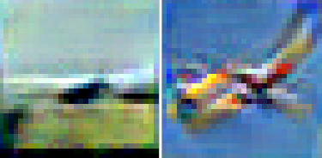
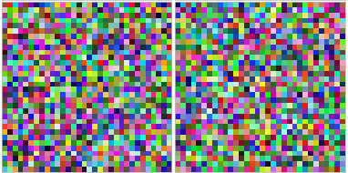

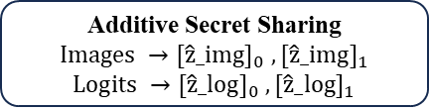
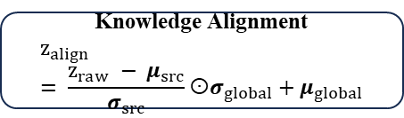
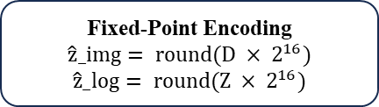
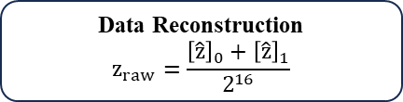
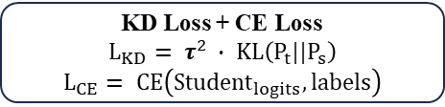
1. Local Preparation
2. Secure Data Sharing
3. Alignment & Training
Institution A
Knowledge Distillation
(Soft Lables / CE Loss)
Distilled Data
Secure Knowledge Sharing
(Secert Sharing / MPC)
Private Data
Institution B
Teacher
Model
Knowledge Alignment
(Multi Teacher Fusion)
Final Student Model
(Privacy-Preserving Train)
Private Data
PHASE 1
PHASE 2
PHASE 3
PHASE 4
Local Model Preparation
MPC Encoding
Decrypt & Knowledge Alignment
Student Distillation Training
Private Data D_A
Private Data D_B
Fixed-Point Encoding
$$\hat{z}_img= round(D × 2^{16})$$
$$\hat{z}_log= round(Z × 2^{16})$$
Data Reconstruction
$$z_{raw}=\frac{{\left[\hat{z}\right]}_{0}+{\left[\hat{z}\right]}_{1}}{2^{16}}$$
Data Augmentation
$$self.augmentor(imgs)$$
MTT Train Trajectory
L_traj = ||θ̂-θ*|| ² / ||θ*|| ²
Raw Logits
Additive Secret Sharing
$$Images →{[\hat{z}_img]}_{0} ,{[\hat{z}_img]}_{1}$$
$$Logits →{[\hat{z}_log]}_{0} ,{[\hat{z}_log]}_{1}$$
Encrypted Images
Knowledge Alignment
$$z_{align}= \frac{z_{raw} − μ_{src}}{σ_{src}}σ_{global}+μ_{global}$$
Student Forward
Distilled Data
Dd_A
Distilled Data
Dd_B
Distilled Data
Encrypted Logits
KD Loss + CE Loss
$$L_{KD}= τ^{2} ∙ KL\left(P_{t}||P_{s}\right)$$
$$L_{CE}= CE\left({Student}_{logits},labels\right)$$
Teacher Traing
T_A
Teacher Traing
T_B
Aligned Teacher Logits
Model Optimization
Final Student Model

Slide 3
1. Local Preparation
2. Secure Data Sharing
3. Alignment & Training
Institution A
Knowledge Distillation
(Soft Lables / CE Loss)
Distilled Data
Secure Knowledge Sharing
(Secert Sharing / MPC)
Private Data
Institution B
Teacher
Model
Knowledge Alignment
(Multi Teacher Fusion)
Final Student Model
(Privacy-Preserving Train)
Private Data

Slide 4
Client 1:
Local MPC Encryption
Inference
Distilled Data
Teacher Model
Server :
Local Samples
Secure Construction
Knowledge Alignment
Client 2:
Student Distillaton
Local MPC Encryption
Inference
Final Global Student
Distilled Data
Teacher Model
Local Samples

Slide 5

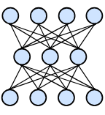

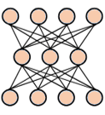





① Local teacher preparation ② Client-side protected knowledge generation ③ Secure reconstruction and knowledge alignment ④ Server-side student distillation
Server
Protected knowledge
Proteced Batch Reception
Protected knowledge
③
Protected batches
Client 1
Secure Reconstruction
Client 2
Local MPC Encryption
Recon-logits
Local MPC Encryption
②
Knowledge Alignment
Distilled images
Teacher logits
Aligned soft
targets
Distilled images
Teacher logits
Teacher Inference
Recon-samples
Teacher Inference
Student Distillation
④
Distilled Samples
Teacher Model
Distilled Samples
Teacher Model
Local Samples
①
Local Samples
Data distillation
Training data
Data distillation
Training data
Raw Images
Labels
Final Global Student
Raw Images
Labels

Slide 6

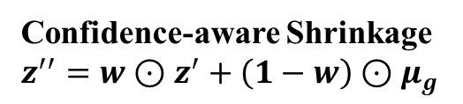
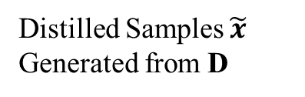

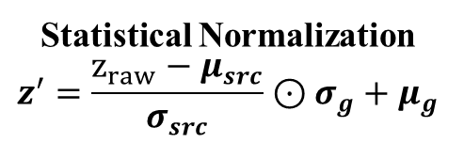

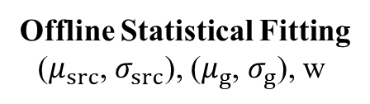
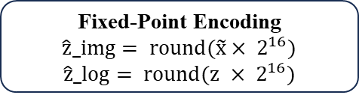



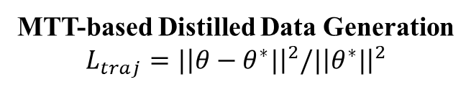
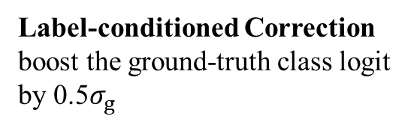
Representative Client
Server
Recon-samples
Private Data D ={($x_{i}$, $y_{i}$)}
Statistical Normalization
Knowledge Alignment
Student Distillation
Teacher Training
T trained on D
Fixed-Point Encoding
$$\hat{z}_img= round(\tilde{x}× 2^{16})$$
$$\hat{z}_log= round(z × 2^{16})$$
Proteceted Batch Reception
receive protected sample
and logit shares
Statistical Normalization
Statistical Normalization
Statistical Normalization
$$z^{′}=\frac{z_{raw}−μ_{src}}{σ_{src}}⊙σ_{g}+μ_{g}$$
Aligned
Soft
Targets
Student Forward
Teacher Inference
$$z = T\left(a\left(\tilde{x}\right)\right)$$
Distilled samples
Teacher logits
Statistical Normalization
Two–Share Additive Secret Sharing
$$Images →{[\hat{z}_img]}_{0} ,{[\hat{z}_img]}_{1}$$
$$Logits →{[\hat{z}_log]}_{0} ,{[\hat{z}_log]}_{1}$$
Statistical Normalization
KD Loss + CE Loss
$$L_{KD}= τ^{2} ∙ KL\left(P_{t}||P_{s}\right)$$
$$ℒ=αℒ_{KD}+(1−α)ℒ_{CE},$$
Distilled Samples $\tilde{x}$
Generated from D
Secure Reconstruction
$$z_{raw}=\frac{{\left[\hat{z}\right]}_{0}+{\left[\hat{z}\right]}_{1}}{2^{16}}$$
Statistical Normalization
Confidence-aware Shrinkage
$$z^{′′}=w⊙z^{′}+\left(1−w\right)⊙μ_{g}$$
Recon-logits
Statistical Normalization
Statistics
Statistical Normalization
MTT-based Distilled Data Generation
$$L_{traj}=|{\left|θ−θ^{∗}|\right|}^{2}/|{\left|θ^{∗}|\right|}^{2}$$
Protected samples
Protected logits
Offline Statistical Fitting
($μ_{src}$, $σ_{src}$), ($μ_{g}$, $σ_{g}$), w
Prior
Label-conditioned Correction
boost the ground-truth class logit
by 0.5$σ_{g}$
Optimized Model
Statistical Normalization
Final Global Student

Slide 7


PHASE 1
PHASE 2
PHASE 3
PHASE 4
Local Preparation
MPC Encoding
Decrypt & Knowledge Alignment
Student Distillation Training
Private Data D = {($x_{i}$, $y_{i}$)}
Fixed-Point Encoding
$$\hat{z}_img= round(D × 2^{16})$$
$$\hat{z}_log= round(Z × 2^{16})$$
Data Reconstruction
$$z_{raw}=\frac{{\left[\hat{z}\right]}_{0}+{\left[\hat{z}\right]}_{1}}{2^{16}}$$
Data Augmentation
$$self.augmentor(imgs)$$
Raw Logits
Additive Secret Sharing
$$Images →{[\hat{z}_img]}_{0} ,{[\hat{z}_img]}_{1}$$
$$Logits →{[\hat{z}_log]}_{0} ,{[\hat{z}_log]}_{1}$$
Encrypted Images
Knowledge Alignment
$$z_{align}= \frac{z_{raw} − μ_{src}}{σ_{src}}σ_{global}+μ_{global}$$
Student Forward
MTT Train Trajectory
L_traj = ||θ̂-θ*|| ² / ||θ*|| ²
Distilled Data
Encrypted Logits
KD Loss + CE Loss
$$L_{KD}= τ^{2} ∙ KL\left(P_{t}||P_{s}\right)$$
$$L_{CE}= CE\left({Student}_{logits},labels\right)$$
Private Data D_A
Aligned Teacher Logits
Model Optimization
Final Student Model

