Slide 1
Iris Dataset Data Visualization Project
By: Yukttam Shrivastava
Course: BBA DA&AI
SEM: IV
YEAR: II

Slide 2
Dataset Overview
The dataset used is the famous Iris dataset, which includes:
150 samples of iris flowers
4 features: Sepal Length, Sepal Width, Petal Length, Petal Width
3 classes: Iris-setosa, Iris-versicolor, Iris-virginica

Slide 3

DATASET
Iris dataset

Slide 4
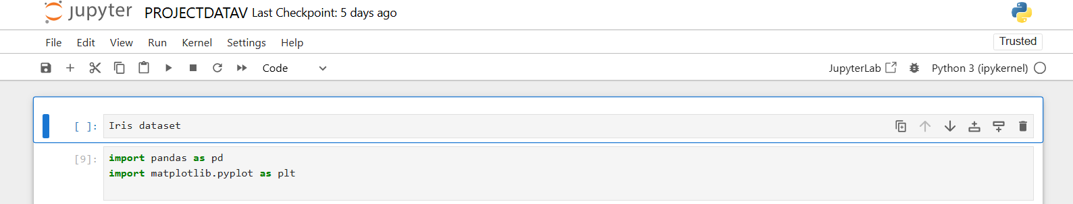
IMPORTS
import pandas as pd
import matplotlib.pyplot as plt

Slide 5

LOAD DATASET
# load the dataset
df = pd.read_csv("Iris.csv")

Slide 6

REMOVE ID COLUMN
# Remove the 'Id' column
df.drop(columns=['Id'], inplace=True)

Slide 7
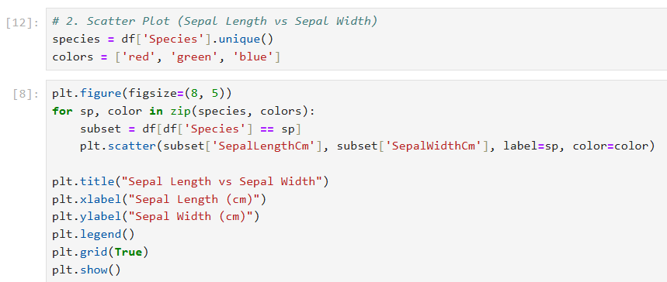
Scatter Plot Code Explanation

Slide 8
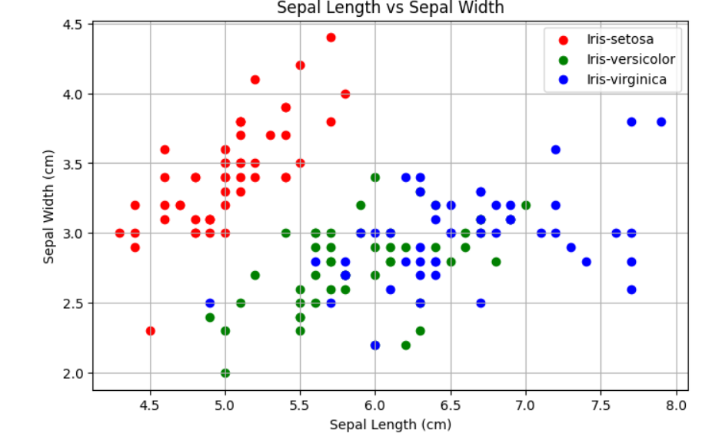
SCATTER PLOT

Slide 9
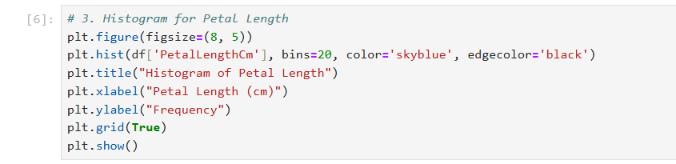
Histogram Code Explanation

Slide 10
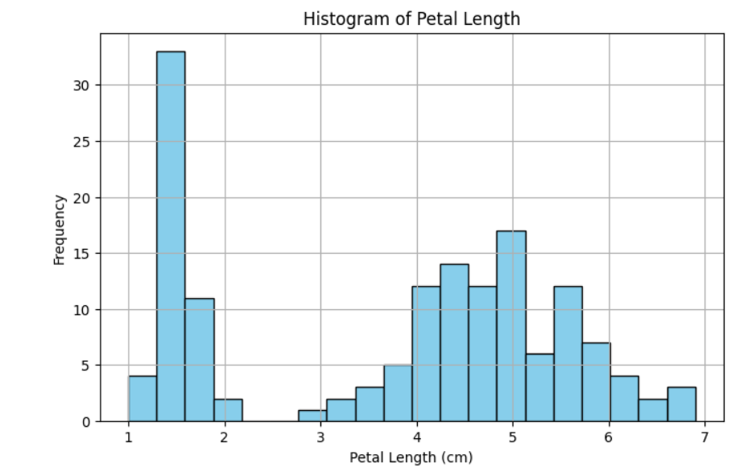
HISTOGRAM

Slide 11
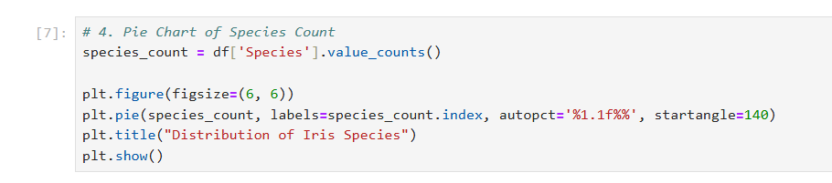
PIE CHART Code Explanation

Slide 12
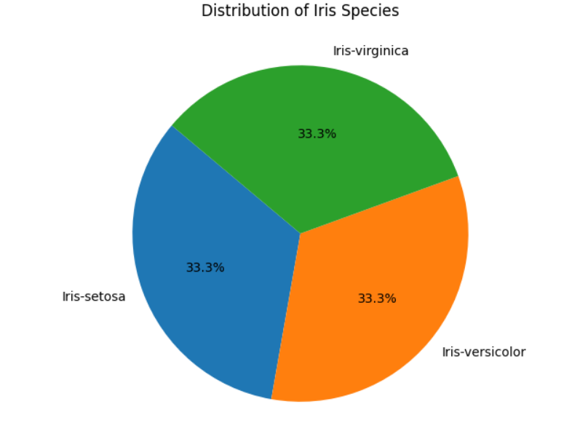
PIE CHART

