Slide 1
ETL PIPELINE PROJECT
BY- YUKTTAM SHRIVASTAVA
COURSE: BBA DA&AI
SEM: IV
YEAR: II

Slide 2
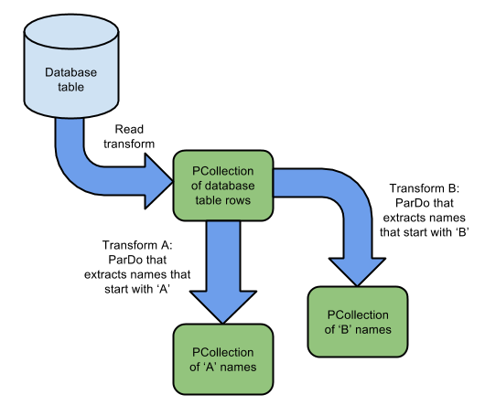
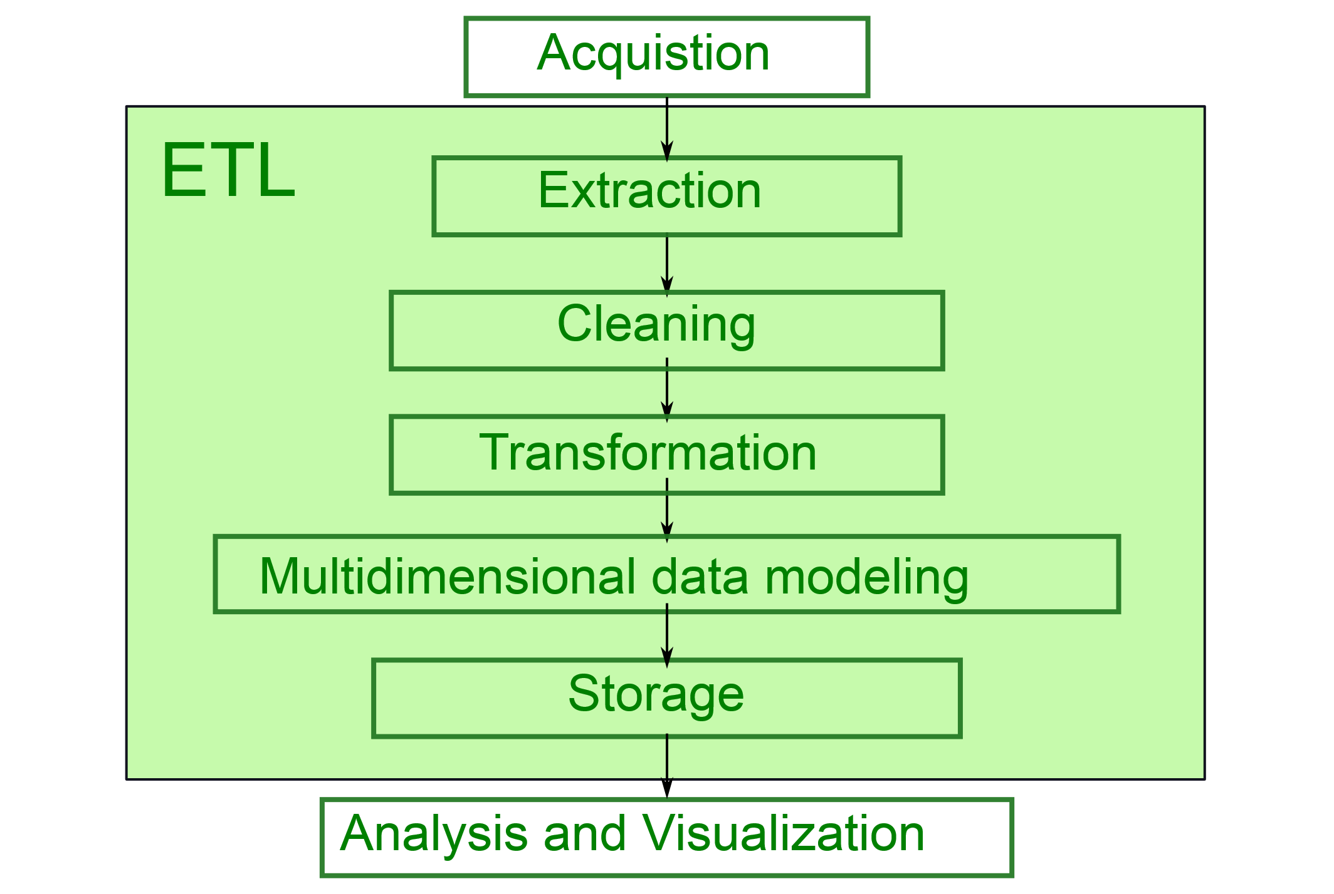
ETL Pipeline Project
A demonstration of Extract, Transform, Load process using Python.

Slide 3


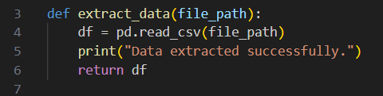
Extract Phase
Extract data from a CSV file using pandas.

Slide 4
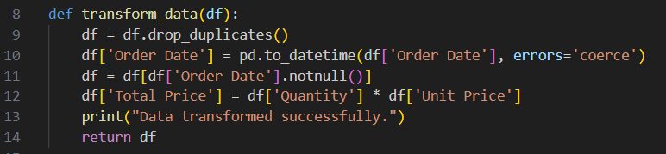
Transform Phase
Clean data, format dates, remove duplicates, and compute total price.

Slide 5

Load Phase
Load the cleaned data to a new CSV file.

Slide 6
Conclusion
This ETL pipeline showcases basic data processing using Python and pandas.

