Slide 1
Superstore Sales Dashboard Explanation
Power BI Report Summary
By: Yukttam Shrivastava
COURSE: BBA DA&AI
SEM: IV
YEAR: II

Slide 2
Dataset Overview
This Power BI report is built on the Superstore US 2015 data and includes:
Order information (date, ID, priority, shipping mode)
Customer and geographic details
Product category and sub-category
Sales, profit, discount, and quantity metrics
The goal is to identify trends, best performing regions, products, and profit drivers.

Slide 3
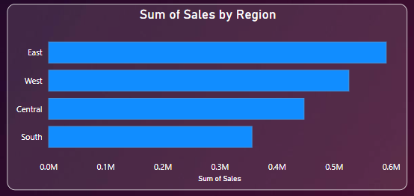
Sales by Region
This bar chart shows total sales for each region.
The West region has the highest sales followed by the East.

Slide 4
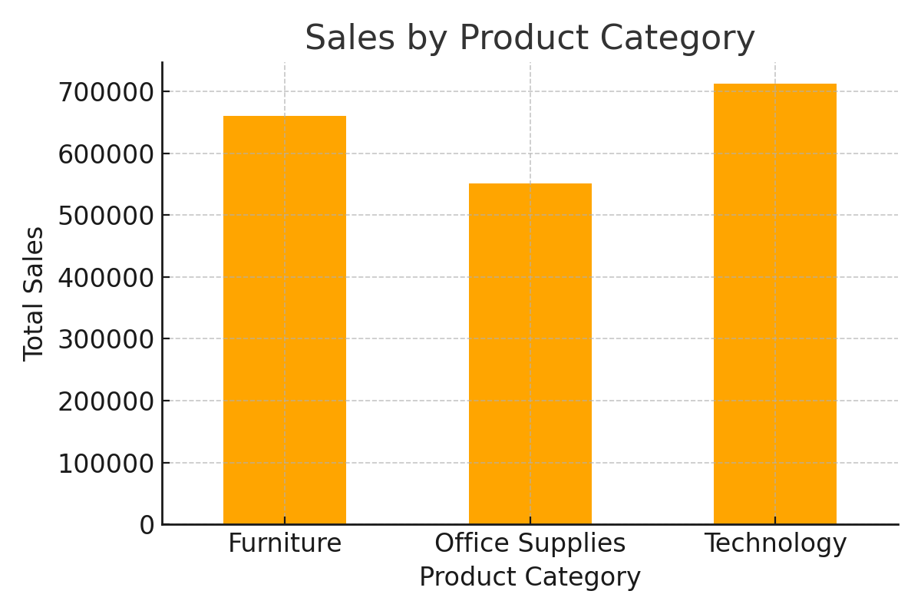
Sales by Product Category
Furniture and Technology categories drive the majority of sales
Office Supplies has relatively lower revenue.

Slide 5
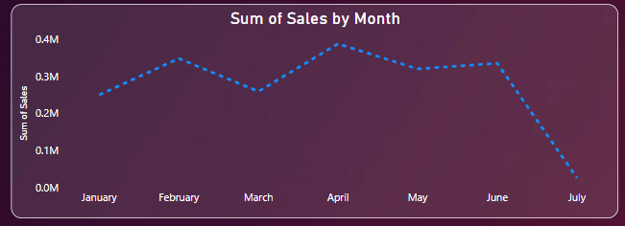
Monthly Sales Trend
Sales peak around March and June
showing potential promotional or seasonal impact.

Slide 6
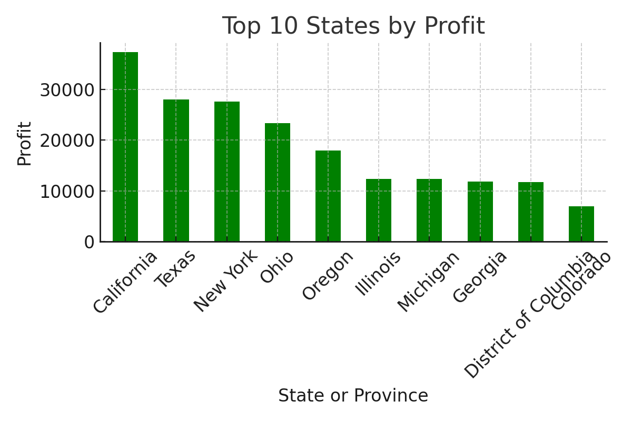
Top 10 States by Profit
This bar chart identifies the most profitable states.
California is the leader, while some states show negative profit.

Slide 7
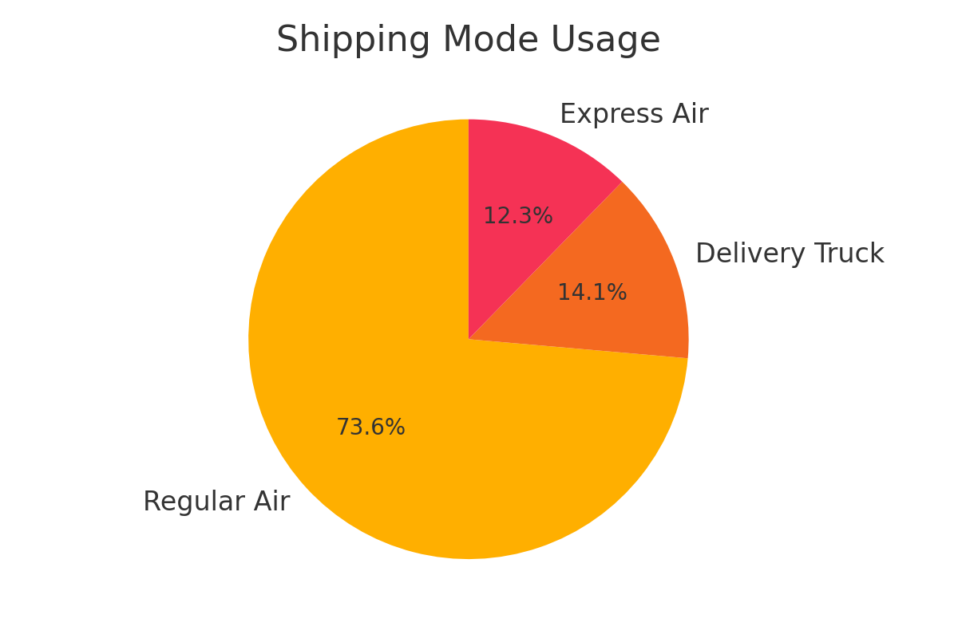
Shipping Mode Usage
The pie chart shows Regular Air and Delivery Truck are the most used shipping modes, indicating their popularity.

Slide 8
Key Insights Summary
West region and California are top performers in terms of sales and profit.
Furniture and Technology lead product sales.
Regular Air and Delivery Truck dominate shipping modes.
Discounts can negatively affect profitability.
March and November show strong seasonal sales trends.

