Slide 1
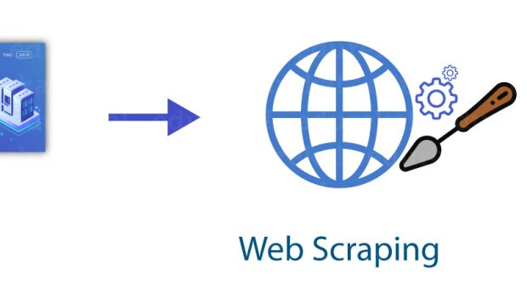
Web Scraping Project Using Python
Scraping Amazon Product Data and Saving to CSV
NAME: YUKTTAM SHRIVASTAVA
COURSE: BBA DA&AI
SEM: IV
YEAR:II

Slide 2


Project Overview
• Objective: Extract product data from Amazon
• Tools: Python, Requests, BeautifulSoup, Pandas
• Output: CSV file with Product Name, Price, and Rating

Slide 3
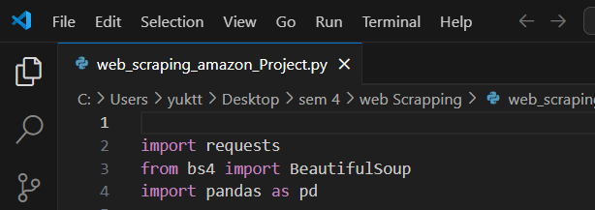
Step 1: Import Libraries
requests - to send HTTP requests
bs4 (BeautifulSoup) - to parse HTML content
pandas - to save data into a CSV file

Slide 4
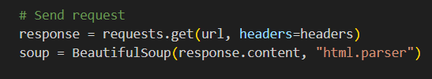
Send HTTP Request
Define the product search term
Set up headers to mimic a browser
Send request using requests.get()
Parse response with BeautifulSoup

Slide 5
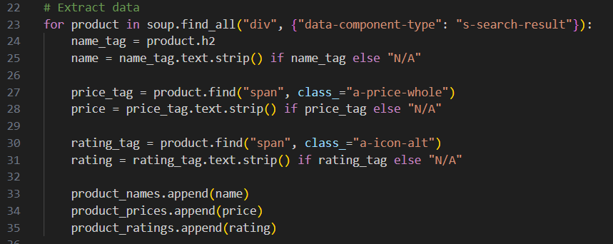
Extract Product Data
Loop through search result containers
Extract:
Product Name
Price
Rating
Append data to lists

Slide 6
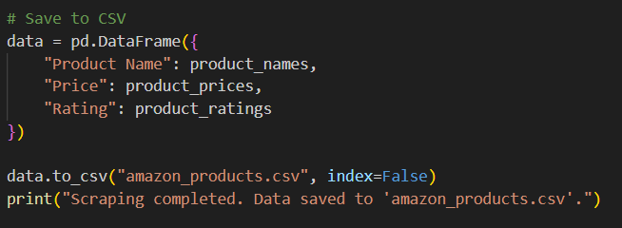
Save Data to CSV
Create a DataFrame using pandas
Save data to a CSV file
File: 'amazon_products.csv'

Slide 7
Possible Enhancements
• Scrape multiple pages
• Use Selenium for dynamic websites
• Add GUI using tkinter
• Schedule scraping with cron or Task Scheduler

