Slide 1

Challenge
Team KONEction
Engineer: Yuko Enqvist

Slide 2

Objective
Once a elevator parameter to be changed, the impact of the change on elevator performance must be characterized
Aim to develop a Machine Learning model to evaluate the impact of the elevator parameters’ change on elevator performance

Slide 3
Model Definition
Input:
Six Parameters
Data set used
measurements collected from a 6-elevator group
processed in a fixed interval (15 mins)
data_before: 1.7 –5.12.2017 (15169 sampling points)
data_after: 15.1 – 8.5.2018 (10849 sampling points)
Output:
calls_up [#]
calls_down [#]
starts_up [#]
starts_down [#]
availability [%]
alarm [#]
Machine
Learning
Model
average call time [s]

Slide 4
Modelling Tools
Scikit-learn machine learning library for Python
Scientific libraries used
NumPy
pandas
Scipy
matplotlib

Slide 5
Models
Linear regression:
in sklearn: LinearRegression()
Ridge regression (Regularization method)
in sklearn: Ridge()
Random forest
an ensemble learning method for regression
in sklearn: ensemble.RandomForestRegressor()

Slide 6
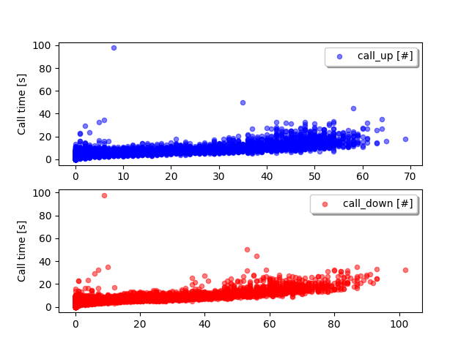
Input data (data_before) (1)
Call time vs calls_up/ calls_down
one outlier removed (id=9877)

Slide 7
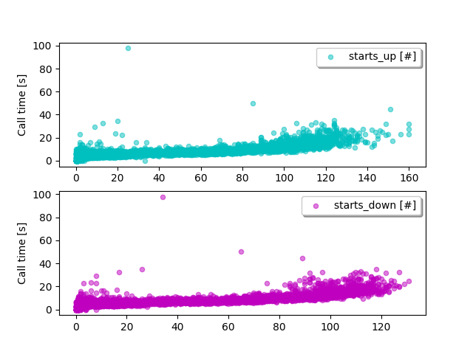
Input data (data_before) (2)
Call time vs starts_up/ starts_down
one outlier removed (id=9877)

Slide 8
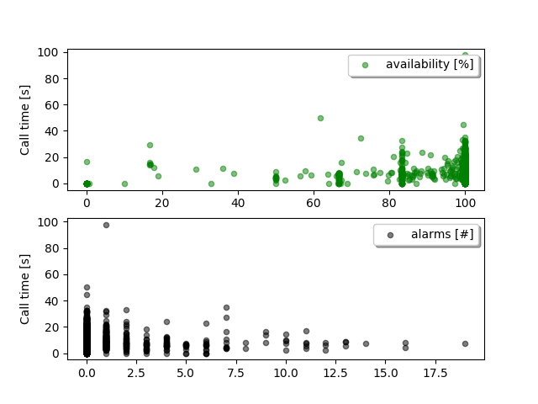
Input data (data_before) (3)
Call time vs availability/ alarms
one outlier removed (id=9877)

Slide 9
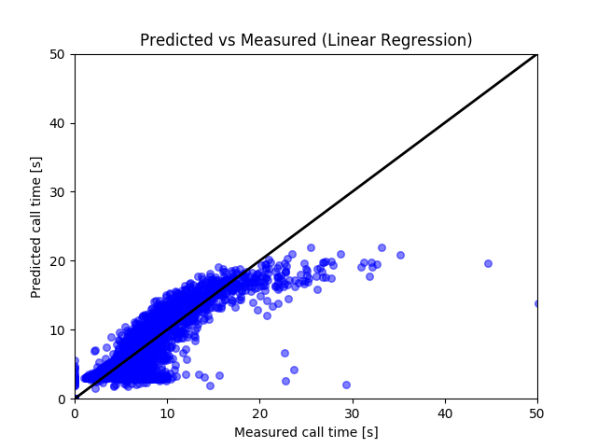
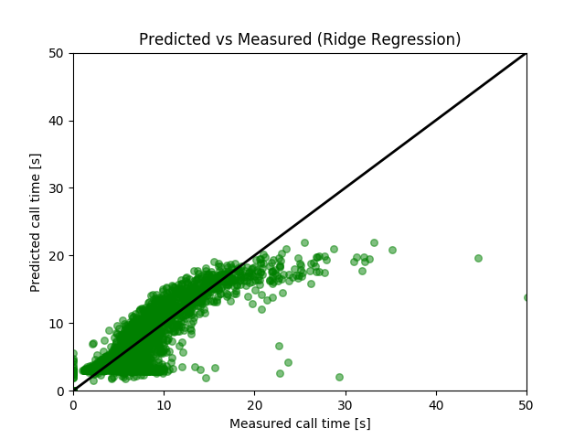
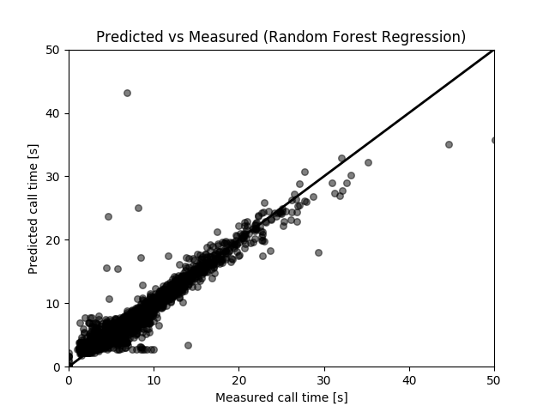
Modelling Results (1)
Data_before used: train(9100)/ test(6068) data
Model | MSE | R-squared
Linear Regression | 4.536 | 0.795
Ridge Regression | 4.536 | 0.795
Random Forest | 0.815 | 0.963

Slide 10
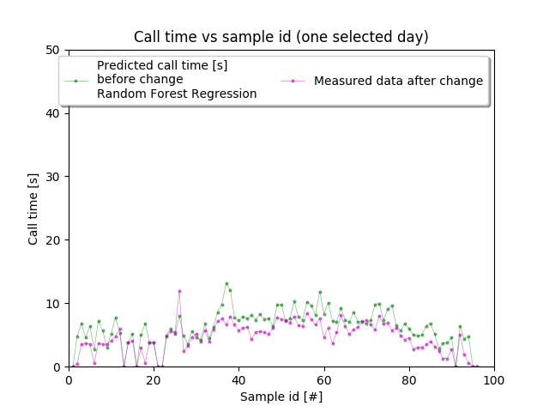
Modelling Results (2)
Data_before used: train(9100)/ test(6068) data
Predicted average call time [s] | 7.821
Measured average call time [s] | 5.653
Average gaps between measured and predicted data [-] | 2.535

Slide 11
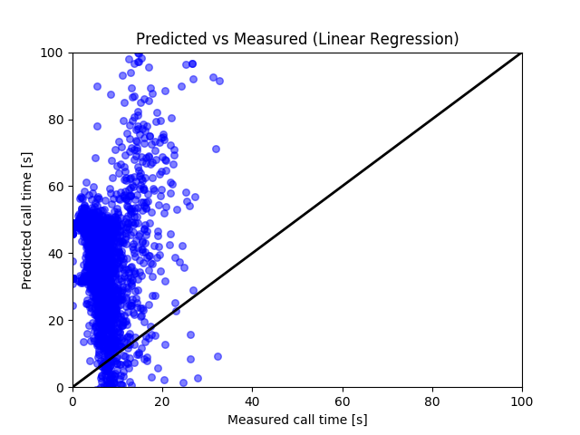
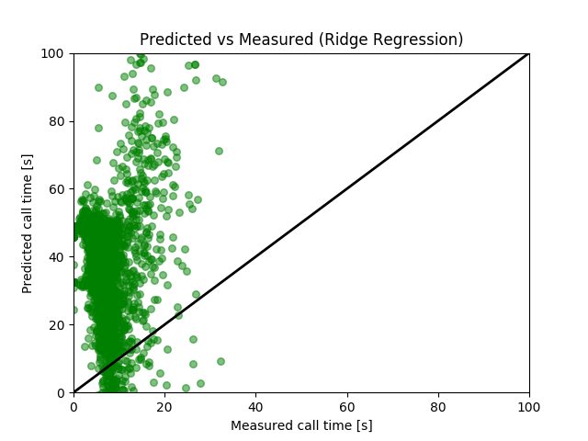
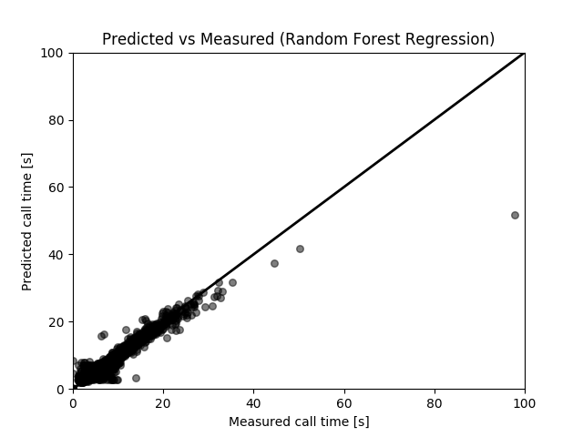
Modelling Results (3)
Data_before used: call time for missing data 0 to -10000; train(9100)/ test(6068) data
 | MSE | R-squared
Linear Regression | 1.230 *10⁵ | 0.995
Ridge Regression | 1.230 *10⁵ | 0.995
Random Forest | 9.897 *10² | 1.0

Slide 12
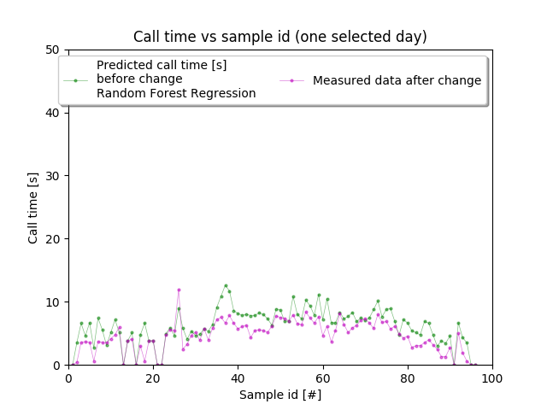
Modelling Results (4)
Data_before used: call time for missing data 0 to -10000; train(9100)/ test(6068) data
Predicted average call time [s] | 7.873
Measured average call time [s] | 5.653
Average gaps between measured and predicted data [-] | 196.81 NA?

Slide 13
Summary
Three Machine Learning models have been tested to map from six inputs to one target output, call time.
Linear regression and Ridge regression model maps reasonably well in lower call time, respectively. When increasing call time, discrepancies for both models increase considerably.
So far Random forest model maps between inputs and output best.
The impact of change of elevator parameters is identified by using Random forest model.

