Slide 1

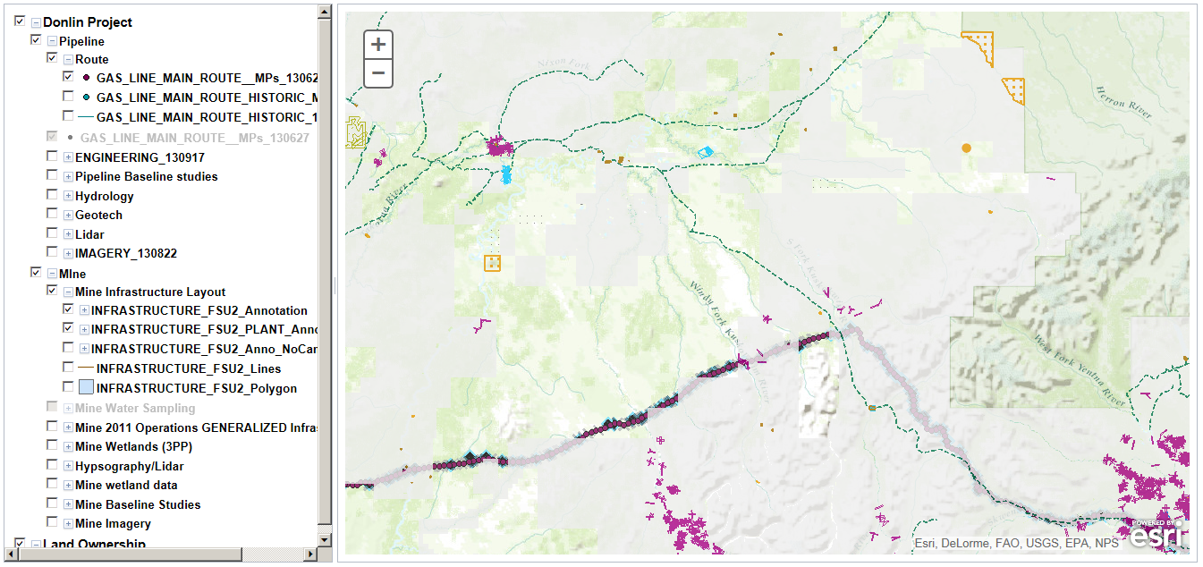
Department of Natural Resources
Project Portal: Donlin Mine Project
Map
Documents
Calendar

Slide 2
Mapping page
Utilizes ESRI web services
Can ingest DNR land record layers used in Alaska Mapper
Uses a 3rd-party “table of contents” control to allow users to toggle layers.
Requires the publishing of a web service through an ArcGIS server.
GIS files could be available for direct download if users needed to perform more advanced analytics on the GIS data.

Slide 3
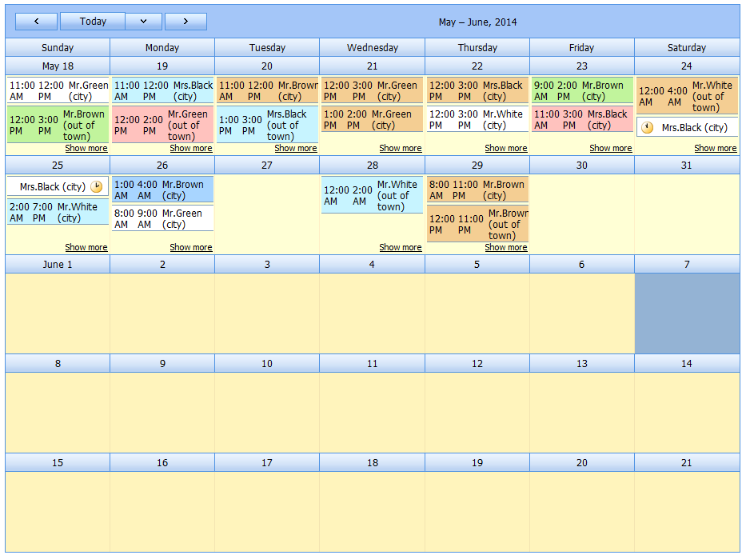
Department of Natural Resources
Project Portal: Donlin Mine Project
Map
Documents
Calendar

Slide 4
Calendar page
Requires the set up of an Exchange calendar object that can be managed from within Outlook
Uses a DevExpress calendar to control to access the Exchange calendar object
Can read and write to the calendar, depending on users needs.

Slide 5
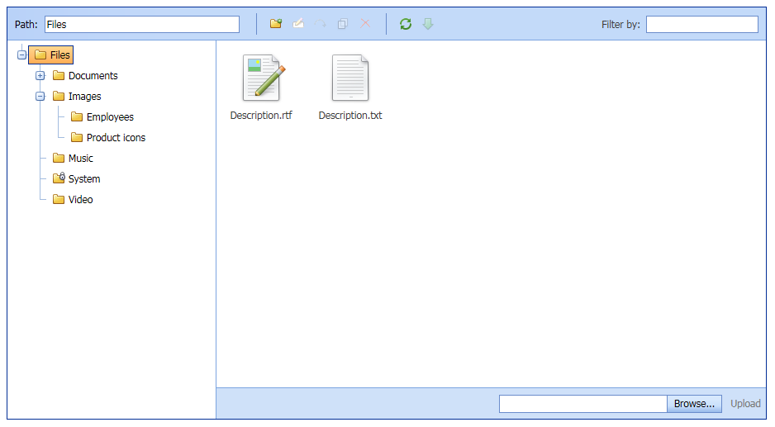
Department of Natural Resources
Project Portal: Donlin Mine Project
Map
Documents
Calendar

Slide 6
Documents page
A networked file share will be set up and managed primarily through Windows File Explorer.
A DevExpress control is used to provide file access on the networked share via a browser.
Files can be read/write accessible via the browser, depending on the users needs.

