Slide 1

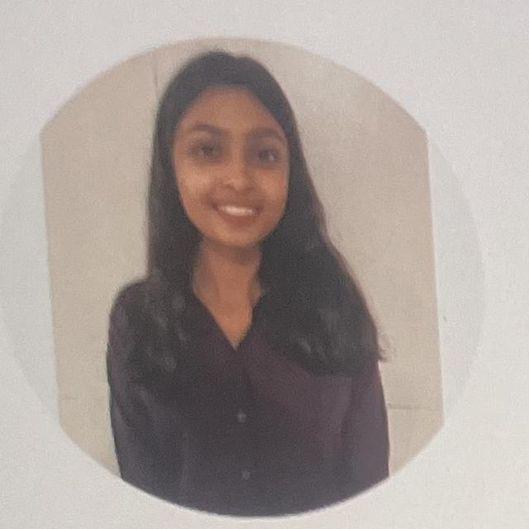
Summary
Certification
Versatile Software Engineer with 4+ years of experience designing, building, and deploying scalable backend systems and APIs. AWS Developer Associate certified, with hands-on expertise across backend frameworks (FastAPI, Node.js), cloud architecture, and Generative AI / LLM systems. Adept at end-to-end project delivery and architecting enterprise-grade solutions that drive measurable business impact.
AWS Certified Developer – Associate
Amazon Web Services
Technology / Skills
Backend
Python · FastAPI · Node.js · REST APIs
Project Experience
Yukta Nagle
Cloud & DevOps
AWS (Dev Associate) · Azure · Docker · Kubernetes
Senior Associate
NIA – Next Intelligent Agent: Architected a multi-tenant AI agent administration platform in FastAPI with JWT authentication and fine-grained RBAC across 8 roles; built an A2A routing layer that dynamically dispatched prompts to specialized agents, improving response accuracy by 30%, and used Apache Kafka for real-time, low-latency messaging under peak loads.
Survey Lens: Architected a scalable serverless backend on AWS (Lambda, DynamoDB, API Gateway, EventBridge) powering dynamic survey creation and bulk distribution that grew survey reach by 40%; integrated TensorFlow/DeepFace for multimedia response analysis and Generative AI for auto-summarization, cutting prep time by 50%.
AI Interviewer: Built an AI-powered interview platform in FastAPI with automated resume evaluation and question generation (AutoGen); implemented real-time engagement monitoring and iris-tracking proctoring (MediaPipe, OpenCV) and identity verification via DeepFace (ArcFace, MTCNN).
Data & Analytics Engineering – Data Science
AI / ML
LLMs · Generative AI · TensorFlow · OpenCV
yukta.nagle@pwc.com
Databases
PostgreSQL · MySQL · DynamoDB · MongoDB
+91-8982315022
Bangalore (SDC) – Business Bay · Pune
pwc.com

