Slide 1
Sales Performance Dashboard
Task 3 – Elevate Labs Internship
By Yukta Dinesh Koli
Date: 05/06/2025

Slide 2
🎯 Dashboard Objective
• Create an interactive dashboard for business stakeholders
• Track KPIs such as Total Sales, Profit, and Units Sold
• Visualize trends using time-series analysis
• Enable drill-downs with slicers and filters

Slide 3
📁 Dataset Details
• Source: Kaggle – Sales Dataset
• Format: CSV file
• Fields: Amount, Profit, Quantity, Order Date, Category, Sub-Category
• Records: 1000+ rows

Slide 4
🛠️ Tools & Techniques
• Power BI Desktop
• Slicers for interactivity
• KPI cards for high-level metrics
• Line chart for time-based trends
• Custom color theme and formatting

Slide 5
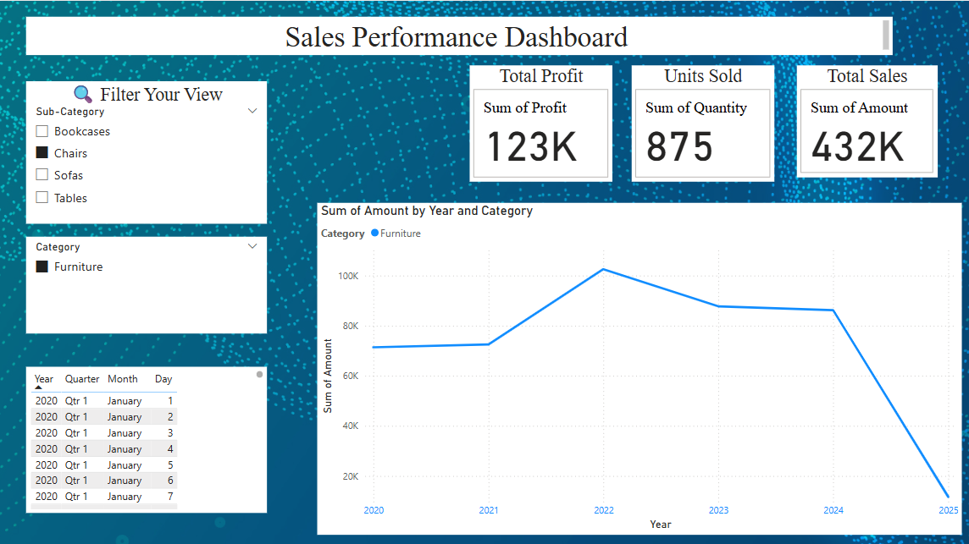
📸 Dashboard Snapshot

Slide 6
🔍 Key Dashboard Features
• Total Sales, Profit, and Units Sold displayed as KPI cards
• Filters: Category, Sub-Category, and Date Range
• Sales trend over years shown using a line chart
• Clean and professional layout with consistent theme

Slide 7
📈 Insights Derived
• Total Sales: 432K | Total Profit: 123K | Units Sold: 875
• Highest sales occurred in 2022
• Consistent sales from 2020 to 2024
• Product category 'Furniture' maintained steady performance

Slide 8
✅ Conclusion & Learnings
• Built an interactive dashboard using Power BI
• Gained hands-on experience with DAX, slicers, and KPIs
• Developed strong skills in visual storytelling
• Ready to apply dashboarding skills in real-world projects

Slide 9
🙏 Thank You!
Presented by: Yukta Dinesh Koli
Project: Sales Dashboard | Task 3
Date: 05/06/2025
GitHub Repository: https://github.com/Yuktaisha7675/Task03_SalesDashboard.git

