Slide 1

cv
BRAIN TUMOR PREDICTION USING DEEP LEARNING NETWORK
Literature Survey - Batch No.: 17
Team Members:
1. Yukta N Shettigar - 1DS19CS197
2. Bhargavi S - 1DS19CS198
3. Keerthana K - 1DS19CS721
4. K R Divyashree - 1DS19CS722
Under the Guidance of
Prof. S Keerthi
Assistant Professor, Department of Computer Science and Engineering
Department of Computer Science & Engineering, DSCE

Slide 2
cv
TABLE OF CONTENTS
Literature Survey 03
2. Base Paper Explanation 13
i. Introduction 14
ii. Architecture 16
iii. Methodology 17
iv. Conclusion 20
3. Valid References 21
4. Individual Contribution 23
Department of Computer Science & Engineering, DSCE

Slide 3
cv
LITERATURE SURVEY
SL No. | Authors | Title | Algorithms and Classifiers | Abstract | Result
1 | Nilesh Bhaskarrao Bahadure, Arun Kumar Ray, and Har Pal Thethi | Image Analysis for MRI Based Brain Tumour Detection and Feature Extraction Using Biologically Inspired BWT and SVM | Support Vector machine (SVM) based classifier, Berkeley wavelet transformation (BWT) based brain tumour segmentation | Brain tumor segmentation to reduce the complexity and improve the performance of the medical image segmentation. To enhance the accuracy and quality rate of the support vector machine (SVM) based classifier, relevant features are extracted from each segmented tissue. | 96.51% Accuracy, 94.2% Specificity, and 97.72% Sensitivity
Department of Computer Science & Engineering, DSCE

Slide 4
cv
LITERATURE SURVEY
SL No. | Authors | Title | Algorithms and Classifiers | Abstract | Result
2 | E.S.A. El-Dahshan, H.M. Mohsen, K. Revett, B.M. Salem A | Computer-aided diagnosis of human brain tumor through MRI: a survey and a new algorithm | Segmentation Region of Interest(ROI), ANN, PCNN | A hybrid technique for processing of MRI Images which first applies feedback pulse-coupled neural network as a front-end processor for image segmentation and detecting the region of interest, and then employs the discrete wavelet transform to extract features from MRI images. | Classification Accuracy of 99% with 100% Sensitivity rate and 92% Specificity rate
Department of Computer Science & Engineering, DSCE

Slide 5
cv
LITERATURE SURVEY
SL No. | Authors | Title | Algorithms and Classifiers | Abstract | Result
3 | Sayan Kahali, Sudip Kumar Adhikari, Jamuna Kanta Sing | A two-stage fuzzy multi-objective framework for segmentation of 3DMRI brain image data | 3D spatial fuzzy c-means (3DSpFCM) algorithm applied on two-stage fuzzy multi-objective framework (2sFMoF) | A 3D spatial fuzzy c-means (3DSpFCM) algorithm is introduced by incorporating the cubic neighborhood information of the volume data to define a new local membership function along with the global membership function for each voxel | The time complexity obtained from the 2sFMoF architecture is approximately; O(3SC + S(BT + BW))
Department of Computer Science & Engineering, DSCE

Slide 6
cv
LITERATURE SURVEY
SL No. | Authors | Title | Algorithms and Classifiers | Abstract | Result
4 | K.B. Vaishnavee, K. Amshakala | An automated MRI brain image segmentation and tumor detection using SOM-clustering and proximal support vector machine classifier | Segmentation and clustering using SOM, SVM classifier, Proximal Support Vector Machines (PSVM) classifier | An effective segmentation and classification using HFS-SOM and PSVM were proposed. The texture features are utilized which can reduce the computation complexity of PSVM classifier. The experimental result shows that the proposed system shows a high accuracy rate and less error rate. | Accuracy measure observed: 82% - SVM 92% - PSVM
Department of Computer Science & Engineering, DSCE

Slide 7
cv
LITERATURE SURVEY
SL No. | Authors | Title | Algorithms and Classifiers | Abstract | Result
5 | W. Zhang, R. Li, H. Deng, L. Wang, W. Lin, S. Ji, D. Shen | Deep convolutional neural networks for multi-modality isointense infant brain image segmentation | Deep CNN for multi-modality brain image segmentation, Support Vector Machine (SVM) Classifier | Deep convolutional neural networks (CNNs) was used for segmenting iso-intense stage brain tissues (infant brain tissues) into white matter (WM), gray matter (GM), and cerebrospinal fluid (CSF) that plays an important role in studying early brain development in health and disease using multi-modality MR images. | CNN outperformed other methods for segmenting all three types of brain tissues
Department of Computer Science & Engineering, DSCE

Slide 8
cv
LITERATURE SURVEY
SL No. | Authors | Title | Algorithms and Classifiers | Abstract | Result
6 | Toan Duc Bui, Jitae Shin, Taesup Moon | Skip- connected 3D DenseNet for volumetric infant brain MRI segmentation, Biomed. Signal Process. | Fully Convolutional Densely Connected Network with Skip Connections for Volumetric infant brain tissue Segmentation, DenseNet for classification task | The paper has provided an accurate volumetric infant brain MRI segmentation approach (to segregate the brain tissues into non-overlapping areas) based on a densely connected network (DenseNet). The suggested network, known as 3D-SkipDenseSeg, extends the benefit of the newly developed DenseNet for classification task to segment the brain tissue using MRI. | The best dice similarity coefficient (DSC) was attained by 3D-SkipDenseSeg, which was 90.37 1.38% (WM), 92.27 0.81% (GM), and 95.79 0.54%. (CSF)
Department of Computer Science & Engineering, DSCE

Slide 9
cv
LITERATURE SURVEY
SL No. | Authors | Title | Algorithms and Classifiers | Abstract | Result
7 | L. Wang, F. Shi, G. Li, Y. Gao, W. Lin, J.H. Gilmore, D. Shen | Segmentation of neonatal brain MR images using patch-driven level sets | Novel Patch-Driven Level Set method | The paper describes a novel patch-driven level set method that makes a proper utilization of sparse representation techniques to segment neonatal brain MR images. The major emphasis of the paper is the segmentation of neonatal brain imaging into general grey matter (GM), white matter (WM), and cerebrospinal fluid (CSF) | Great accuracy of 0.919±0.008 and 0.901±0.005 for WM and GM respectively, is obtained.
Department of Computer Science & Engineering, DSCE

Slide 10
cv
LITERATURE SURVEY
SL No. | Authors | Title | Algorithms and Classifiers | Abstract | Result
8 | Mehdi Amian, Mohammadreza Soltaninejad | Multi-Resolution 3D CNN for MRI Brain Tumor Segmentation and Survival Prediction | Automated method for 3D deep segmentation, Random Forest | The prime objective is to segment the area surrounding glioma into its several sub-regions and provide segmentation labels for each of them. In this paper, a computerized method / an automated method for 3D deep segmentation is proposed for the detection of gliomas in 3D pre-operative MRI scans. | For predicting survival rate, the model's overall accuracy is: 49% - test dataset, and 52% - validation dataset
Department of Computer Science & Engineering, DSCE

Slide 11
cv
LITERATURE SURVEY
SL No. | Authors | Title | Algorithms and Classifiers | Abstract | Result
9 | O. Çiçek, A. Abdulkadir, S.S. Lienkamp, T. Brox, O. Ronneberger | 3D U-Net: learning dense volumetric segmentation from sparse annotation | Network for Volumetric Segmentation | The proposed network replaces all 2D activities with their equivalent 3D operations, extending the prior U-net architecture (19069955 parameters in total), given by Ronneberger et al. The confocal microscopic data set of the Xenopus kidney serves to demonstrate the successful implementation of the proposed strategy. | Intersection over Union (IoU) averages up to 0.863 in the semi-automated configuration.
Department of Computer Science & Engineering, DSCE

Slide 12
cv
LITERATURE SURVEY
SL No. | Authors | Title | Algorithms and Classifiers | Abstract | Result
10 | Salma Alqazzaz, Xianfang Sun, Xin Yang, Len Nokes | Automated brain tumor segmentation on multi-modal MR image using SegNet | Fully Convolutional Neural Network SegNet to 3D data | A fully convolutional neural network SegNet is applied to 3D data sets for four MRI modalities (Flair, T1, T1ce, and T2). This algorithm for precisely segmenting a brain tumor, attempts to locate the complete tumor volume and divide it into four sub-tumor regions. | F-measure scores were 0.85, 0.81, and 0.79. Specifically, for the augmenting tumor, the tumor core, and the overall tumor.
Department of Computer Science & Engineering, DSCE

Slide 13
cv
EXISTING SYSTEM EXPLAINATION
TITLE:
Brain tumor prediction on MR images with semantic segmentation by using deep learning network and 3D imaging of tumor region
AUTHORS:
Gokay Karayegen: Biomedical Equipment Technology, Vocational School of Technical Sciences, Baskent University, Baglica Campus, , Etimesgut, Ankara, Turkey
Mehmet Feyzi Aksahin: Biomedical Engineering Department, Faculty of Engineering, Baskent University, Baglica Campus, 06790, Etimesgut, Ankara, Turkey
Department of Computer Science & Engineering, DSCE

Slide 14
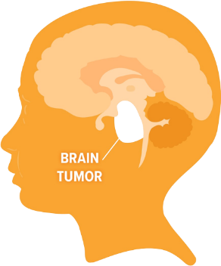
cv
INTRODUCTION
A brain tumor is the development of abnormal brain cells, which might lead to cancer. The main purpose of diagnosing brain tumors is to acquire substantial clinical information regarding the tumor presence, location, and type. The manual segmentation of 3D MRI images performed by medical experts is dependent on the clinician's knowledge and experience. Therefore, brain tumor segmentation that is both automatic and robust will have a significant impact on brain tumor diagnosis and treatment. To overcome the drawbacks of using manual features, the deep learning technique called Deep Convolutional Neural Networks (DCNNs) can be used as it has significant potential for segmenting brain image.
Department of Computer Science & Engineering, DSCE

Slide 15
cv
INTRODUCTION (contd..)
This paper uses 3D imaging of whole brain and a comparison between ground truth and predicted labels in 3D using MATLAB, which is a computing environment that can be used for image sharpening and histogram equalization to enhance the image contrast. In this paper, Brain Tumor Segmentation (BraTS) image datasets are used, which includes four different modalities for each brain image. These can be classified respectively as :
T1 (native),
T1C (post-contrast T1-weighted),
T2 (T2-weighted) and
Flair (T2 Fluid Attenuated Inversion Recovery).
Each MR imaging modalities represent different meaning in terms of diagnosing brain tumor. A different approach for segmenting 3D medical images by using deep learning network called Multi-Projection Network is introduced in this project.
Department of Computer Science & Engineering, DSCE

Slide 16
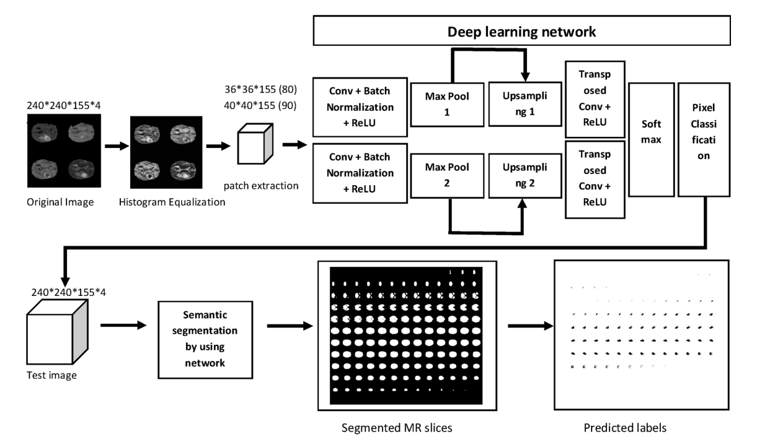
cv
ARCHITECTURE DIAGRAM
Fig. 1: Architecture of deep learning network and semantic segmentation.
Department of Computer Science & Engineering, DSCE

Slide 17
cv
METHODOLOGY
Pre-processing: Histogram equalization was applied to original images in order to contrast enhancement.
Deep learning network : The network consists of 2 operations namely: Up-Sampling and Down-Sampling.
Up-Sampling: Transposed convolution layers are added to the neural network for up-sampling the 3D feature maps of the data. Therefore, size of image can be enhanced at the end of these layers.
Down-Sampling: Max-pooling layers, which are inserted into network after convolution, batch normalization and Relu layers, are basically responsible for completing down-sampling of the image. Fundamentally, with these layers, it is aimed to manage data of a more suitable size, provide a faster processing time of the image.
Semantic segmentation: Semantic segmentation identifies the operation of correlating each pixel of a MR brain image with a class label such as background and tumor.
Department of Computer Science & Engineering, DSCE

Slide 18
cv
METHODOLOGY (cont…)
The suggested approach begins with image acquisition on MATLAB, which is followed by the pre-processing application, like histogram equalization.
Then, random patches taken from MR images are used as input for a neural network.
Training process of this network which consists 16 layers such as convolution layers, batch normalization layers, relu layers, max pooling layers corresponding to down-sampling and for up-sampling, transposed convolution layers and relu layers were used.
The softmax layer and pixel categorization layer serve as the network's final layers.
Department of Computer Science & Engineering, DSCE

Slide 19
cv
METHODOLOGY (cont…)
After the training phase, semantic segmentation was applied to test images. Results of the semantic segmentation include segmented MR slices and predicted labels.
In final stage, semantic segmentation results are presented and 3D imaging including whole brain, ground truth and predicted labels and tumor location.
Department of Computer Science & Engineering, DSCE

Slide 20
cv
CONCLUSION
This paper presented an approach to diagnose whole brain tumor and display the exact tumor region in 3D.
Providing 3D model of ground truth and predicted labels inserted in the brain was proven to be beneficial for surgeons to locate the exact region and dimensions including height, width and depth.
3D imaging of the brain tumor was successfully carried out in this research.
It can be concluded that, this study is quite effective and promising in terms of brain tumor detecting and imaging.
Department of Computer Science & Engineering, DSCE

Slide 21
cv
VALID REFERENCES
[1] N. Bahadure, A. Kumar Ray, H. Pal Thethi, Image analysis for MRI based brain tumor detection and feature extraction using biologically inspired BWT and SVM, Int. J. Biomed. Imaging (2017) 1–12.
[2] E.S.A. El-Dahshan, H.M. Mohsen, K. Revett, B.M. Salem A-, Computer-aided diagnosis of human brain tumor through MRI: a survey and a new algorithm, Expert Syst. Appl. 41 (11) (2014) 5526–5545.
[3] Sayan Kahali, Sudip Kumar Adhikari, Jamuna Kanta Sing, A two-stage fuzzy multiobjective framework for segmentation of 3DMRI brain image data, Appl. Soft Comput. 60 (2017) 312–327.
[4] K.B. Vaishnavee, K. Amshakala, An automated MRI brain image segmentation and tumor detection using SOM-clustering and proximal support vector machine classifier, IEEE Int.Conf. Engineering and Technology (ICETECH) (2015).
Department of Computer Science & Engineering, DSCE

Slide 22
cv
[5] W. Zhang, R. Li, H. Deng, L. Wang, W. Lin, S. Ji, D. Shen, Deep convolutional neural networks for multi-modality isointense infant brain image segmenta- tion, NeuroImage 108 (2015) 214–224.
[6] Toan Duc Bui, Jitae Shin, Taesup Moon, Skip- connected 3D DenseNet for volumetric infant brain MRIsegmentation, Biomed. Signal Process. Control 54 (2019) 101613.
[7] L. Wang, F. Shi, G. Li, Y. Gao, W. Lin, J.H. Gilmore, D. Shen, Segmentation ofneonatal brain MR images using patch-driven level sets, NeuroImage 84 (2014) 141–158.
[8] Mehdi Amian, Mohammadreza Soltaninejad, Multi-Resolution 3D CNN for MRI Brain Tumor Segmentation and Survival Prediction, Lecture Notes in Computer Science (LNCS), 2021.
[9] O. Çiçek, A. Abdulkadir, S.S. Lienkamp, T. Brox, O. Ronneberger, 3D U-Net: learning dense volumetric segmentation from sparse annotation, in: International Conference on Medical Image Computing and Computer- Assisted Intervention (MICCAI), Springer, 2016, pp. 424–432.
[10] Salma Alqazzaz, Xianfang Sun, Xin Yang, Len Nokes, Automated brain tumor segmentation on multi-modal MR image using SegNet, Comput. Vis. Media 5 (June 2) (2019) 209–219.
Department of Computer Science & Engineering, DSCE

Slide 23
cv
INDIVIDUAL CONTRIBUTION
Yukta N Shettigar 1DS19CS197 Contribution: Collecting and summarizing the research papers. Preparation of literature survey | Bhargavi S 1DS19CS198 Contribution: Collecting and summarizing the research papers. Preparation of literature survey
Keerthana K 1DS19CS721 Contribution: Collecting and summarizing the research papers. Preparation of PPT | K R Divyashree 1DS19CS722 Contribution: Collecting and summarizing the research papers. Preparation of PPT
Department of Computer Science & Engineering, DSCE

Slide 24
cv
THANK YOU
Department of Computer Science & Engineering, DSCE

