Slide 1

cv
BRAIN TUMOR PREDICTION USING DEEP LEARNING NETWORK
Batch No.: 17
Team Members:
1. Yukta N Shettigar - 1DS19CS197
2. Bhargavi S - 1DS19CS198
3. Keerthana K - 1DS19CS721
4. K R Divyashree - 1DS19CS722
Under the Guidance of
Prof. Keerthi S
Assistant Professor, Department of Computer Science and Engineering
Department of Computer Science & Engineering, DSCE

Slide 2
cv
ABSTRACT
Brain tumor localization and segmentation from magnetic resonance imaging (MRI) are hard and important tasks for several applications in the field of medical analysis.
Manual segmentation of a brain tumor is a time-consuming task and there can be errors, hence , the semantic segmentation method is applied with the help of deep learning (Convolutional Neural Network - CNN) to segment brain tumors automatically.
In addition, the project includes 3D imaging of the whole brain and a comparison between ground truth and predicted labels in 3D.
The Brain Tumor Segmentation (BraTS) image data sets comprising of four different imaging modalities (T1, T1C, T2, and Flair) is used along with MATLAB, a computing environment used to enhance the image contrast.
As a result, both semantic segmentation metrics and 3D imaging can be interpreted as meaningful for diagnosing brain tumors accurately.
Department of Computer Science & Engineering, DSCE

Slide 3
cv
CHALLENGES IN THE APPLICATIONS
To apply segmentation successfully to three-dimensional (3D) medical images by using deep learning methods, few different types of issues might arise such as, limitations of resource memory and unstable dataset problem.
Even though the model is highly effective to predict brain tumor in MR images accurately, performance of this system can be improved by adding more class identifications to obtain more information regarding the kind of the brain tumor.
The number of training and test data can be increased in order to obtain more results for improved tumor prognosis.
Analyzing the resultant 3D image might lead to high small target miss rates and a significantly decreased decision confidence on the observer’s side.
Department of Computer Science & Engineering, DSCE

Slide 4
cv
MOTIVATION IN CHOOSING THIS PARTICULAR APPLICATION
The primary driving force for the development of the application is the requirement to preserve human lives that are in danger by providing medical care as soon as possible.
To increase the accuracy of tumor diagnosis.
In order to speed up the tumor detection process.
Predict cancer at early stages and provide a solution appropriately.
Get timely consultation.
The main motivation behind Brain tumor detection is to not only detect tumor but it can also classify types of tumor.
Department of Computer Science & Engineering, DSCE

Slide 5
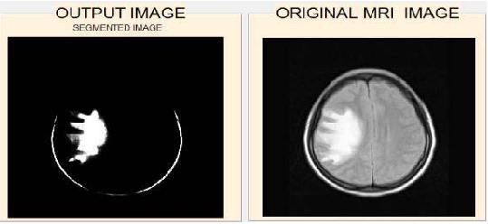
cv
PROBLEM FORMULATION
Brain tumor prediction on MR images with semantic segmentation by using deep learning network and 3D imaging of tumor region using MATLAB
Department of Computer Science & Engineering, DSCE

Slide 6
cv
PROPOSED OBJECTIVES
The primary objective of the application is tumor identification.
To develop an application in which the primary intention is to save human lives that are in danger by delivering medical care as quickly as possible.
To develop an application that is beneficial to both patients and doctors.
The manual identification is not fast, accurate and efficient; to resolve these issues, this application is designed.
To develop a user-friendly application.
It is also used to detect the type of tumor present inside the brain.
Department of Computer Science & Engineering, DSCE

Slide 7
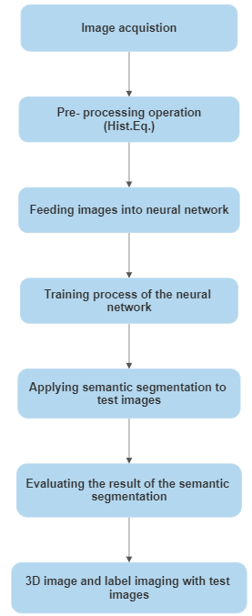
cv
PROPOSED METHODOLOGY WITH BLOCK DIAGRAM
Department of Computer Science & Engineering, DSCE

Slide 8
cv
METHODOLOGY
The suggested approach begins with image acquisition on MATLAB, which is followed by the pre-processing application, like histogram equalization.
Then, random patches taken from MR images are used as input for a neural network.
Training process of this network which consists 16 layers such as convolution layers, batch normalization layers, relu layers, max pooling layers corresponding to down-sampling and for up-sampling, transposed convolution layers and relu layers were used.
The softmax layer and pixel categorization layer serve as the network's final layers.
Department of Computer Science & Engineering, DSCE

Slide 9
cv
METHODOLOGY (cont…)
After the training phase, semantic segmentation was applied to test images. Results of the semantic segmentation include segmented MR slices and predicted labels.
In final stage, semantic segmentation results are presented and 3D imaging including whole brain, ground truth and predicted labels and tumor location.
Department of Computer Science & Engineering, DSCE

Slide 10
cv
CONCLUSION
The project presents a different approach in diagnosing the brain tumor and displays the exact tumor region in 3D.
Nevertheless, providing 3D model of ground truth and predicted labels inserted in the brain can be beneficial for surgeons to know exact region and dimensions including height, width and depth.
Department of Computer Science & Engineering, DSCE

Slide 11
cv
VALID REFERENCES
[1] N. Bahadure, A. Kumar Ray, H. Pal Thethi, Image analysis for MRI based brain tumor detection and feature extraction using biologically inspired BWT and SVM, Int. J. Biomed. Imaging (2017) 1–12.
[2] Anjali Wadhwaa, Anuj Bhardwaj, Vivek Singh Verma, A review on brain tumor segmentation of MRI images, Magn. Reson. Imaging 61 (2019) 247–259.
[3] E.S.A. El-Dahshan, H.M. Mohsen, K. Revett, B.M. Salem A-, Computer-aided diagnosis of human brain tumor through MRI: a survey and a new algorithm, Expert Syst. Appl. 41 (11) (2014) 5526–5545.
[4] Mahmoud Khaled Abd-Ellah, Ali Ismail Awad, Ashraf A.M. Khalaf, Hesham F.A. Hamed, A review on brain tumor diagnosis from MRI images: practical implications, key achievements, and lessons learned, Magn. Reson. Imaging 61 (2019) 300–318.
Department of Computer Science & Engineering, DSCE

Slide 12
cv
[5] A. Maier, C. Syben, T. Lasser, C. Riess, A gentle introduction to deep learning in medical image processing, Z. Med. Phys. 29 (2) (2019) 86–101.
[6] N. Gordillo, E. Montseny, P. Sobrevilla, State of the art survey on MRI brain tumor segmentation, Magn. Reson. Imaging 31 (8) (2013) 1426–1438.
[7] Sayan Kahali, Sudip Kumar Adhikari, Jamuna Kanta Sing, A two-stage fuzzy multi-objective framework for segmentation of 3DMRI brain image data, Appl. SoftComput. 60 (2017) 312–327.
[8] A. Ben Rabeh, F. Benzarti, H. Amiri, Segmentation of brain MRI using active contour model, Int. J. Imaging Syst. Technol. 27 (1) (2017) 3–11.
[9] K. Kamnitsas, C. Ledig, V.F. Newcombe, J.P. Simpson, A.D. Kane, D.K. Menon,Efficient multi- scale 3D CNN with fully connected CRF for accurate brain lesion segmentation, Med. Image Anal. 36 (2017) 6178.
[10] K.B. Vaishnavee, K. Amshakala, An automated MRI brain image segmentation and tumor detection using SOM-clustering and proximal support vector machine classifier, IEEE Int.Conf. Engineering and Technology (ICETECH) (2015).
Department of Computer Science & Engineering, DSCE

Slide 13
cv
THANK YOU
Department of Computer Science & Engineering, DSCE

