Slide 1

Employee management system
Presented by
P. Yuktha priya
Ch. Lakshmi devi
y. L . N . Maheswari
m. s. v. Lakshmi durga

Slide 2

Introduction:
The project aims at the development of the online employee management system .
It will assist an organization to keep the records of the employee along with the project they are working on and to calculate their pay in a more robust and efficient manner.
Along with that it also provides the list of employees who are working on more than one project and able to give the details of working hours on a project for an employee.
The project employee management system stores employee ID, name, department, project details and salary of the employee.
After adding the data we can perform various operations such as calculating the salary, generating various reports such as pay report, query report and employee report.
This system does not allow wrong inputs as we have provided validations for various inputs such as employee name, contact number, salary, employee id, project id, department.

Slide 3
requirements:
Problem statement.
Flowchart and ER diagram.
Functional Specifications.
Non-Functional Specifications.

Slide 4
Problem Statement:
Any employee who manages data from the organization should be able to add, edit, view and delete the employee details as well as project details according to the requirements.
To perform this functionality a menu is provided where the options are given for adding, editing, displaying, deleting records from employee and project list.
Along with that it also provides the option as query employee to view information of a single employee based on employee code and to calculate the pay according to the company policies .
Not only this, if a user wants to view how many hours an employee spent on a particular project, they can also retrieve that information and it also provides the list of employees working on more than one project at the moment in the form of a report.

Slide 5
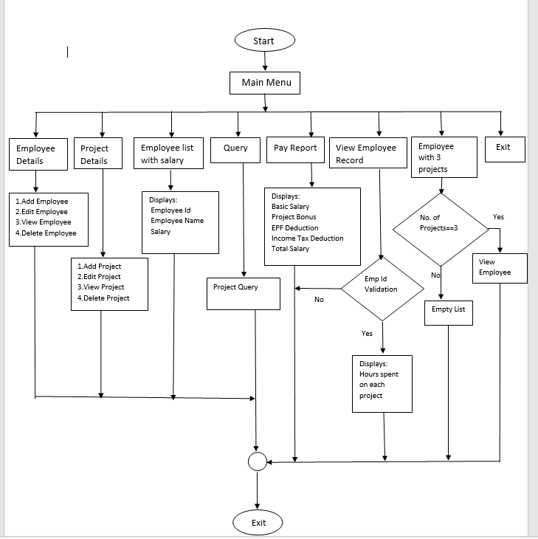
Flow chart:

Slide 6
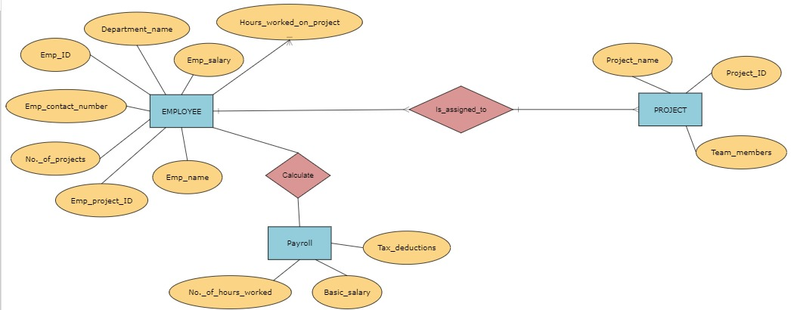
Er diagram:

Slide 7
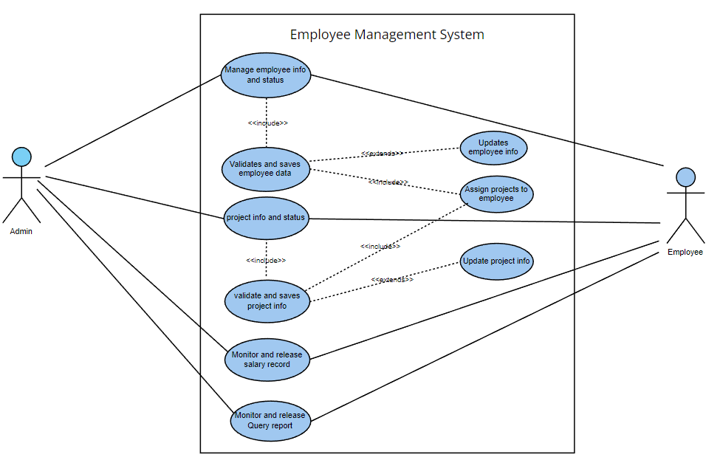
Use case diagram:

Slide 8
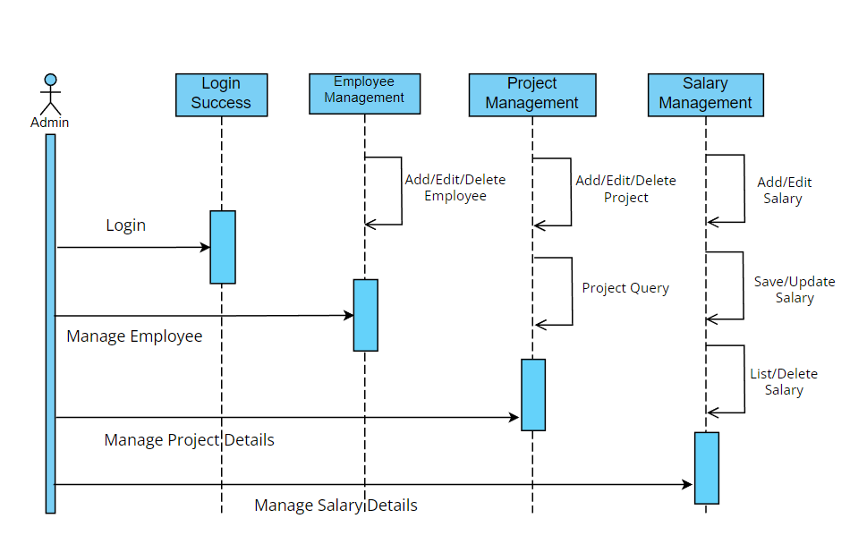
Sequence diagram:

Slide 9
Functional specification:
3.1.1Employee Details:
3.1.1.1 EMS_01 => add_employee ()
This feature adds the employee record to the file. It asks for employee_id, employee_name, department, salary, contact number whose record is to be created.
3.1.1.2 EMS_02 => edit_employee ()
This feature edits the employee record in the file. It asks for the employee_id and asks the user to enter new employee_name, department, salary, contact number and the list of projects done by the new employee by adding project_id, project_name, number of hours worked . Whose record is to be edited Upon successful editing of employee details into the employee database it will return to the main menu.

Slide 10
3.1.1.3 EMS_03 =>view_employee ()
This feature displays all the employee details present in the employee database. It displays employee_id, employee_name, department, contact number and list of projects done by the employee with project_id, project name, number of hours worked.
3.1.1.4 EMS_04 => delete_employee ()
This feature deletes the employee details from the employee database. The user needs to provide the employee_id to be deleted from the employee database. Upon successful deletion of employee details from the employee database it will return to the main menu.
3.1.2 Project Details:
3.1.2.1 EMS_05 => add_project ()
This feature adds the new project details into the project database. It asks for project_id, project name and number hours to be worked on that project. Upon successful addition of a new project details into the project database then it returns to the main menu.

Slide 11
3.1.2.2 EMS_06 => edit_project ()
This feature edits the project's details from the project database. It asks for project_id and asks the user to enter a new project name and number of hours to be extended to the project. Upon successful editing of project details into the project database then it returns to the main menu.
3.1.2.3 EMS_07 => view_project ()
This feature displays the project details in the project database. It displays project_id, project name, number of hours to be worked on that project.
3.1.2.4 EMS_08 => delete_project ()
This feature deletes the project details from the project database. The user needs to provide the project_id to be deleted from the project database. Upon successful deletion of project details from the employee database it will return to the main menu.
3.1.2.5 EMS_09 => query ()
This feature presents a query on top projects should show the project on which the highest number of employees are working. If the number is more than one, then all those projects should be displayed.

Slide 12
3.1.2.6 EMS_10 => pay_report ()
This function calls salary_view () member function of SALARY class which displays the pay report for all the employees (id, name, basic salary, bonus, deduction and final salary) according to the criteria set by the organization.
3.1.2.7 EMS_11 => calc_fi_salary ()
This feature generates the pay report for a particular employee (id, name, basic salary, bonus, deduction and final salary) according to the criteria set by the organization.
3.1.2.8 EMS_12 => emp_project report ()
This feature allows an employee to view how many hours he has already spent on which project through a menu option. This option requires him to enter his employee_id, which is validated, and the details are shown.
3.1.2.9 EMS_13 => emp_list_with_3_projects ()
This feature shows the details of all employees who are working on 3 projects at time.

Slide 13
Non - functional specifications:
Supportability: The system is easy to maintain.
Design Constraints: The system is built using only CPP language.
Usability: Employee management system helps to manage the employee records and also displays the information according to the requirement of the moment. For example, if we want to calculate the pay of an employee, the system provides that functionality. Next time if you want to query an employee it also works like that. This function also adds to the usability of the system.
Reliability & Availability: The system shall provide employees along with project information with the creation of a file in every machine.
Performance: The system will work on the user’s terminal.

Slide 14
Uses of employee management system:
The purpose of an employee management system is to help improve workforce productivity, identify ways to engage and retain talent, and alleviate administrative burdens for HR professionals.
Achieving greater efficiency through the use of technology can also help control costs and minimize compliance risks.
It helps managers and employees to work together and accurately monitor, access, manage, and efficiently utilize the working hours for better business growth..
Also, it helps in error-free payrolls that can be done on time..

Slide 15
Advantages and disadvantages:
Advantages:
Workload Optimization and well-organized tasks
Efficiency And Better Accuracy
Boosted Profitability
Reduce Manual Errors
Higher Productivity
Lower Costs
Data security
Increased Employee Engagement
Disadvantages:
Time consuming.

Slide 16
conclusion:
By using this project, we can manage the employee details and provide project details as per the requirement from the organisation.
With the help of this project, we can track all information related to Employee(add employee, edit employee, view employee and delete employee (if needed));
And Project details on which employee is working (add project, edit project, delete project(if needed);
And query an employee, giving the pay stub according to the working hours of the employee on the particular project, employee will be able to view the number of hours he spent on a particular project .
The application will also provide the report for the employees who are working on more than one project.

Slide 17


