Slide 1

Line Ed – Your own line editor

Slide 2
INTRODUCTION:
A line editor is a basic type of computer-based text editor where one line of a file can be edited at a time.
Here , this line editor is used for reading ,saving , appending the files and also adding text ,finding text and deleting specific text in a file.
This line editor lets you access commands from the executable files that are user defined.
This is a text-based user interface used to run programs , manage files and interact with the computer.

Slide 3
REQUIREMENTS:
Problem Statement
Functional Specification
Flow chart
Technical Specification
Uses of line editor
Tools
Output
Advantages and Disadvantages
Conclusion

Slide 4
PROBLEM STATEMENT:
Develop your own line editor “LineEd” to create text file line by line. When LineEd starts it should display message ‘Enter a command’ and wait for user to LineEd command.
After user enters a command LineEd would perform editing on current text buffer according to command and display appropriate output message in case of successful completion of command or error message in case command fails.
LineEd maintain a text buffer of characters entered in form of array of lines. Each line ends with “\0”. It also maintain current line number.
This text buffer gets filled with content when file is read. User can save text buffer into a text file. The default extension of files is .txt so in case file extension is not specified byuser it is taken as .txt.

Slide 5
Functional Specification :
This editor must give output for every command as it works in actual editor.
Accepting input should take care for case sensitivity of characters.
The application uses File handling.
Use Data structures like linked-list, sorting, searching wherever required.

Slide 6
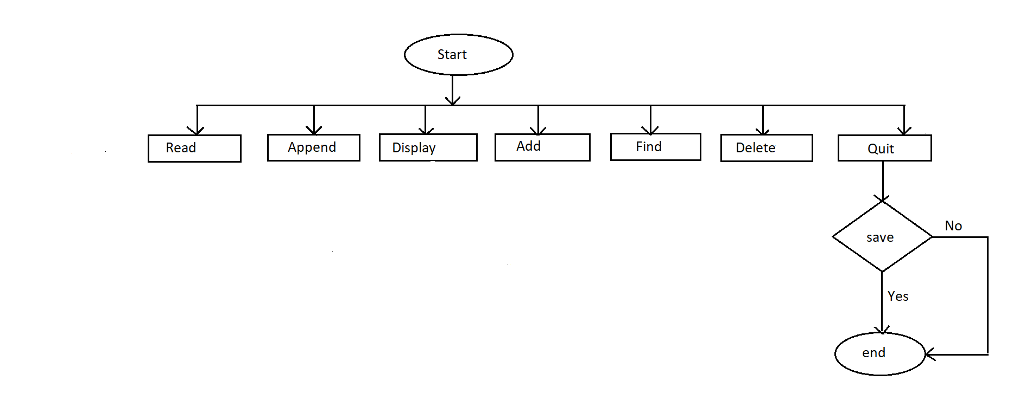
FLOW CHART:

Slide 7
Technical Specification :
Following is a list of functionalities of the system. Wherever, the description of functionality is not adequate; you can make appropriate assumptions and proceed.
Following commands should be supported by LineEd –
a.) Enter a command - read <filename>
Arguments
1. filename data type is string denotes name of file which is to be read
Function -
1. This command reads file with given filename and loads its content in text buffer.
If there is any text in text buffer it is overwritten. Current line number = 1.

Slide 8
b.) Enter a command - save <filename>
Arguments
1. filename data type is string denotes name of file where text buffer is stored.
Function –
1. This command saves text buffer as file. The command should display error if file already exist and should not overwrite file. Current line number does not change.
c. )Enter a command - append <filename>
Arguments
1. filename data type is string denotes name of file which is to be appended
Function -
1.This command reads file with given filename and appends its content to existing
text buffer at the end. If there is no text in text buffer then this command is same as
read command. Current line number = 1.

Slide 9
d.) Enter a command - display
Display command has various formats
1. display with no argument
=>Displays entire content of text buffer line by line with line numbers. If text buffer is large it may scroll on the screen.
2. display no scroll
=>Displays entire content of text buffer line by line with line numbers. If text buffer is large, it displays 12 lines and wait for user to enter any key. After user enters a key it displays next 12 lines and so on.
3. display 10-20
=>Displays entire content of text buffer line by line with line numbers from line 10 to
20. If text buffer contains less than 10 lines then display nothing. If text buffer contains less
than 20 lines then display from line 10 till end of text buffer.
Current line number does not change.

Slide 10
e.) add <text>
Arguments -
1. text denotes string of characters.
Function -
1. This command will insert <text> as new line after the current line. Current line
number = line number of newly inserted line.
f.) find <word>
Arguments -
1. <word> denotes word to find.
Function -
1.This command will find lines containing <word> in text buffer. Current line number
does not change.

Slide 11
g.) delete <FromLineNo>-<toLineNo>
Arguments -
1. <FromLineNo> denotes starting line number from where to delete
2. <ToLineNo>denoted ending line number to delete
Function -
1.This command will delete lines whose line numbers are >= <FromLineNo> and >=
<ToLineNo> If only <FromLineNo> is given it will delete single line. Current line number = 1.
h.) quit
No arguments.
Function –
=>This command will quit the LineEd. But before quitting it should check if current
contents of text buffer is saved in file. If not, it should ask user if user wants to save the
content of text buffer (yes/no), if users chooses ‘yes’ then it should ask filename to save to
and save the content of text buffer to that file.

Slide 12
Tools :
Valgrind:
It is a programming tool for memory debugging, memory leak, detection and profiling.
To use Valgrind, first we have to compile the code with –g flag , and after use Valgrind
as a wrapper for running the binary and perform stress testing.
Makefile:
Makefile is program building tool which runs on Unix, Linux, and their flavours. To
determine how the modules need to be complied or recompiled together, make takes the
help of user – defined makefiles. These are special format files that help build and manage
the projects automatically.
Splint:
Splint, short for Secure Programming Lint, is a programming tool for statically checking C
programs for security vulnerabilities and coding mistakes. Splint is free software released under the
terms of the GNU General Public License.

Slide 13
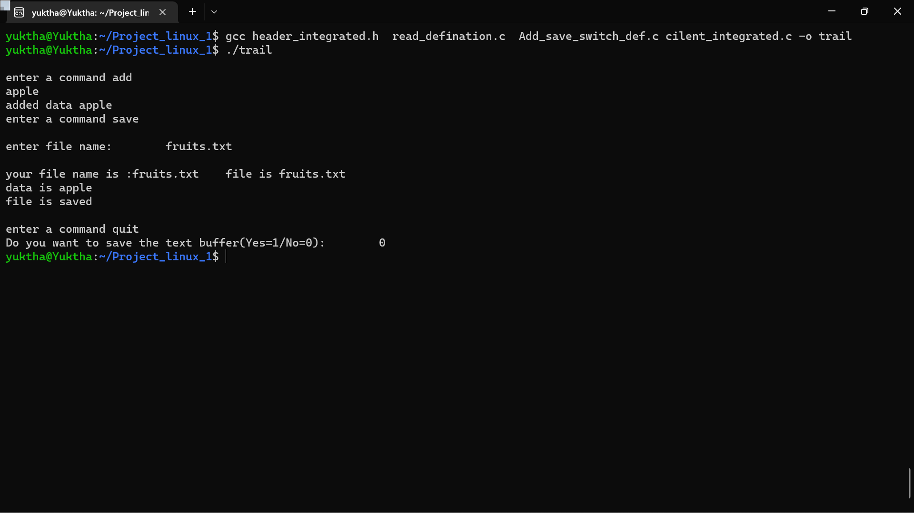
OUTPUT:

Slide 14
USES OF LINE EDITOR
A Line Ed works line by line , tightening up sentence structure.
It can access user to make changes to their file at any where in the text.
In computing , a line editor in which each editing command applies to one or more complete lines of text designated by the user.

Slide 15
Advantages and Disadvantages
Advantages:
Time saving
Easily accessible
Save the Editable file
Provides Best Editing Features
Disadvantages:
Internet connection :User can’t access the line editor without having an internet connection.
Line Editor can work on only one line at a time.

Slide 16
CONCLUSION
Line Editors are basically computer programs that are utilised to edit files on a computer.
They provide environment to a programmer to edit or format a document in any order he/she wants to.
In system programming or programming , editors are software or tools that are used to edit the program.

Slide 17


