Slide 1
AI-DRIVEN CROP DISEASE PREDICTION AND MANAGEMENT SYSTEM
CSE7301 University Project
Final Review
Batch Number: CSE - 26
Under the Supervision of,
Dr. Ramesh Sengodan
Professor
School of Computer Science and Engineering
Presidency University
Roll Number | Student Name
20211CSE0271 | PARINITHA M
20211CSE0334 | NETHRA K
20211CSE0272 | YUKTHI V

Slide 2
Introduction
Traditional crop disease identification methods are time-consuming, error-prone, and dependent on expert knowledge, which is often inaccessible to rural farmers.
This project aims to leverage AI and computer vision to develop a web-based system that accurately detects plant diseases from images.
The system utilizes Python with Flask for the backend, integrates a deep learning model for classification, and offers an intuitive web interface for users.
By automating disease detection, the solution empowers farmers with quick, reliable diagnostics, leading to timely interventions and improved crop yield.

Slide 3
Literature Review
Papers | Advantages | Disadvantages
1. Waseem, M., Raza, A., & Malik, A. (2024). AI-Driven Crop Yield Prediction and Disease Detection in Agroecosystems. In Maintaining a Sustainable World in the Nexus of Environmental Science and AI (pp. 229-258). IGI Global. | • Accurate yield prediction • Improved planning and resource allocation • Supports sustainable agricultural practices | • High costs. • Limited access to AI tools for smallholder farmers • Infrastructure challenges in rural areas
2. AI-Powered Predictive Analysis for Pest and Disease Forecasting in Crops: Palani, Hari Kumar, et al. "AI-Powered Predictive Analysis for Pest and Disease Forecasting in Crops." 2023 International Conference on Communication, Security and Artificial Intelligence (ICCSAI). IEEE, 2023. | • Early prediction of risk • Improved preparedness and prevention • Enhances decision-making with real-time insights | • High tech and data needs • Limited access to IoT and satellite data • Dependency on historical data quality
3. Mishra, Harshit, and Divyanshi Mishra. "AI for Data-Driven Decision-Making in Smart Agriculture: From Field to Farm Management." Artificial Intelligence Techniques in Smart Agriculture. Singapore: Springer Nature Singapore, 2024. 173-193. | • Improved efficiency • Data-driven farm management • Enhanced resource conservation | • Data security issues • Complexity in integration with existing farm practices • Expensive for small-scale use
4. Nazir, Aisha. "AI-Driven Approaches to Enhance Plant Disease Detection and Monitoring: A Focus on Machine Learning in Agriculture." International Journal of Applied Sciences and Society Archives (IJASSA) 1.1 (2022): 9-15. | • High precision in disease identification • Automated detection with minimal human input • Scalable to different crop types | • Data shortages • Model accuracy depends on dataset diversity • Limited generalization across regions
5. Elsayed, Mohamed Z., et al. "Role of AI for plant disease detection and pest detection." 2024 International Telecommunications Conference (ITC-Egypt). IEEE, 2024. | • Early disease detection • Reduces crop loss • Improves farm sustainability | • High expertise demand • Limited rural tech adoption • Challenges in system training and maintenance

Slide 4
Literature Review
6. Kaur, Avneet, et al. "Artificial Intelligence Driven Smart Farming for Accurate Detection of Potato Diseases: A Systematic Review." IEEE Access (2024). | • Early detection, high precision, real-time monitoring • Low cost per use once deployed • Data-driven recommendations | • High initial cost • Technical expertise required • Data privacy and dependency issues
7. Pothiraj, Siva, PR Thivin Kumar, and J. Martin Leo Manickam. "AI-DRIVEN FARM MANAGEMENT SYSTEM (AI-FMS)." International Journal on Global Business Management & Research 12.2 (2023): 73-81. | • Increased crop yield • Automated tracking and analysis • Cost-effective in long term | • High initial cost • Technical skills required • System maintenance and reliability concerns
8. N. Santha Raju, R. Tamilkodi, V. C. Shekar, B. Jaya Bharathi, K. Dinesh Kumar and Y. Sumanth, "AI-Powered Crop Suggestion, Yield Prediction, Disease Detection, and Soil Monitoring," 2024 3rd International Conference on Automation, Computing and Renewable Systems (ICACRS), Pudukkottai, India, 2024, pp. 1120-1124, doi: 10.1109/ICACRS62842.2024.10841754. | • Precise crop recommendation • Early disease identification • Effective soil and environment monitoring | • High installation cost • Technical training needed • Maintenance and data privacy issues
9. H. K. Palani, S. Ilangovan, P. G. Senthilvel, D. R. Thirupurasundari and R. K. K, "AI-Powered Predictive Analysis for Pest and Disease Forecasting in Crops," 2023 International Conference on Communication, Security and Artificial Intelligence (ICCSAI), Greater Noida, India, 2023, pp. 950-954, doi: 10.1109/ICCSAI59793.2023.10421237. | • Early pest detection • Precise forecasts • Minimizes losses and optimizes resources | • High installation and operation cost • Heavy data reliance • Risk of model failure or misprediction
10. Tammina, Manoj Ram, et al. "Prediction of Plant Disease Using Artificial Intelligence." Microbial Data Intelligence and Computational Techniques for Sustainable Computing. Singapore: Springer Nature Singapore, 2024. 24-48. | • Early disease detection • High prediction accuracy • Reduces manual effort and crop loss | • High implementation cost • Requires technical expertise • Data protection and system complexity

Slide 5
Research Gaps Identified
Inadequate Real-Time Accessibility to Farmers: Most AI models have no friendly interfaces for field usage, so farmers in distant or low-technology settings may not easily get real-time diagnosis.
Narrow Multi-Crop and Multi-Disease Focus: Most studies focus on specific crops or limited numbers of diseases, thereby lowering broad applicability across diverse farm settings.
Limited Mobile Technology Integration: Most of the systems are not designed for mobile access, and hence, their use is restricted for small and marginal farmers who use smartphones as their main digital device.
Poor Integration of Detection with Actionable Recommendations: A number of models are able to detect diseases but do not offer useful treatment or management recommendations, thus limiting their real-world applicability.
Scalability and Usability Constraints: Most research prototypes are not scalable or user-friendly and are difficult to apply to actual agricultural environments.

Slide 6
Proposed Methodology
Data Collection and Preprocessing: Healthy and diseased crop leaf images of high quality are gathered, resized, and augmented to enhance dataset diversity and avoid overfitting.
Model Architecture and Training: The labeled images are trained using cross-entropy loss and Adam optimizer with a lightweight CNN model (ResNet9) and tested using accuracy and confusion matrix.
Image Input Interface: A friendly interface enables farmers to upload or take leaf images for disease detection via GUI or command-line input.
Disease Prediction and Classification: Input images are preprocessed and fed into the trained model, which predicts the disease class and shows the result with a confidence score.
Treatment and Management Suggestions: The system yields particular treatment strategies and preventive suggestions on the basis of the projected disease from a predefined knowledge base.

Slide 7
Objectives
Early Disease Detection: Enable timely identification of crop diseases through AI-powered image processing, preventing widespread damage.
Accurate Disease Classification: Utilize machine learning models to accurately classify and diagnose specific diseases, ensuring proper management strategies.
Minimize Pesticide Use: Reduce reliance on chemical treatments by providing targeted disease management recommendations, promoting sustainable farming practices.
Improved Crop Yield: Enhance crop health and productivity by offering actionable insights to farmers on disease prevention and treatment.

Slide 8
Objectives
Automation of Disease Management: Streamline the decision-making process by providing automated recommendations for disease control, saving time and effort for farmers.
Support Sustainable Agriculture: Promote eco-friendly practices by focusing on disease management that minimizes chemical usage, supporting long-term agricultural sustainability.
Global Food Security: Contribute to enhancing food security by reducing crop losses due to diseases, improving overall agricultural efficiency.

Slide 9
System Design and Implementation
Image Input Interface
Web-based UI developed using Flask.
Allows users to upload crop leaf images easily.
Designed for accessibility by farmers, officers, and researchers.
Image Preprocessing
Uploaded images are resized to 224x224 pixels.
Converted into tensors and normalized.
Enhances model accuracy by standardizing inputs.
Disease Classification (ResNet9 Model)
Lightweight CNN architecture (ResNet9) is used.
Pre-trained on labelled datasets of diseased and healthy leaves.
Residual blocks improve accuracy without vanishing gradients.
Model Prediction
Model outputs probability scores for each disease class.
Highest score determines the predicted disease.
Includes confidence score for reliability estimation.

Slide 10
System Design and Implementation
Recommendation System
Maps disease class to treatment recommendations.
Uses a predefined dictionary of expert-approved remedies.
Converts diagnosis into actionable insights for users.
Model Optimization Techniques
Techniques like data augmentation, dropout, and batch normalization used during training.
Model pruned and fine-tuned for faster predictions.
Ensures performance on low-resource devices.
Scalability & Future Enhancements
Modular design allows integration into mobile apps or cloud dashboards.
Future plans: multi-disease detection, camera integration, multilingual support, and offline use.
Potential for environmental data integration (e.g., weather).

Slide 11
Timeline of Project
Review 1
Review 2
Source code
Review 3
Abstract
Objectives
Initial Report
February 2025
Title
March 2025
Source code
Algorithm
50%
50% Report
April 2025
Algorithm
100%
100% Report
Implementation
Implementation

Slide 12
Outcomes
Accurate Disease Detection.
Advanced Crop Yield.
Reduced Pesticide Use.
Enhanced Decision-Making
Sustainability in Agriculture.
Cost Savings.
Increased Food Security.

Slide 13
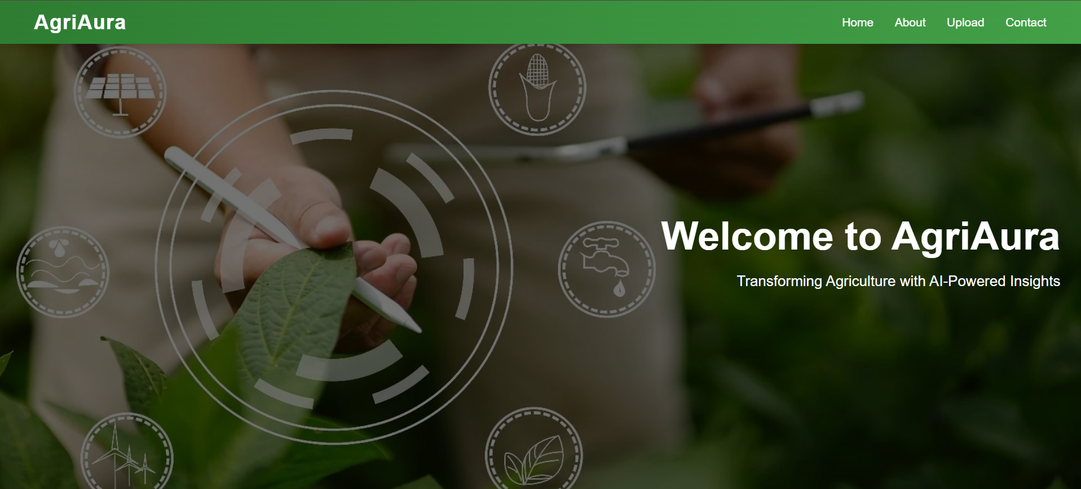
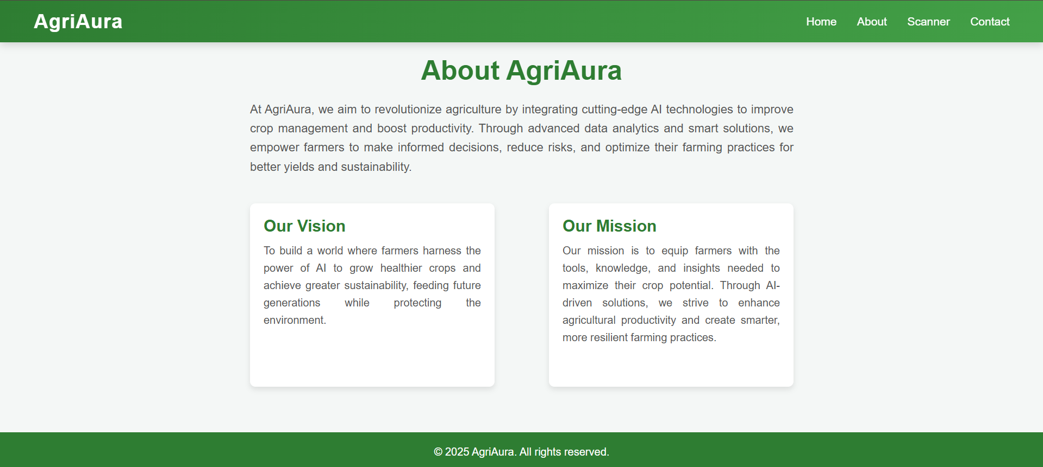
Results Obtained
Home Page
About Page

Slide 14

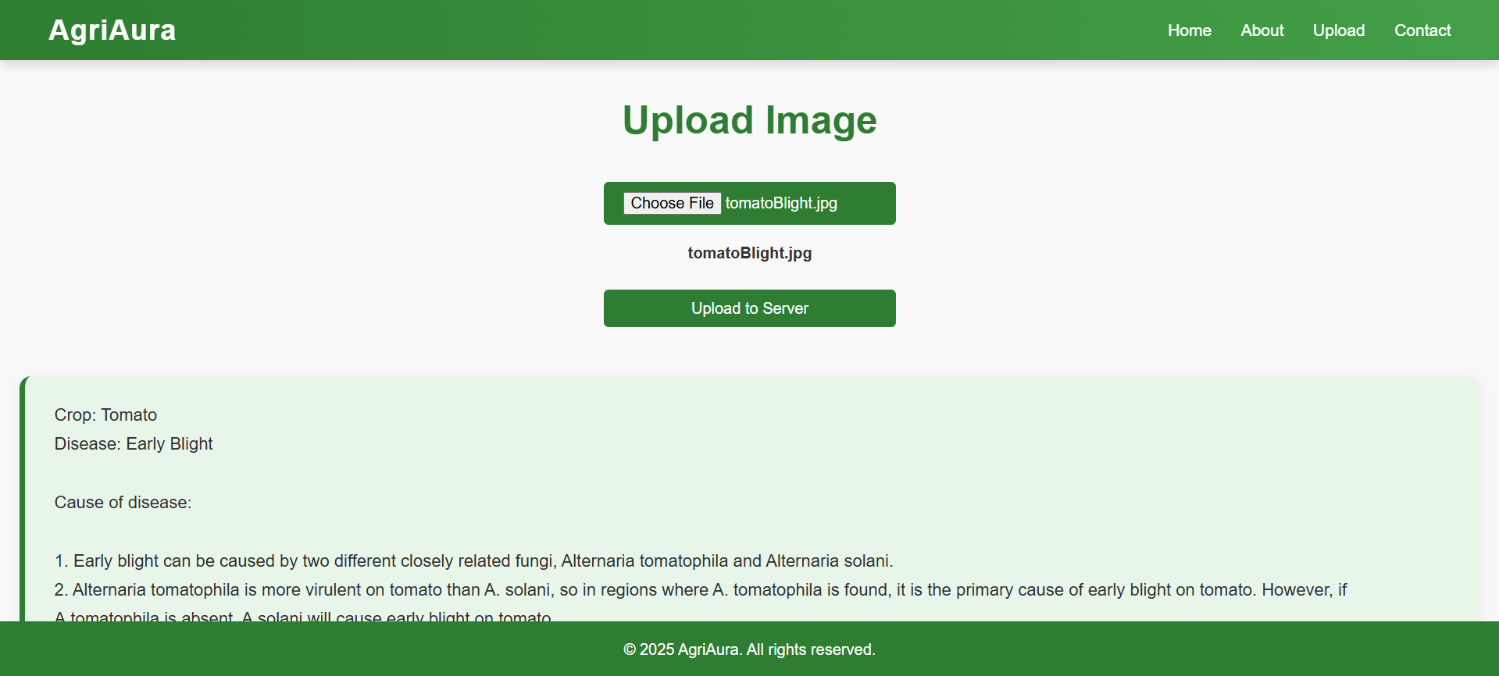
Results
Upload Image
Disease Prediction

Slide 15
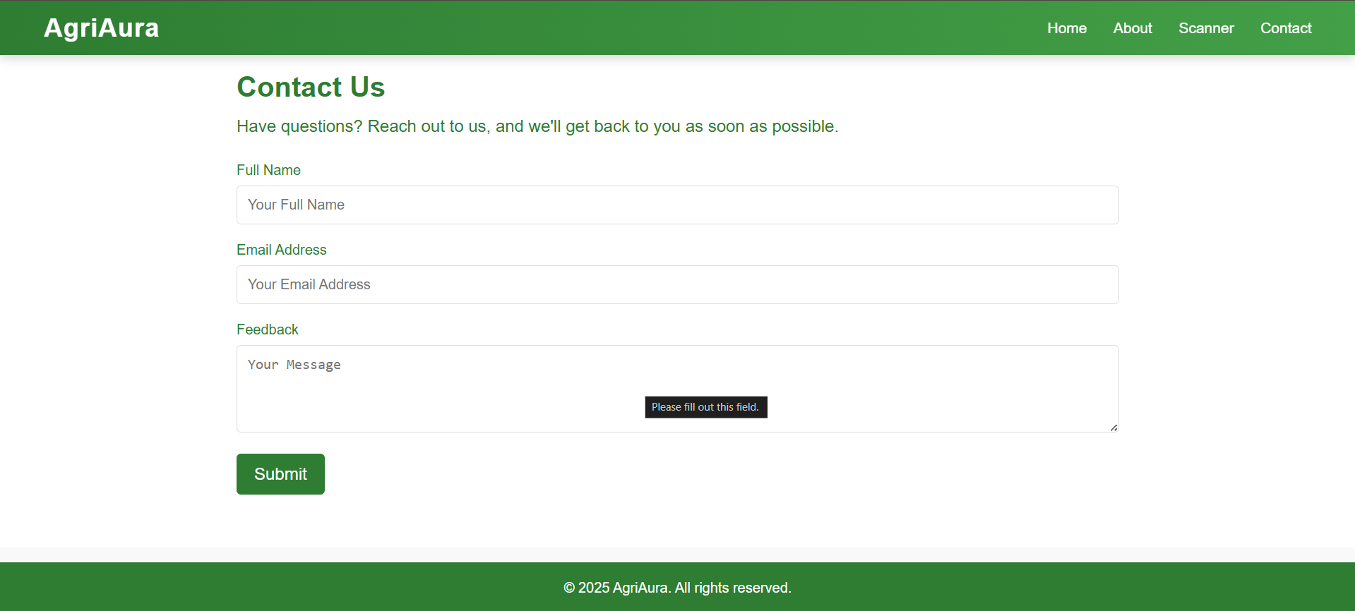
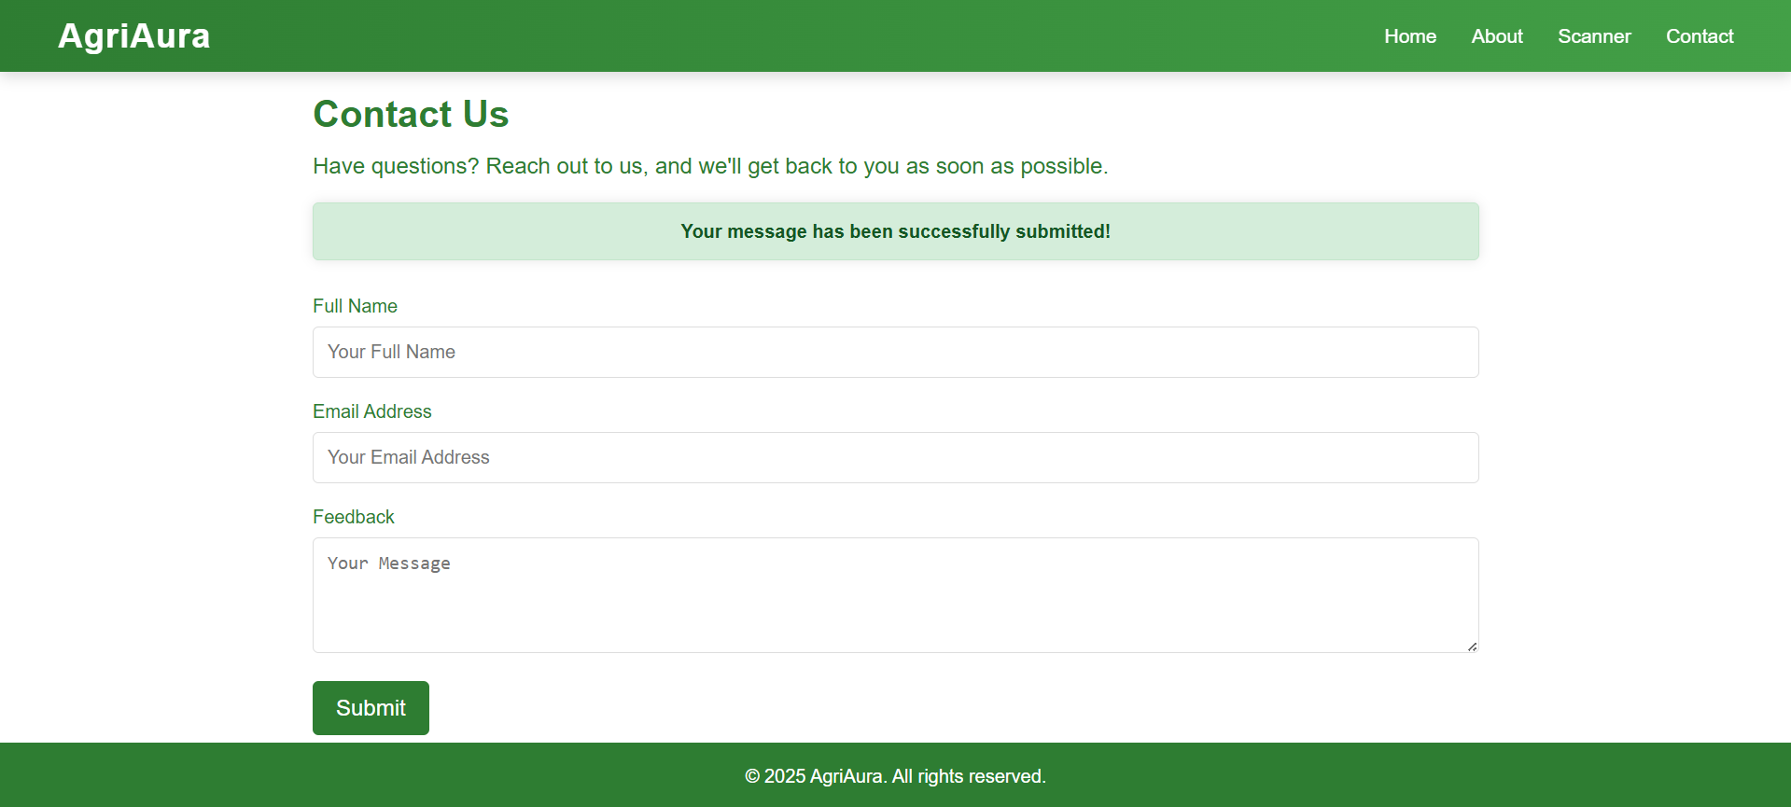
Results
Feedback Form
Feedback Submission

Slide 16
Conclusion
The proposed AI-driven system effectively detects crop diseases using a deep learning model with a high accuracy of 94.8%, enabling early diagnosis and timely intervention.
Its user-friendly web interface allows farmers to upload leaf images and receive instant predictions, making the technology accessible even to those with limited digital skills.
By reducing dependence on manual inspections and expert consultations, the system empowers farmers to make independent, informed decisions.
It supports multiple crop types and adapts to various regional conditions, enhancing its usability across diverse agricultural environments.
The system also helps control pesticide usage by providing targeted treatment suggestions, thereby improving crop yield while promoting eco-friendly practices.
Overall, the project demonstrates the potential of artificial intelligence to drive sustainable, efficient, and smart farming solutions.

Slide 17
References
Waseem, M., Raza, A., & Malik, A. (2024). AI-Driven Crop Yield Prediction and Disease Detection in Agroecosystems. In Maintaining a Sustainable World in the Nexus of Environmental Science and AI (pp. 229-258). IGI Global.
AI-Powered Predictive Analysis for Pest and Disease Forecasting in Crops: Palani, Hari Kumar, et al. "AI-Powered Predictive Analysis for Pest and Disease Forecasting in Crops." 2023 International Conference on Communication, Security and Artificial Intelligence (ICCSAI). IEEE, 2023.
Mishra, Harshit, and Divyanshi Mishra. "AI for Data-Driven Decision-Making in Smart Agriculture: From Field to Farm Management." Artificial Intelligence Techniques in Smart Agriculture. Singapore: Springer Nature Singapore, 2024. 173-193.
Nazir, Aisha. "AI-Driven Approaches to Enhance Plant Disease Detection and Monitoring: A Focus on Machine Learning in Agriculture." International Journal of Applied Sciences and Society Archives (IJASSA) 1.1 (2022): 9-15.
Elsayed, Mohamed Z., et al. "Role of AI for plant disease detection and pest detection." 2024 International Telecommunications Conference (ITC-Egypt). IEEE, 2024.
Kaur, Avneet, et al. "Artificial Intelligence Driven Smart Farming for Accurate Detection of Potato Diseases: A Systematic Review." IEEE Access (2024).
Pothiraj, Siva, PR Thivin Kumar, and J. Martin Leo Manickam. "AI-DRIVEN FARM MANAGEMENT SYSTEM (AI-FMS)." International Journal on Global Business Management & Research 12.2 (2023): 73-81.
N. Santha Raju, R. Tamilkodi, V. C. Shekar, B. Jaya Bharathi, K. Dinesh Kumar and Y. Sumanth, "AI-Powered Crop Suggestion, Yield Prediction, Disease Detection, and Soil Monitoring," 2024 3rd International Conference on Automation, Computing and Renewable Systems (ICACRS), Pudukkottai, India, 2024, pp. 1120-1124, doi: 10.1109/ICACRS62842.2024.10841754.
H. K. Palani, S. Ilangovan, P. G. Senthilvel, D. R. Thirupurasundari and R. K. K, "AI-Powered Predictive Analysis for Pest and Disease Forecasting in Crops," 2023 International Conference on Communication, Security and Artificial Intelligence (ICCSAI), Greater Noida, India, 2023, pp. 950-954, doi: 10.1109/ICCSAI59793.2023.10421237.
Tammina, Manoj Ram, et al. "Prediction of Plant Disease Using Artificial Intelligence." Microbial Data Intelligence and Computational Techniques for Sustainable Computing. Singapore: Springer Nature Singapore, 2024. 25-48.

Slide 18
Publication Details
JOURNAL PUBLICATION
AT
INTERNATIONAL JOURNAL OF SCIENTIFIC RESEARCH IN ENGINEERING AND MANAGEMENT(IJSREM)
VOLUME 09 ISSUE 05 MAY, 2025
https://ijsrem.com/download/ai-driven-crop-disease-prediction-and-management-system-using-deep-learning/

Slide 19
Thank You

