Slide 1
HEART DISEASE PREDICTION SYSTEM
Machine Learning Based Heart Disease Risk Prediction
ML Internship - Week 4 Capstone Project

Slide 2
Problem Statement
Cardiovascular disease is a leading global cause of death. Early identification of at-risk patients from routine, non-invasive clinical measurements can support timely medical attention.
920
Patient Records
Given a patient's clinical attributes (age, blood pressure, cholesterol, chest pain type, and more), can a Machine Learning model reliably predict whether heart disease is present?
4
Clinical Sites
16
Clinical Attributes
Heart Disease Prediction System - ML Internship Capstone
2

Slide 3
Objectives
1
2
3
Clean & Prepare Data
Explore the Data
Build a Leak-Free Pipeline
Handle missing values, duplicates and inconsistent types without discarding data.
Understand feature distributions and their relationship to heart disease.
Preprocessing fit only on training data; reused unchanged at prediction time.
4
5
6
Train & Compare Models
Select the Best Model
Deploy a Web App
Logistic Regression vs. Decision Tree, evaluated objectively.
Choose using ROC-AUC and Recall, not assumptions.
An interactive Streamlit app for real-time predictions.
Heart Disease Prediction System - ML Internship Capstone
3

Slide 4
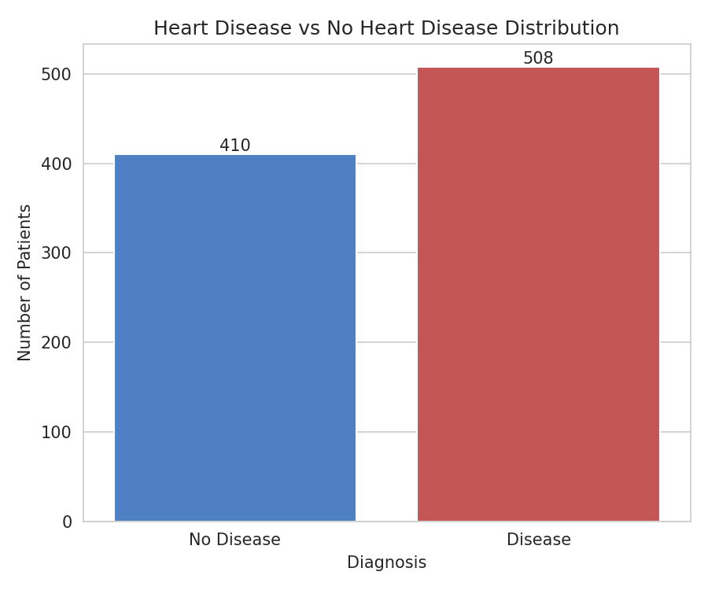
Dataset
UCI Heart Disease Dataset — heart_disease_uci.csv
920 patient records across 4 clinical sites: Cleveland, Hungary, Switzerland, VA Long Beach
Demographics: age, sex
Clinical measurements: resting blood pressure, cholesterol, max heart rate, oldpeak
Diagnostic results: chest pain type, resting ECG, exercise-induced angina, slope, major vessels (ca), thalassemia
Target: num (0–4 severity) → converted to binary heart_disease (0 = No Disease, 1 = Disease)
Target distribution after cleaning (508 disease-positive, 410 disease-negative)
Heart Disease Prediction System - ML Internship Capstone
4

Slide 5
Data Preprocessing
Cleaning Decisions
ColumnTransformer Pipeline
Dropped id (non-predictive identifier)
Removed 2 duplicate records
Cast fbs / exang to categorical
ca, thal, slope kept despite missingness — imputed, not dropped, to avoid losing most of the dataset
Numerical features
Median imputation → StandardScaler
Categorical features
Most-frequent imputation → One-Hot Encoding
Fit ONLY on training data — no leakage into test set or live predictions.
Heart Disease Prediction System - ML Internship Capstone
5

Slide 6
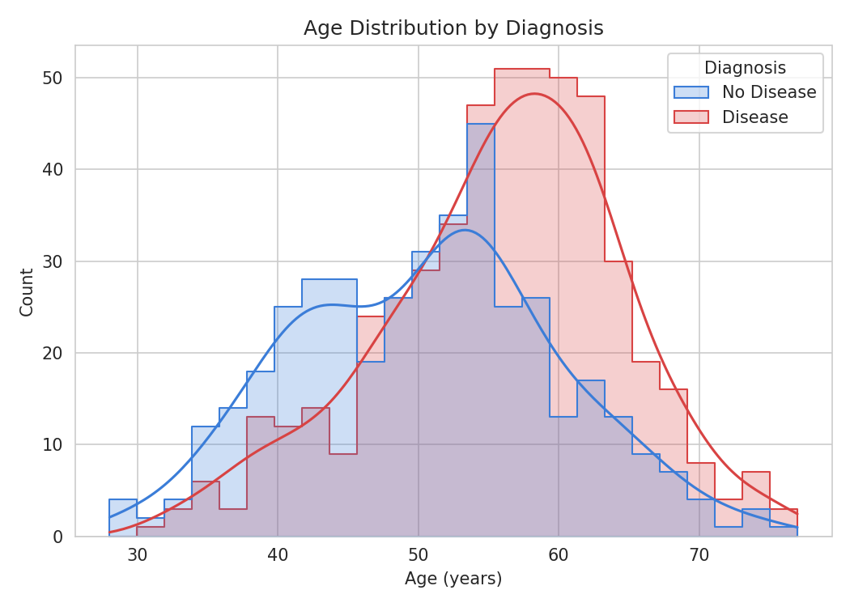
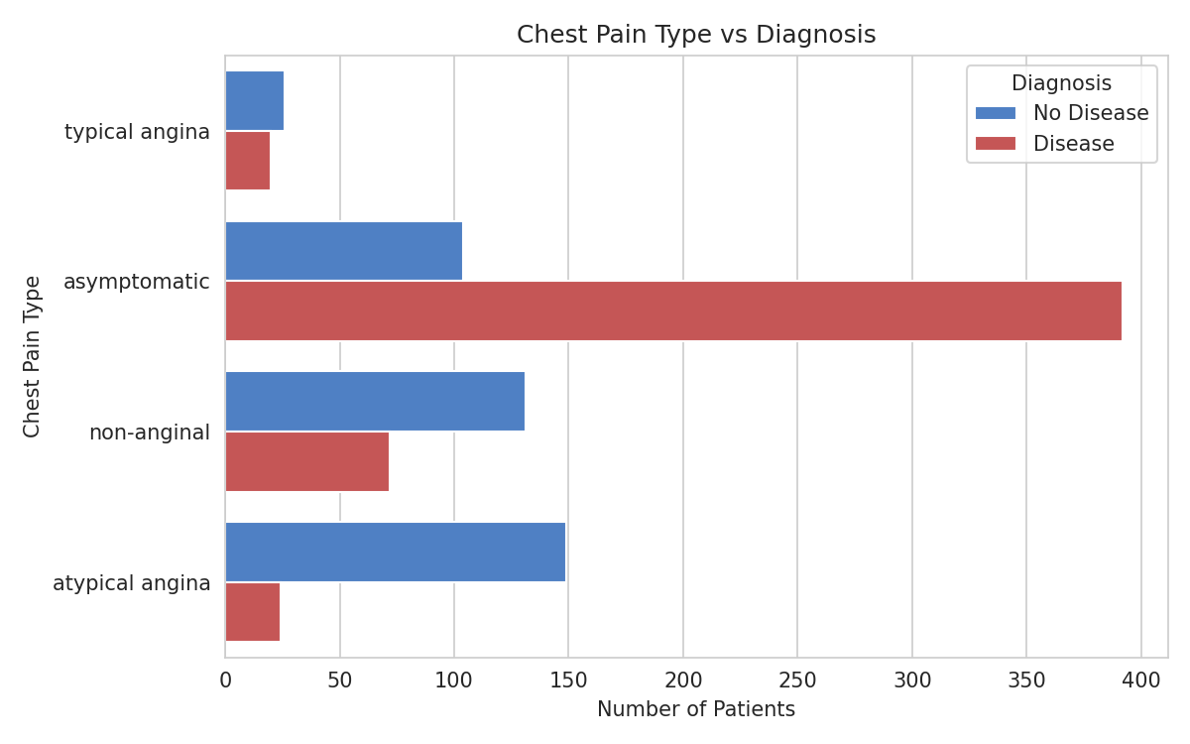
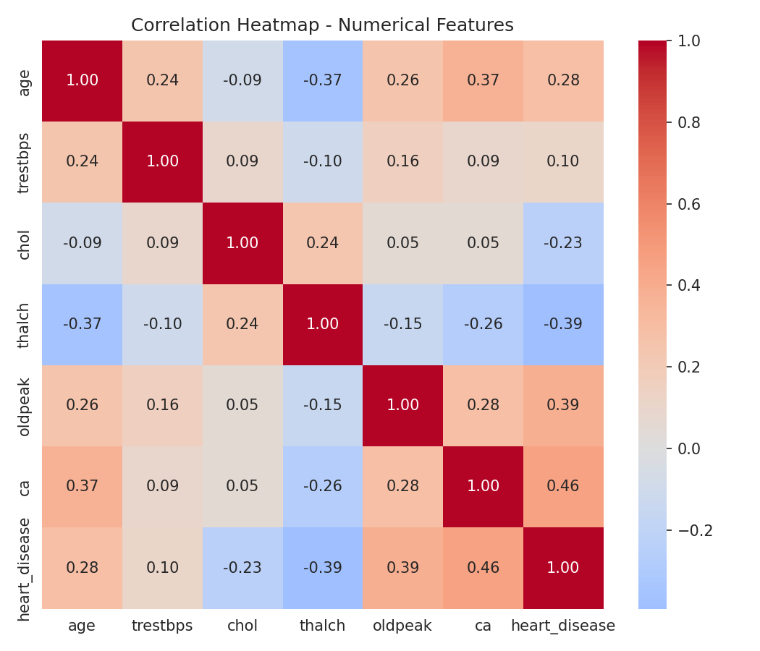
Exploratory Data Analysis
Age Distribution
Chest Pain Type vs Diagnosis
Correlation Heatmap
Asymptomatic chest pain shows a strong association with disease-positive cases; heart-disease-positive patients skew slightly older.
Heart Disease Prediction System - ML Internship Capstone
6

Slide 7
Machine Learning Models
1
Logistic Regression
2
Decision Tree Classifier
Linear baseline classification model
max_iter = 1000, random_state = 42
Highly interpretable coefficients
Strong performance on well-behaved tabular clinical data
Non-linear, rule-based model
max_depth = 5, min_samples_leaf = 10, random_state = 42
Constrained depth to reduce overfitting
Captures feature interactions Logistic Regression cannot
Heart Disease Prediction System - ML Internship Capstone
7

Slide 8
Evaluation Metrics
Accuracy
Overall proportion of correct predictions.
Precision
Of predicted-positive patients, how many truly have disease.
Recall
Of truly-positive patients, how many were correctly caught. Prioritised here — missing a real case is costlier.
F1-Score
Harmonic mean of Precision and Recall.
ROC-AUC
Ability to discriminate between classes across all thresholds.
Heart Disease Prediction System - ML Internship Capstone
8

Slide 9
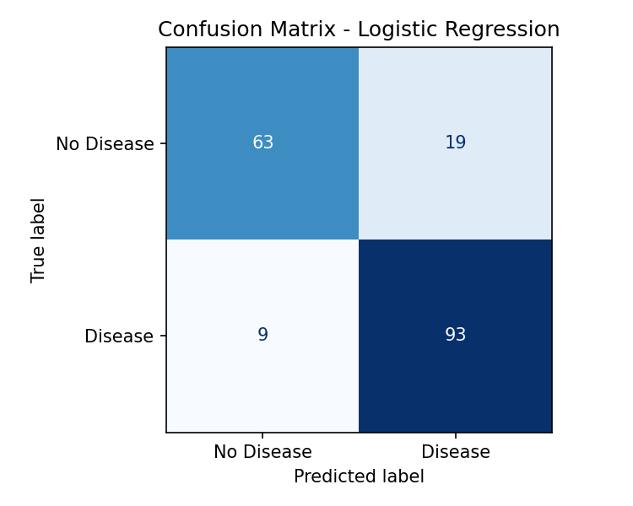
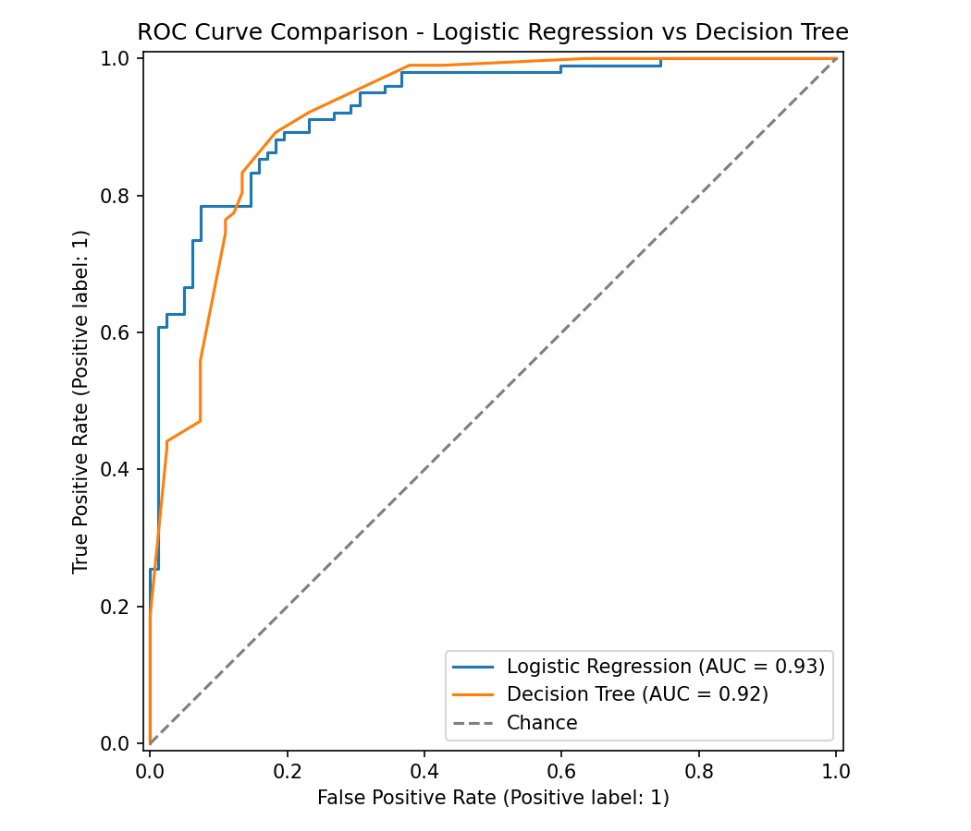
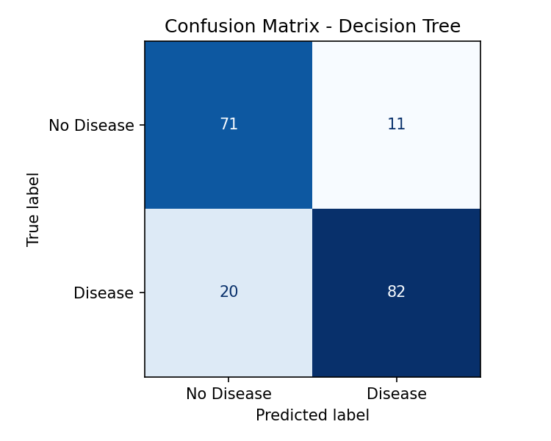
Confusion Matrix & ROC Curve
Heart Disease Prediction System - ML Internship Capstone
9

Slide 10
Model Comparison & Results
Model | Accuracy | Precision | Recall | F1-Score | ROC-AUC
Logistic Regression | 0.8478 | 0.8304 | 0.9118 | 0.8692 | 0.9284
Decision Tree | 0.8315 | 0.8817 | 0.8039 | 0.8410 | 0.9193
Selected Final Model: Logistic Regression
Highest ROC-AUC (0.9284) — best overall discriminative ability
Highest Recall (0.9118) — catches more true disease-positive cases
Decision Tree had slightly higher Precision, but missed more true positives
Selection criteria: ROC-AUC first, Recall as tie-breaker (missed cases are costlier than false alarms)
Heart Disease Prediction System - ML Internship Capstone
10

Slide 11
Web Application
Built with Streamlit — a clean, healthcare-inspired interface
Home
Predict
Project introduction, objective, technologies used and the medical disclaimer.
Interactive patient form with meaningful labels; returns a clear result and predicted probability.
Model Performance
Dataset Insights
Live metrics, confusion matrices, ROC curves and the model comparison table.
Key EDA visualizations for exploring the training data.
Heart Disease Prediction System - ML Internship Capstone
11

Slide 12
Conclusion & Future Scope
Built a complete, reproducible ML pipeline
from raw multi-site clinical data to a deployed web application. Logistic Regression achieved ~85% accuracy, ~91% recall and ~93% ROC-AUC on unseen test data.
Future Scope
Additional algorithms (Random Forest, Gradient Boosting, SVM)
Hyperparameter tuning and cross-validation
Deeper interpretability (e.g. SHAP)
Larger, more diverse datasets
Model monitoring after deployment
Deployment on a cloud platform
Integration with healthcare systems (with appropriate privacy & regulatory safeguards)
Not clinically validated — for educational and internship demonstration purposes only.

