Slide 1





Synopsis Presentation
on
AI- Mock Interview with Streaming Avatar”
Synopsis Presentation I
on
“AI- Mock Interview with Streaming Avatar”
Siya Purohit(0827IT231134)
Tulja Vishwakarma (0827IT231142)
Yuvanshi Bhalawat(0827IT231154)
Yukti Baldua (0827IT231153)
Guided By: Presented By:
Prof. Pawan Kumar Gupta
External Guide:
Mrs. Kalpana Paliwal

Slide 2

Contents
Introduction
1.1 Overview
1.2 Purpose
Literature Review
Problem Statement
Proposed Solution
Objectives
Theoretical Analysis
5.1 Block Diagram
5.2 Hardware Requirements
5.3 Software Requirements
Applications
REFERENCES
2

Slide 3
1. Introduction
1.1Overview
This thing called the AI Mock Interview with Streaming Avatar, it seems like a smart setup for practicing interviews that feel pretty real. You know, it pulls in AI and some natural language processing stuff to make the whole thing interactive, adapting as you go along.
It looks at your resume first, I think, and then comes up with questions that fit your skills or what jobs youre aiming for, based on experience and all that. The avatar part is cool, its this virtual character that talks to you live, making it seem like an actual room with someone across the table.
Sometimes I wonder if it catches everything right away. Anyway, it turns what you say into text and checks how clear or confident you sound, plus if it matches what they are asking. That evaluation bit might help spot weak spots, or at least thats the idea.
The system overall just tries to mimic those nerve-wracking interviews without the real pressure, I suppose. Not sure how perfect it gets with every response though.
1.2 Purpose
This thing is supposed to give people a way to practice interviews without any real stress. Like, a platform that feels real but not overwhelming.
I think the main point is helping folks get better at talking and feeling more sure of themselves by doing it over and over. Sessions like that can build up skills, you know. Then theres the feedback part, where it points out what youre good at and what needs work, all tailored to you. That seems useful.
It also cuts down on needing actual people to interview with or coach you, which might be a hassle sometimes. And overall, it shows how AI and stuff like speech tech and these LLM systems can actually help with training for interviews in a practical way. Not sure if it covers everything, but that is the gist.
3

Slide 4
2. Literature Review
S.No | Author | Features | Methods | Advantages | Disadvantage
1 | S. S. Sagare, S. D. Shelke, S. V. Anekar (2025) | Automated question generation, answer analysis | NLP, ML-based evaluation | Scalable, consistent feedback | Lacks human-like interaction depth
2 | Ayush Modanval, Ankitha Mohan, Nabeel Ahmed Khan, Payal Koolwal (2025) | Voice-based interviews, real-time interaction | Real-time AI voice agent, Speech Processingng | More realistic experience, interactive | High computation, latency issues
3 | Mohd Adnan Ahmed, Shashank BS, Munmeeth K, Sanjay J Ganiga (2025 | Performance tracking, feedback system | AI-based assessment, NLP | Improves preparation efficiency | Limited personalization
4 | G. Ramachandra Rao, B. C. Reddy, A. S. Kalyan, G. K. Priya, K. Rajesh (2025) | Mock interview simulation, scoring | AI + rule-based system | Easy to use, structured evaluation | Rigid system, less adaptive
5 | Nguyen, T. T. H., N. M. Nguyen, and T. H. Truong. (2025) | Personalized interview, adaptive Q&A, feedback | LLM-based conversational AI, NLP | Realistic, scalable | High cost, possible inaccuracies
4

Slide 5
3. Problem Statement
Many students and job seekers face difficulties during interviews despite having strong technical knowledge.
Existing preparation methods like reading questions, watching videos, or practicing with peers lack real-time interaction and personalized feedback.
Most available mock interview platforms follow fixed question patterns and fail to simulate the dynamic nature of real interviews.
Access to experienced mentors or interview coaches is often limited, costly, or not always available.
Candidates do not receive proper insights into their communication skills, confidence level, and answer quality.
There is a need for a system that provides a realistic, adaptive, and intelligent interview environment for effective practice and improvement.
5

Slide 6
4.Proposed Solution
The process begins when a user uploads their resume into the system. Artificial intelligence quickly studies the information. Skills, projects, work history — everything gets scanned. From there, the interview slowly starts to take shape.
Advanced language models guide the conversation. Questions are not fixed beforehand. They adapt depending on what the candidate says. Sometimes the flow feels formal, other times a bit casual. Almost like a real interviewer thinking on the spot.
Repeating practice sessions helps candidates slowly build confidence. Each round improves clarity and response quality. Small progress appears over time.
Mistakes during practice are expected. In fact, they help the learning process. With repeated sessions, thinking becomes faster and interview anxiety begins to fade
7

Slide 7
5. Objectives
Simulate realistic interview experiences using AI-driven adaptive questioning and conversational interaction
Generate personalized interview questions based on user resumes, skills, and target roles
Analyze responses to provide feedback on clarity, communication, strengths, and areas for improvement.
7

Slide 8
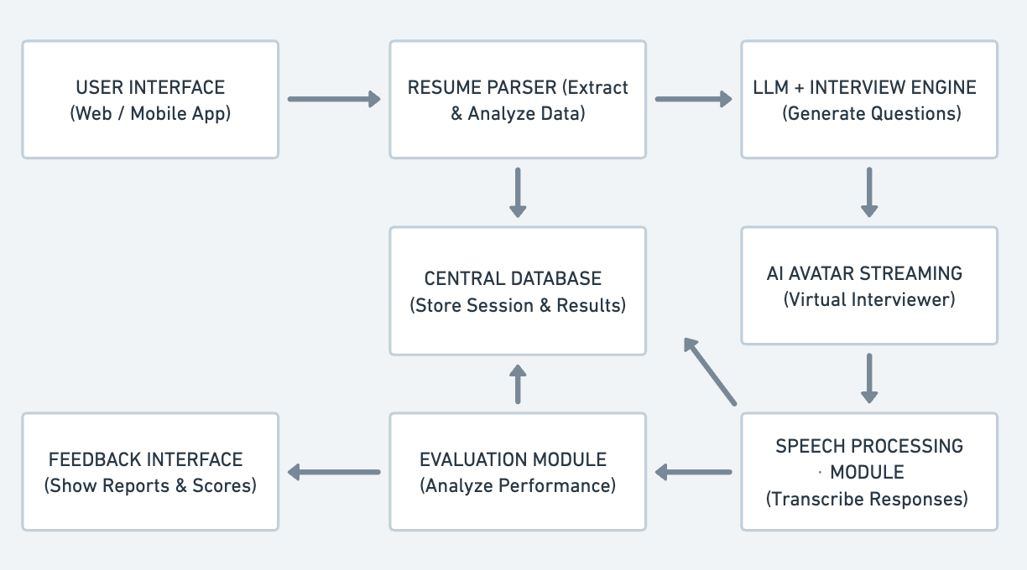
6. Theoretical Analysis
6.1 Block Diagram
fig. 1. Architecture of AI Mock Interview with Streaming Avatar
8

Slide 9
6. Theoretical Analysis
6.2 Hardware Requirements:
Since this is a software-focused project, hardware needs are minimal:
A laptop or desktop with internet access
Minimum 8 GB RAM , multi core processor , audio/video input device(microphone/webcam)
Cloud or local server infrastructure for deployment, data storage, and handling AI model processing and user sessions.
6.3 Software Requirements
Component | Frameworks
Programming language | Python(backend , AI/ML, NLP integration)
Operating System | Windows 11
Framework | Flask or Django (for web interface)
Database | MySQL (to store college data)
Frontend Tools | HTML , CSS , JavaScript (for user interface)
AI Architecture | LLM-based system (GPT/Gemini) with Agentic AI (multi-agent system for HR, technical, and evaluation roles)
9

Slide 10
Applications
Student Interview Practice: Helps students prepare for campus placements through realistic mock interviews.
Job Seeker Preparation: Allows candidates to practice and improve responses before real job interviews.
Career Training Institutes: Supports training centers in conducting automated mock interviews for learners.
Skill Assessment: Evaluates communication, technical knowledge, and problem-solving abilities.
Communication Improvement: Enhances speaking clarity, confidence, and structured answering skills.
Self-Learning Platform: Enables users to practice interviews anytime without needing a mentor.
10

Slide 11
GitHub Link
https://github.com/Yuvi25Jain/AI-Mock-Interview-with-Streaming-Avatar
11

Slide 12
REFERENCES
S. S. Sagare, S. D. Shelke, and S. V. Anekar. (2025). Review Paper on AI-Driven Mock Interview System. Available: Springer Professional / Journal of Advances in Artificial Intelligence and Financial Research
Ayush Modanval, Ankitha Mohan, Nabeel Ahmed Khan, and Payal Koolwal. (2025). Mock Interview Platform with a Real-Time AI Voice Agent . Available: International Journal of Scientific Research in Engineering and Management
Mohd Adnan Ahmed, Shashank BS, Munmeeth K, and Sanjay J Ganiga. (2025). AI-Driven Mock Interviews: A Catalyst for Enhanced Interview Preparation . Available: International Journal of Science, Engineering and Technology
G. Ramachandra Rao, Bijjamula Chakradhar Reddy, Anne Srinivas Kalyan, Goli Keerthi Priya, and Kanakamedala Rajesh. (2025). AI-Powered Mock Interview Preparation . Available: International Journal for Modern Trends in Science and Technology
Nguyen, T. T. H., N. M. Nguyen, and T. H. Truong.(2025). SimInterview: Large Language Model-Based Simulated Interview Training System . Available: arXiv Research Paper
12

Slide 13
Thank You
We are open to suggestions now..
13

