Slide 1



“AI- Mock Interview with
Streaming Avatar”
Minor Project Presentation II
Internal Mentor:
Prof. Pawan Kumar Gupta
External Mentor:
Mrs. Kalpana Paliwal
Submitted By:
Siya Purohit(0827IT231134)
Tulja Vishwakarma(0827IT231142) Yukti Baldua(0827IT231153) Yuvanshi Bhalawat(0827IT231154)

Slide 2


PROBLEM STATEMENT
Many students and job seekers face difficulties during interviews despite having strong technical knowledge.
Existing preparation methods like reading questions, watching videos, or practicing with peers lack real-time interaction and personalized feedback.
Most available mock interview platforms follow fixed question patterns and fail to simulate the dynamic nature of real interviews.
Access to experienced mentors or interview coaches is often limited, costly, or not always available.
There is a need for a system that provides a realistic, adaptive, and intelligent interview environment for effective practice and improvement.
Candidates do not receive proper insights into their communication skills, confidence level, and answer quality.
2

Slide 3

PROPOSED SOLUTION
The process begins when a user uploads their resume into the system. Artificial intelligence quickly studies the information. Skills, projects, work history — everything gets scanned. From there, the interview slowly starts to take shape.
Advanced language models guide the conversation. Questions are not fixed beforehand. They adapt depending on what the candidate says. Sometimes the flow feels formal, other times a bit casual. Almost like a real interviewer thinking on the spot.
Repeating practice sessions helps candidates slowly build confidence. Each round improves clarity and response quality. Small progress appears over time.
Mistakes during practice are expected. In fact, they help the learning process. With repeated sessions, think
3

Slide 4

Use Case Diagram Data Flow Diagram Activity Diagram Sequence Diagram Class Diagram Deployment Diagram
UML Diagrams
4

Slide 5
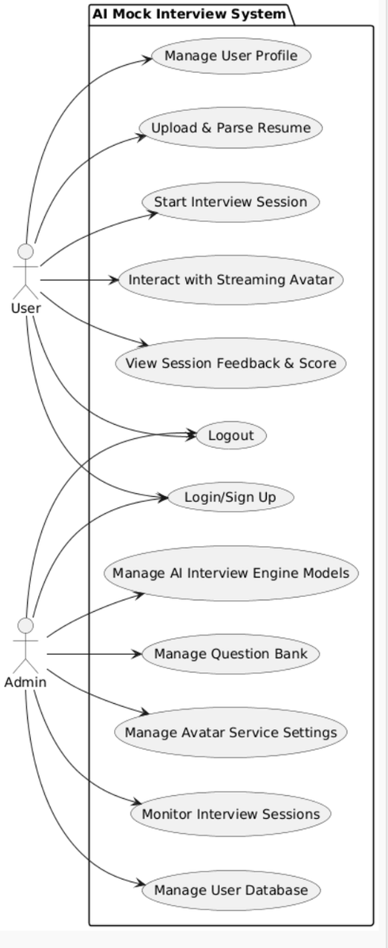
USE CASE DIAGRAM
5

Slide 6
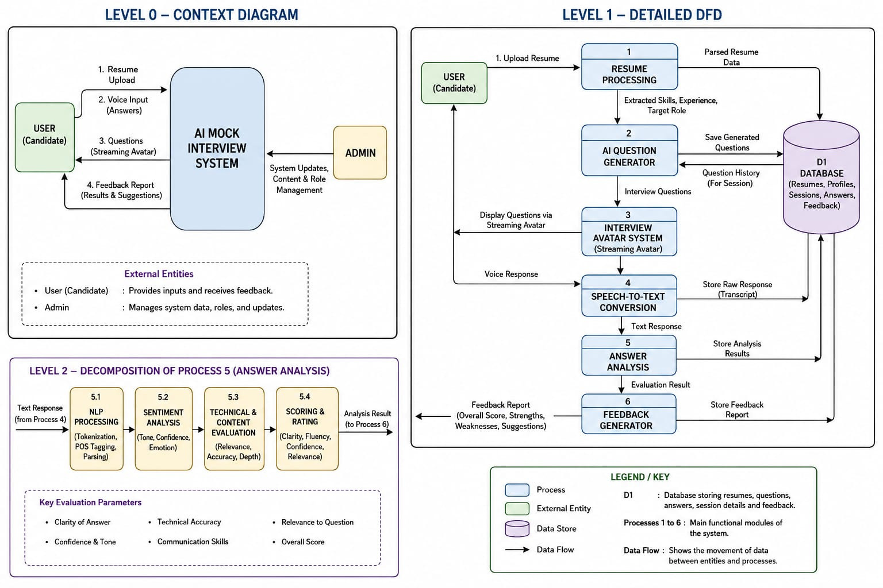
Data Flow Diagram
6

Slide 7
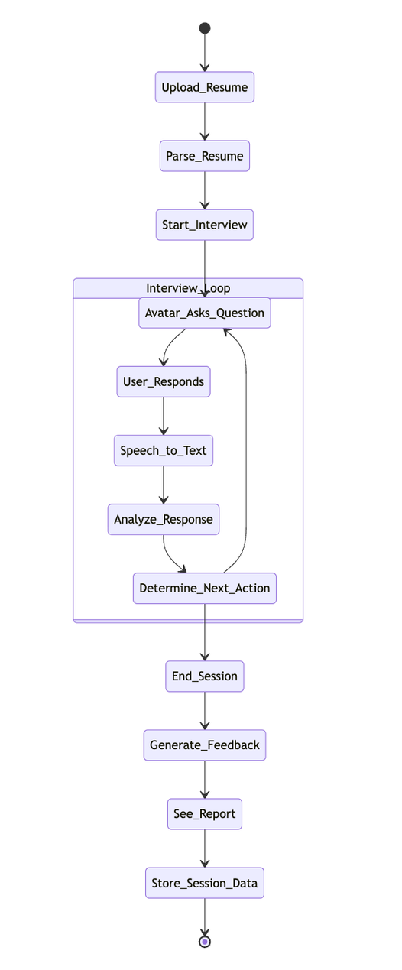
Activity Diagram
(Student as an actor)
7

Slide 8
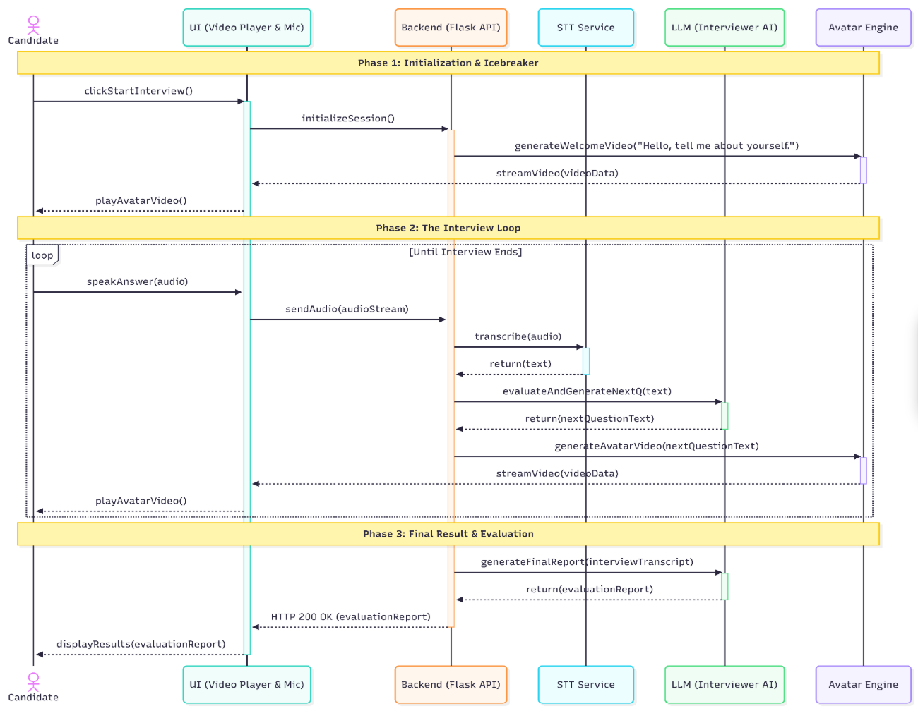
Sequence Diagram
8

Slide 9
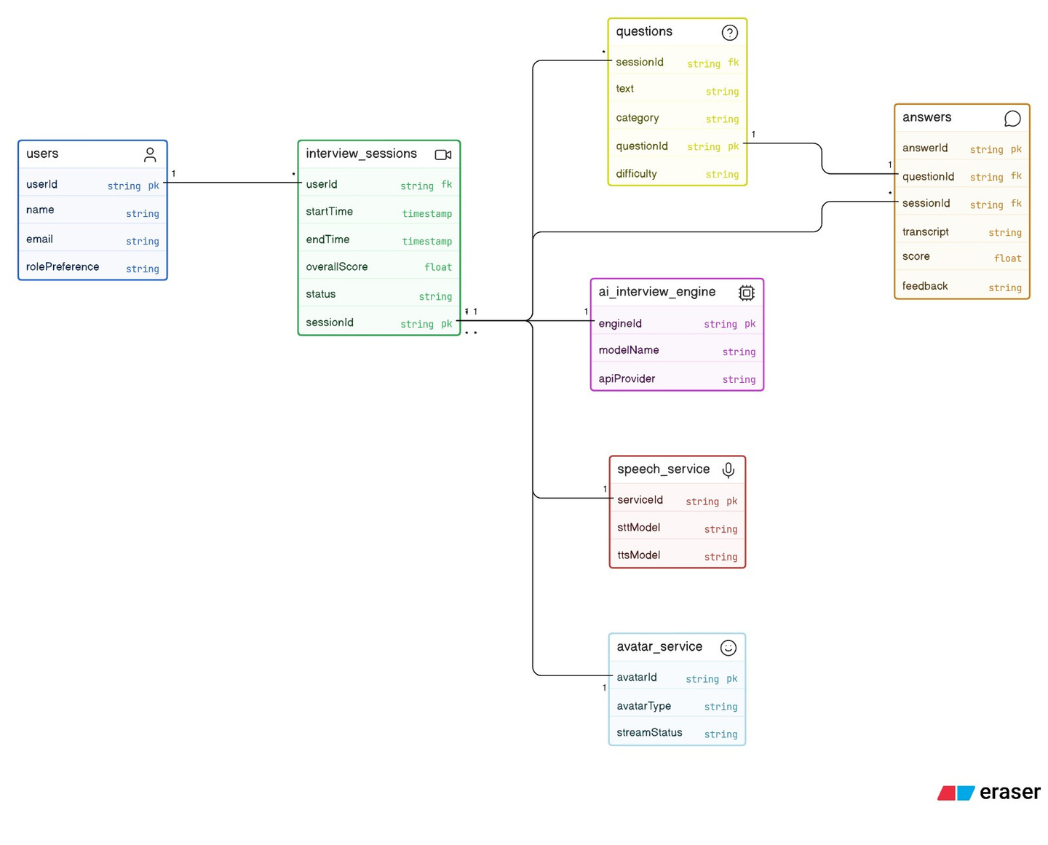
Class Diagram
10

Slide 10
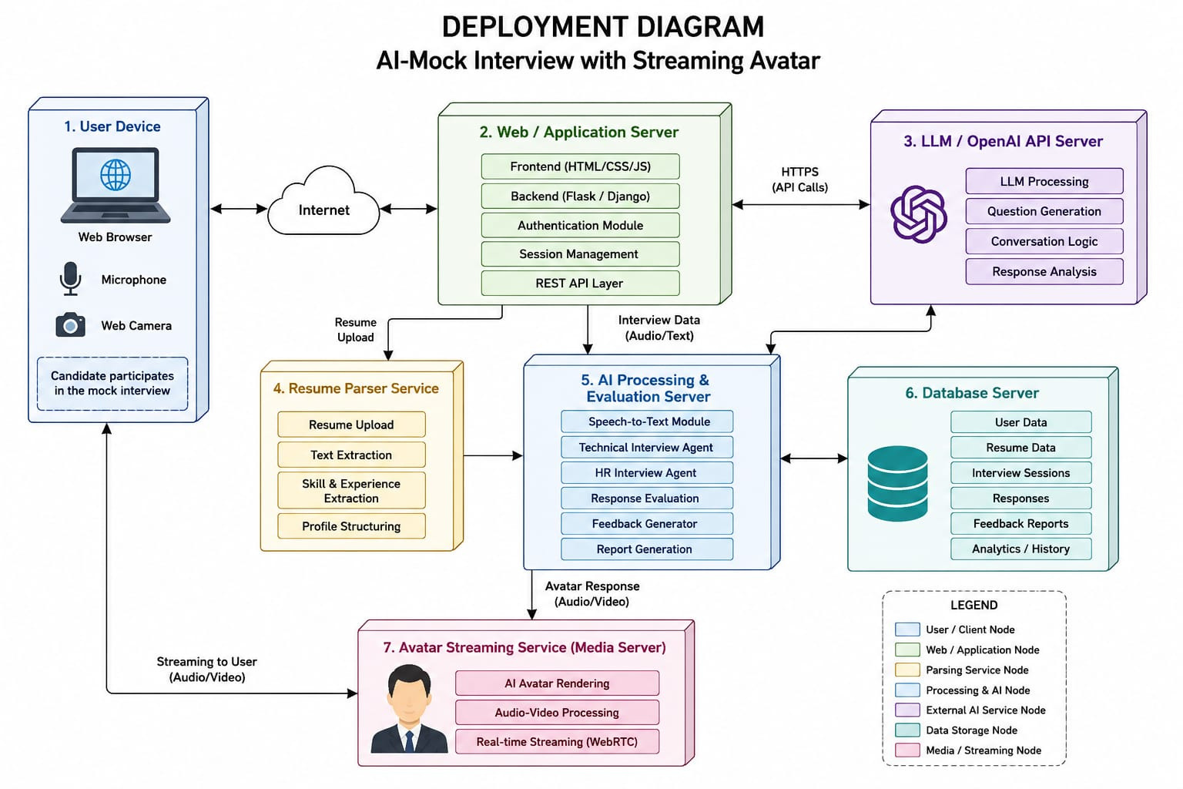
DeployMENT Diagram
11

