Slide 1



Minor Project Presentation III
on
“AI- Mock Interview with
Streaming Avatar”
Internal Mentor:
Prof. Pawan Kumar Gupta
External Mentor:
Mrs. Kalpana Paliwal
Presented By:
Siya Purohit(0827IT231134)
Tulja Vishwakarma (0827IT231142)
Yukti Baldua (0827IT231153) Yuvanshi Bhalawat(0827IT231154)

Slide 2



Contents
1.Problem Statement
2.Existing Solution Limitations 3.Proposed Solution Overview 4. Solution features
5. Methdology
6.Result
7.Future Scope
8. Conclusion
2

Slide 3

1. Problem Statement
Many students and job seekers face difficulties during interviews despite having strong technical knowledge.
Existing preparation methods like reading questions, watching videos, or practicing with peers lack real-time interaction and personalized feedback.
Most available mock interview platforms follow fixed question patterns and fail to simulate the dynamic nature of real interviews.
Access to experienced mentors or interview coaches is often limited, costly, or not always available.
Candidates do not receive proper insights into their communication skills, confidence level, and answer quality.
There is a need for a system that provides a realistic, adaptive, and intelligent interview environment for effective practice and improvement.
5

Slide 4
2. Existing Solution Limitations
Existing Solutions
Traditional mock interviews conducted by mentors.
Static interview preparation websites.
Generic AI chatbots.
Online question banks and aptitude platforms.
Limitations
Lack of personalized interview questions.
No realistic interviewer interaction.
Limited feedback and performance analysis.
Requires human intervention in many cases.
Does not simulate real interview pressure.
5

Slide 5
3. Proposed Solution (overview)
The process begins when a user uploads their resume into the system. Artificial intelligence quickly studies the information. Skills, projects, work history — everything gets scanned. From there, the interview slowly starts to take shape.
Advanced language models guide the conversation. Questions are not fixed beforehand. They adapt depending on what the candidate says. Sometimes the flow feels formal, other times a bit casual. Almost like a real interviewer thinking on the spot.
Repeating practice sessions helps candidates slowly build confidence. Each round improves clarity and response quality. Small progress appears over time.
Mistakes during practice are expected. In fact, they help the learning process. With repeated sessions, thinking becomes faster and interview anxiety begins to fade
6

Slide 6
4.
Solution (Features)
Resume-based interview personalization using AI.
Automatic extraction of skills, projects, certifications, and experience.
Dynamic question generation using Gemini Large Language Model.
Real-time interaction through a Streaming Avatar interviewer.
Voice-based communication using Speech Recognition technology.
Automated evaluation of technical knowledge and communication skills.
Comprehensive feedback reports with improvement suggestions.
Performance analytics and interview history tracking.
User-friendly and interactive web-based interface.
6

Slide 7

5.
Methodology
User registers and logs into the platform.
Resume is uploaded in PDF or DOCX format.
Resume Analysis Module extracts candidate information.
AI generates personalized interview questions based on the profile.
Streaming Avatar acts as a virtual interviewer.
User answers questions through voice interaction.
Speech Recognition converts voice responses into text.
Evaluation Engine analyzes responses for relevance and quality.
Performance scores are calculated automatically.
Detailed feedback and analytics reports are generated.
6

Slide 8
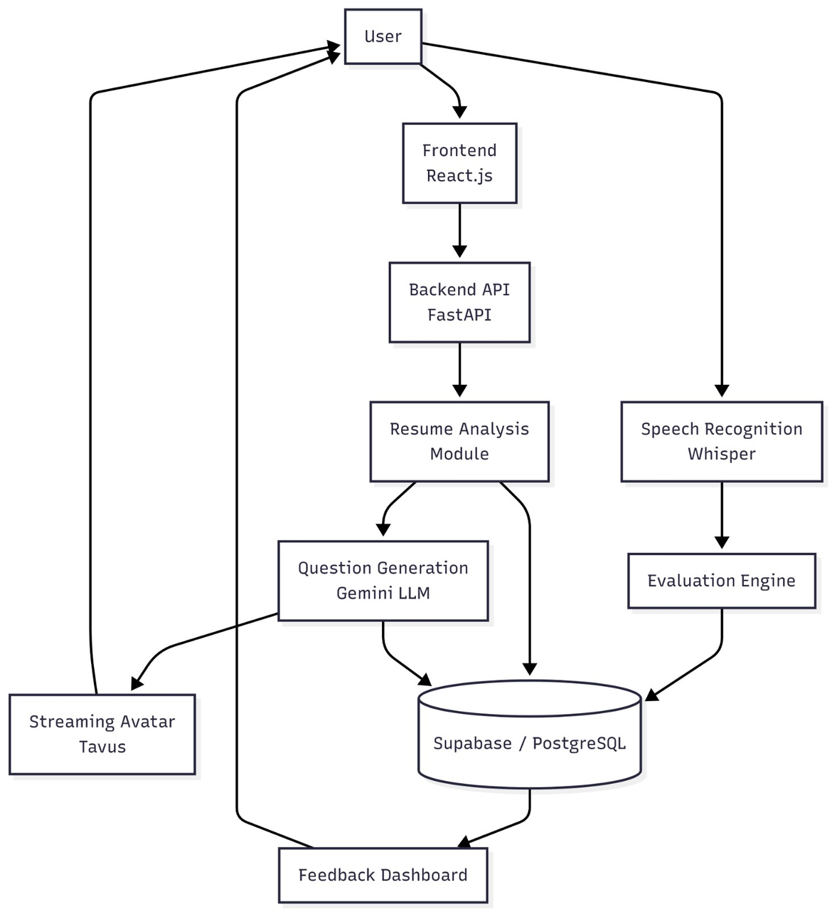
6.1 Block Diagram
8

Slide 9

6.2 Hardware Requirements
Since this is a software-focused project, hardware needs are minimal:
• A laptop or desktop with internet access
• Minimum 8 GB RAM and i5 processor (recommended for smooth development)
• Optional: Server for hosting chatbot (can use cloud services like AWS or Firebase)
6.3 Software Requirements
Component
Programming language Operating System
Framework
Database
Frontend Tools
APIs
Frameworks
Python(backend and NLP integration)
Windows11
FastAPI
supabase/postgrseql
JavaScript (for user interface)
whisper APIs, Gemini API etc
9

Slide 10

7.
Result
Personalized interview questions generated successfully.
Accurate speech recognition and response evaluation achieved.
Detailed feedback reports provided to users.
6

Slide 11

7.
Impact
Provides personalized interview practice using AI.
Enables continuous learning through automated feedback.
Improves confidence and communication skills.
6

Slide 12
8.
Future Scope
Emotion and facial expression analysis.
Multilingual interview support.
AI-based career guidance and recommendations.
6

Slide 13
9.
Conclusion and Call to Action
Developed an AI-powered mock interview platform.
Successfully integrated avatar interaction and automated evaluation.
Enhanced interview preparation through personalized practice.
6

Slide 14

Thank You
We are open to Questions now..
13

