Slide 1




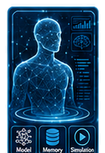

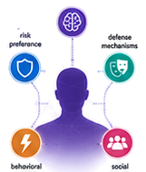


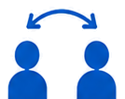



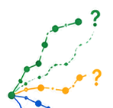


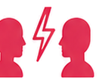







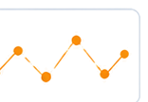







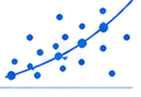




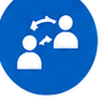


1
Observable Signals
2
Latent Attribute Set
3
Human Digital Twin
4
Predictive Engine
5
Predicted Outcomes
messages
future actions
What will
they do next?
choices
interaction
dynamics
reactions
Inference
from sparse
data
Simulation
under
different
stimuli
When will
conflict
emerge?
compatibility /
conflict
Reverse
engineering
Forecasts
social posts
timing of
escalation
How will they
respond under
pressure?
micro-
behaviors
response
patterns
Stable internal parameters
A computational proxy
of the person
Now
Future
State-space trajectories
Scientific Framing
Research Questions
Potential Applications
digital twin of humans
1
2
3
4
behavior prediction
computability of behavior
Bayesian inference
interaction outcome
forecasting
How much data is
enough to infer a
reliable latent profile?
Which probes
best reveal hidden
attributes?
How accurately can
the digital twin
predict future
behavior?
What are the
privacy and ethical
limits of such
modeling?
complex system modeling
privacy-risk assessment

