Slide 1
Exploring Academic Performance: Visualising Student Data
Yulan Yaneth
Purpose: To analyse key academic factors that influence student performance.

Slide 2
Background & Motivation
- Education is a key driver of success
- Data can reveal what affects performance
- This project helps identify important academic factors
Motivation: Apply KNIME to real-world education data

Slide 3
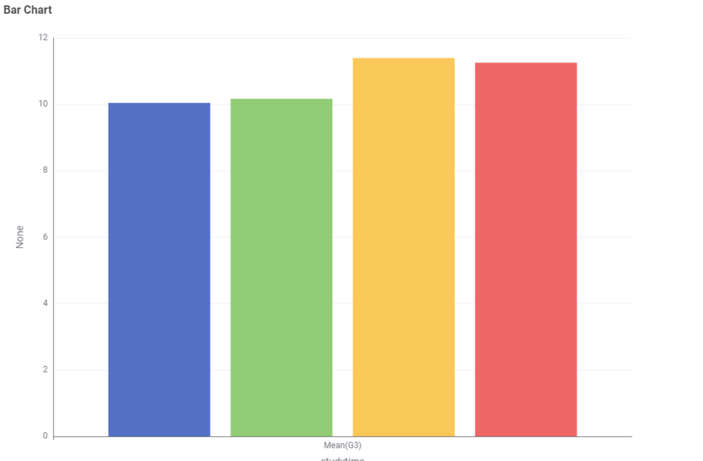
Insight 1 – Study Time vs Final Grade
- More study time = higher final grade
- Grouped by studytime, calculated mean of G3
- Clear upward trend

Slide 4
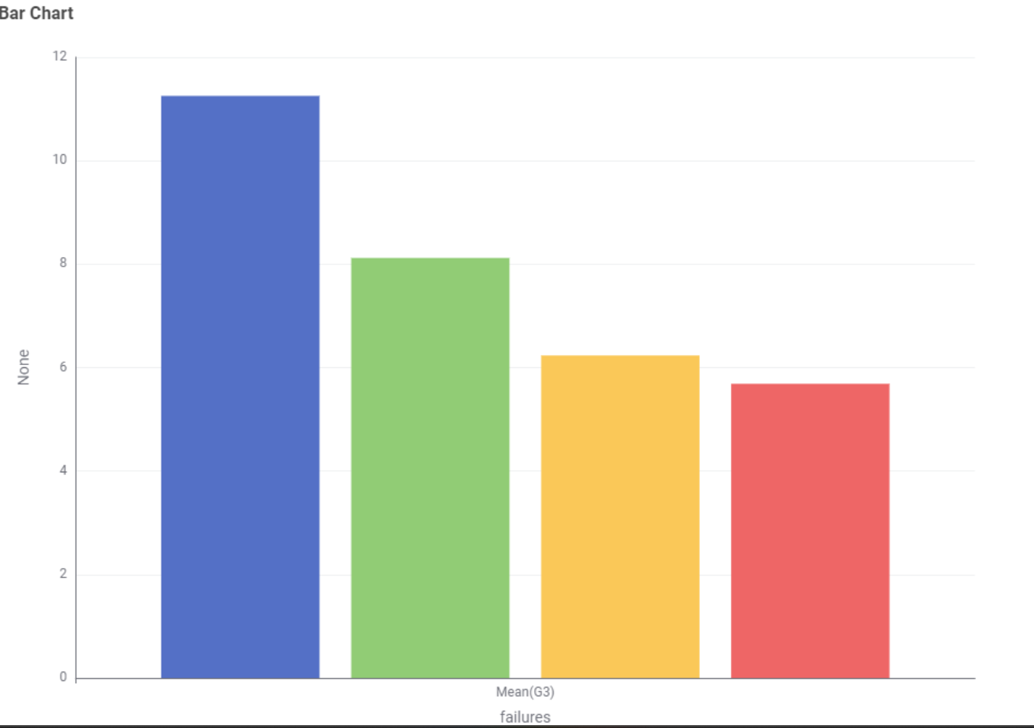
Insight 2 – Past Failures vs Final Grade
- More past failures = lower final grades
- Students with 0 failures avg 11.25
- 3 failures avg just 5.68

Slide 5

Work Done, Blockers & Next Steps
Completed:
- KNIME pipeline
- 2 insights with visualisation
- Design book draft ready
Blockers:
- Initial CSV format issues
Next Steps:
- Add third insight
- Final report and GitHub upload

