Slide 1
COS30045 DATA VISUALISATION
Team Name – CL01_G21
Name – Yulan yaneth karunanayake
ID - 105107919

Slide 2
DATA VISUALISATION PROJECT
Draft of Project
Design Book
Link to team GitHub classroom
KNIME file
Submission guidelines

Slide 3
DATA VISUALIZATION PROJECT -
The assignment's goal

Slide 4

The background, motivation, and ultimate goal of the visualisation project are all spelled out in detail in the introduction section that has been created.
The necessary dataset has been found and gathered by the team, and its source and governance considerations have been carefully documented.
To guarantee a thorough comprehension of every area and its significance, a thorough examination of the data dictionary was conducted.
KNIME has been used to carry out preliminary data processing tasks, such as determining missing values, performing necessary transformations, and calculating important summary statistics.
Across jurisdictions and demographics, exploratory data analysis (EDA) has been used to find trends, patterns, and possible problems with data quality.
For COS30045, a special GitHub Classroom repository has been made to facilitate collaborative code management and tracking.

Slide 5

The goal of this project is to create an interactive dashboard that displays information from drug tests conducted at roadside locations throughout Australia. Using official government enforcement information, the dashboard will enable users to examine variations in testing results by state, year, and detection stage. In order to improve road safety across the country, the main goal is to assist law enforcement, legislators, and the general public in comprehending testing trends, locating high-risk regions, and assessing the efficacy of present enforcement tactics.

Slide 6
So far, I have written a clear and well-structured project introduction that outlines the reasoning and purpose behind visualising roadside drug testing data. The dataset, sourced from the Road Safety Enforcement Data Dictionary provided by the Australian Government, has been collected and properly documented. I thoroughly reviewed the data dictionary to understand the key attributes and their relevance to the project.
Using KNIME, I initiated the data cleaning process by addressing missing values, correcting inconsistencies, and filtering for the most accurate records based on the BEST_DETECTION_METHOD flag. I also conducted preliminary exploratory data analysis (EDA) to identify early trends and enforcement patterns across different states and demographics.
As I am working individually, I have created a personal GitHub Classroom repository for COS30045 to manage version control, organise project files, and ensure a smooth development workflow. This setup allows me to keep track of all changes efficiently and maintain a structured approach throughout the project.
WORK COMPLETED SO FAR

Slide 7

IN PROGRESS
Right now, my main goal is to improve the dashboard's interaction design and visualisation arrangement. This entails choosing the best chart styles to accurately depict important trends in the data as well as setting up filters for state, year, and detection stage. In order to guarantee uniformity in characteristics like testing phases and jurisdiction names, I am also carrying on with data transformation and cleansing. I have started creating interface mockups and using user needs to inform layout choices in an effort to make the website more usable. The goal of these initiatives is to produce a dashboard that is both informative and easy to use for all target groups.

Slide 8

BLOCKERS AND CHALLENGES
Challenge 1: Some jurisdictions—particularly Tasmania and the Northern Territory—provided incomplete or inconsistent data. Key figures such as total test counts, charges, or arrests were missing in certain records, making it difficult to achieve accurate cross-state comparisons.
Challenge 2: While KNIME is effective for data processing and basic visualisation, it has limitations when it comes to generating the interactive and dynamic layouts required for the final dashboard. This has created an additional layer of complexity as I plan for external tools or manual solutions.
Challenge 3: Comparing results across different drug testing stages (e.g., roadside vs. laboratory confirmation) is difficult because this level of detail is only available in the 2023 data. The lack of stage-level data in earlier years restricts longitudinal comparisons.
In addition to these technical challenges, working independently without a team member has made it more difficult to manage the overall workload. Balancing data preparation, design planning, technical development, and documentation alone has been demanding, but I am continuing to make steady progress.

Slide 9
Potential Solutions for Blockers and Challenges
Challenge 1: Incomplete Data (e.g., TAS, NT)
• Use proxy values (e.g., fines + charges) where test count data is missing
• Focus analysis on states with complete and reliable records
Challenge 2: KNIME Visual Limitations
• Use KNIME primarily for data cleaning and processing
• Export cleaned data to build visualisations in D3.js or Chart.js for better interactivity
Challenge 3: Limited Testing Stage Data (Only 2023)
• Add clear labels and explanations to charts using 2023 stage-level data
• Focus year-over-year comparisons on overall test volumes and positive rates
Challenge 4: Working Individually Without a Team Member
• Use a structured project timeline to manage tasks and reduce overload
• Focus on one task at a time (e.g., clean → analyse → design) to maintain progress

Slide 10
FUTURE STEPS
Completing the report's Visualization Design, Interaction Design, and Website Design parts is the next step. Creating sketches and prototypes will be my first step in defining the dashboard's general structure. I intend to begin developing the visualisation on the technical side by loading the cleaned dataset, configuring shared constants, and generating the essential interactive elements and chart components.
The goal will be to provide an interface that is easy to use and understand. Important interactions will be added to improve usability, like filtering by year, jurisdiction, and testing stage. Every element will be gradually combined to create a functional prototype, which will be improved in response to ongoing testing and feedback.

Slide 11
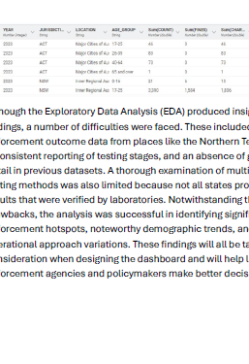
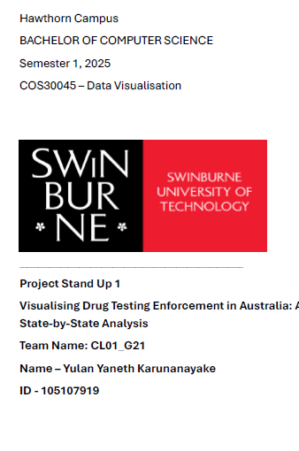
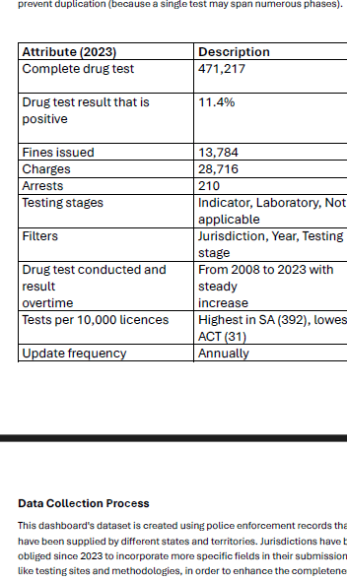
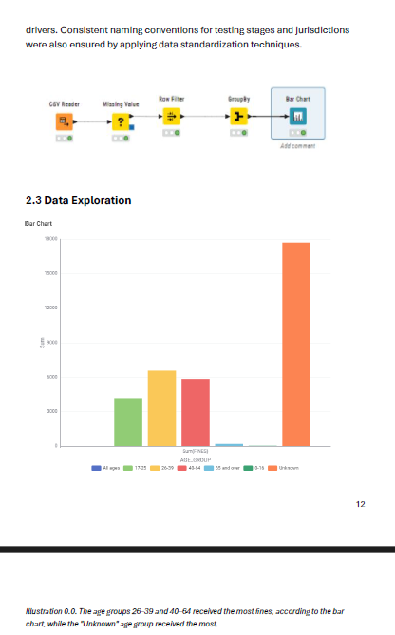
SCREENSHOTS

Slide 12

GEN AI DECLARATION
I admit that generative AI technologies helped with this project in a number of ways. These tools aided in the formulation of ideas, the organization of summaries and important insights in the data analysis documentation, and the enhancement of written material. Nonetheless, every essential activity was finished on its own, including the analysis, coding, processing of KNIME data, and design choices. AI was only utilized as a supporting tool to improve efficiency, clarity, and communication, and the final results were carefully examined and validated.

