Slide 1
The Gap to GLASS
Yuli Tshuva
October 2026

Slide 2
Delineation
Claude:
Design (presentation, table, figures)
Code
Yuli:
Flow
Conclusions
Follow up ideas
Y. Tshuva | Subgraph representation learning
2 / 24

Slide 3
Outline
1. Model ideas: clique weights, hub graph, copies, edge counts
2. Model or training? GLASS-style training and input
3. Debugging: running GLASS's own code
Y. Tshuva | Subgraph representation learning
3 / 24

Slide 4
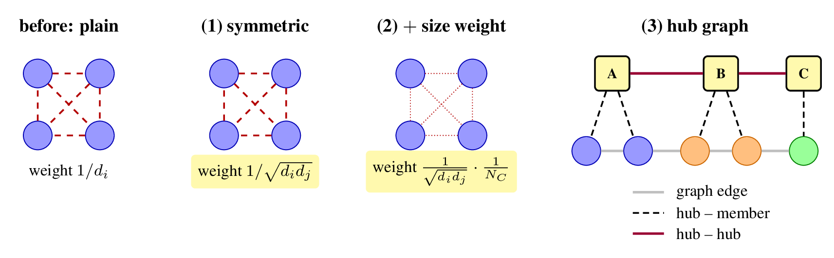
Clique Weights and the Hub Graph
GCN-style weights: less than one std change.
Hub nodes: w and w/o hub graph.
The weight between two hubs is the number of nodes their subgraphs share plus the graph edges between them. Each hub keeps only its 10 strongest links, because keeping all of them makes the hub graph nearly complete.
Y. Tshuva | Subgraph representation learning
4 / 24

Slide 5
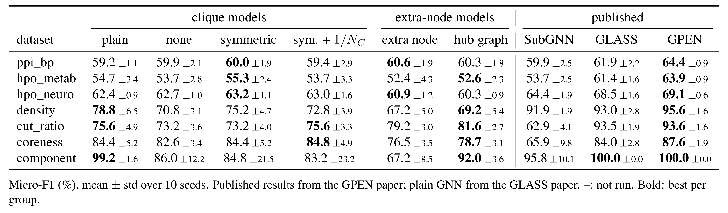
Results
Y. Tshuva | Subgraph representation learning
5 / 24

Slide 6
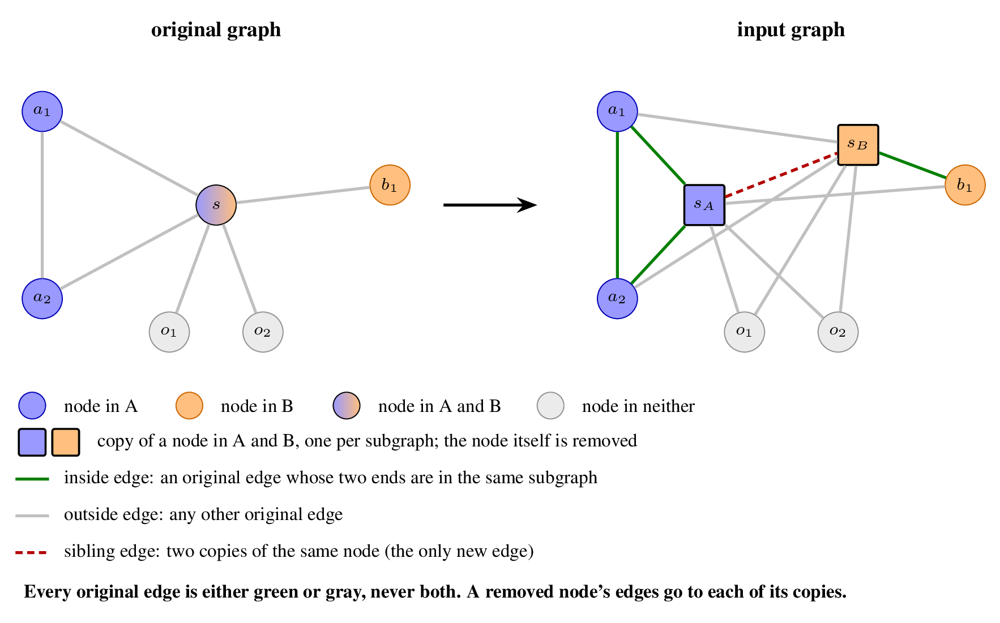
Copies Plus Edge Counts
Maybe we should try also adding the green in addition to the grey (instead of just painting them in green).
Y. Tshuva | Subgraph representation learning
10 / 24

