Slide 1
The Gap to GLASS
Yuli Tshuva
October 2026

Slide 2
Delineation
Claude:
Design (presentation, table, figures)
Code
Yuli:
Flow
Conclusions
Follow up ideas
Y. Tshuva | Subgraph representation learning
2 / 24

Slide 3
Outline
1. Model ideas: clique weights, hub graph, copies, edge counts
2. Model or training? GLASS-style training and input
3. Debugging: running GLASS's own code
Y. Tshuva | Subgraph representation learning
3 / 24

Slide 4
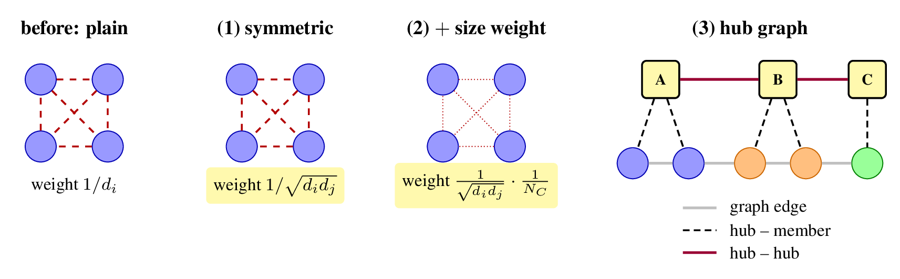
Clique Weights and the Hub Graph
GCN-style weights: less than one std change.
Hub nodes: w and w/o hub graph.
The weight between two hubs is the number of nodes their subgraphs share plus the graph edges between them. Each hub keeps only its 10 strongest links, because keeping all of them makes the hub graph nearly complete.
Y. Tshuva | Subgraph representation learning
4 / 24

Slide 5
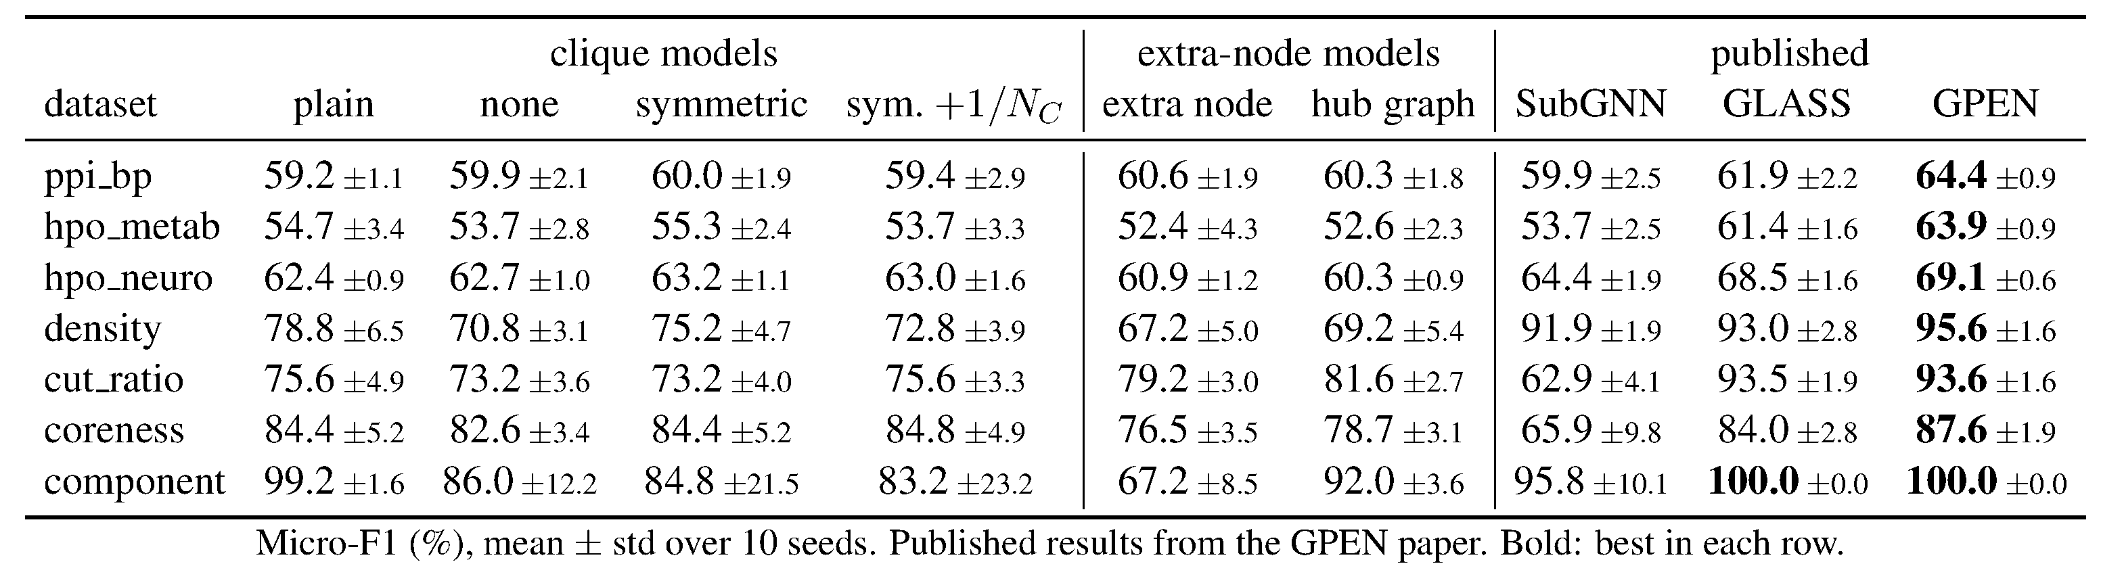
Results
Y. Tshuva | Subgraph representation learning
5 / 24

Slide 6
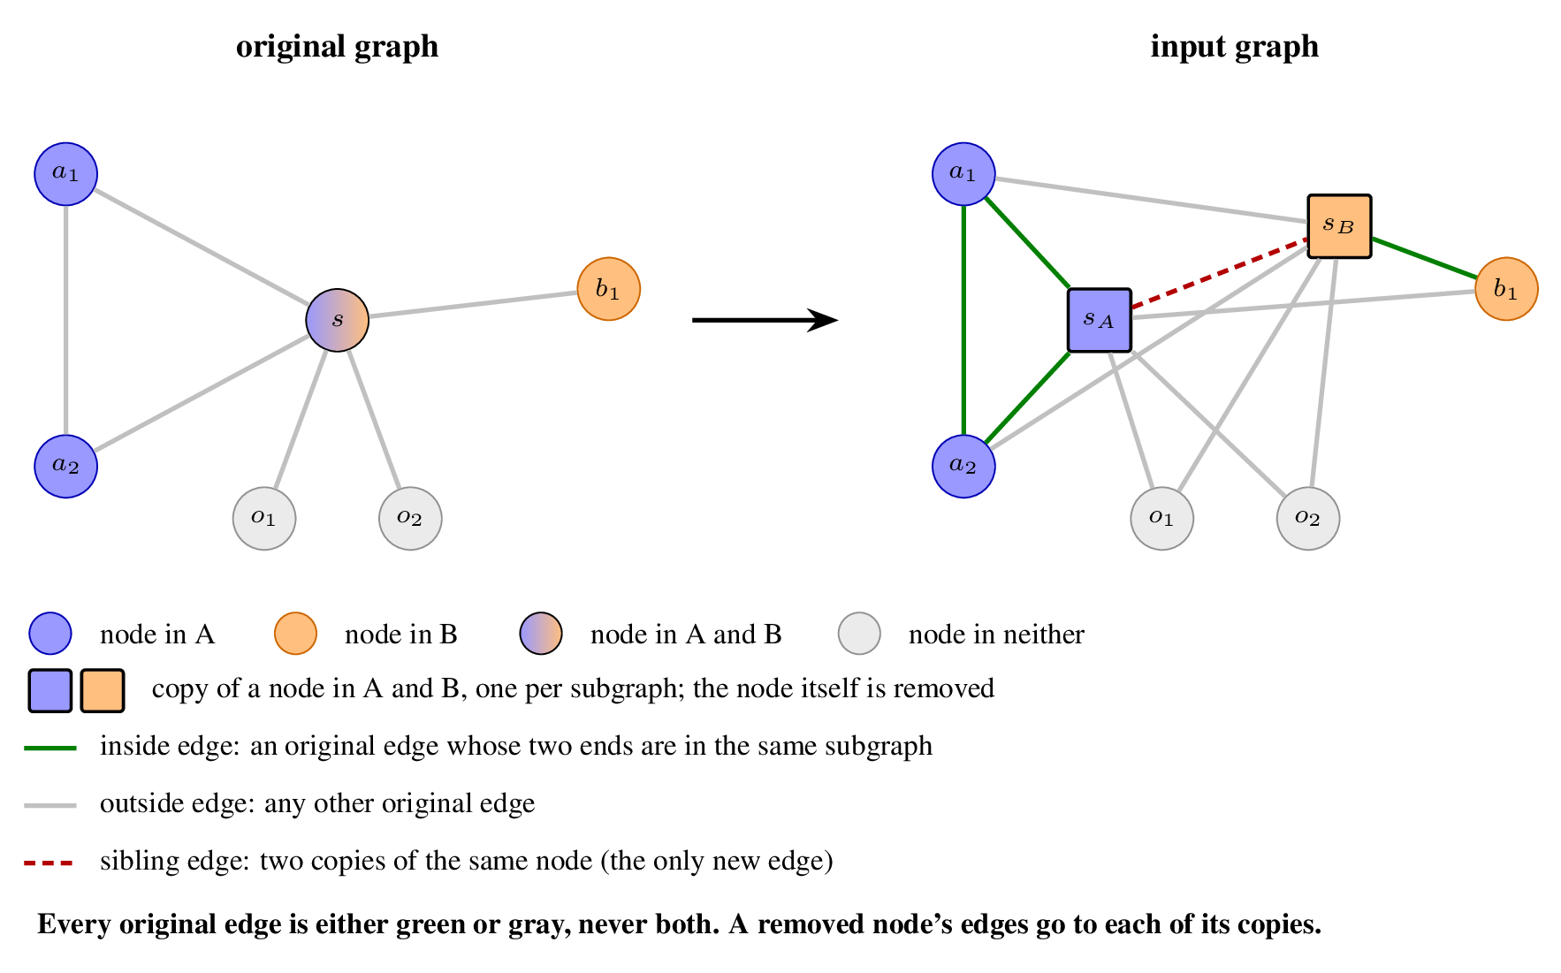
Edge Colors: The Graph
A coloring sorts the edges into groups; each group gets its own GNN weights.
Y. Tshuva | Subgraph representation learning
6 / 11

Slide 7
Edge Colors: Four Steps
23 colorings × 2 trainings (ours, GLASS's), 3 seeds.
Top 3 colorings × 4 aggregations × 7 poolings, 3 seeds.
Top 3 setups × small grid (hidden, lr, dropout, edge counts), 3 seeds.
Top 3 + our previous best, 10 seeds.
em_user, hpo_metab, hpo_neuro: no copies (35M–1.3B edges, out of GPU memory). All runs on GLASS's splits.
Y. Tshuva | Subgraph representation learning
7 / 11

Slide 8
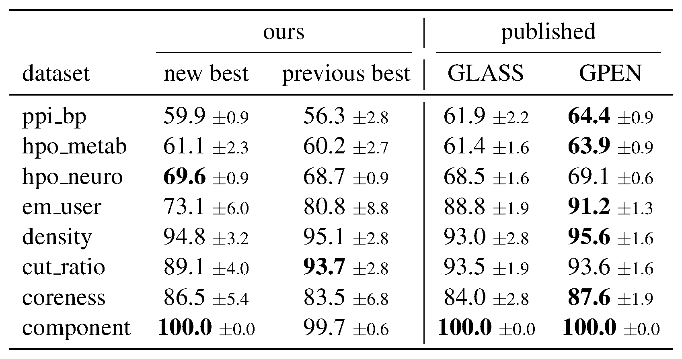
Edge Colors: Results
Test micro-F1, 10 seeds. Previous best rerun on the same splits. GLASS, GPEN: GPEN paper. Bold: best in row.
Y. Tshuva | Subgraph representation learning
8 / 11

Slide 9
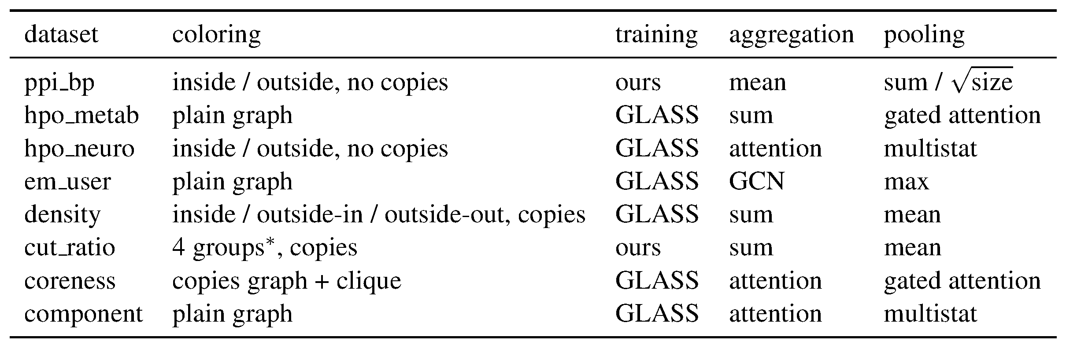
Edge Colors: Chosen Setups
*Inside split by touching a copy; outside split by both ends in subgraphs. Outside-in / out: by whether the receiver is in a subgraph.
Y. Tshuva | Subgraph representation learning
9 / 11

Slide 10
Edge Colors: Copies and Siblings
Copies, synthetic: density 69.8 → 92.6, cut_ratio 80.4 → 90.0 (step 1, test, 3 seeds).
Copies, ppi_bp / coreness / component: no gain.
Sibling edges: < 1 point on every dataset.
Y. Tshuva | Subgraph representation learning
10 / 11

Slide 11
Edge Colors: Training and Selection
Training: GLASS's in 6 of 8 best setups; +8 val on coreness, +4 on density.
Aggregation + pooling: hpo_metab val 62 → 67. Tuning: at most +2.5.
Val vs. test: hpo_metab 69 vs. 61. On cut_ratio and density, the previous best had higher val.
Y. Tshuva | Subgraph representation learning
11 / 11

Slide 12
Colorings: Notation
Kinds: I inside, O outside, S sibling, C clique.
Groups are separated by |; + joins kinds into one group.
Icopy / Iplain: inside edge touches a copy or not.
Osub / Onone: outside edge between two subgraphs, or with an end in none.
Oin / Oout: by whether the receiving node is in a subgraph.
Next →
← Back
Y. Tshuva | Subgraph representation learning

Slide 13
Colorings: 14 Base
I+O+S
S | I+O
I | O+S
O | I+S
I | O | S
I | O
I+O
I | Osub | Onone | S
I+Osub | Onone | S
Icopy | Iplain | O | S
I | Oin | Oout | S
Icopy | Iplain | Osub | Onone | S
I | O | S | C
I+O+S | C
Next →
← Back
Y. Tshuva | Subgraph representation learning

Slide 14
Colorings: Without Siblings, Without Copies
I+O | C
I+Osub | Onone
I | O | C
I | Oin | Oout
I | Osub | Onone
Icopy | Iplain | O
Icopy | Iplain | Osub | Onone
No copies:
G (graph as is)
Gin | Gout (inside / outside)
← Back
Y. Tshuva | Subgraph representation learning

Slide 15
Trainings
Ours: our best training so far for the dataset (its lr, batches, norm, dropout, MLP head, node head); early stop on val micro-F1; lr decay on val loss.
GLASS's: its batch size and lr; lr decay on training loss; GraphNorm; input and message dropout; linear head; its early stopping; no node head.
← Back
Y. Tshuva | Subgraph representation learning

Slide 16
Aggregations
Mean: average of the messages, within each group.
Sum: sum of the messages.
GCN: messages scaled by 1/√(d_i d_j) within each group, then summed.
Attention: RGAT, learned attention weights per group.
← Back
Y. Tshuva | Subgraph representation learning

Slide 17
Poolings
Multistat: mean ‖ max ‖ sum, concatenated.
Mean, Max, Sum: over the subgraph's nodes.
Size: sum / √(size).
Gated attention: learned weight per node.
Set Transformer: self-attention among the nodes, then attention pooling.
← Back
Y. Tshuva | Subgraph representation learning

Slide 18
Small Grid
Hidden size: GLASS's, or 128.
Learning rate: × 1/3, × 1, × 3 of the training's own lr.
Dropout: 0 or 0.5.
Edge counts (synthetic only): off or on; inside / outside edge counts per copy as input, and per subgraph at the head.
← Back
Y. Tshuva | Subgraph representation learning

Slide 19
Previous Best
ppi_bp: edge colors (inside / outside) + GLASS input.
hpo_metab: edge colors (inside / outside).
hpo_neuro, em_user: GLASS-plain rebuild.
density, cut_ratio: copies + GLASS's recipe.
coreness: Set Transformer readout.
component: copies + count skip to the head.
← Back
Y. Tshuva | Subgraph representation learning

