Slide 1
Subgraph Representation Learning
Methods and Benchmarks
Yuli Tshuva
October 2026

Slide 2
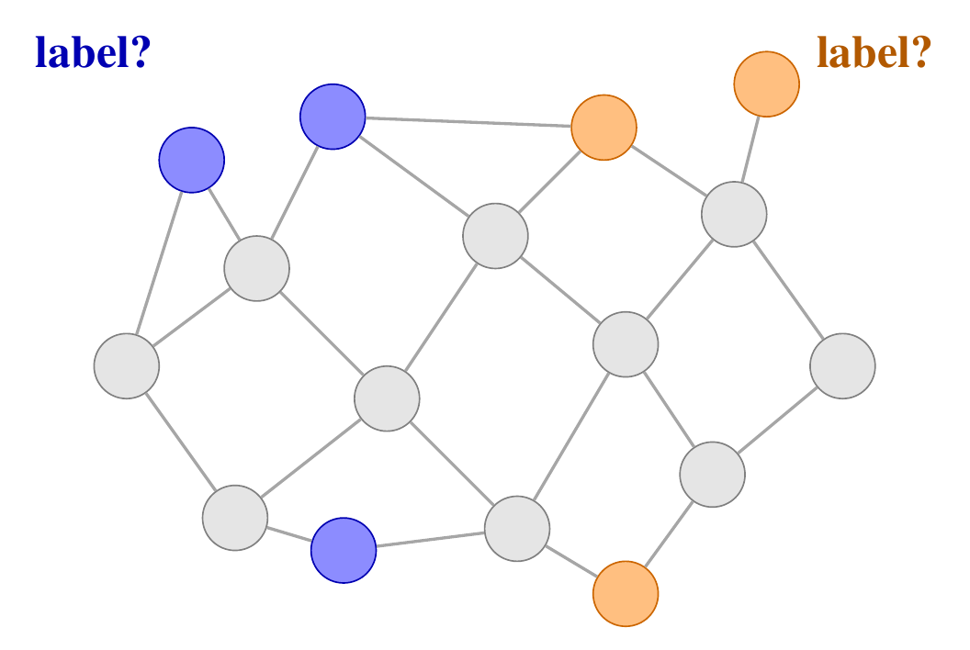
The Problem
One large graph. A subgraph is a set of its nodes, e.g. the visits of one patient.
Task: predict a label for each subgraph.
Between node classification (one node) and graph classification (a whole small graph).
A plain GNN gives a node the same vector for every subgraph, so it cannot tell inside from outside.
Y. Tshuva | Subgraph representation learning
2 / 28

Slide 3
Outline
1. Existing methods: GLASS, S2N, GPEN
2. Datasets: four real benchmarks and four synthetic ones
3. POC: our method on the GPEN benchmarks
Y. Tshuva | Subgraph representation learning
3 / 28

Slide 4
Timeline of Subgraph Methods
Sub2Vec
PAKDD 2018
Adhikari et al.
GLASS
ICLR 2022
Wang and Zhang
S2N
ICML 2024
Kim and Oh
2020
2023
2025
2018
2022
2024
SubGNN
NeurIPS 2020
Alsentzer et al.
SSNP
CIKM 2023
Jacob et al.
GPEN
ICML 2025
Wu et al.
Y. Tshuva | Subgraph representation learning
4 / 28

Slide 5
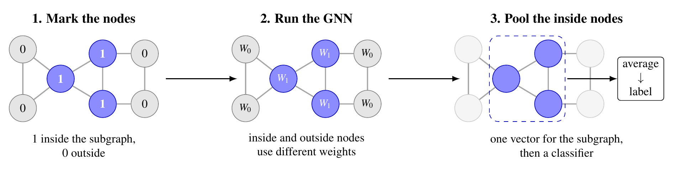
GLASS (Wang and Zhang, ICLR 2022)
Marks each node as inside (1) or outside (0) the subgraph; the two kinds use different weights.
Y. Tshuva | Subgraph representation learning
5 / 28

Slide 6
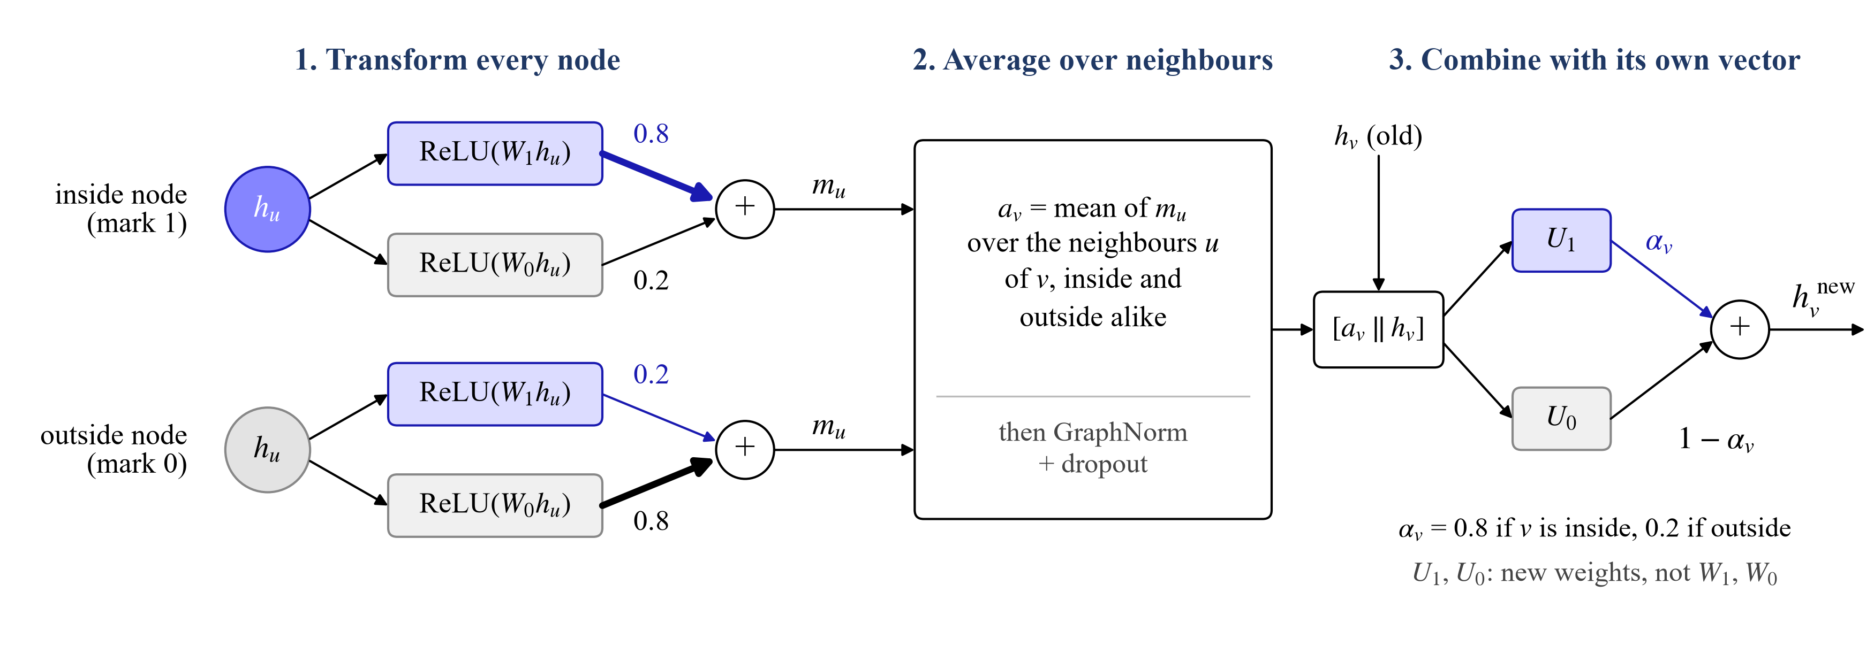
GLASS: Inside One Layer
Every node goes through both W1 and W0; its mark only decides the mix (0.8 / 0.2).
The 0.8 is fixed, not learned. The mark is not given as an input feature (authors' code).
Y. Tshuva | Subgraph representation learning
6 / 28

Slide 7
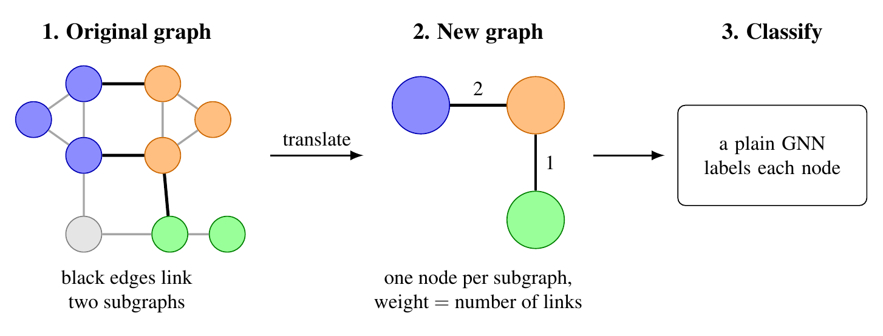
S2N (Kim and Oh, ICML 2024)
Each subgraph becomes one node of a small new graph; the edge weight is the number of edges between two subgraphs.
Y. Tshuva | Subgraph representation learning
7 / 28

Slide 8
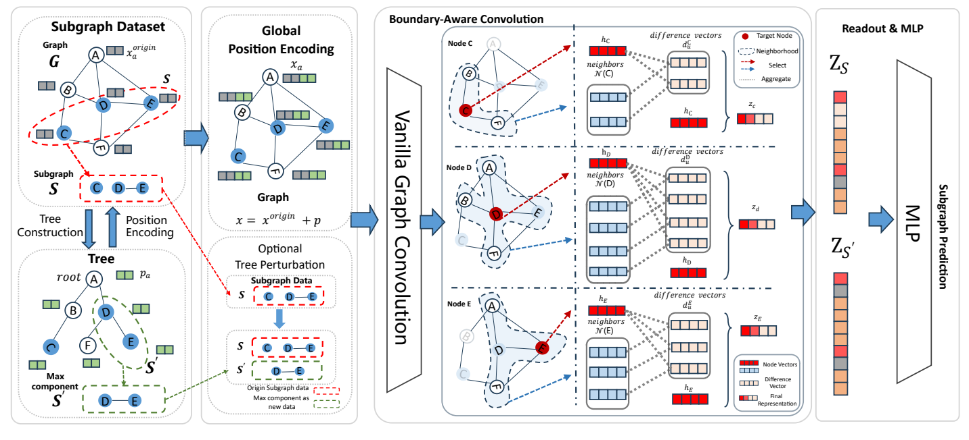
GPEN (Wu et al., ICML 2025)
Y. Tshuva | Subgraph representation learning
8 / 28

Slide 9
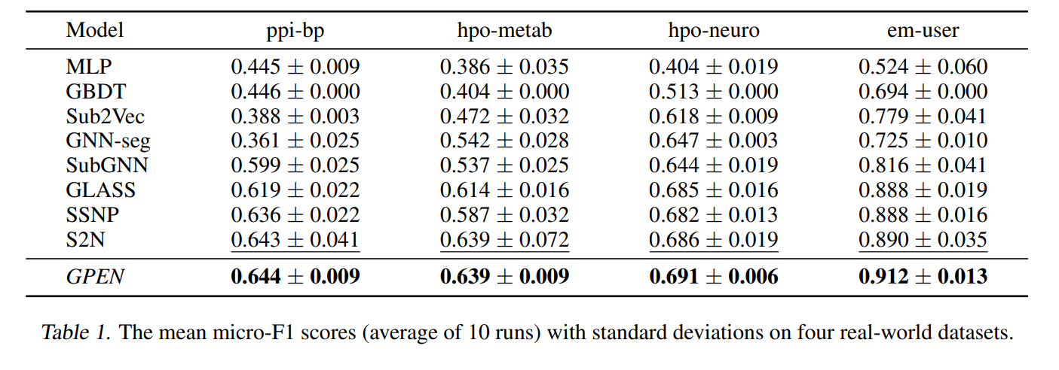
Published Results: Real Datasets
Micro-F1 (%), mean of 10 runs; accuracy for the binary EM-User. Best in bold. Source: Wu et al. (ICML 2025), Table 1.
Y. Tshuva | Subgraph representation learning
9 / 28

Slide 10
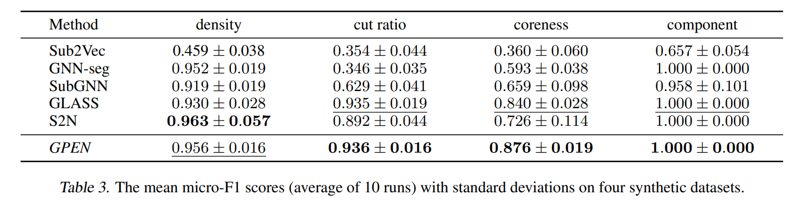
Published Results: Synthetic Datasets
Micro-F1 (%), mean of 10 runs. Best in bold. Source: Wu et al. (ICML 2025), Table 3.
Y. Tshuva | Subgraph representation learning
10 / 28

Slide 11
Outline
1. Existing methods: SubGNN, GLASS, S2N, GPEN
2. Datasets: four real benchmarks and four synthetic ones
3. POC: our method on the GPEN benchmarks
Y. Tshuva | Subgraph representation learning
11 / 28

Slide 12
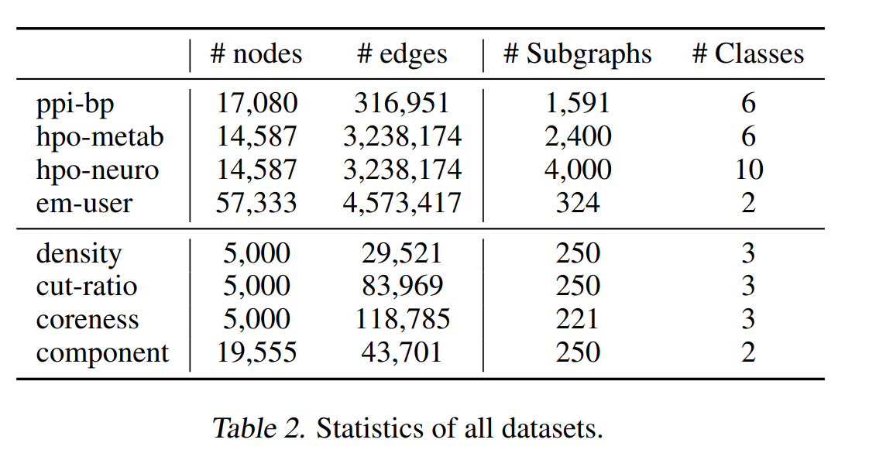
Datasets
Y. Tshuva | Subgraph representation learning
12 / 28

Slide 13
PPI-BP
Graph: human proteins, with an edge when two proteins are known to interact.
Subgraph: the proteins that take part in one biological process (Gene Ontology).
Label: the broad group of the process: metabolism, development, signal transduction, stress and death, cell organization, or transport.
Y. Tshuva | Subgraph representation learning
13 / 28

Slide 14
HPO-Metab
Graph: a knowledge graph of symptoms (Human Phenotype Ontology) and genes.
Subgraph: the list of symptoms of one rare disease.
Label: one of six kinds of metabolic disease, e.g. lipid or lysosomal. All classes are the same size.
Y. Tshuva | Subgraph representation learning
14 / 28

Slide 15
HPO-Neuro
Graph: the same graph as HPO-Metab.
Subgraph: the symptoms of one rare neurological disease.
Label: a disease can be in more than one of the ten classes, so the label is a set of classes.
Y. Tshuva | Subgraph representation learning
15 / 28

Slide 16
EM-User
Graph: workouts from the fitness app Endomondo.
Subgraph: all the workouts of one user.
Label: the user's gender. The only binary dataset, and it is balanced.
Y. Tshuva | Subgraph representation learning
16 / 28

Slide 17
Real Datasets: How the Subgraphs Sit
 | Nodes in no subgraph | In two or more | Components per subgraph (components of nodes) | In one component | Edges inside | Same-label neighbours (chance)
Pregnancy (ours) | 0% | 0% | 8.8 of 9.3 | - | 0.4% | 83.0% (81.7%)
PPI-BP | 67.4% | 47.8% | 7.0 of 10.2 | 2.1% | 2.3% | 27.5% (19.4%)
HPO-Metab | 82.5% | 78.2% | 1.6 of 14.4 | 54.8% | 2.9% | 21.8% (17.0%)
HPO-Neuro | 76.3% | 78.2% | 1.5 of 14.8 | 59.3% | 5.1% | -
EM-User | 87.6% | 68.0% | 30.6 of 155.4 | 0% | 1.1% | 49.6% (50.0%)
Y. Tshuva | Subgraph representation learning
17 / 28

Slide 18
Synthetic Datasets
Each is one made-up graph with subgraphs planted in it.
The label is a property of the subgraph's shape, fixed when the dataset was made.
The nodes have no features, so a model can only use the structure.
Y. Tshuva | Subgraph representation learning
18 / 28

Slide 19
Density
Label: how many of the subgraph's possible edges are present: low, medium or high.
In the files the three ranges do not overlap.
Subgraphs fall apart into many pieces, as in our data.
Y. Tshuva | Subgraph representation learning
19 / 28

Slide 20
Cut Ratio
Label: how many edges leave the subgraph, out of how many could.
The subgraphs are almost complete, and the three classes differ only a little.
Y. Tshuva | Subgraph representation learning
20 / 28

Slide 21
Coreness
Label: how deep in the core of the graph the subgraph sits, in three classes.
The coreness of a subgraph is computed by averaging over its nodes coreness.
Y. Tshuva | Subgraph representation learning
21 / 28

Slide 22
Component
Label: whether the subgraph is one piece or several.
Every piece has the same size, so a subgraph's size alone gives its label.
Y. Tshuva | Subgraph representation learning
22 / 28

Slide 23
Synthetic Datasets: Size
 | Nodes | Edges | Avg. degree | Subgraphs | Classes | Avg. size | Median | Range
Density | 4,998 | 29,962 | 12.0 | 250 | 3 | 20.0 | 20 | 20-20
Cut ratio | 5,000 | 84,295 | 33.7 | 250 | 3 | 20.0 | 20 | 20-20
Coreness | 5,000 | 119,205 | 47.7 | 221 | 3 | 20.0 | 20 | 20-20
Component | 17,260 | 91,619 | 10.6 | 250 | 2 | 65.0 | 15 | 15-150
Every subgraph has 20 nodes, except in Component, where size gives the label: 15 nodes for one class, 75 or more for the other.
Y. Tshuva | Subgraph representation learning
23 / 28

Slide 24
Synthetic Datasets: How the Subgraphs Sit
 | Nodes in no subgraph | In two or more | Components per subgraph (components of nodes) | In one component | Edges inside | Same-label neighbours (chance)
Density | 55.0% | 40.5% | 8.1 of 20.0 | 3.2% | 15.8% | 32.9% (33.5%)
Cut ratio | 37.5% | 42.1% | 1.0 of 20.0 | 100% | 53.4% | 31.4% (33.5%)
Coreness | 11.6% | 0% | 1.0 of 20.0 | 100% | 8.0% | 38.6% (39.1%)
Component | 5.8% | 0% | 4.3 of 65.0 | 50.4% | 93.4% | 82.6% (84.1%)
Y. Tshuva | Subgraph representation learning
24 / 28

Slide 25
Outline
1. Existing methods: SubGNN, GLASS, S2N, GPEN
2. Datasets: four real benchmarks and four synthetic ones
3. POC: our method on the GPEN benchmarks
Y. Tshuva | Subgraph representation learning
25 / 28

Slide 26
POC: Our Method on the GPEN Benchmarks
Graph: the dataset's own edges replace our text-similarity kNN graph.
Same subgraph: a second relation links every two nodes of one subgraph, as our same-color edges do.
Overlap: a node can be in several subgraphs. Its node label is the mean label of the training subgraphs it is in.
Labels: one output per class. HPO-Neuro has several labels per subgraph, so it gets a yes/no output per class.
Node input: a learned vector per node, or SubGNN's pretrained embeddings. Synthetic datasets have no features, so a constant.
Scoring: micro-F1 on GPEN's fixed splits, as in their tables.
Y. Tshuva | Subgraph representation learning
26 / 28

Slide 27
POC: Hyperparameter Search
Hyperparameter | Values
Backbone | RGAT (2 or 4 heads), RGCN
Readout | mean, node-score mean, gated attention, supernode, multistat, PMA
Node input | learned vector (32, 64, 128), GIN or GCN embeddings, constant
Embedding / hidden dim | 100, 128, 156
GNN layers | 1, 2, 3
Dropout | 0, 0.1, 0.2
MLP hidden dim | 50, 64, 80 (node head); 32, 50, 64 (subgraph head)
Weight decay | 0, 1e-5, 1e-4, 1e-3, 1e-2
100 trials per dataset (Optuna), chosen by validation micro-F1. AdamW, learning rate 0.001, up to 10,000 epochs, stopping after 30 epochs without a 1% drop in validation loss. The best setting is then rerun over 10 seeds.
Y. Tshuva | Subgraph representation learning
27 / 28

Slide 28
POC: Results
Dataset | Ours | SubGNN | GLASS | GPEN
PPI-BP | 55.0 ± 2.4 | 59.9 | 61.9 | 64.4
HPO-Metab | 51.7 ± 3.1 | 53.7 | 61.4 | 63.9
HPO-Neuro | 52.4 ± 3.7 | 64.4 | 68.5 | 69.1
EM-User | not run yet | 81.6 | 88.8 | 91.2
Density | 35.6 ± 5.5 | 91.9 | 93.0 | 95.6
Cut Ratio | 29.2 ± 11.3 | 62.9 | 93.5 | 93.6
Coreness | 29.6 ± 3.8 | 65.9 | 84.0 | 87.6
Component | 93.2 ± 20.4 | 95.8 | 100.0 | 100.0
Micro-F1 (%). Ours: mean ± std over 10 seeds of the best setting found in about 100 trials. Others: published means, Wu et al. (ICML 2025), Tables 1 and 3.
Y. Tshuva | Subgraph representation learning
28 / 28

Slide 29
POC Run 2: What We Changed
Longer training: at least 200 epochs, then stop after 150 epochs without a better validation F1. Run 1 stopped after 30 epochs, often before learning anything.
Best checkpoint: the epoch with the best validation micro-F1.
Learning rate: halved when the validation loss stalls; the starting rate is searched.
Structural input: each node's degree, how many of its neighbors share its subgraph, and how many subgraphs it is in. It replaces the constant input, which gave every node the same embedding.
Narrower grid: only the two readouts that won run 1, and 250 trials instead of 100.
Y. Tshuva | Subgraph representation learning
29 / 31

Slide 30
POC Run 2: Hyperparameter Search
Hyperparameter | Values
Backbone | RGAT (4 heads), RGCN
Readout | multistat, gated attention
Learning rate | 0.001, 0.003, 0.01
Node input | learned vector (64, 128), structural features, GIN embeddings
Embedding / hidden dim | 100, 128, 156
GNN layers | 1, 2
Dropout | 0, 0.2
MLP hidden dim | 50, 64, 80 (node head); 32, 50, 64 (subgraph head)
Weight decay 0 or 1e-4. 250 trials per dataset (Optuna), chosen by validation micro-F1. AdamW, at least 200 epochs. The best setting is then rerun over 10 seeds.
Y. Tshuva | Subgraph representation learning
30 / 31

Slide 31
POC Run 2: Results
Dataset | Run 1 | Run 2 | GLASS | GPEN
PPI-BP | 55.0 | 59.2 ± 1.1 | 61.9 | 64.4
HPO-Metab | 51.7 | 54.7 ± 3.4 | 61.4 | 63.9
HPO-Neuro | 52.4 | 62.4 ± 0.9 | 68.5 | 69.1
EM-User | - | not run | 88.8 | 91.2
Density | 35.6 | 78.4 ± 5.7 | 93.0 | 95.6
Cut Ratio | 29.2 | 75.2 ± 3.0 | 93.5 | 93.6
Coreness | 29.6 | 84.4 ± 4.4 | 84.0 | 87.6
Component | 93.2 | 98.4 ± 2.0 | 100.0 | 100.0
Micro-F1 (%). Run 2: mean ± std over 10 seeds of the best setting found in 250 trials. Run 1: slide 28. GLASS and GPEN: published means, Wu et al. (ICML 2025).
Y. Tshuva | Subgraph representation learning
31 / 31

Slide 32
POC Run 3: Transformer and Extra Node
Dataset | Pooling | Transformer | Extra node | SubGNN | GLASS | GPEN
PPI-BP | 59.2 ± 1.1 | 58.0 ± 1.7 | 60.6 ± 1.9 | 59.9 | 61.9 | 64.4
HPO-Metab | 54.7 ± 3.4 | 52.9 ± 3.5 | 52.4 ± 4.3 | 53.7 | 61.4 | 63.9
HPO-Neuro | 62.4 ± 0.9 | 58.3 ± 1.6 | 60.9 ± 1.2 | 64.4 | 68.5 | 69.1
EM-User | not run | not run | not run | 81.6 | 88.8 | 91.2
Density | 78.4 ± 5.7 | 74.4 ± 5.4 | 67.2 ± 5.0 | 91.9 | 93.0 | 95.6
Cut Ratio | 75.2 ± 3.0 | 70.0 ± 4.5 | 79.2 ± 3.0 | 62.9 | 93.5 | 93.6
Coreness | 84.4 ± 4.4 | 89.1 ± 4.9 | 76.5 ± 3.5 | 65.9 | 84.0 | 87.6
Component | 98.4 ± 2.0 | 97.6 ± 3.7 | 67.2 ± 8.5 | 95.8 | 100.0 | 100.0
Micro-F1 (%), mean ± std over 10 seeds; bold = best of our three. Transformer and extra node keep each dataset's run 2 setting with the readout swapped, plus a small search (8 and 6 settings). SubGNN, GLASS and GPEN: Wu et al. (ICML 2025).
Y. Tshuva | Subgraph representation learning
32 / 32

