Slide 1
Subgraph representation learning
Methods and benchmarks
Yuli Tshuva · October 2026

Slide 2
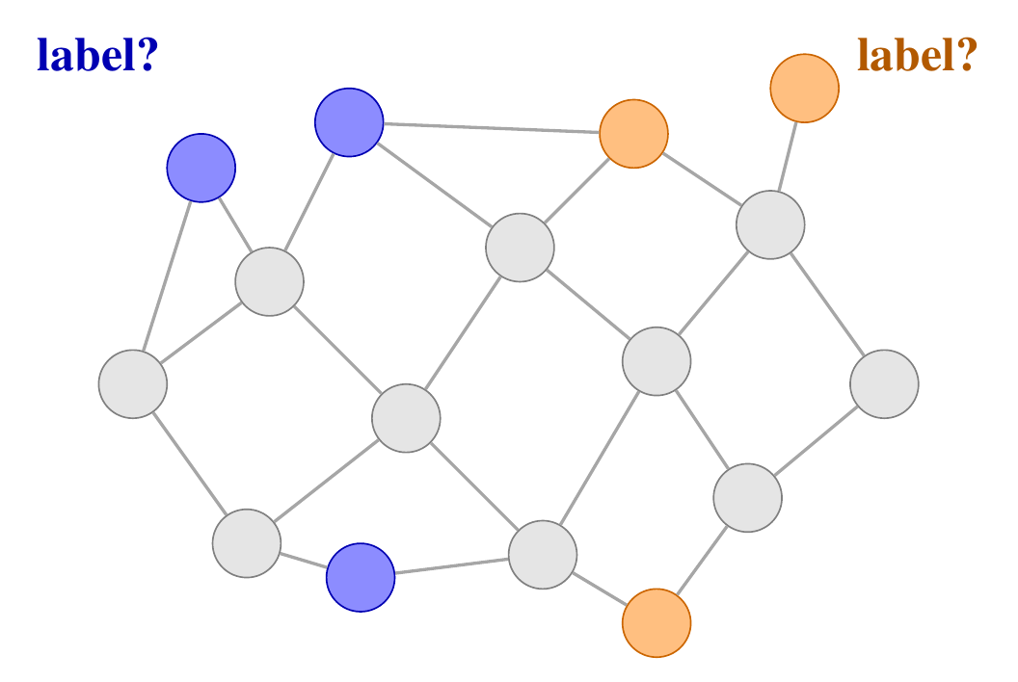
The problem
THE TASK
Predict a label for each subgraph: a set of nodes inside one large graph, like the visits of one patient.
THE CATCH
A plain GNN gives a node the same vector for every subgraph, so it cannot tell inside from outside.

Slide 3
Existing methods
01
Four methods, 2020 to 2025:
SubGNN · GLASS · S2N · GPEN

Slide 4
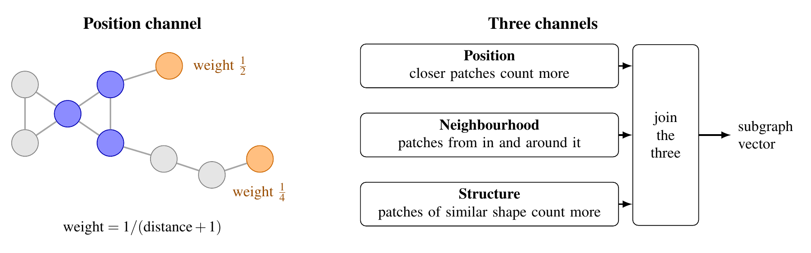
SubGNN
NeurIPS 2020
Describe a subgraph by comparing it with random pieces of the graph. Closer or more similar pieces count more.
COST
Slow: the pieces and distances must be computed before training.

Slide 5
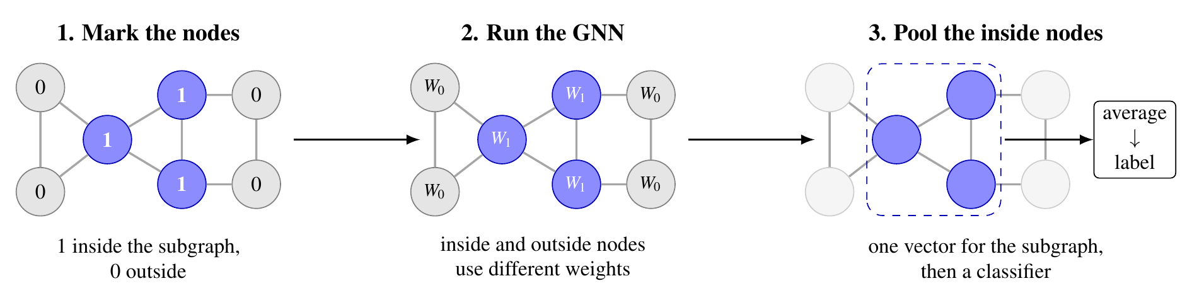
GLASS
ICLR 2022
Tell the GNN which nodes are inside the subgraph, and let inside and outside nodes use different weights.
RESULT
Simpler than SubGNN, better on all 8 datasets, about 3x faster to train.

Slide 6
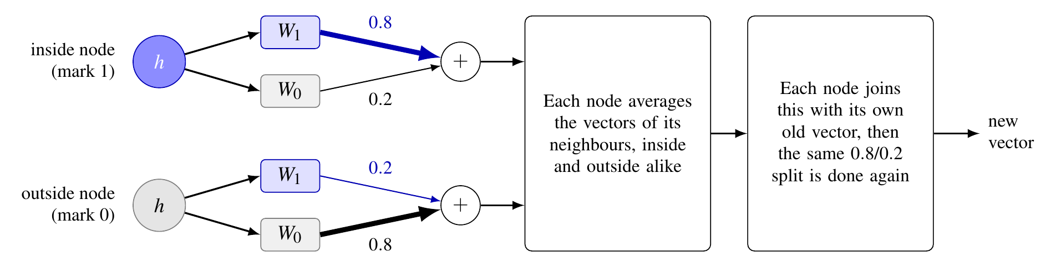
GLASS: inside one layer
authors' code
Every node goes through both weight sets. Its mark only decides the mix.
NOTE
The 0.8 is fixed, not learned. The mark is not given as an input feature.

Slide 7
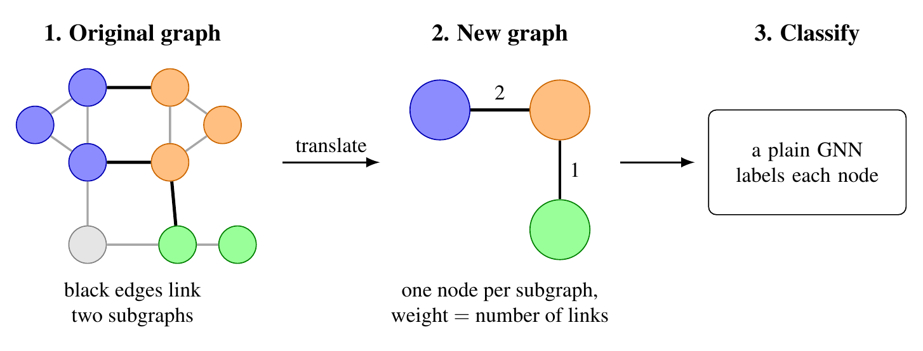
S2N
ICML 2024
Squeeze each subgraph into one node of a small new graph, then run a plain GNN on it.
RESULT
As good as GLASS, and 183 to 711 times more subgraphs per second.

Slide 8
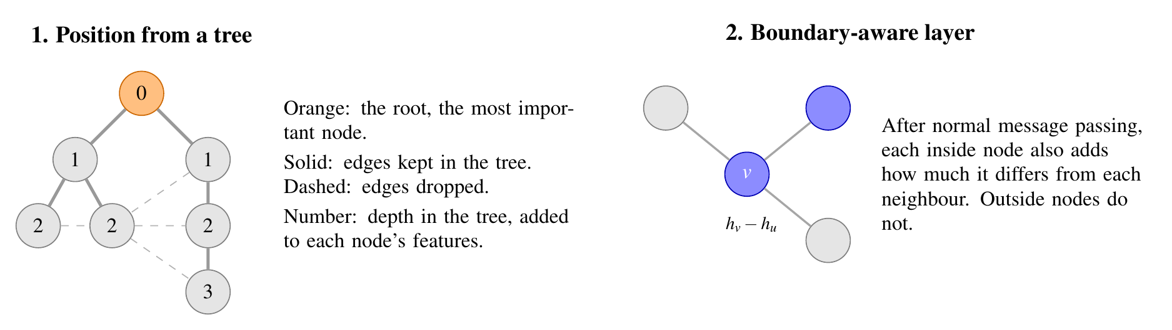
GPEN
ICML 2025
Give each node a position in a tree over the whole graph, and let inside nodes compare themselves with their neighbours.
RESULT
Best on all four real datasets, but only slightly ahead of S2N.

Slide 9
Published results: real datasets
 | PPI-BP | HPO-Metab | HPO-Neuro | EM-User
SubGNN | 59.9 | 53.7 | 64.4 | 81.6
GLASS | 61.9 | 61.4 | 68.5 | 88.8
S2N | 64.3 | 63.9 | 68.6 | 89.0
GPEN | 64.4 | 63.9 | 69.1 | 91.2
GPEN is best everywhere, but its lead over S2N, at most 2.2 points, is within S2N's spread across runs.
Micro-F1 (%), mean of 10 runs; accuracy for the binary EM-User. Source: GPEN paper (Wu et al., ICML 2025), Table 1.

Slide 10
Published results: synthetic datasets
 | Density | Cut ratio | Coreness | Component
SubGNN | 91.9 | 62.9 | 65.9 | 95.8
GLASS | 93.0 | 93.5 | 84.0 | 100
S2N | 96.3 | 89.2 | 72.6 | 100
GPEN | 95.6 | 93.6 | 87.6 | 100
Component is solved by all newer methods. The only clear gap is Coreness, where GPEN leads GLASS by 3.6 points.
Micro-F1 (%), mean of 10 runs. Source: GPEN paper (Wu et al., ICML 2025), Table 3.

Slide 11
Datasets
02
The SubGNN benchmark:
four real graphs and four synthetic ones

Slide 12
PPI-BP
THE GRAPH
Human proteins, with an edge when two proteins are known to interact.
A SUBGRAPH
The proteins that take part in one biological process, from the Gene Ontology.
ITS LABEL
The broad group of the process: metabolism, development, signal transduction, stress and death, cell organization, or transport.

Slide 13
HPO-Metab
THE GRAPH
A knowledge graph of symptoms, from the Human Phenotype Ontology, and genes.
A SUBGRAPH
The list of symptoms of one rare disease.
ITS LABEL
One of six kinds of metabolic disease, for example lipid or lysosomal. All six classes are the same size.

Slide 14
HPO-Neuro
THE GRAPH
The same graph as HPO-Metab.
A SUBGRAPH
The symptoms of one rare neurological disease.
ITS LABEL
A disease can be in more than one of the ten classes, so the label is a set of classes.

Slide 15
EM-User
THE GRAPH
Workouts from the fitness app Endomondo.
A SUBGRAPH
All the workouts of one user.
ITS LABEL
The user's gender. The only binary dataset, and it is balanced: half women, half men.

Slide 16
The datasets: size
 | Nodes | Edges | Avg. degree | Subgraphs | Avg. size | Median | Range
Pregnancy (ours) | 61,046 | 972,557 | 31.9 | 6,590 | 9.3 | 5 | 2-221
PPI-BP | 21,521 | 338,625 | 31.5 | 1,591 | 10.2 | 7 | 1-160
HPO-Metab | 14,587 | 3,238,174 | 444.0 | 2,400 | 14.4 | 13 | 1-50
HPO-Neuro | 14,587 | 3,238,174 | 444.0 | 4,000 | 14.8 | 14 | 2-55
EM-User | 57,333 | 4,573,417 | 159.5 | 324 | 155.4 | 134 | 3-499
Size is the number of nodes in a subgraph, and range is its smallest and largest. Edges are counted once.

Slide 17
The datasets: how the subgraphs sit
 | Nodes in no subgraph | In two or more subgraphs | Pieces per subgraph | Subgraphs in one piece | Edges inside a subgraph | Same-label neighbours (chance)
Pregnancy (ours) | 0% | 0% | 8.8 of 9.3 | - | 0.4% | 83.0% (81.7%)
PPI-BP | 67.4% | 47.8% | 7.0 of 10.2 | 2.1% | 2.3% | 27.5% (19.4%)
HPO-Metab | 82.5% | 78.2% | 1.6 of 14.4 | 54.8% | 2.9% | 21.8% (17.0%)
HPO-Neuro | 76.3% | 78.2% | 1.5 of 14.8 | 59.3% | 5.1% | -
EM-User | 87.6% | 68.0% | 30.6 of 155.4 | 0% | 1.1% | 49.6% (50.0%)
In two or more: out of the nodes that are in some subgraph. Pieces: keep only the edges between a subgraph's own nodes and count the separate groups. Same-label neighbours: how often two linked subgraphs share a label; chance in brackets.

Slide 18
Synthetic datasets
WHAT THEY ARE
Each is one made-up graph with subgraphs planted in it. The label is a property of the subgraph's shape.
WHY THEY MATTER
The nodes have no features, so a model can only use the structure.

Slide 19
Density
THE LABEL
How many of the subgraph's possible edges are present: low, medium or high.
IN THE FILES
The three ranges do not overlap. Subgraphs fall apart into many pieces, like ours.

Slide 20
Cut ratio
THE LABEL
How many edges leave the subgraph, out of how many could.
IN THE FILES
The subgraphs are almost complete, and the three classes differ only a little.

Slide 21
Coreness
THE LABEL
How deep in the core of the graph the subgraph sits, in three classes.
IN THE FILES
The classes overlap: each one covers almost the whole range of depths.

Slide 22
Component
THE LABEL
Whether the subgraph is one piece or several.
IN THE FILES
Every piece has the same size, so a subgraph's size alone gives its label.

Slide 23
Synthetic: size
 | Nodes | Edges | Avg. degree | Subgraphs | Classes | Avg. size | Median | Range
Density | 4,998 | 29,962 | 12.0 | 250 | 3 | 20.0 | 20 | 20-20
Cut ratio | 5,000 | 84,295 | 33.7 | 250 | 3 | 20.0 | 20 | 20-20
Coreness | 5,000 | 119,205 | 47.7 | 221 | 3 | 20.0 | 20 | 20-20
Component | 17,260 | 91,619 | 10.6 | 250 | 2 | 65.0 | 15 | 15-150
Every subgraph has 20 nodes, except in Component, where size gives the label: 15 nodes for one class, 75 or more for the other.

Slide 24
Synthetic: how the subgraphs sit
 | Nodes in no subgraph | In two or more subgraphs | Pieces per subgraph | Subgraphs in one piece | Edges inside a subgraph | Same-label neighbours (chance)
Density | 55.0% | 40.5% | 8.1 of 20.0 | 3.2% | 15.8% | 32.9% (33.5%)
Cut ratio | 37.5% | 42.1% | 1.0 of 20.0 | 100% | 53.4% | 31.4% (33.5%)
Coreness | 11.6% | 0% | 1.0 of 20.0 | 100% | 8.0% | 38.6% (39.1%)
Component | 5.8% | 0% | 4.3 of 65.0 | 50.4% | 93.4% | 82.6% (84.1%)
Neighbouring subgraphs share a label no more often than chance, as in our data.
Same columns as for the real datasets; here chance is the sum of the squared label shares. Test sets are small, about 63 subgraphs, so one subgraph moves the score by 1.6 points.

