Slide 1
Hackathlon Presentation

Slide 2
Problem Statement
Problem
For every new support case, classify it, highlight potential risk, find the most similar historical cases, and show the agent how those cases were previously resolved.
User: frontline support agent
Problem: difficult to triage and act on new cases consistently
Solution: AI-assisted classification + risk flagging + similar-case retrieval
Customer value: better-informed, potentially faster handling
Business value: more consistent routing and reuse of historical case knowledge

Slide 3
User Journey
The app is a single-page SaaS-style dashboard: a fixed left sidebar (brand, nav, profile), a top header with a View models button, a wider Case details panel beside a compact Triage prediction panel, and a full-width Similar cases table below. "View models" swaps the body for the exploration view.
Who uses it
Primary user — frontline support agent ("Priya"). Opens each new case cold. Needs, in a few seconds: what kind of case this is, which team should own it, whether it is likely to escalate, and how similar cases were handled before. Not technical; will not read a confusion matrix; trusts the tool only if it explains itself.
Secondary user — team lead / reviewer ("Sam"). Wants to judge whether the tool is safe to rely on: how accurate is each model, where it fails, and what it uses to decide. Looks at numbers and at individual predictions against known outcomes.
These two needs map to the two tabs.
The job to be done
Success = the agent accepts or overrides the suggestion in one action, and the suggestion is right often enough that overriding is the exception.
Feature contract (guardrails)
All models use inbound fields only. Tags are never an input (leakage); plan_tier/region_uk are excluded except the direct priority model; protected attributes are never used.
Success
Sam, before sign-off, reads the metrics table and the confusion matrices. One app, two audiences, no black box.

Slide 4
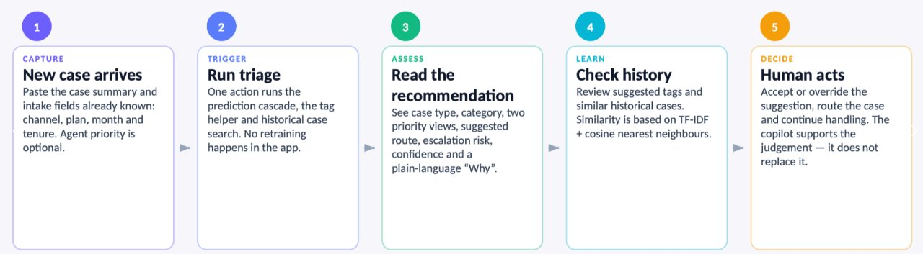
Priya's journey
1. Paste the case summary and set the intake fields (channel, plan, month, tenure), optionally with her own priority
2. Run triage
3. Read one card: case type, category, priority, route and escalation risk, each with a confidence and a plain-language Why
4. Act: confirm the suggested tags, check how similar past cases were handled, and route the case. She can accept or override in one action
How "Success" is defined for Priya
Priya pastes a case → presses Triage → reads the card, confirms the suggested tags, and glances at how two similar cases were resolved → routes the case. If she doubts it, she opens the exploration tab, finds a held-out case like hers, and sees the model was right on that one.

Slide 5
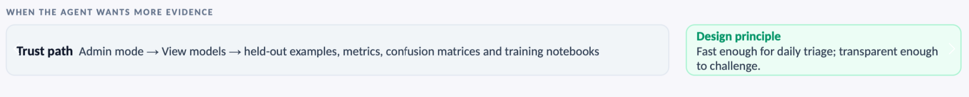
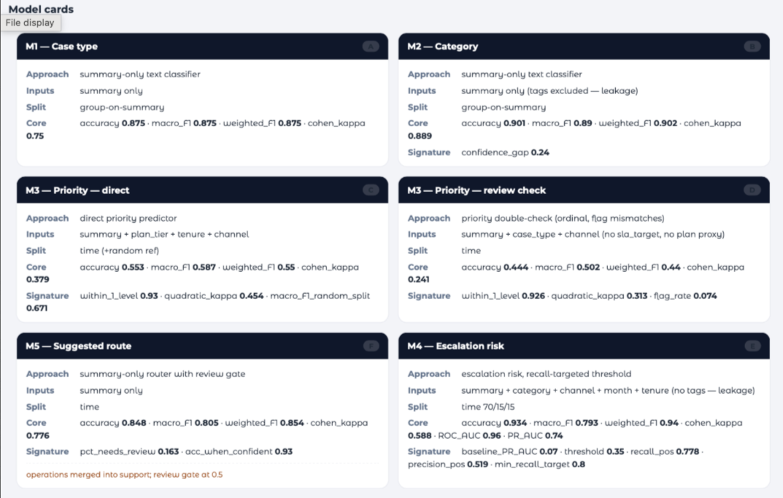
Sam’s Journey
Model cards → metrics table → held-out case inspector → confusion matrices: all on data the models never trained on.
Success: Sam, before sign-off, reads the metrics table and the confusion matrices. One app, two audiences, no black box.

Slide 6
Data Preparation
Source: 12 monthly CSV exports, about 1.85k rows, in a fictional and synthetic dataset. Each row is one case: structured triage fields, outcomes and timings, a free-text summary, and tags.
Cleaning: rows were audited and spam/duplicate rows dropped, leaving 1,713 cases.
Dates: created_at is the authoritative date. The monthly filenames are shifted by a month and February is missing, so month_num is taken from created_at.
Team labels: operations and support are the same team under different names in different months, so they are merged.
Text: missing summaries and tags are filled with empty strings. Priority is treated as an ordered scale: Low < Medium < High < Urgent.
One shared module (case_pipeline.py) handles loading, splits, features and evaluation, so every notebook and the app use the same steps.
Notes:
Louis

Slide 7
The modelling discipline
Inbound-only feature contract. Models use only what is known when a case lands. Outcome/history fields are never inputs.
Tags are leakage. Tags are written after an agent understands a case, so they encode the very fields we predict. No model uses tags as a feature. Instead a tag suggester proposes tags from the summary to speed up and standardise tagging — its output is shown to the agent, never fed back into the models.
Honest, normalised evaluation. Every model is scored with the same metric set (accuracy, macro-F1, weighted-F1, Cohen's kappa; ROC-AUC/PR-AUC for the binary model). Text models use a group-aware split (identical summaries can't leak across train/test); sequential models use a chronological split (train early months, score later ones). plan_tier/region_uk are excluded except the direct priority model; protected attributes are never used.
Fit-for-purpose choices.
Exact priority has a ~50% ceiling but is ~93% within one level — so the review model flags gross mismatches rather than asserting a value.
Escalation tunes its threshold to catch ≥80% of escalations, because a miss costs more than a false alarm.
Routing is summary-only and gates low-confidence suggestions to human review.
Notes:
Yulia

Slide 8
Model 1: Case Type Classification Model
Purpose: Predicts the new support cases’ type either incident where something has gone wrong or service request such as requesting help or action.
How it is computed: From the historical data of case summaries are converted into numerical features using word and character TF-IDF (min_df = 2 to remove words and terms not used in 2 or more cases helping to reduce noise) into a logistic regression, evaluated on a 80/20 group-aware split so identical summaries never don’t appear in train and test data.
What the agent sees: This helps the agent understand the issue and decide which case to classify it as The model achieved 87.5% accuracy and 0.875 macro F1
Scope and caveat: The model achieved strong results using only the case summary, making it a simple and efficient tool for initial triage. It supports consistent classification while allowing the agent to review the prediction when a case is unclear or requires further investigation. This model only uses one feature being case_summary so vague descriptions could affect accuracy.
Notes:
Louis

Slide 9
Model 2 :Category Prediction Model
The M2 model analyses the text entered in a case summary and predicts the most likely of 10 support categories, such as billing_payments, access_permissions, integrations, bug and performance_outage.
How does it work?
Case Summary → Word & Character TF-IDF → Logistic Regression → Predicted Category + Confidence
Word TF-IDF identifies important words and short phrases, for example “charged twice” or “stopped syncing”.
Character TF-IDF identifies smaller patterns within words. This makes the model more robust to spelling variations, technical terminology and error codes.
Logistic Regression uses these features to select the most likely category.
Historical tags are excluded because they are added after a case has been understood and could introduce data leakage.
A group-aware train/test split prevents identical case summaries appearing in both the training and test data.
Model Performance
The model was tested using 1,713 cases, with 1,369 used for training and 344 held back for testing.
Testing different Logistic Regression C values showed that C=2.0 produced the best overall result:
What did we learn?
M2 performs strongly across the 10 categories.
Increasing C from 1.0 to 2.0 produced a small but consistent improvement.
Error analysis showed the main area of confusion was between bug and data_reporting.
Confidence can help identify less-certain predictions where the user may want to review the suggested category.
Key Outcome
M2 turns free-text case summaries into a suggested support category, helping the user triage cases while still allowing the prediction and confidence to be reviewed.
Metric | C = 1.0 | C = 2.0
Accuracy | 90.1% | 90.4%
Macro F1 | 0.890 | 0.892
Weighted F1 | 0.902 | 0.905
Cohen's Kappa | 0.889 | 0.892
Confidence Gap | 0.240 | 0.271
Notes:
Scott

Slide 10
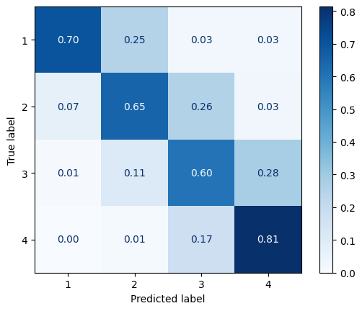
Model 3: Priority
Features:
customer_tenure_months
plan_tier
channel
summary
Model ✅Logistic Regression
❌ Random Forest (63.58%) ❌ LinearSVC
Hyperparameter tuning by Optuna
(with 5-fold CV)
Overall accuracy | 64.45% -> 71.34%
tfidf__max_features | 10000
tfidf__ngram_max | 3
tfidf__min_df | 1
tfidf__max_df | 0.9336629843087688
tfidf__sublinear_tf | True
lr__C | 6.631976617235484
lr__solver | newton-cg
lr__max_iter | 2500
Notes:
Tacy

Slide 11
Model 3b: Priority (Review)
What does a model do?
Estimates how serious a case is from its summary and flags it for review when the agent's priority is 2+ levels away. The agent always decides.
How does it work?
Summary + Case Type + Channel → Word TF-IDF → Logistic Regression → Estimated Priority → Flag if 2+ levels from agent
It excludes SLA hours (it is derived from priority, so there is a possibility of data leakage) and plan tier (for fairness)
Model Performance
Accuracy | 44.4%
Macro F1 | 0.502
Within 1 level | 92.6%
Quadratic Kappa | 0.313
Flag Rate | 7.4%
Lesson learnt
Past priorities are inconsistent, so exact accuracy is capped, but the model is rarely far off (92.6% within one level)
Notes:
Milind

Slide 12
Model 4: Escalation Risk
The purpose of M4 is to help a frontline agent identify new support cases that may be more likely to escalate. It's deliberately a decision-support tool rather than an automated decision-maker. The model provides a risk signal so the agent can decide which cases deserve earlier attention.
Predictors are:
Case summary text – strongest predictor
Customer Tenure in months – risk rises sharply with tenure months
Category
Channel
The model was tested using 1,713 cases. 70% was used to train the model, 15% to validate and 5% to test.
Escalations are the minority class and became rarer over the year. Accuracy alone can look strong even when a model misses nearly every escalation.
Testing different Logistic Regression C values showed that C=3.0 produced the best overall result:
What did we learn?
Escalation risk can be predicted from what is known when a case is arriving
Long standing customers have a greater frequency of escalated cases
What the case is about matters : server errors , broken integrations, accidental data loss, security and outages push the risk up
Key Outcome
M4 adds a suggestion whether the case should be escalated or not, aiding each agent to decide on this action quicker. Escalated cases get a lower CSAT, so this can help increase the CSAT of escalated cases.
Metric | C = 3.0
Accuracy | 92.2%
ROC- AUC | 0.955
PR-AUC | 0.744
Notes:
Train : model studies these cases with answers and learns patters. Parameter estimation . Estimates the log regression coefficients
Validation: used to make choices about the model . Model section , decision threshold, C and which features to keep
Test: model assessment
Case summary text: TF-IDF on words and word pairs
PR : reflects operating reality of rare events – when model raises a flag how often is it true

Slide 13
Model 5: Suggested Route
Predicts: assigned team ("operations" merged into "support")
Inputs: Case summary only
Model: Word + character TF-IDF → class-balanced logistic regression
Split: Chronological: train Jan–Sep, test Oct–Dec (450 cases), plus 5-fold CV
Held-out: Accuracy 0.77 · macro-F1 0.72 · top-2 0.91 (CV: 0.86 / 0.81 / 0.97)
Review threshold: Top suggestion below 0.5 → needs human review
Why it makes sense
• Channel, plan tier and tenure were tried and dropped: their link to the team shifted month to month, so they made routing on new months worse
• The summary text stays stable over time
• The agent sees the top 2 teams and the summary words that pushed the case towards the suggested team
Watch-outs
• Most mistakes are support cases sent to security, engineering or billing
• On accuracy it only just beats simple keyword rules (0.77 vs 0.76), but it is clearly better on macro-F1 (0.72 vs 0.67)
Notes:
Christian

Slide 14
Model 6: Smart Resolution Recommendation
Individual contribution | Resolution-aware filtering on existing similar-case retrieval
Recommends
Previously solved cases and their resolution codes
Input
New customer case summary
Technique
Existing TF-IDF + cosine nearest neighbours → rule-based filtering
Filtering
Keep solved cases with similarity ≥ configurable threshold
Output
Top 3 qualifying cases, or manual investigation if no match
Test results
0.35 → 3 cases (0.502, 0.480, 0.456) | 0.60 → no matches
Why it makes sense
Watch-outs
• Prioritises cases with completed outcomes
• Similar wording ≠ same underlying issue
• Avoids weak matches; analyst retains control
• Thresholds exploratory; not yet in Gradio
Notes:
Naentra

Slide 15
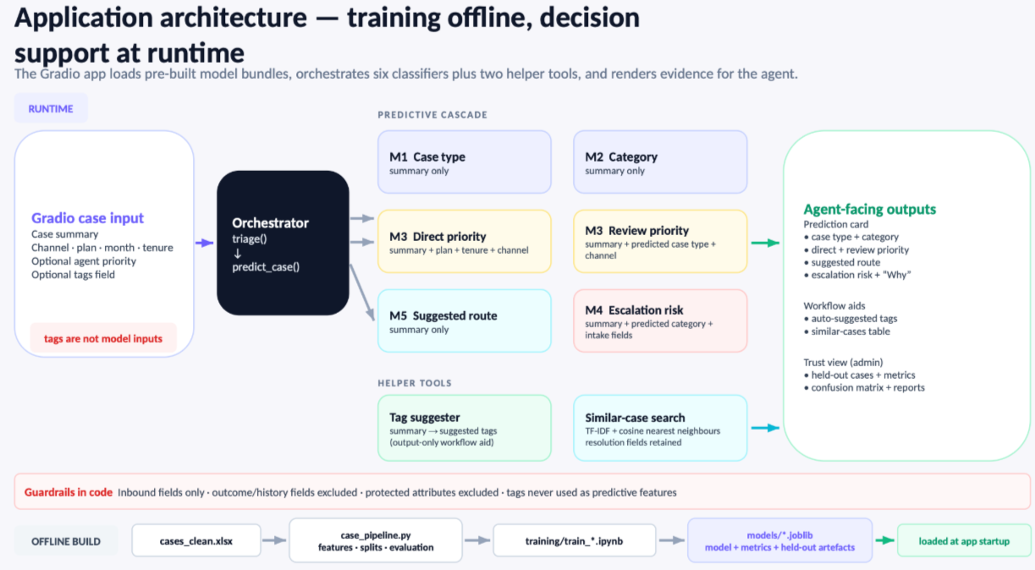
Notes:
Yulia

Slide 16
Appendix- Exploratory Data Analysis

Slide 17
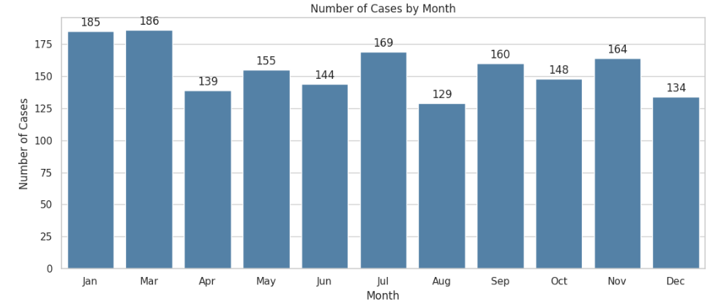
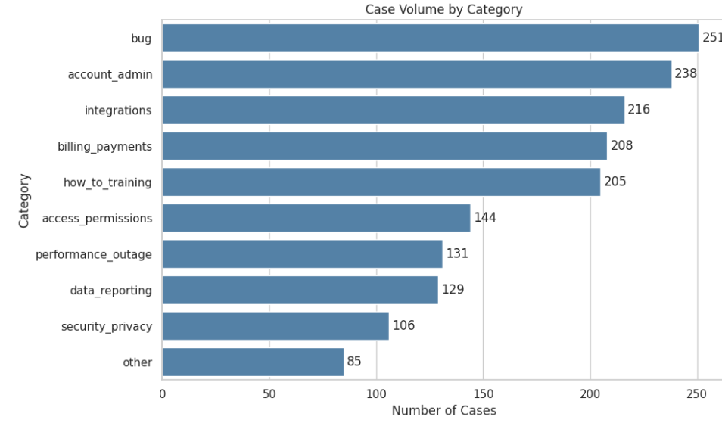
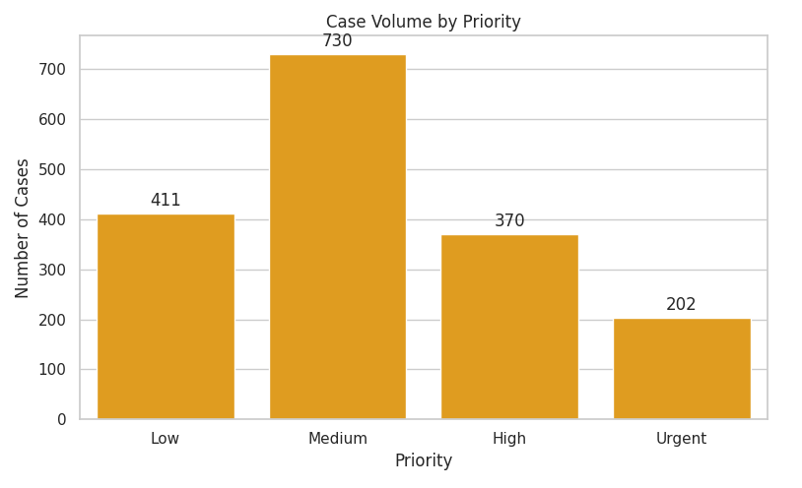

Slide 18
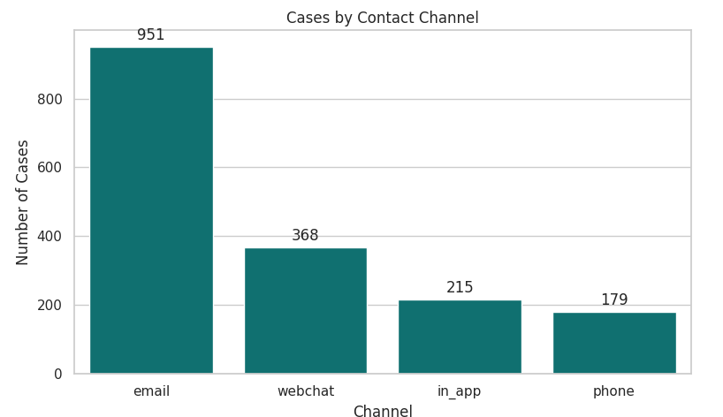
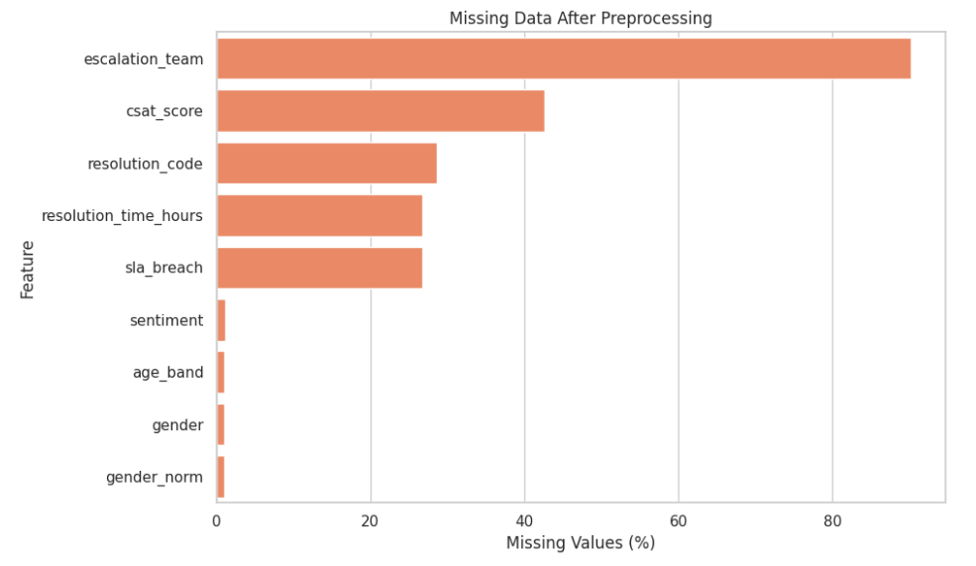
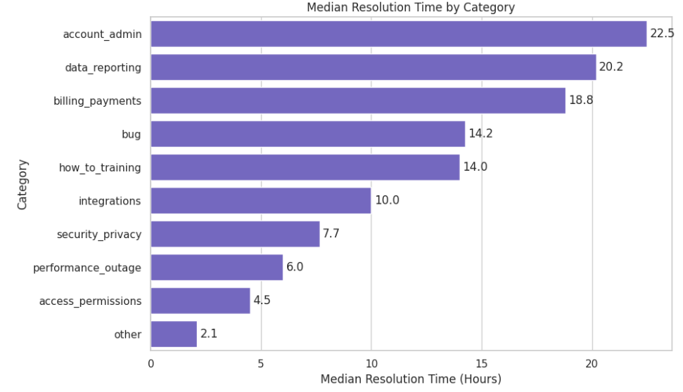

Slide 19
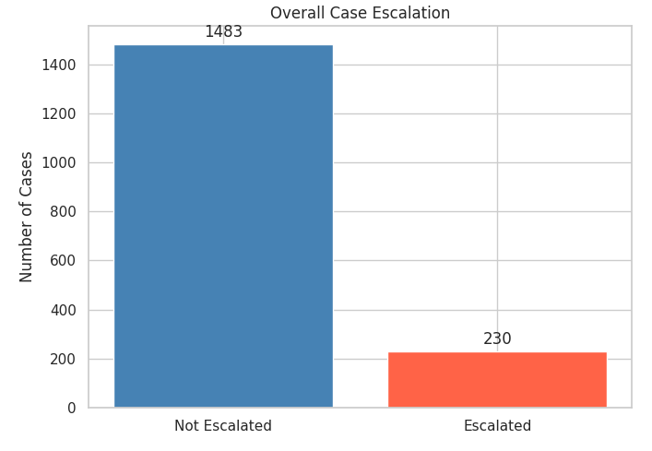
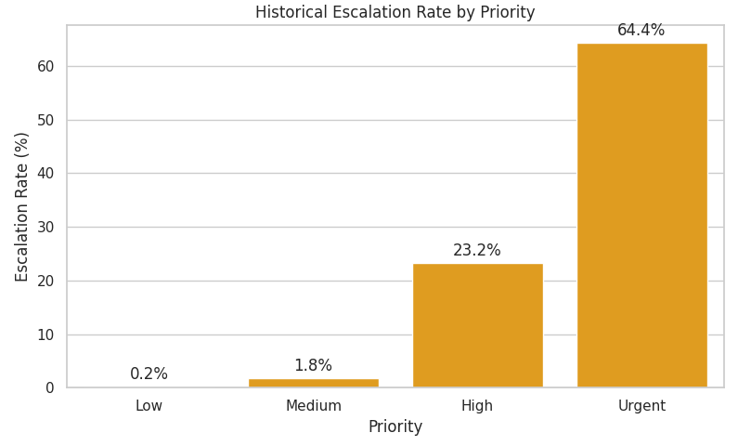
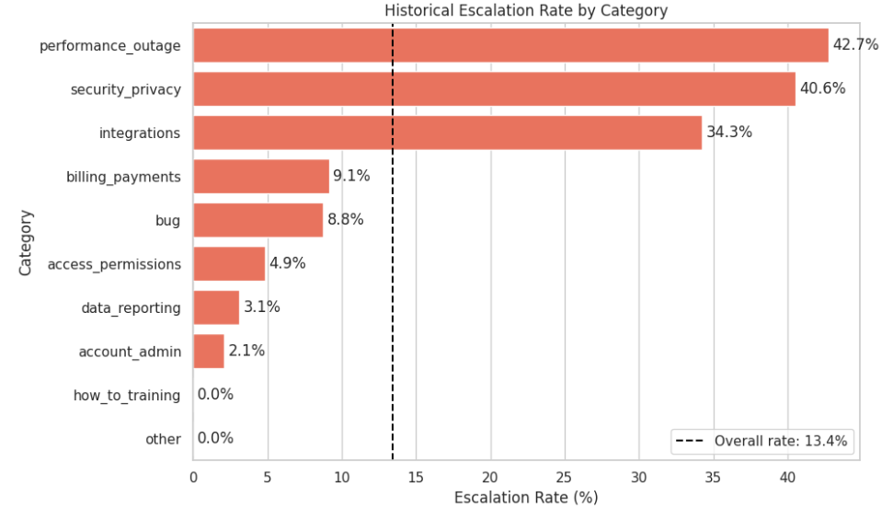

Slide 20
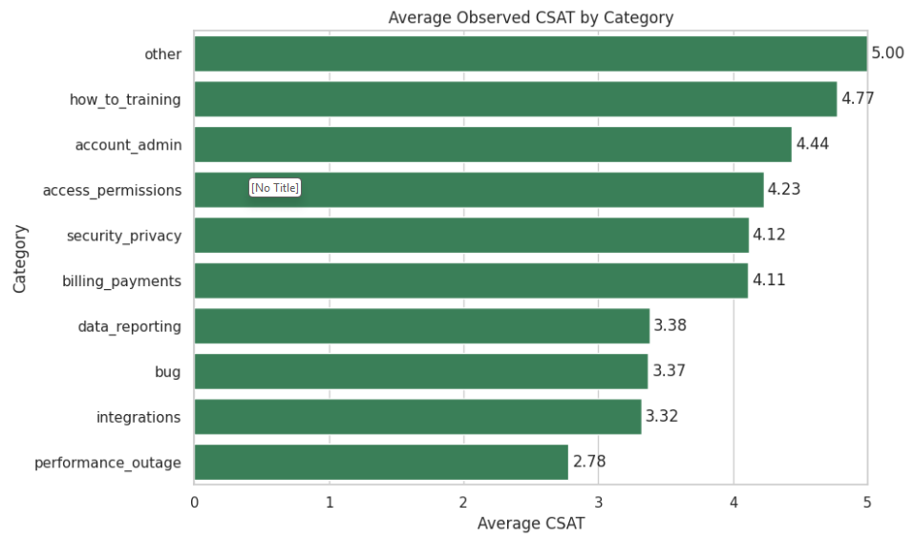
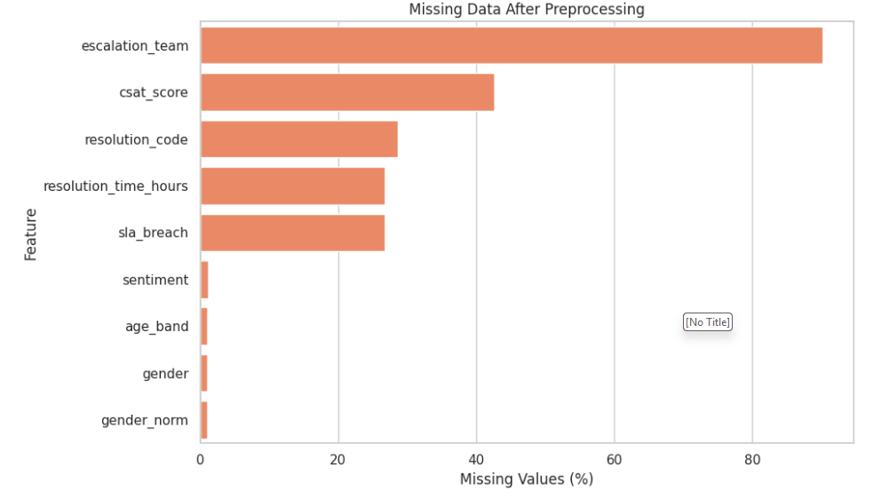
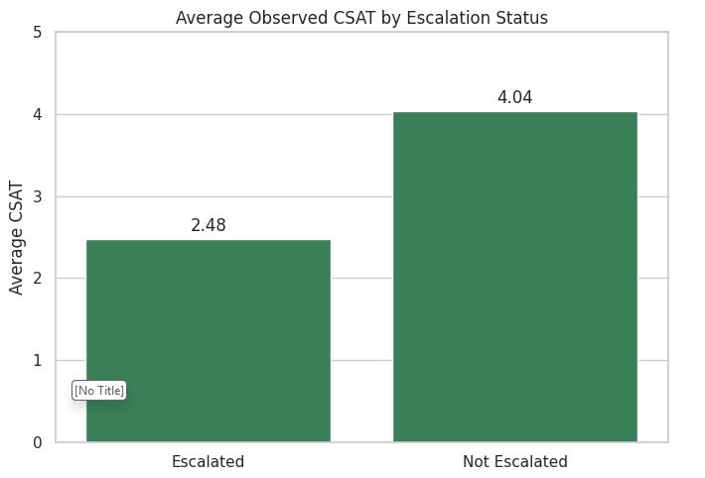
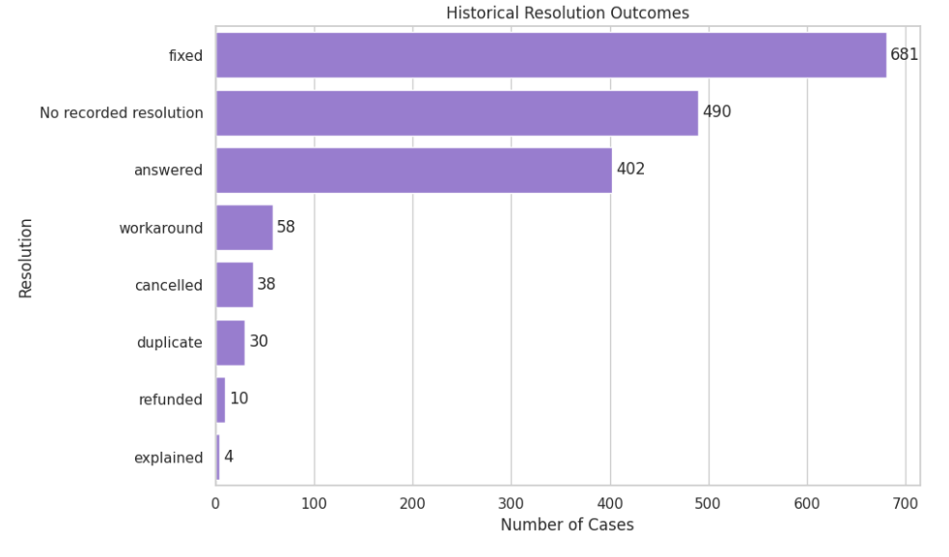

Slide 21
Evaluation metrics, and what each adds
Accuracy — the fraction of cases predicted correctly. Intuitive, but inflated when one class dominates, so it is read against its baseline.
Baseline accuracy — the accuracy of always predicting the most common class. It sets the floor; accuracy only signals skill to the extent it clears this line.
Macro-F1 — the unweighted mean of per-class F1. It counts every class equally, so performance on rare classes cannot be hidden by the common ones; it is the headline metric for the multiclass models.
Weighted-F1 — F1 averaged by class frequency. It summarises typical-case performance and sits closer to accuracy, complementing macro-F1's focus on rare classes.
Cohen's kappa — agreement corrected for chance. It discounts the share of correct predictions expected from guessing with the class frequencies, guarding against scores that look high only because of imbalance.
ROC-AUC (binary escalation model) — the probability the model ranks a random positive above a random negative, across all thresholds. It measures separability independently of the chosen cut-off.
PR-AUC (average precision) — the precision/recall trade-off, focused on the positive class. For a rare event such as escalation it is the more honest summary than ROC-AUC, which heavy negatives can flatter.
Baseline PR-AUC — the positive-class prevalence on the test set, i.e. the score a no-skill model would reach. It is the reference PR-AUC must beat (escalation: 0.734 against a 0.07 baseline).
Operating-point metrics — recall and precision of the positive class at the deployed threshold. These describe behaviour in use rather than across all thresholds (escalation is tuned to catch at least 80% of escalations).
Signature metrics — one task-specific measure per model: within-1 accuracy for the ordinal priority models, the flag rate for the review model, and the needs-review rate for routing. Each reports the quantity the model is actually used for.

Slide 22
Frontline Agent
Goal: turn a new case into an action in one glance, without reading the whole history.
For a pasted case summary (plus a few intake fields) the tool returns:
Case type and category (text models on the summary).
Priority, two ways: a direct estimate, and a review check that flags when the agent's own priority is far from the estimate.
Suggested route (team), with a needs human review flag on low-confidence calls.
Escalation risk, with a plain-language Why.
Suggested tags (a workflow aid) and the most similar past cases with how they were resolved.
Everything shown is explained, and the agent always makes the final call.

