Slide 1
MACHINE LEARNING PROJECT
Massive Transfusion
Prediction in
Trauma Patients
ABC Score
Logistic Regression
XGBoost
Lab Values
Extending the ABC Score with machine
learning regression models
Dima Spektor
Aysha Azaizeh
Yuliana Vainshtein
Notes:
Dima

Slide 2
SECTION 1 — PROBLEM DEFINITION
What problem are we solving?
Why is early prediction of Massive Transfusion important?
Massive hemorrhage is one of the leading causes of preventable death in trauma patients.
When a severely injured patient arrives at the Emergency Department, the trauma team has only a few minutes to decide whether to activate the Massive Transfusion Protocol (MTP).
An incorrect decision can have serious consequences:
Delayed activation
- Ongoing hemorrhage
- Delayed blood preparation
- Increased mortality
Unnecessary activation
- Wasted blood products
- Increased hospital workload
- Transfusion-related complications
Clinical challenge
The decision must be made rapidly, using only the information available immediately after patient admission
Notes:
Dima

Slide 3
SECTION 1 — PROBLEM DEFINITION
Proposed Solution
We propose a Machine Learning Clinical Decision Support System integrated into the Emergency Department.
Immediately after receiving patient’s first measurements and lab results, the system analyzes routinely available clinical parameters and estimates the probability of Massive Transfusion within seconds.
If a high-risk patient is identified, the system can support the clinical workflow by:
Alerting the trauma team to consider early Massive Transfusion Protocol activation.
Notifying the blood bank that blood products may soon be required, allowing earlier preparation and logistics.
Supporting faster, more consistent clinical decision - making.
Optimizing the use of limited blood resources.
Future Vision If validated in clinical practice, the system could be integrated into hospital information systems and expanded to additional hospitals, providing standardized decision support for trauma care.
Notes:
Dima; ->Ayesha

Slide 4
SECTION 2 — Define the scoring to be used and a reasonable target
Project Objectives & Evaluation Metrics
Objective
Develop a machine learning model that accurately predicts whether a trauma patient will require Massive Transfusion using data available immediately after admission.
Target Performance
ROC-AUC ≥ 0.85
Recall ≥ 0.80
Specificity ≥ 0.75
ABC Score
Penetrating mechanism of injury
Systolic Blood Pressure (SBP) ≤ 90 mmHg
Heart Rate (HR) ≥ 120 bpm
Positive FAST examination
ABC Score ≥ 2 → High risk of Massive Transfusion; activation of the Massive Transfusion Protocol (MTP) is recommended. ABC Score < 2 → Lower likelihood of requiring Massive Transfusion.
Primary metric
ROC-AUC
Secondary metrics
Recall (Sensitivity)
Specificity
Precision
F1-score
Notes:
Ayesha; ->Yuliana

Slide 5
SECTION 3 — Define the data
Data: what we need vs what we have
CRASH-2 Trauma Dataset
Source: international multicenter trauma dataset derived from the CRASH-2 clinical trial.
Required features
Available Dataset
- Systolic Blood Pressure (SBP)
- Heart Rate (HR)
- Lactate
- Arterial Base Excess (ABE)
- Mechanism of Injury
Age
Gender
- Systolic Blood Pressure (SBP)
Heart Rate (HR)
Respiratory Rate
Mechanism of Injury
GCS Score
Units Transfused
Notes:
Yuliana

Slide 6
SECTION 3 — Define the data
Final Model Features
Selected features
SBP
HR
Mechanism of Injury
Engineered features
Shock Index (HR/SBP)
Generated variables
Lactate
Arterial Base Excess (ABE)
Target variable
Massive Transfusion (MT:0/1)
Notes:
Yuliana;-> Ayesha

Slide 7
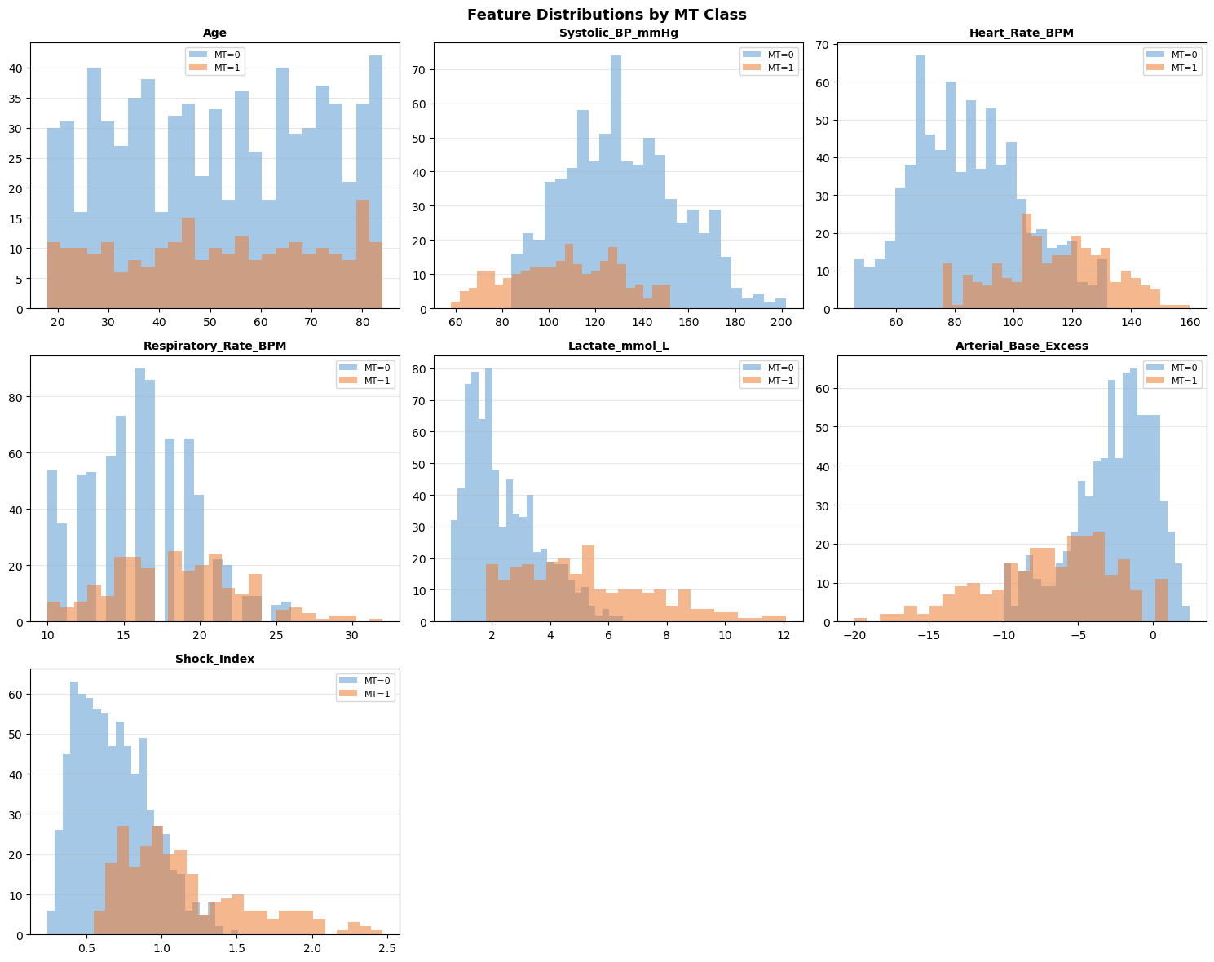
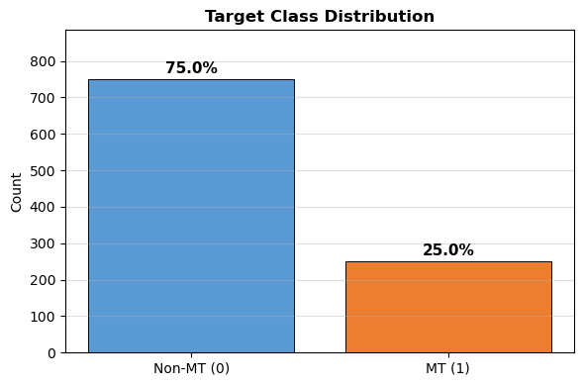
SECTION 4 — DATA EXPLORATION
Dataset Overview, Class Distribution & Feature Histograms
Feature Distributions by MT Class — Histograms
1,000
800/200
Patients
Train/Test
9
25%
Features
MT Rate
Class Distribution
Notes:
Ayesha

Slide 8
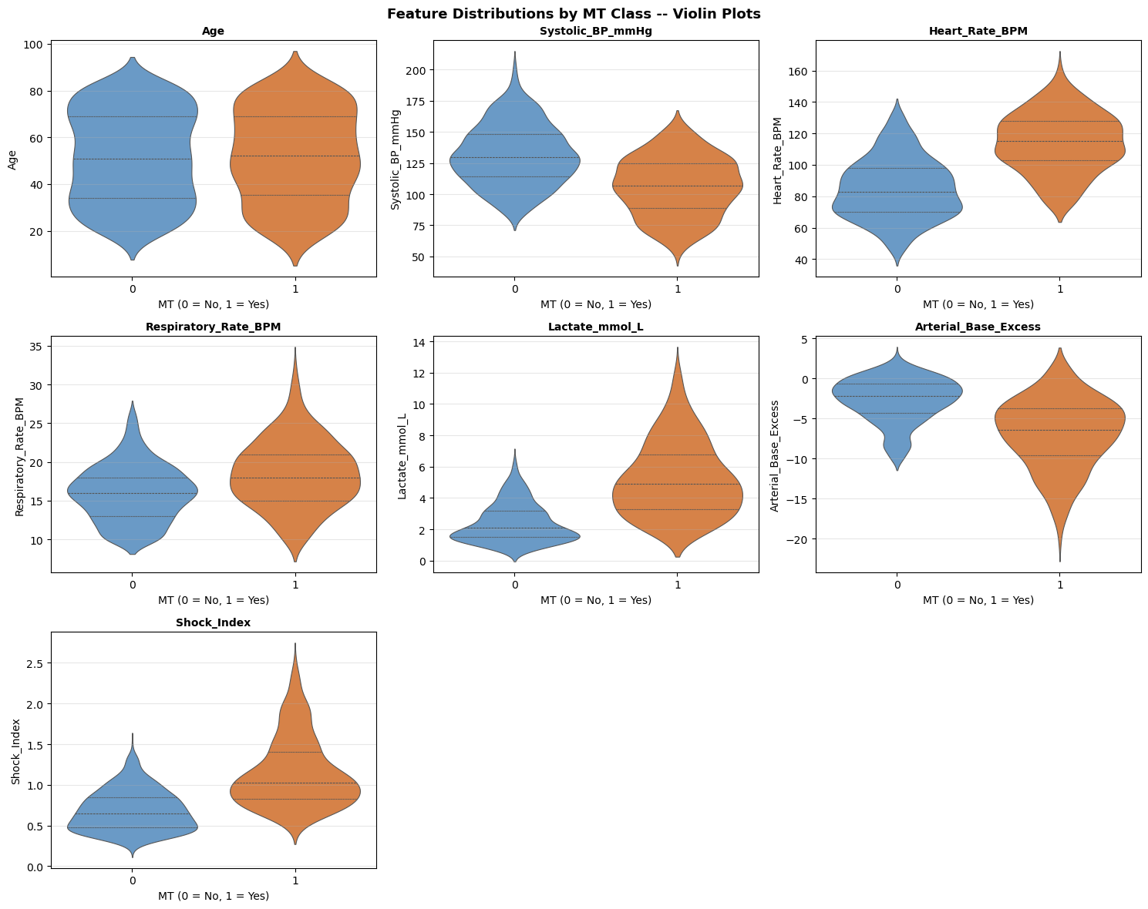
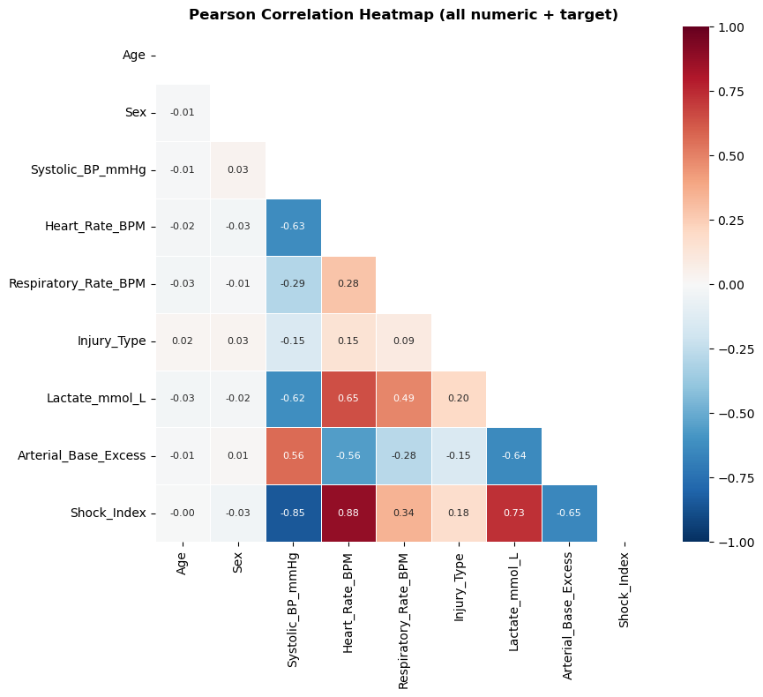
SECTION 4 — DATA EXPLORATION
Violin Plots, Correlation Heatmap & EDA Conclusions
Violin Plots — Distribution Shape & Spread
Pearson Correlation Heatmap
EDA Conclusions
✓
Strong Signal
Lactate, HR,
SBP, ABE, SI
Clear class shift
Expected to dominate
↔
Weak Signal
Age, Sex, RespRate
Near-zero class diff
Regularization zeros them
!
Difficulty
3:1 imbalance
Recall is critical
Lactate right-skewed (+1.46)
Notes:
Ayesha

Slide 9
SECTION 5 — DATA PRE-PROCESSING
Data Preprocessing Pipeline
Column Removal
Feature Engineering
sklearn Pipeline
Column | Reason
Patient_ID | Identifier — no predictive value
Units_Transfused | Defines MT label → data leakage
Time_to_Hospital | Out of project scope
Column | Mapping
Sex | Female=1, Male=0
Injury_Type | Penetrating=1, Blunt=0
Step 1
SimpleImputer
strategy='median'
fitted on train only
Feature | Lower | Upper | Rationale
Systolic_BP_mmHg | 40 | 250 mmHg | < 40: non-survivable
Heart_Rate_BPM | 20 | 220 bpm | < 20: asystole; > 220: physical max
↓
Step 2
StandardScaler
✓ No missing values (0 / 9,000 cells)
zero mean, unit variance
fitted on train only
Notes:
Ayesha; -> Yuliana

Slide 10
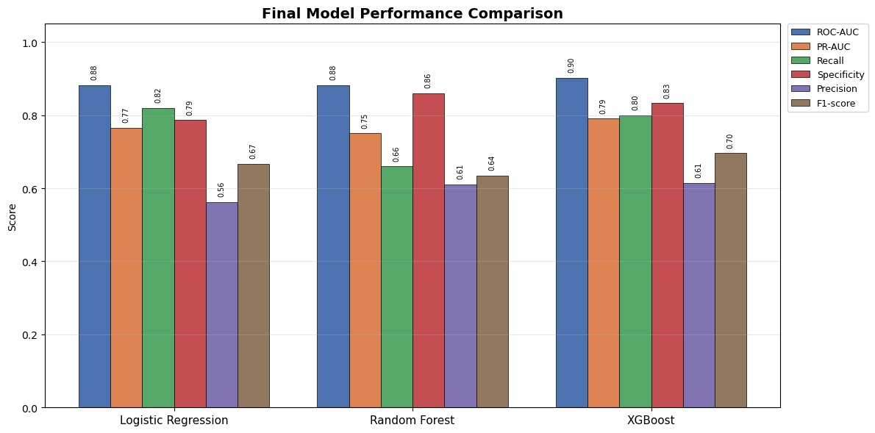
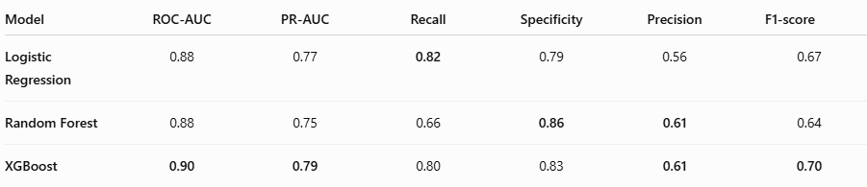
SECTION 5 — SUPERVISED LEARNING
Choosing the methods – XGBoost the best model
Notes:
Yuliana

Slide 11
SECTION 5 — SUPERVISED LEARNING
XGBoost - Testing environment & validation
01
Train / test split
80% training / 20% test
Hyperparameter search
02
Manual tuning → initial parameter exploration
GridSearchCV (144 combinations) → confirmed optimal parameters
CV (5-fold cross-validation, scoring = PR-AUC)
Threshold Optimization
03
Out-of-Fold (OOF) predictions
Optimal threshold selection
Model Evaluation
04
Primary metric: ROC-AUC
Secondary metrics: Recall • Specificity • Precision • F1-score
Comparison with ABC Score
Notes:
Yuliana

Slide 12
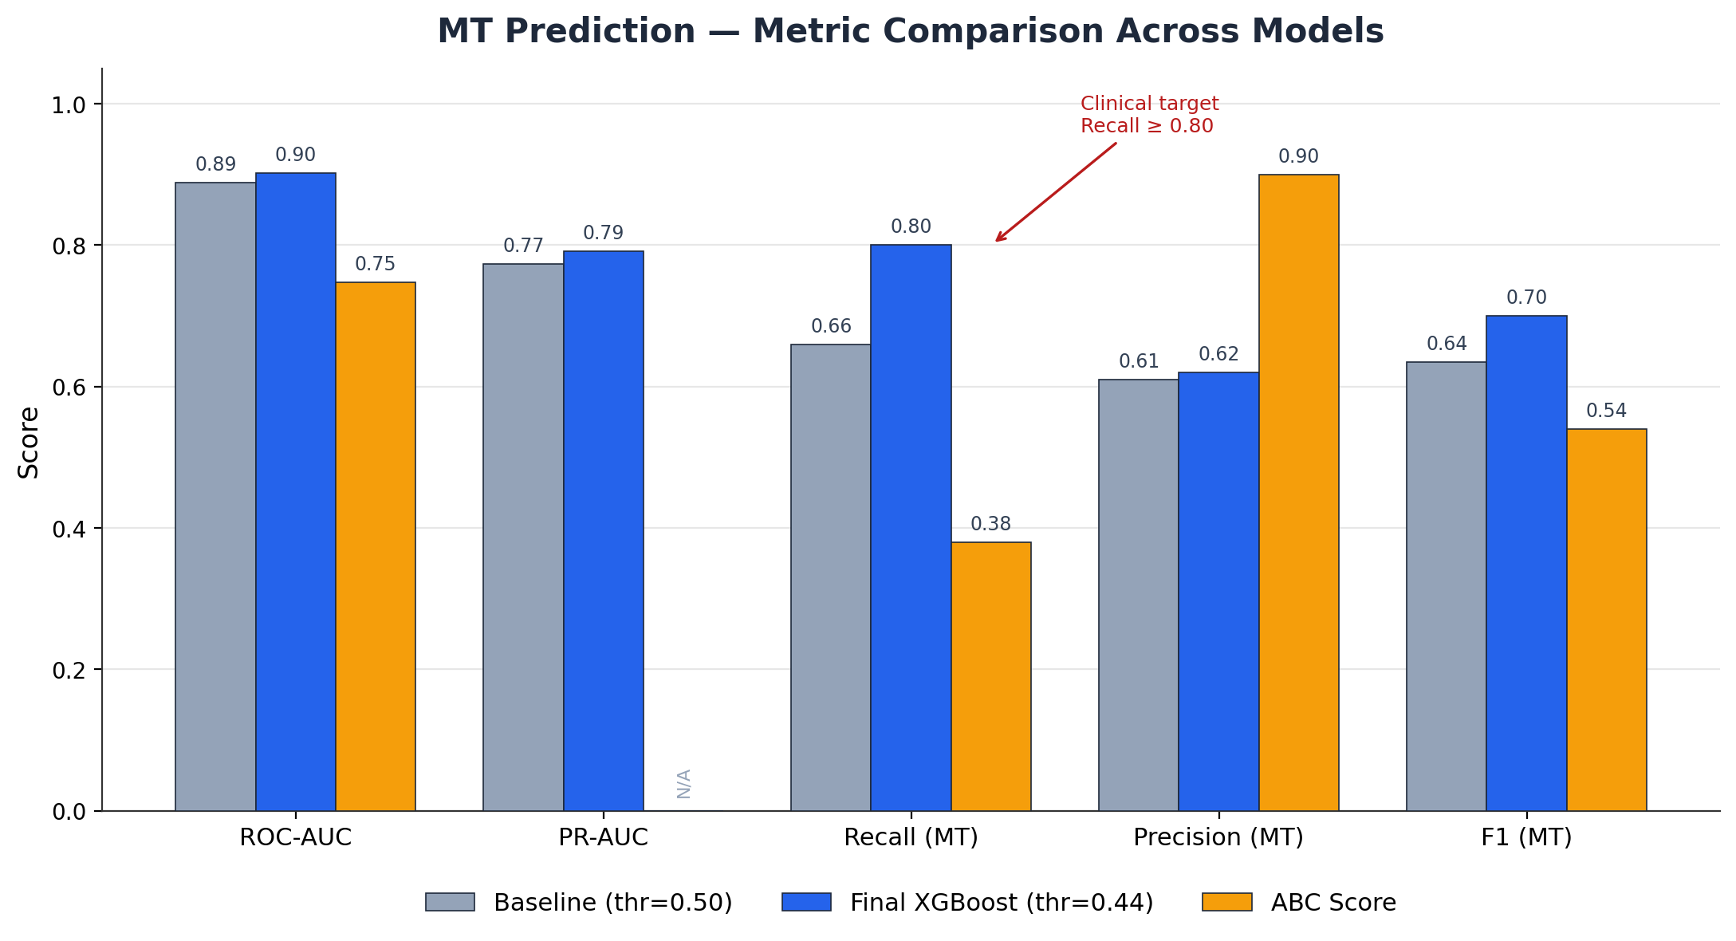
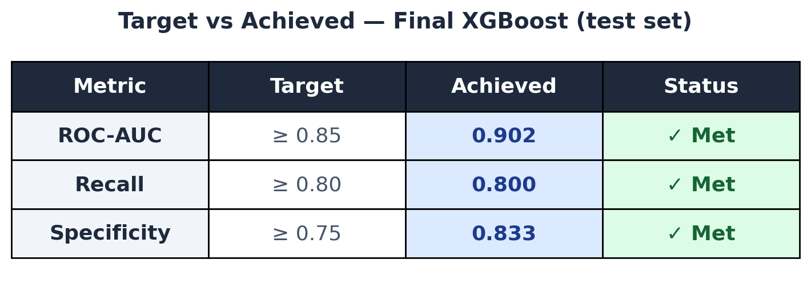
SECTION 5 — SUPERVISED LEARNING
XGBoost - Model results & scoring comparison
n_estimators = 100,
max_depth = 3,
learning_rate = 0.1,
min_child_weight = 1,
subsample=1.0,
scale_pos_weight = scale_pos_weight,
random_state =42,
eval_metric= logloss
Threshold = 0.44
Notes:
Yuliana

Slide 13
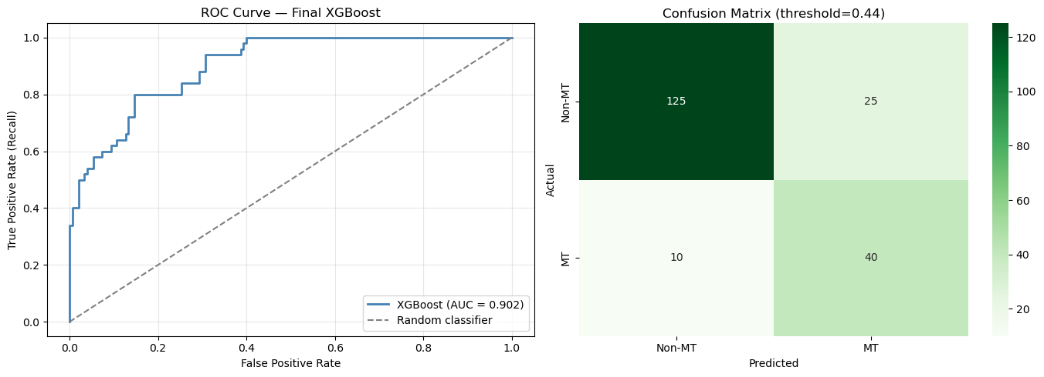
SECTION 5 — SUPERVISED LEARNING
Notes:
Yuliana

Slide 14
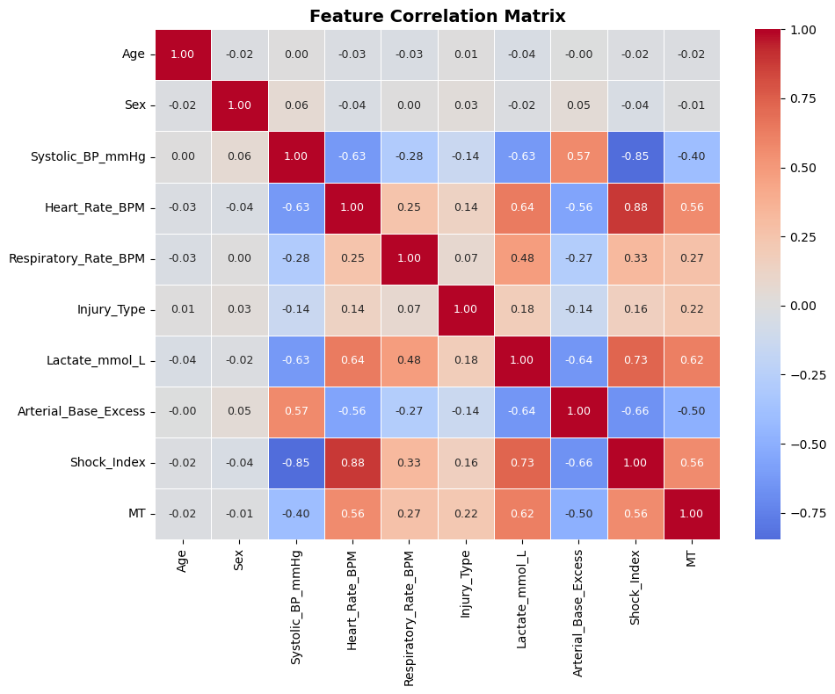
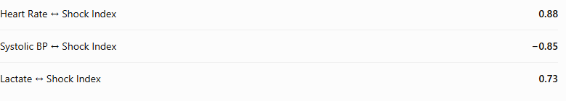
SECTION 5 — SUPERVISED LEARNING
Notes:
Yuliana

Slide 15
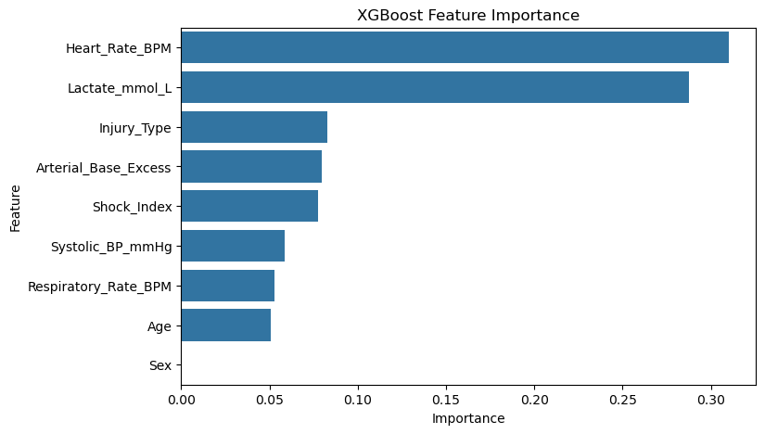
SECTION 5 — SUPERVISED LEARNING
Notes:
Yuliana

Slide 16
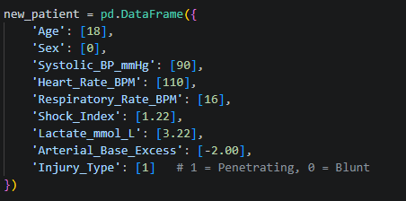
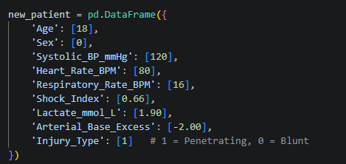
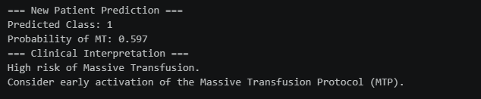

SECTION 5 — SUPERVISED LEARNING
Notes:
Yuliana; -> Dima

Slide 17
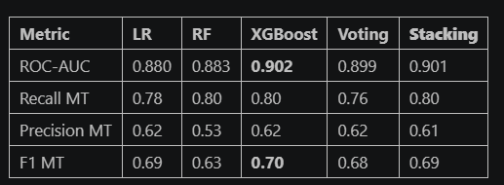
SECTION 5 — SUPERVISED LEARNING
Why did we try Voting and Stacking?
Voting Classifier
Stacking Classifier
Final P(MT) = (LR + RF + XGBoost) / 3
LR → P(MT) = 0.72
RF → P(MT) = 0.65
XGBoost → P(MT) = 0.81
Final P(MT) = w1 × 0.72 + w2 × 0.65 + w3 × 0.81
Notes:
Dima

Slide 18
SECTION 6 — insights and conclusions
Back to the data — insights from modelling & conclusions
Data insights
Despite Stacking matching XGBoost in Recall (both 0.80), XGBoost remains the best model overall
Conclusion
More complex ensemble methods did not help because:
1. All base models share the same weaknesses (gray zone patients)
2. Dataset is too small for meta-model to learn meaningful patterns
3. XGBoost is already an ensemble method internally (100 sequential trees)
Final recommendation: use tuned XGBoost with optimal threshold = 0.44
Notes:
Dima

