Slide 1
FINAL PROJECT
Student: Yuliia Sadoma

Slide 2


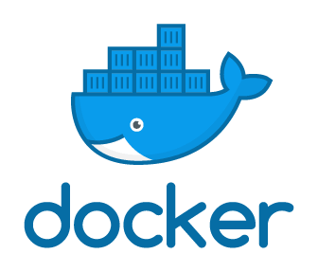




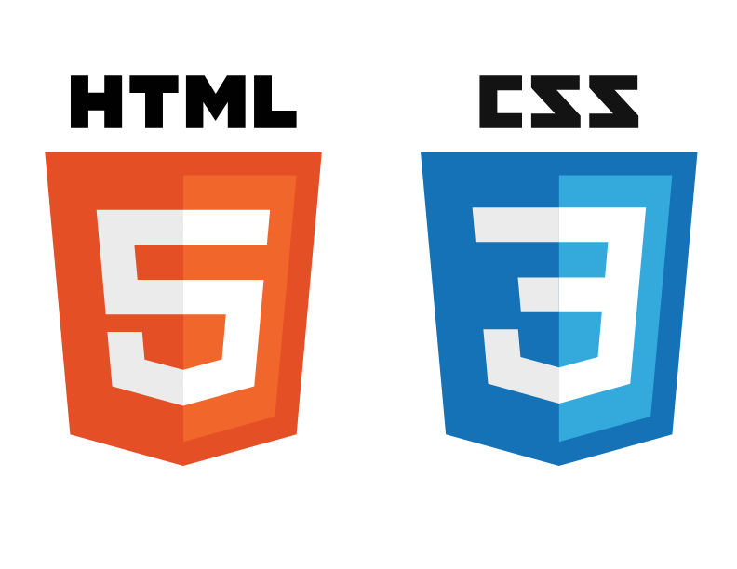

Used tools

Slide 3
Triggering Jenkins pipeline job by pushing code on GitHub
01
Building project by using Maven
02
Description
03
04
05
Building Docker image
Pushing Docker image to DockerHub
Using Ansible playbook deploy Docker container to development server

Slide 4
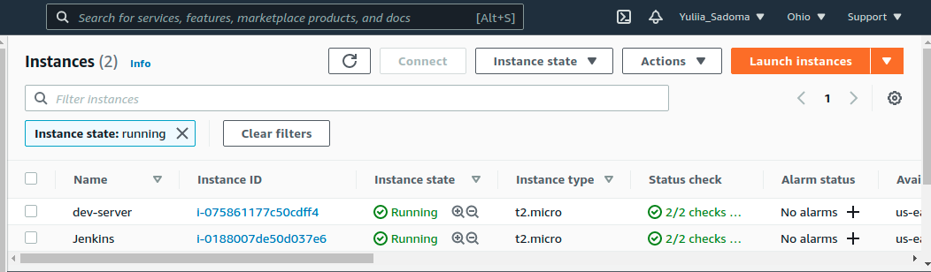
AWS Instances

Slide 5
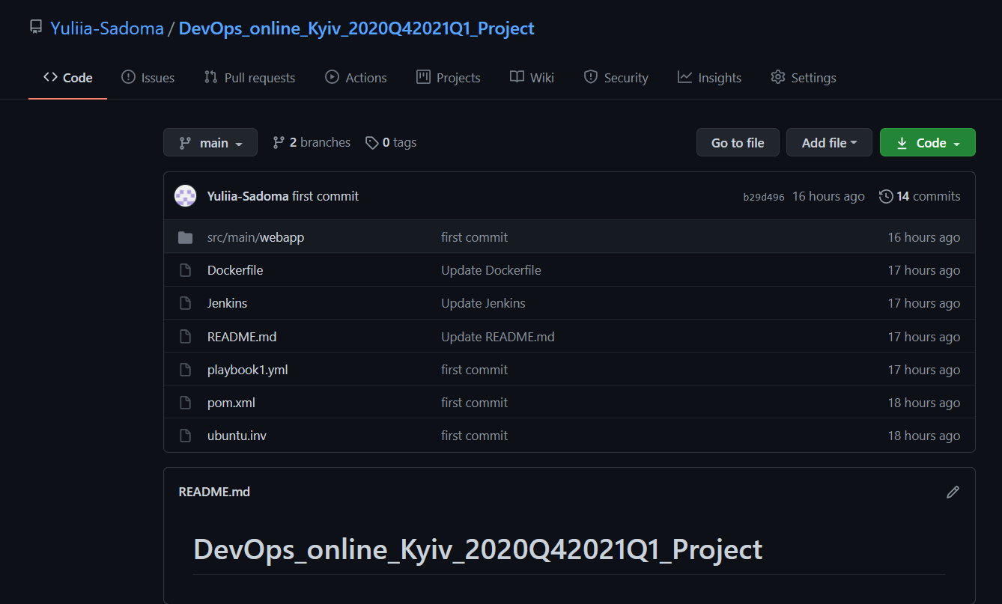
Сontents of the GitHub repository

Slide 6
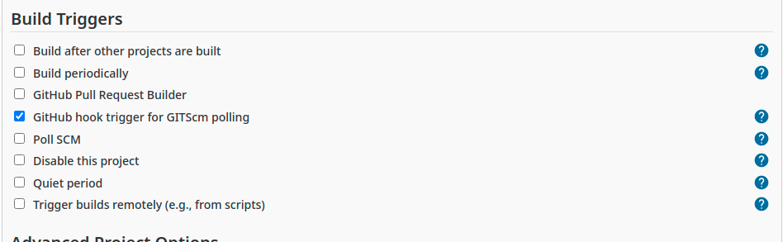
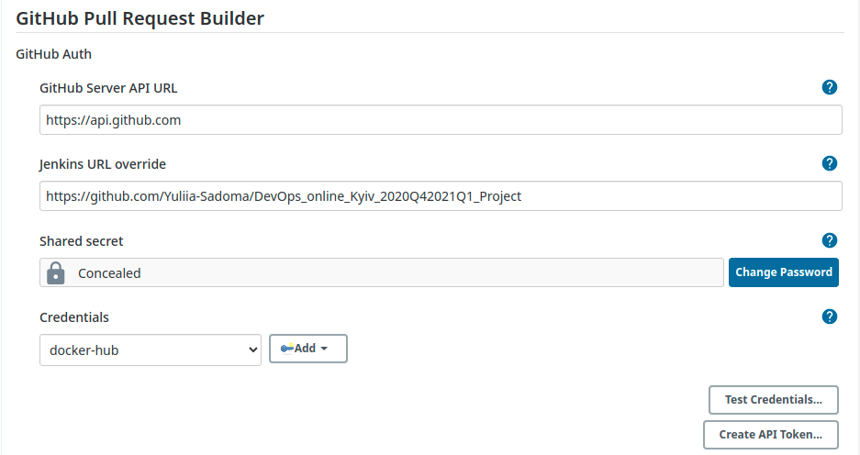
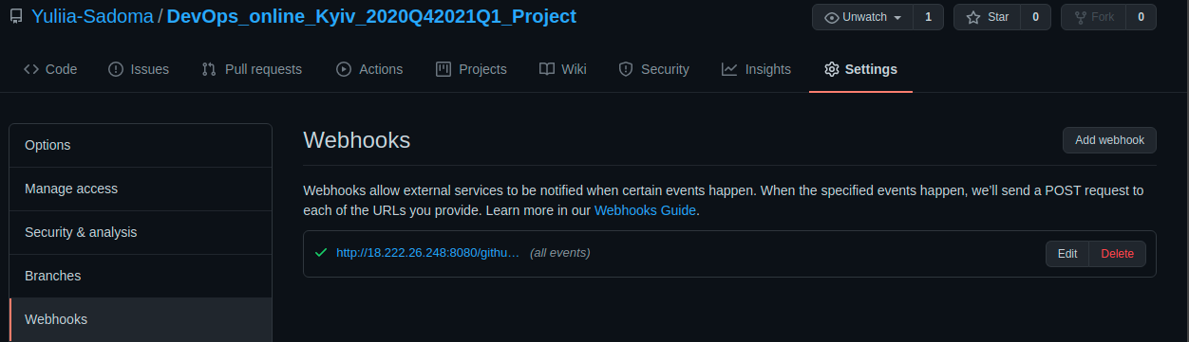
Building Triggers. Webhook

Slide 7
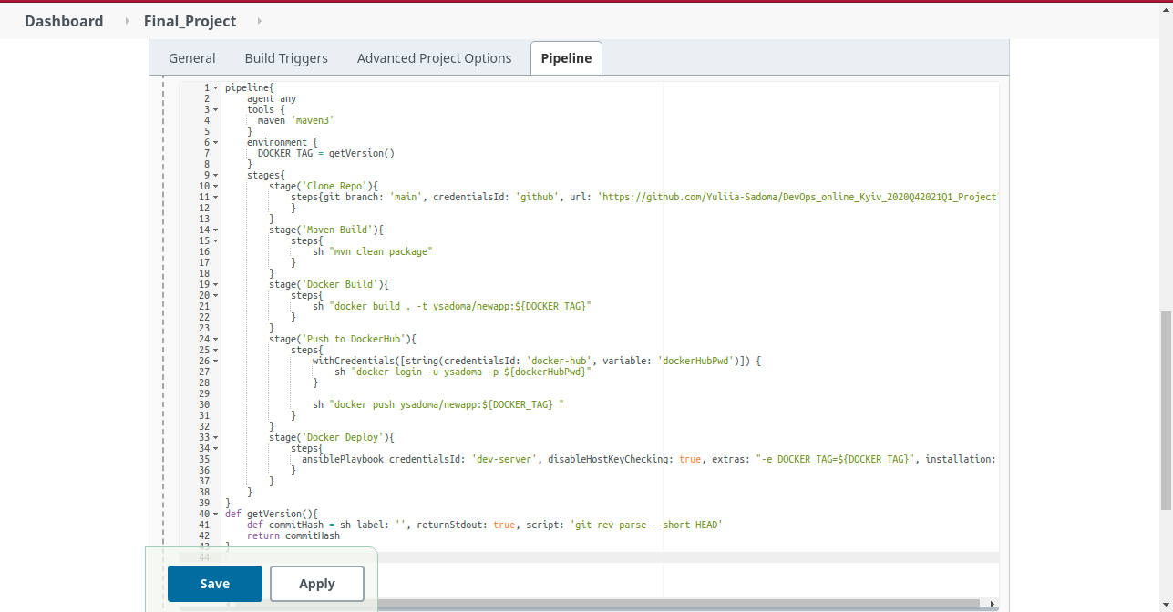
Jenkins pipeline job

Slide 8
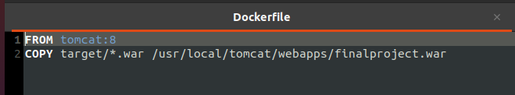
Сontent of Dockerfile

Slide 9
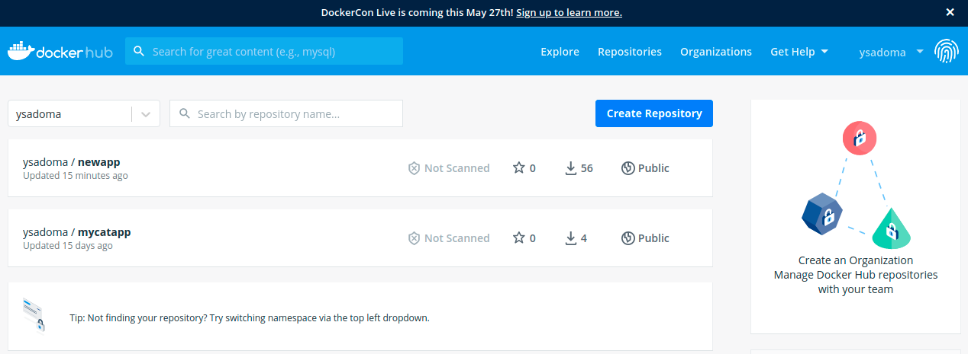
Project on DockerHub

Slide 10
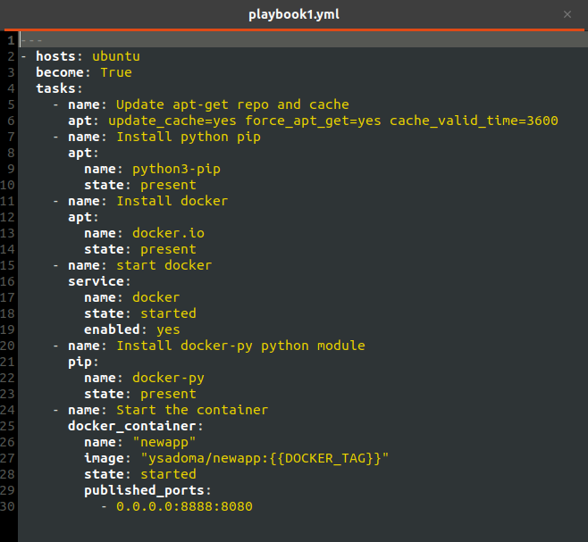
Сontent of ansible playbook

Slide 11
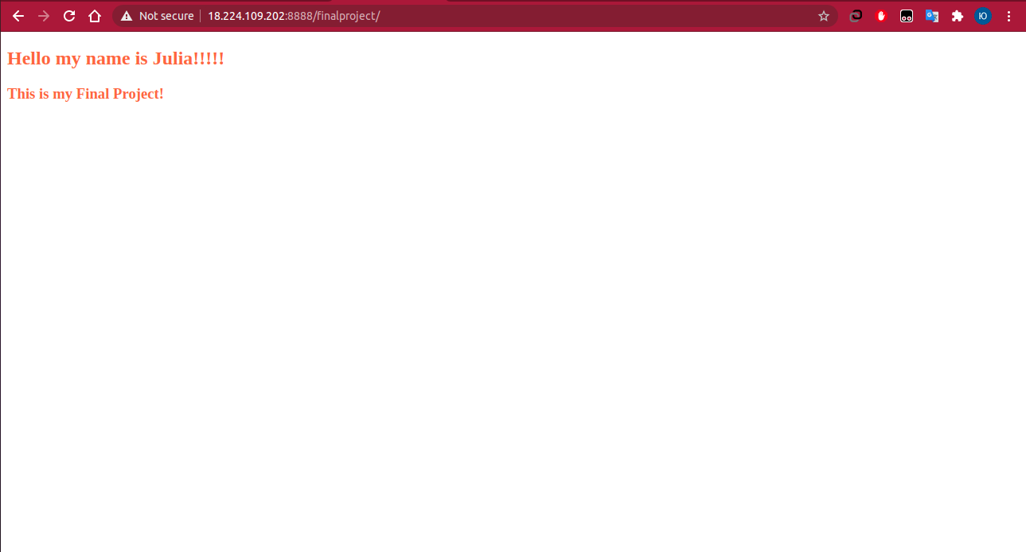
Result

Slide 12
Thank you for your attention!
Does anyone have any questions?

