Slide 1
Structured Query Language
by Yuliia Humeniuk

Slide 2


What is database?
Database is a collection of information that is organized so that it can be easily accessed, managed and updated.

Slide 3
Types of Database model
Hierarchical
Network
Relational
OOP
A hierarchical database model is a data model in which the data are organized into a tree-like structure.
The network model is a database model conceived as a flexible way of representing objects and their relationships.
The relational data model represents the database as a collection of relations. A relation is nothing but a table of values.
An object-oriented database is a database that is based on object-oriented programming (OOP)

Slide 4


What is SQL?
Ask me, use SQL
How many animals are in the zoo?

Slide 5
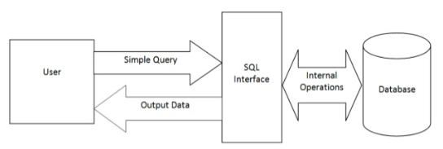
What is SQL?
SQL is a data manipulation language
SQL is not a programming language
Ways to use SQL:
SQL commands are interpreted by the DBMS engine
SQL commands can be used interactively as a query language within the DBMS
SQL commands can be embedded within programming languages

Slide 6

What can SQL do?
SQL can execute queries against a database
SQL can create new databases, new tables in a database
SQL can retrieve data from a database
SQL can insert records in a database
SQL can update records in a database
SQL can delete records from a database
SQL can set permissions

Slide 7
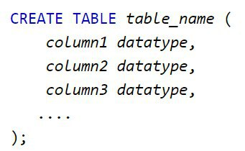



Types of SQL commands
Data Definition Language (DDL):
CREATE
ALTER
DROP

Slide 8


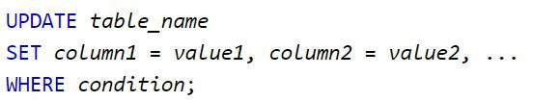
Types of SQL commands
Data Manipulation Language (DML):
INSERT
SELECT
UPDATE
DELETE

Slide 9

Types of SQL commands
Data Control Language (DCL):
GRANT
DENY
REVOKE

Slide 10
Types of SQL commands
Transaction Control Language (TCL):
BEGIN TRANSACTION
COMMIT
ROLLBACK

Slide 11
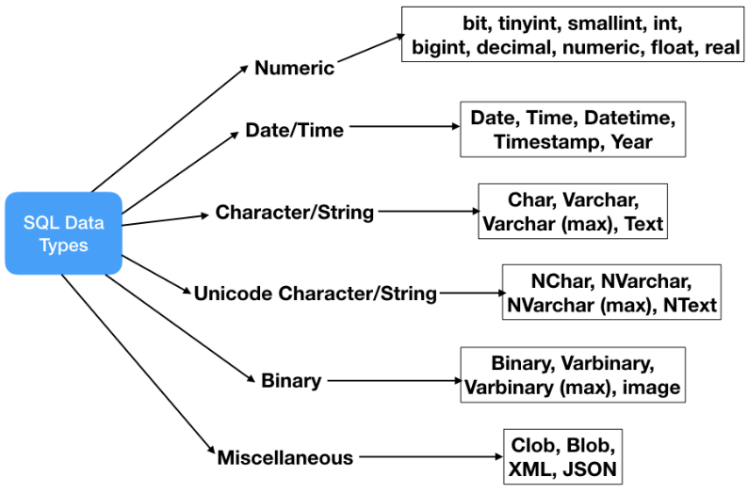
SQL Data Types

Slide 12
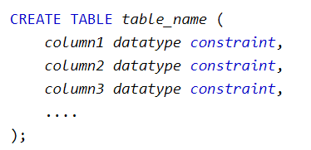
Simple integrity constraint types
Integrity constraint can be divided into the following types:
PRIMARY KEY
UNIQUE
NULL/NOT NULL
FOREIGN KEY/REFERENCE

Slide 13
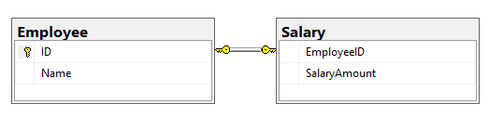
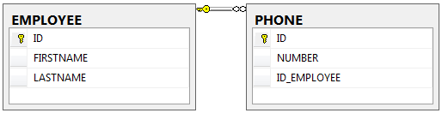
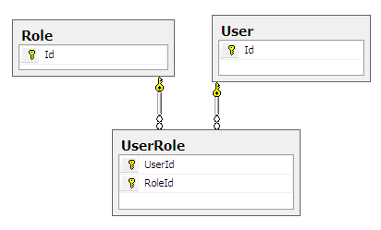
Relationships between tables
There are three types of relationships between tables:
One to one
One to many, many to one
Many to many

Slide 14

Keys
Primary key
The PRIMARY KEY constraint uniquely identifies each record in a table.
Primary keys must contain UNIQUE values, and cannot contain NULL values.
A table can have only ONE primary key; and in the table, this primary key can consist of single or multiple columns.
Foreign key
A FOREIGN KEY is a key used to link two tables together.
A FOREIGN KEY is a field (or collection of fields) in one table that refers to the PRIMARY KEY in another table.
The table containing the foreign key is called the child table, and the table containing the candidate key is called the referenced or parent table.

Slide 15
Select and organize data from one table
SELECT
<list_of_fields>
FROM
<table_name>
WHERE
<condition>
ORDER BY
<list_of_fields>
Comparison operators:
=, >, <, >=, <=, <>
NOT
AND
OR
IN (..,..,..)
BETWEEN
LIKE
Wildcard characters:
% - a substitute for zero or more characters
_ - a substitute for a single character
NULL
IS NULL
IS NOT NULL

Slide 16
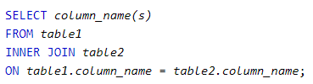
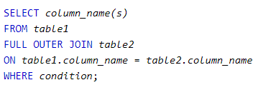
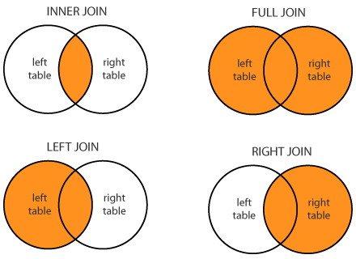


Select and organize data from database tables

Slide 17






Data aggregation
SQL aggregate functions return a single value, calculated from values in a field.
Aggregate functions:
COUNT(*);
COUNT(field name)
МАХ(field name)
MIN(field name)
SUM(field name)
AVG(field name)

Slide 18
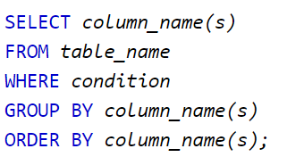
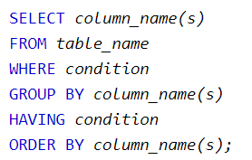
GROUP BY and HAVING
The GROUP BY statement is used in conjunction with the aggregate functions to group the result by one or more fields.
The HAVING clause includes a predicate used to filter rows resulting from the GROUP BY clause. Because it acts on the results of the GROUP BY clause, aggregation functions can be used in the
HAVING clause predicate.

Slide 19
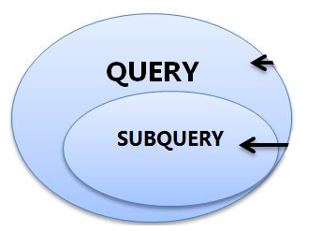
Subqueries
A subquery is a query that is nested inside a SELECT, INSERT, UPDATE, or DELETE statement, or inside another subquery.
There are a few rules that subqueries must follow:
Subqueries must be enclosed within parentheses.
A subquery can have only one column in the SELECT clause, unless multiple columns are in the main query for the subquery to compare its selected columns.
An ORDER BY cannot be used in a subquery.
Subqueries that return more than one row can only be used with multiple value operators, such as the IN operator.
The BETWEEN operator cannot be used with a subquery; however, the BETWEEN operator can be used within the subquery.

Slide 20
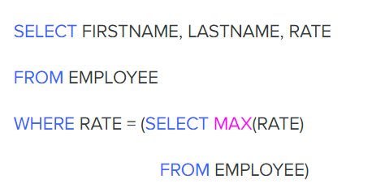
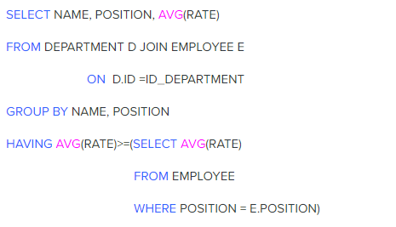
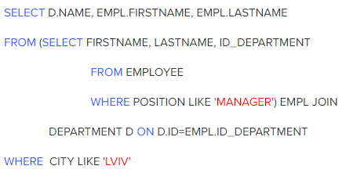
Subqueries examples
1.
3.
2.

Slide 21
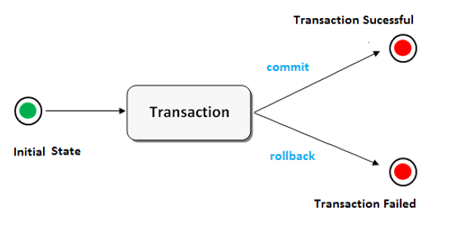
SQL - Transactions
A transaction is a sequence of operations performed (using one or more SQL statements) on a database as a single logical unit of work. The effects of all the SQL statements in a transaction can be either all committed (applied to the database) or all rolled back (undone from the database).

Slide 22

ACID
Each transaction is “all or nothing”
Transaction do not affect each other
Committed data would not be lost, even after power failure
Data should be valid according to all defined rules

Slide 23
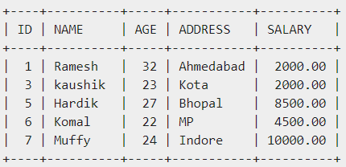

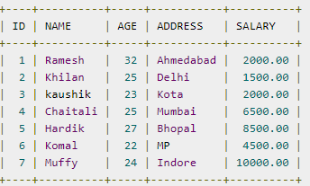
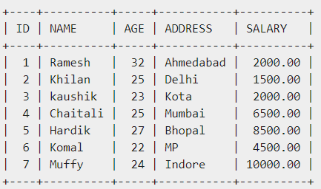

SQL – Transactions Example

Slide 24


