Slide 1
Principles of OOP in JS
by Yuliia Humeniuk

Slide 2
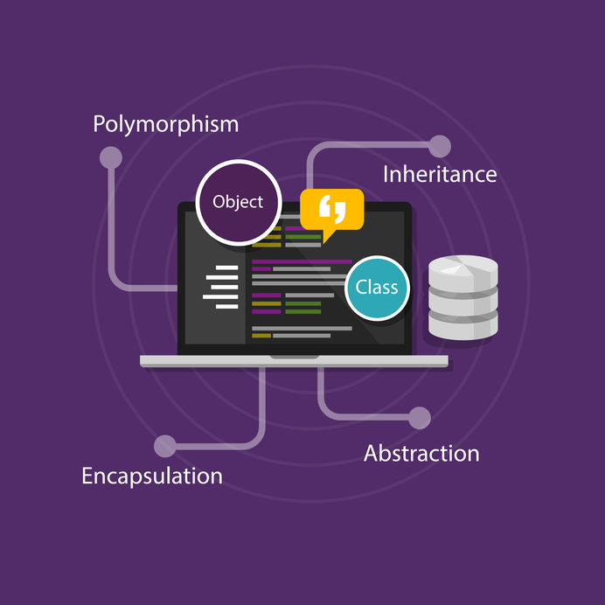
What is OOP?
Object-oriented programming (OOP) is a programming paradigm based on the concept of "objects", which can contain data, in the form of fields (often known as attributes or properties), and code, in the form of procedures (often known as methods). In OOP, computer programs are designed by making them out of objects that interact with one another.
OOP is based on four main concepts:
Encapsulation
Inheritance
Polymorphism
Abstraction

Slide 3

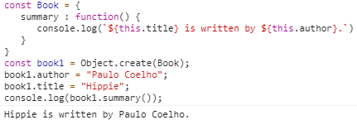
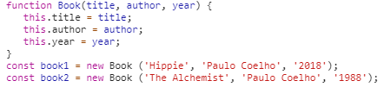
Object, property, and method
Object literal
Object.create()
Object constructor

Slide 4
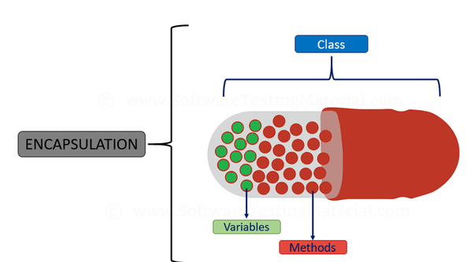
Encapsulation
Encapsulation is one of the key concepts of object-oriented programming and represents the concealment of the state of an object from direct access from the outside.
By default, all properties of objects are public, public, and we can access them from anywhere in the program.

Slide 5
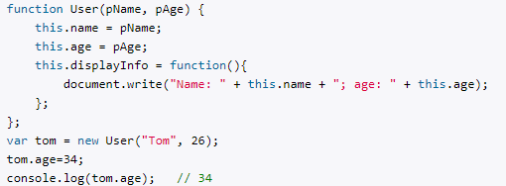

Slide 6
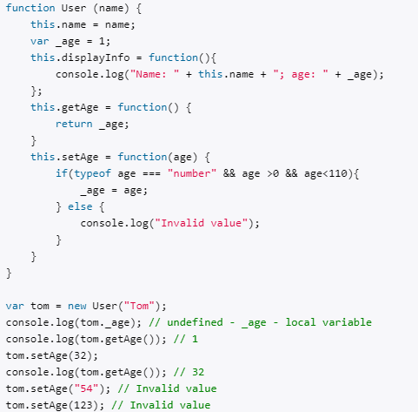
The User constructor declares the local variable _age instead of the age property. As a rule, the names of local variables in constructors begin with an underscore.
In order to work with the age of the user from the outside, two methods are defined. The getAge () method is designed to get the value of the _age variable. This method is also called getter. The second method, setAge, also called setter, is used to set the value of the _age variable.
The advantage of this approach is that we have more control over access to the _age value.

Slide 7
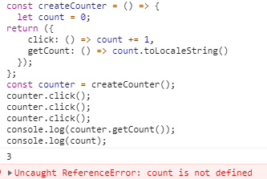
Of course, as the functional crowd knows, JavaScript has supported real data encapsulation all along. It’s very easy to declare private data in JavaScript.
// A variable defined in a factory or constructor function scope is private to that function.
// Any other functions defined in the same scope are privileged: these both have access to the private `count` variable.

Slide 8
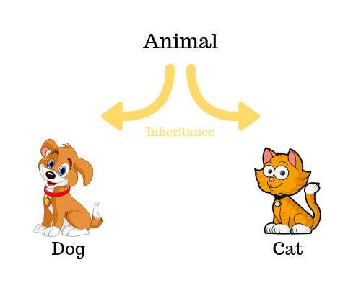
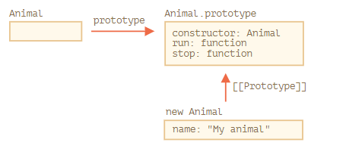
Inheritance
In object-oriented programming, inheritance is the mechanism of basing an object or class upon another object (prototype-based inheritance) or class (class-based inheritance), retaining similar implementation. Also defined as deriving new classes (sub classes) from existing ones.

Slide 9
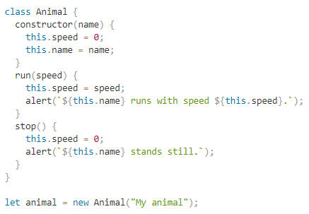
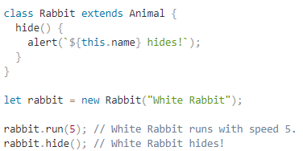
Inheritance allows for parent class to pass functionality to a child class, again, creating clean and reusable code, avoiding repeats.

Slide 10
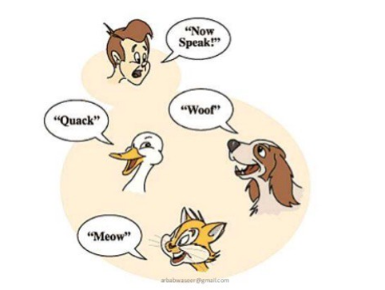
Polymorphism
Poly = many.
Morph = change or form.
Polymorphism is an ability to substitute classes that have common functionality in sense of methods and data. In other words, it is an ability of multiple object types to implement the same functionality that can work in a different way but supports a common interface.

Slide 11
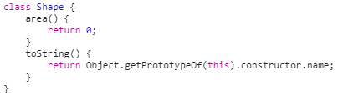
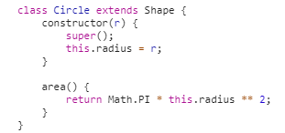
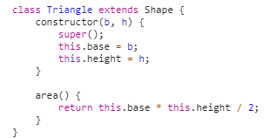
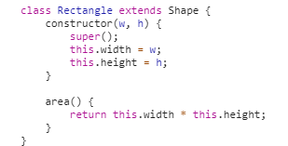

Slide 12
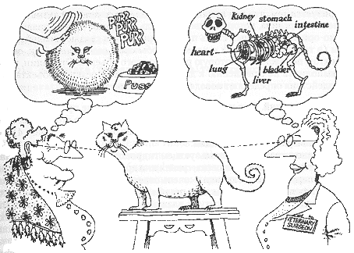
Abstraction
Abstraction is a way of creating a simple model of a more complex real-world entities, which contains the only important properties from the perspective of the context of an application.
Abstraction manages complexity of a system by hiding internal details and composing it in several smaller systems.
The main idea of abstraction is to define real-life components in different complex data types.

Slide 13
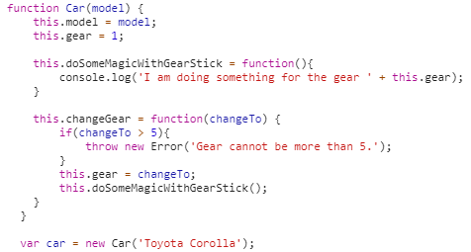
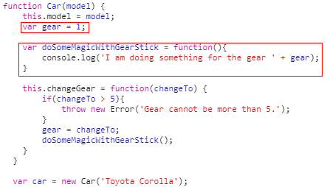

Slide 14
Advantages of OOP
Re-usability
Data Redundancy
Code Maintenance
Security
Design Benefits
Better productivity
Easy troubleshooting
Polymorphism Flexibility
Problems solving

Slide 15


