Slide 1
REDUX
by Yuliia Humeniuk

Slide 2

Redux (JavaScript library)
Redux is an open-source JavaScript library for managing application state.
It is most commonly used with libraries such as React or Angular for building user interfaces.
Similar to (and inspired by) Facebook's Flux architecture.
It was created by Dan Abramov and Andrew Clark in 2015.
It is tiny (2kB, including dependencies).

Slide 3
What problem does Redux solve?

Slide 4
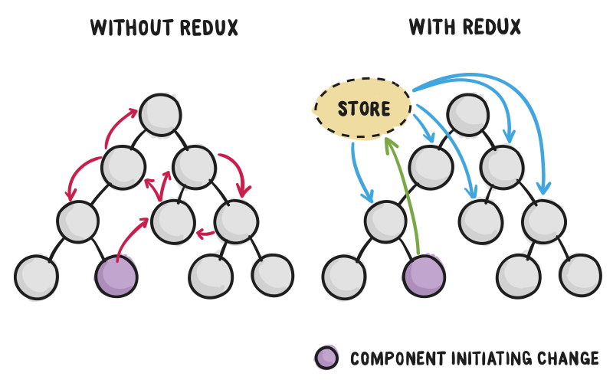
Redux organizes the management of the state (data) for application.

Slide 5
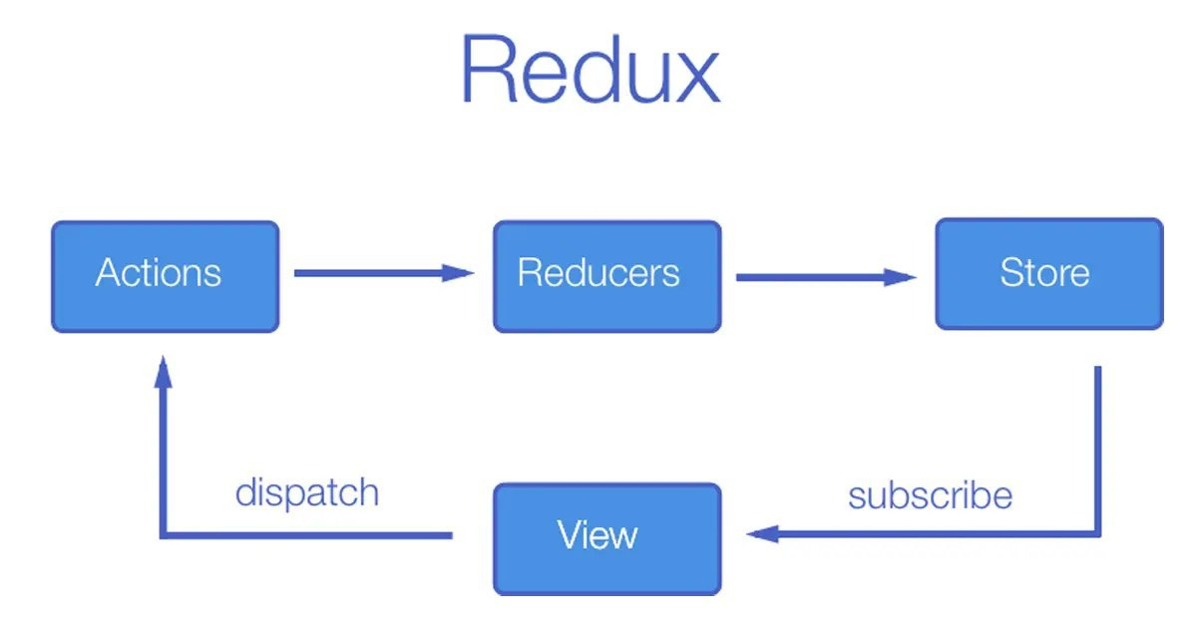
Understanding how Redux works
There are three building parts:
Actions
Reducers
Store

Slide 6
Three Principles
Single source of truth
The state of your whole application is stored in an object tree within a single store.
2. State is read-only
The only way to change the state is to emit an action, an object describing what happened.
3. Changes are made with pure functions
To specify how the state tree is transformed by actions, you write pure reducers.

Slide 7
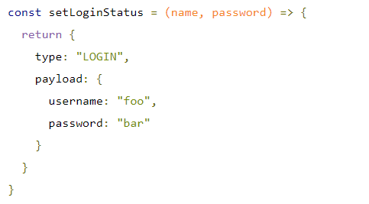
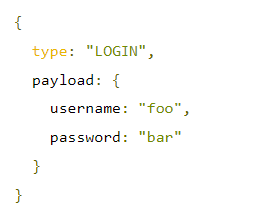
Actions in Redux
Actions are events. They are the only way you can send data from your application to your Redux store. The data can be from user interactions, API calls, or even form submissions.
Actions are sent using the store.dispatch() method.
Actions are plain JavaScript objects, and they must have a type property to indicate the type of action to be carried out. They must also have a payload that contains the information that should be worked on by the action.
Actions are created via an action creator.

Slide 8
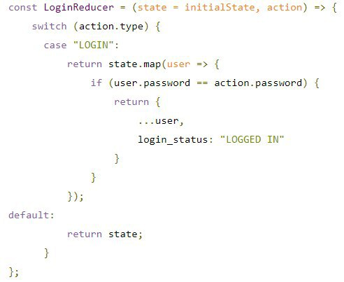
Reducers in Redux
Reducers are pure functions that take the current state of an application, perform an action, and return a new state.
These states are stored as objects, and they specify how the state of an application changes in response to an action sent to the store.

Slide 9
Combine Reducers
The combineReducers helper function turns an object whose values are different reducing functions into a single reducing function you can pass to createStore.
The resulting reducer calls every child reducer, and gathers their results into a single state object. The state produced by combineReducers() namespaces the states of each reducer under their keys as passed to combineReducers()

Slide 10

Store in Redux
The store holds the application state. There is only one store in any Redux application.
You can:
Allows access to state via getState();
Allows state to be updated via dispatch(action);
Registers listeners via subscribe(listener);
Handles unregistering of listeners via the function returned by subscribe(listener).

Slide 11

Async Actions
Usually, for any API request you'll want to dispatch at least three different kinds of actions:
An action informing the reducers that the request began.
An action informing the reducers that the request finished successfully.
An action informing the reducers that the request failed.

Slide 12

Redux Thunk
The standard way to use the asynchronous action creators with Redux is to use the Redux Thunk middleware.
By using this specific middleware, an action creator can return a function instead of an action object.
When an action creator returns a function, that function will get executed by the Redux Thunk middleware. This function doesn't need to be pure; it is thus allowed to have side effects, including executing asynchronous API calls. The function can also dispatch actions - like those synchronous actions we defined earlier.

Slide 13
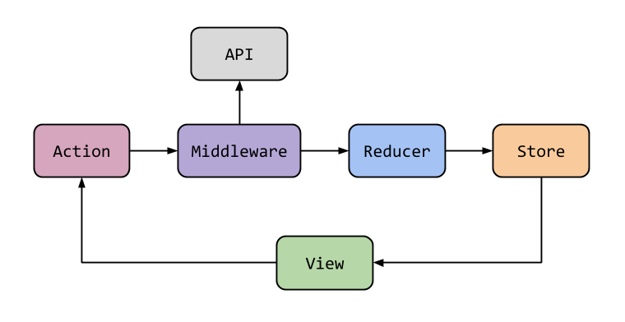
Middleware
Middleware - functions that are subsequently called in the process of updating the container.
The general principle of work:
Middlewars are built into the repository when it is created.
During dispatching (sending actions),
data passes through them and only then gets into the reducer.

Slide 14


Installation
Redux is available as a package on NPM for use with a module bundler or in a Node application:

Slide 15
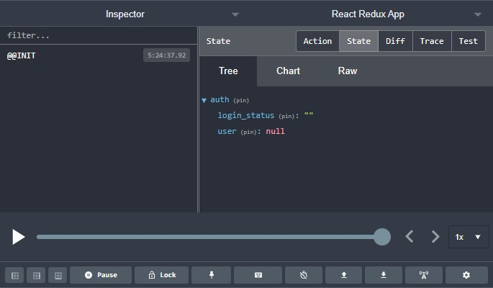

Redux DevTools
Redux-Devtools provide us debugging platform for Redux apps.
It lets you inspect every state and action payload.
It lets you go back in time by “cancelling” actions.
If you change the reducer code, each “staged” action will be reevaluated.
If the reducers throw, we can identify the error and also during which action this happened.
Installation:

Slide 16
Redux Toolkit
The Redux Toolkit package is intended to be the standard way to write Redux logic. It was originally created to help address three common concerns about Redux:
“Configuring a Redux store is too complicated”
“I have to add a lot of packages to get Redux to do anything useful”
“Redux requires too much boilerplate code”
Reference: https://redux-toolkit.js.org.

Slide 17


