Slide 1
Built-in Collections
by Yuliia Humeniuk

Slide 2

Array
An array is an ordered set of values that you refer to with a name and an index.
The bracket syntax is called an "array literal" or “array initializer”. It's shorter than other forms of array creation, and so is generally preferred.

Slide 3
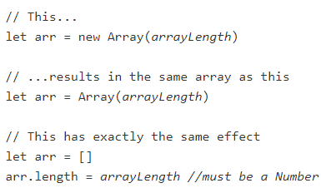
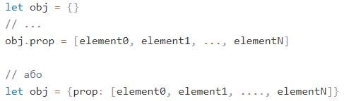
Array
To create an array with non-zero length, but without any items, either of the following can be used:
Arrays can also be assigned as a property of a new or an existing object:

Slide 4




What about result?
?

Slide 5





Array Iteration
1
Array iteration methods operate on every array item.
1
The forEach() method calls a function (a callback function) once for each array element.
3
2
4
!It is not advisable to iterate through JavaScript arrays using for...in loops, because normal elements and all enumerable properties will be listed.

Slide 6


Array Iteration
Array.map()
The map() method creates a new array by performing a function on each array element.
The map() method does not execute the function for array elements without values.
The map() method does not change the original array.
1
+

Slide 7


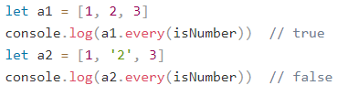

Array Iteration
Array.filter()
The filter() method creates a new array with array elements that passes a test.
1
Array.every() / Array.some() The every() / some() method check if all / some array values pass a test.

Slide 8

Array iteration
Array.reduce()
The reduce() method runs a function on each array element to produce (reduce it to) a single value.
The reduce() method works from left-to-right in the array
The reduce() method does not reduce the original array.
Array.reduceRight() The reduceRight() works from right-to-left in the array.
!reduce and reduceRight are the least obvious of the iterative array methods. They should be used for algorithms that combine two values recursively in order to reduce a sequence down to a single value.

Slide 9
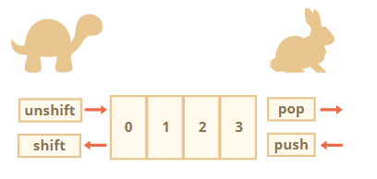



Array methods
The Array object has the following methods:
1
2
3
And other methods: https://developer.mozilla.org/en-US/docs/Web/JavaScript/Guide/Indexed_collections
4

Slide 10
Typed Array
The basic binary object is ArrayBuffer – a reference to a fixed-length contiguous memory area.
ArrayBuffer is not an array of something ArrayBuffer has nothing in common with Array:
It has a fixed length, we can’t increase or decrease it.
It takes exactly that much space in the memory.
To access individual bytes, another “view” object is needed, not buffer[index].

Slide 11
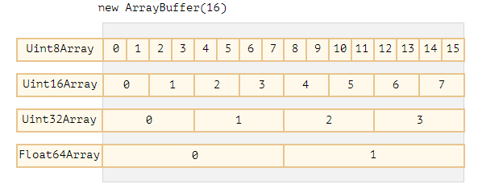
Typed Array
To manipulate an ArrayBuffer, we need to use a “view” object. A view object does not store anything on it’s own. It’s the “eyeglasses” that give an interpretation of the bytes stored in the ArrayBuffer. For instance:
Uint8Array – treats each byte in ArrayBuffer as a separate number, with possible values are from 0 to 255 (a byte is 8-bit, so it can hold only that much). Such value is called a “8-bit unsigned integer”.
Uint16Array – treats every 2 bytes as an integer, with possible values from 0 to 65535. That’s called a “16-bit unsigned integer”.
Uint32Array – treats every 4 bytes as an integer, with possible values from 0 to 4294967295. That’s called a “32-bit unsigned integer”.
Float64Array – treats every 8 bytes as a floating point number with possible values from 5.0x10-324 to 1.8x10308.

Slide 12
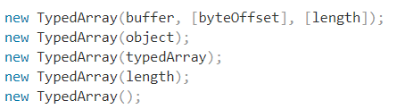
Typed Array
The common term for all these views (Uint8Array, Uint32Array, etc) is TypedArray. They share the same set of methods and properities.
Typed array behave like regular arrays: have indexes and iterable.
There are 5 variants of arguments:

Slide 13


Typed Array

Slide 14
Typed Array methods
There are few things we can’t do though:
No splice – we can’t “delete” a value, because typed arrays are views on a buffer, and these are fixed, contiguous areas of memory. All we can do is to assign a zero.
No concat method.
There are two additional methods:
arr.set(fromArr, [offset]) copies all elements from fromArr to the arr, starting at position offset (0 by default).
arr.subarray([begin, end]) creates a new view of the same type from begin to end (exclusive). That’s similar to slice method (that’s also supported), but doesn’t copy anything – just creates a new view, to operate on the given piece of data.
*Details: https://javascript.info/arraybuffer-binary-arrays https://developer.mozilla.org/ru/docs/Web/JavaScript/Reference/Global_Objects/TypedArray

Slide 15
Map
Map is a collection of keyed data items, just like an Object. !But the main difference is that Map allows keys of any type.
Methods and properties are:
new Map() – creates the map.
map.set(key, value) – stores the value by the key.
map.get(key) – returns the value by the key, undefined if key doesn’t exist in map.
map.has(key) – returns true if the key exists, false otherwise.
map.delete(key) – removes the value by the key.
map.clear() – removes everything from the map.
map.size – returns the current element count.

Slide 16
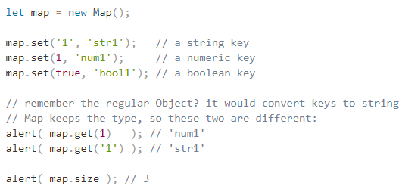

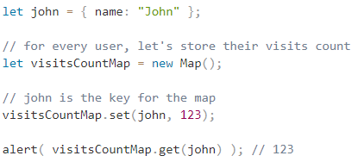
Map

Slide 17
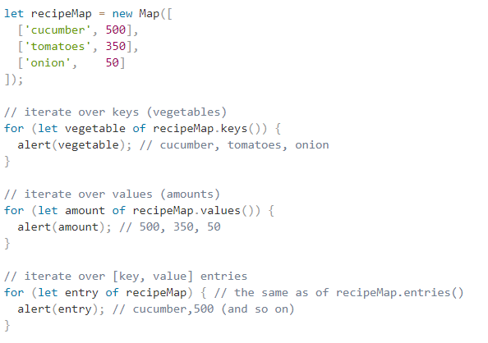
Iteration over Map
For looping over a map, there are 3 methods:
map.keys() – returns an iterable for keys,
map.values() – returns an iterable for values,
map.entries() – returns an iterable for entries [key, value], it’s used by default in for..of.

Slide 18
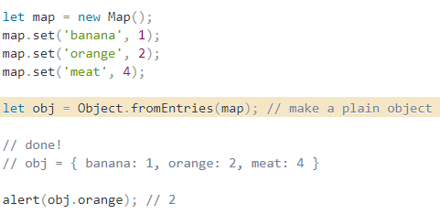
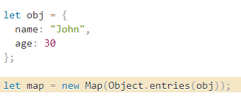
Object from Map and Map from Object
Object.fromEntries

Slide 19
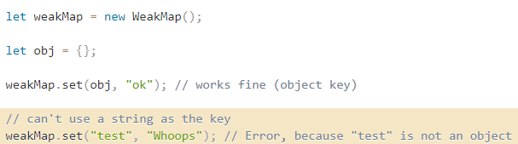
WeakMap
The first difference from Map is that WeakMap keys must be objects, not primitive values.
WeakMap does not support iteration and methods keys(), values(), entries(), so there’s no way to get all keys or values from it.
WeakMap has only the following methods:
weakMap.get(key).
weakMap.set(key, value).
weakMap.delete(key).
weakMap.has(key).

Slide 20
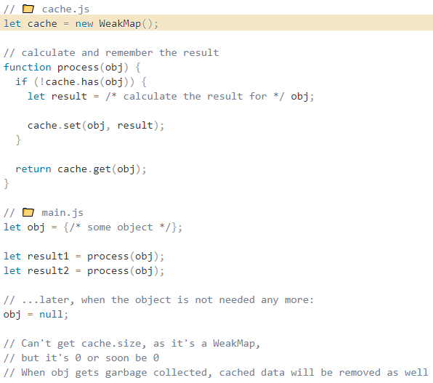
WeakMap

Slide 21
Set
Set is a special type collection - “set of values” (without keys), where each value may occur only once.
Its main methods are:
new Set(iterable) – creates the set, and if an iterable object is provided (usually an array), copies values from it into the set.
set.add(value) – adds a value, returns the set itself. set.delete(value) – removes the value, returns true if value existed at the moment of the call, otherwise false. set.has(value) – returns true if the value exists in the set, otherwise false.
set.clear() – removes everything from the set.
set.size – is the elements count.

Slide 22
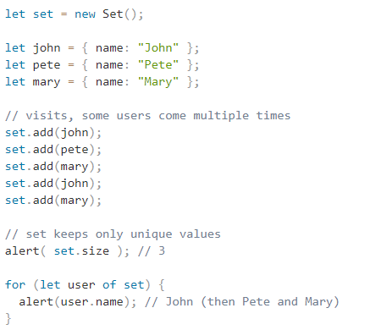
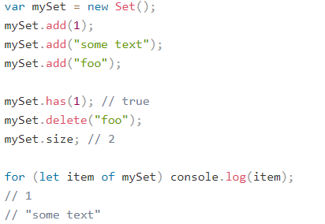
Set

Slide 23
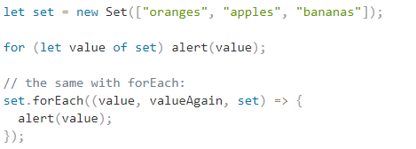
Set
The same methods Map has for iterators are also supported:
set.keys() – returns an iterable object for values.
set.values() – same as set.keys(), for compatibility with Map.
set.entries() – returns an iterable object for entries [value, value], exists for compatibility with Map.

Slide 24
WeakSet
WeakSet behaves similarly:
It is analogous to Set, but we may only add objects to WeakSet (not primitives). An object exists in the set while it is reachable from somewhere else.
Like Set, it supports add, has and delete, !but not size, keys() and no iterations.
Being “weak”, it also serves as an additional storage. But not for an arbitrary data, but rather for “yes/no” facts. A membership in WeakSet may mean something about the object.

Slide 25
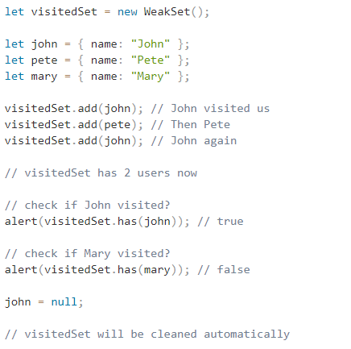
WeakSet

Slide 26


