Slide 1
ES7-ES10 FEATURES
by Yuliia Humeniuk

Slide 2
ECMAScript 7 (2016)
They decided to release a new version of ECMAScript every year starting in 2015. A yearly update means no more big releases like ES6.
ECMAScript 2016(ES7) introduced only two new features:
Array.prototype.includes()
Exponentiation operator

Slide 3
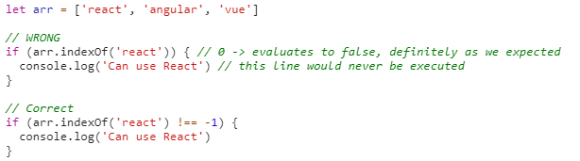
Array.prototype.includes()
With Array.prototype.includes everything is easy and simple. It’s a replacement for indexOf which developers used to check for presence of a value in an array. indexOf is kind of awkward to use because it returns the position of an element in array or -1 in case such an element could not be found. So it returns a number, not a boolean value.

Slide 4
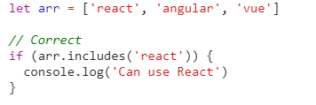
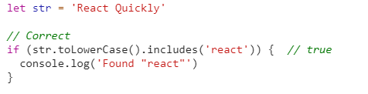
The ES7 code with includes would be:
Developers can also use includes with strings:

Slide 5








Slide 6

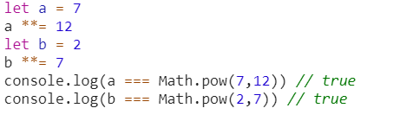
Exponentiation Operator
This operator is mostly for developers doing some math and is useful in case of 3D, Virtual Reality, SVG or data visualization.
Developers also can use operation assignment:

Slide 7
ECMAScript 8 (2017)
At the TC39 meeting in January 2017, the last feature of ECMAScript 2017, “Shared memory and atomics” .
ES8 edition included:
Async/await (new way of writing asynchronous code, an alternative to Promises)
New methods:
Object.values(),
Object.entries(),
String.prototype.padEnd(),
String.prototype.padStart()
Trailing commas.

Slide 8
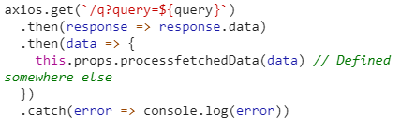
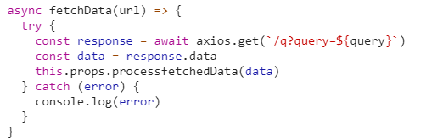
Asynchronous functions
Developers can define an async function which may or may not contain await for promise-based asychronous operations. Under the hood, an async function is a function that returns Promise, however you won’t see such a word anywhere in its body.

Slide 9
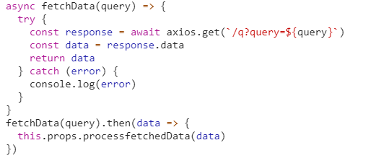
Asynchronous functions
Async function return a Promise, so we can continue our execution flow like this:
With async/await, your code performs asynchronously but looks like synchronous. It’s easier to read such code from top to bottom and understand what it is doing, because the order of results appearing along with execution of function body goes precisely from top to bottom.

Slide 10
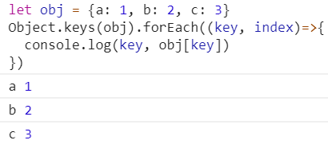
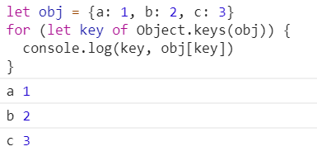
Object.values/Object.entries
Before ES8/ES2017, JavaScript developers who needed to iterate over own properties of an object had to use Object.keys, iterate over an array returned by it and use obj[key] to access each value:

Slide 11
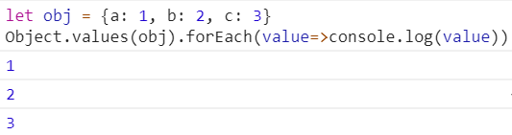
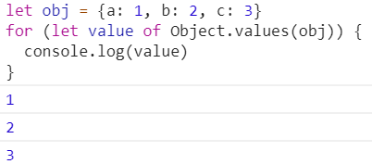
Object.values/Object.entries
Object.values returns an array of object’s own enumerable property values. We can iterate over it using good Array.prototype.forEach, but with ES6 arrow function and implicit return:

Slide 12

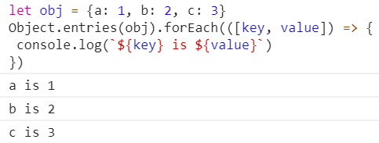
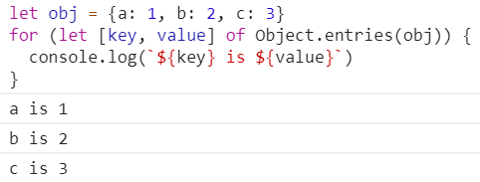
Object.values/Object.entries
Object.entries will return an array of object’s own enumerable property key-value pairs (as an array). Each item of the resulting array will be an array too.
We can use ES6/ES2015 destructuring to declare key and value from a nested array:

Slide 13


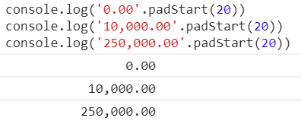
String.prototype.padStart/String.prototype.padEnd
padStart() returns a string of a given length (targetLength) by inserting pads at the beginning. Pads are a given string, repeated if needed until the desired length is reached.
It can be a useful methods for financial statements:

Slide 14





Slide 15
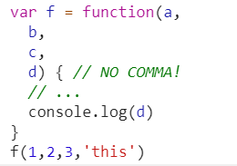
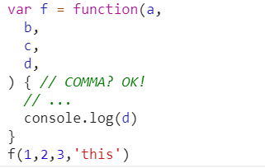
Trailing commas
The trailing comma in function definitions is a purely syntax change. In ES5, to make it a valid JavaScript, there should be no comma after the last function argument:
In ES8, it’s okay to have the trailing comma:

Slide 16
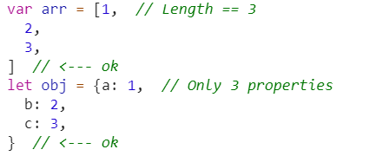
Trailing commas
Now, trailing comma in functions is consistent with tolerating trailing commas in array (ES3) and object literals (ES5):
Trailing commas are mostly useful when using multi-line style (typically with lots of long argument names). Now, you can have commas everywhere, even after the last argument.

Slide 17
ECMAScript 9(2018)
This release offered new features:
Rest / Spread operators (in object)
Asynchronous iteration
Promise.finally()
Tagged string template
New regex functionality.

Slide 18
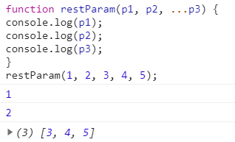

Rest / Spread operators
This feature has been introduced in the ES6, ES6 but the role of the object in the array is limited.
Rest parameters convert the last arguments passed to a function into an array:
The spread operator works in the opposite way, and turns an array into separate arguments which can be passed to a function.

Slide 19
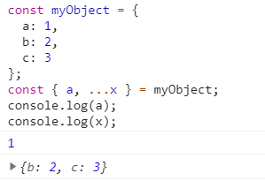
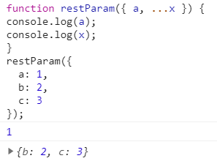
Rest / Spread operators
ES2018 enables similar rest/spread functionality for object destructuring as well as arrays.
Or you can use it to pass values to a function:
Like arrays, you can only use a single rest parameter at the end of the declaration. In addition, it only works on the top level of each object and not sub-objects.

Slide 20

Rest / Spread operators
The spread operator can be used within other objects.
You could use the spread operator to clone objects (obj2 = { ...obj1 };), but be aware you only get shallow copies. If a property holds another object, the clone will refer to the same object.

Slide 21



Asynchronous iteration
At some point in your async/await journey, you’ll attempt to call an asynchronous function inside a synchronous loop.
ES2018 introduces asynchronous iterators, which are just like regular iterators except the next() method returns a Promise. Therefore, the await keyword can be used with for … of loops to run asynchronous operations in series.

Slide 22
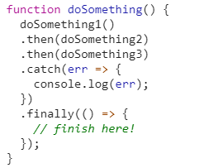
Promise.finally()
A Promise chain can either succeed and reach the final .then() or fail and trigger a .catch() block. In some cases, you want to run the same code regardless of the outcome - for example, to clean up, remove a dialog, close a database connection.
The .finally() prototype allows you to specify final logic in one place rather than duplicating it within the last .then() and .catch():

Slide 23
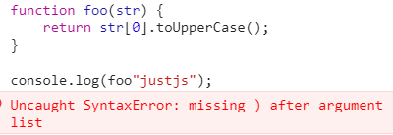
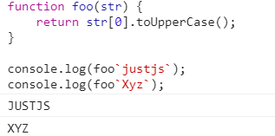
Tagged string template
Tags allow you to parse Template Strings with functions. The first parameter of the tag function contains an array of string values. The rest of the parameters are expression dependent. Finally, your function can return the processed string (or it can return something completely different).

Slide 24
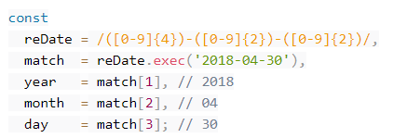
Regex Named Capture Groups
JavaScript regular expressions can return a match object - an array-like value containing matched strings. For example, to parse a date in YYYY-MM-DD format:

Slide 25
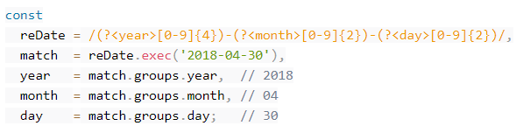
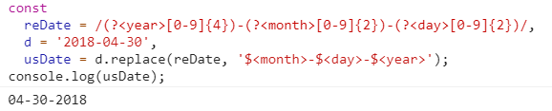
Regex Named Capture Groups
ES2018 permits groups to be named using the notation ?<name> immediately after the opening capture bracket ( .
Any named group that fails to match has its property set to undefined.
Named captures can also be used in replace() methods

Slide 26
ECMAScript 10(2019)
ES10 version included:
New Methods:
Array.flat()
Array.flatMap()
String.trimStart()/trimEnd()
Object.fromEntries()
try…catch (e – optional param.),
Function.toString() method revised,
Symbol class update.

Slide 27


Array.flat()
The flat() method creates a new array with all sub-array elements.
Array.flat() will remove all empty slots from our array.

Slide 28
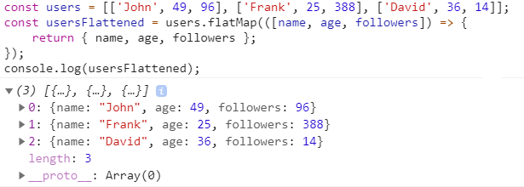
Array.flatMap()
This method first maps each element using a mapping function, then flattens the result into a new array.

Slide 29
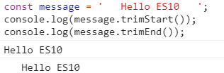
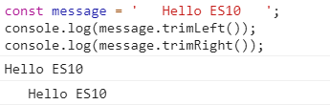
String.trimStart() / String.trimEnd()
String.trimStart method removes whitespace from the beginning of a string, and String.trimEnd method removes whitespace from the end of a string. Both of them have an alias, trimLeft and trimRight correspondingly.
*Note that both of these methods return a new string with whitespaces stripped. The original string is not modified.

Slide 30

Object.fromEntries()
Object.fromEntries method transforms a list of key-value pairs into an object.

Slide 31
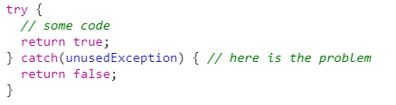
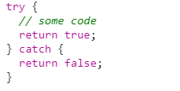
Optional Catch Binding
Developers were forced to bind an exception whenever we used try...catch statement. The engine didn't care if the exception was later used or not, which was a bad thing.
We are able to omit the exception binding if it's not required now. Our code is cleaner and less confusing.

Slide 32
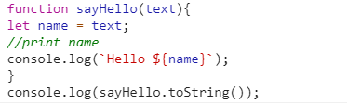

Function.toString()
The toString() method returns a string representing the source code of the function.
Earlier white spaces,new lines and comments will be removed, but now they are retained with original source code.

Slide 33
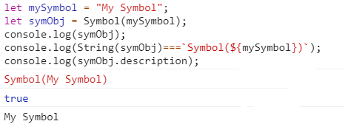
Symbol.description
The read-only description property is a string returning the optional description of Symbol objects.

Slide 34
References
https://www.sitepoint.com/es2018-whats-new/
https://medium.com/@selvaganesh93/javascript-whats-new-in-ecmascript-2019-es2019-es10-35210c6e7f4b
https://devinduct.com/blogpost/48/8-new-es10-es2019-features-by-example
https://tproger.ru/translations/wtf-is-ecmascript/

Slide 35


