Slide 1
Asynchronous programming
by Yuliia Humeniuk

Slide 2
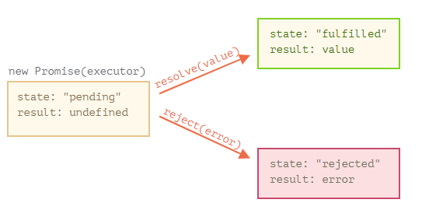
Promise
Promise is a special object that contains its state. First pending (“waiting”), then one of: fulfilled (“completed successfully”) or rejected (“completed with error”).

Slide 3

Promise
The function passed to new Promise is called the executor. When new Promise is created, the executor runs automatically. It contains the producing code which should eventually produce the result. Its arguments resolve and reject are callbacks provided by JavaScript itself.
The executor runs automatically and attempts to perform a job. When it is finished with the attempt it calls resolve if it was successful or reject if there was an error.

Slide 4
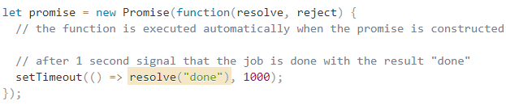
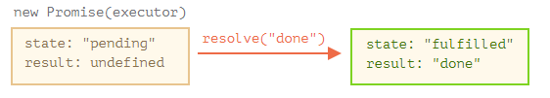

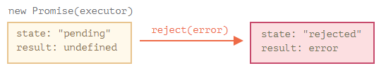

Slide 5
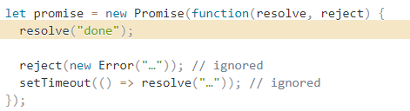
There can be only a single result or an error. The executor should call only one resolve or one reject. Any state change is final. All further calls of resolve and reject are ignored:

Slide 6

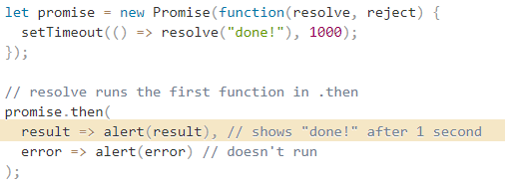
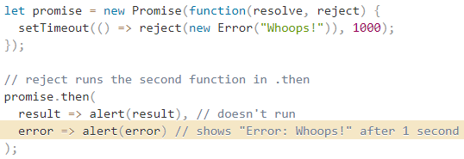
Consumers: then, catch, finally
A Promise object serves as a link between the executor and the consuming functions, which will receive the result or error. Consuming functions can be registered (subscribed) using methods: .then, .catch and .finally.

Slide 7
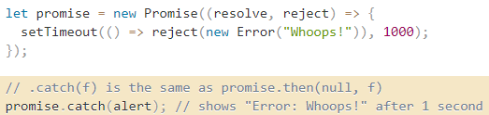
Consumers: then, catch, finally
If we’re interested only in errors, then we can use null as the first argument: .then(null, errorHandlingFunction).
Or we can use .catch(errorHandlingFunction), which is exactly the same:
The call .catch(f) is a complete analog of .then(null, f), it’s just a shorthand.

Slide 8
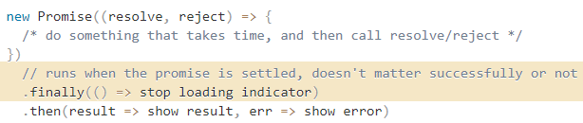
Consumers: then, catch, finally
Just like there’s a finally clause in a regular try {...} catch {...}, there’s finally in promises. The call .finally(f) is similar to .then(f, f) in the sense that f always runs when the promise is settled: be it resolve or reject.

Slide 9
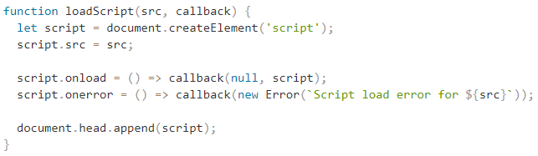
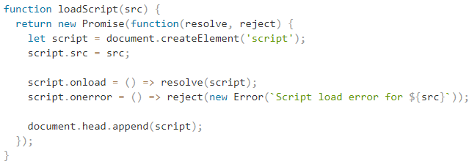
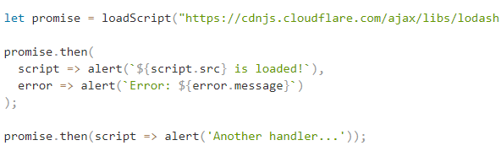

Slide 10
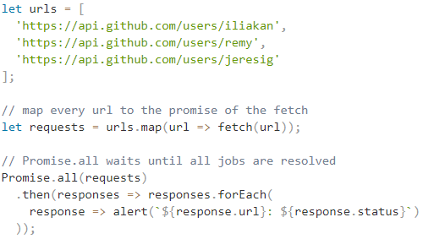
Promise API
1.Promise.all

Slide 11

Promise API
If any of the promises is rejected, the promise returned by Promise.all immediately rejects with that error.
If one promise rejects, Promise.all immediately rejects, completely forgetting about the other ones in the list. Their results are ignored.

Slide 12


Promise API
2.Promise.allSettled
Promise.allSettled just waits for all promises to settle, regardless of the result. The resulting array has: {status:"fulfilled", value:result} for successful responses, {status:"rejected", reason:error} for errors.
3.Promise.race
Similar to Promise.all, but waits only for the first settled promise and gets its result (or error).

Slide 13

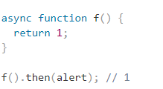
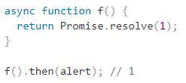
Async/await
Let’s start with the async keyword. It can be placed before a function, like this:
The word “async” before a function means one simple thing: a function always returns a promise. Other values are wrapped in a resolved promise automatically.

Slide 14

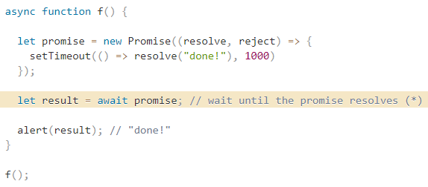
Async/await
The keyword await makes JavaScript wait until that promise settles and returns its result.

Slide 15


Error handling
If a promise resolves normally, then await promise returns the result. But in the case of a rejection, it throws the error, just as if there were a throw statement at that line.

Slide 16
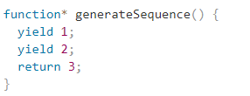
Generators
Regular functions return only one, single value (or nothing).
Generators can return (“yield”) multiple values, one after another, on-demand. They work great with iterables, allowing to create data streams with ease.
To create a generator, we need a special syntax construct: function*, so-called “generator function”.

Slide 17
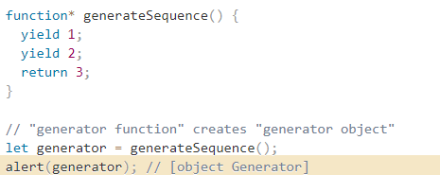
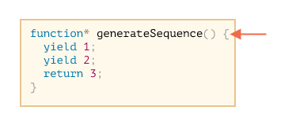
Generators
Generator functions behave differently from regular ones. When such function is called, it doesn’t run its code. Instead it returns a special object, called “generator object”, to manage the execution.

Slide 18
Next()
The main method of a generator is next(). When called, it runs the execution until the nearest yield <value> statement (value can be omitted, then it’s undefined). Then the function execution pauses, and the yielded value is returned to the outer code. The result of next() is always an object with two properties:
value: the yielded value.
done: true if the function code has finished, otherwise false.

Slide 19
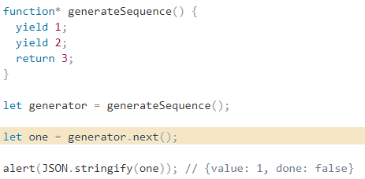
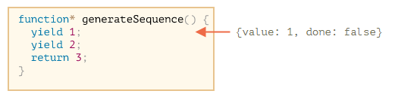
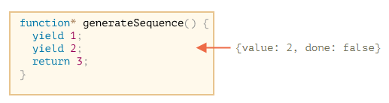

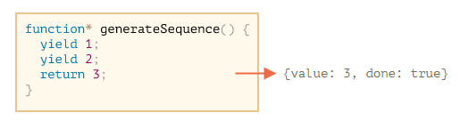

New calls to generator.next() don’t make sense any more. If we do them, they return the same object: {done: true}.

Slide 20
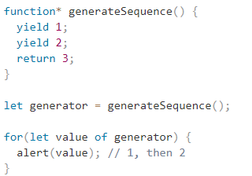
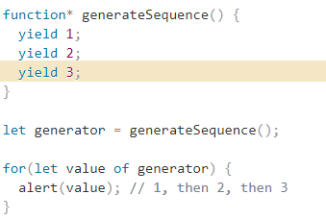
Generators are iterable
Why? Where is 3?

Slide 21
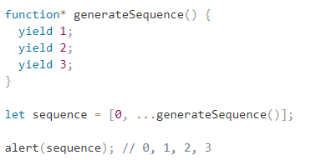
Generators are iterable
As generators are iterable, we can call all related functionality, e.g. the spread syntax ...:

Slide 22
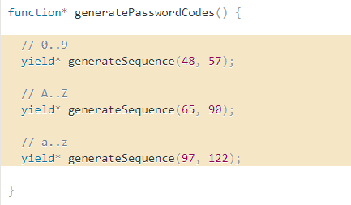

Generator composition
Generator composition is a special feature of generators that allows to transparently “embed” generators in each other.

Slide 23
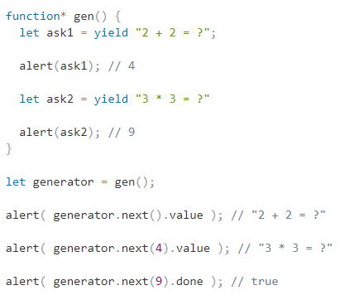
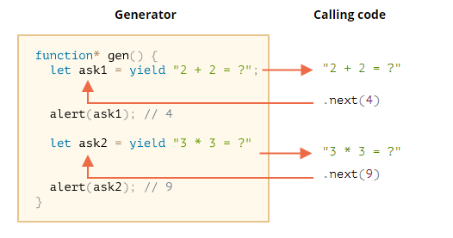
Yield
Yield is a two-way street: it not only returns the result to the outside, but also can pass the value inside the generator.

Slide 24
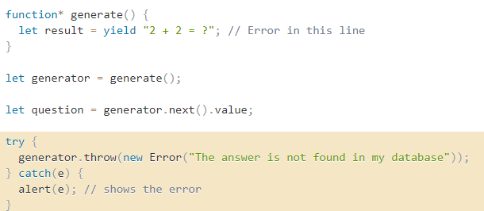
generator.throw
To pass an error into a yield, we should call generator.throw(err). In that case, the err is thrown in the line with that yield.

Slide 25


