Slide 1
JavaScript Syntax
by Yuliia Humeniuk

Slide 2
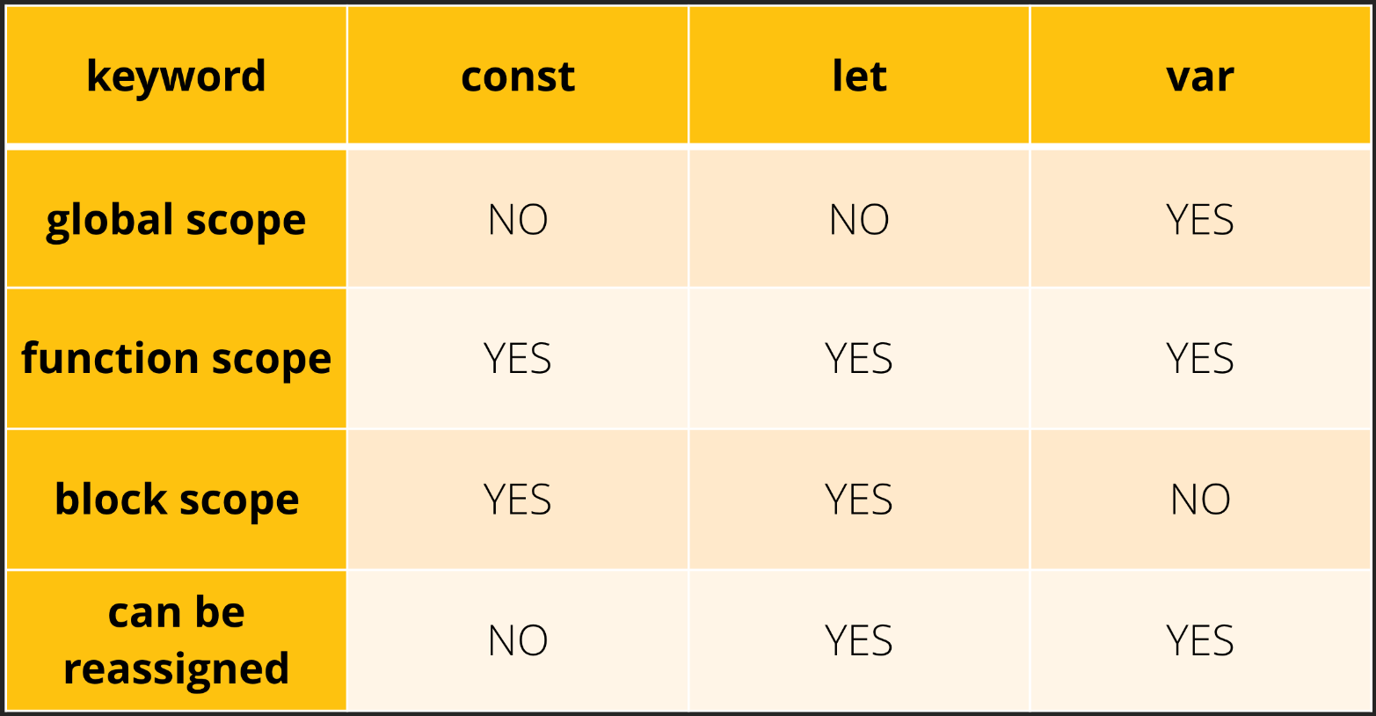
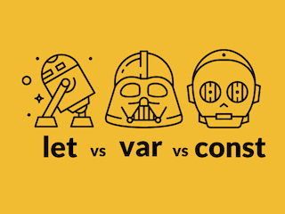
A variable
A variable is a “named storage” for data.

Slide 3





Variable naming
A variable name should have a clean, obvious meaning, describing the data that it stores. Limitations on variable names in JavaScript:
The name must contain only letters, digits, or the symbols $ and _.
The first character must not be a digit.
When the name contains multiple words, camelCase is commonly used.

Slide 4
Variable naming
Some good-to-follow rules are:
Use human-readable names like userName or shoppingCart.
Stay away from abbreviations or short names like a, b, c, unless you really know what you’re doing.
Make names maximally descriptive and concise. Examples of bad names are data and value. Such names say nothing. It’s only okay to use them if the context of the code makes it exceptionally obvious which data or value the variable is referencing.
Agree on terms within your team and in your own mind. If a site visitor is called a “user” then we should name related variables currentUser or newUser instead of currentVisitor or newManInTown.

Slide 5
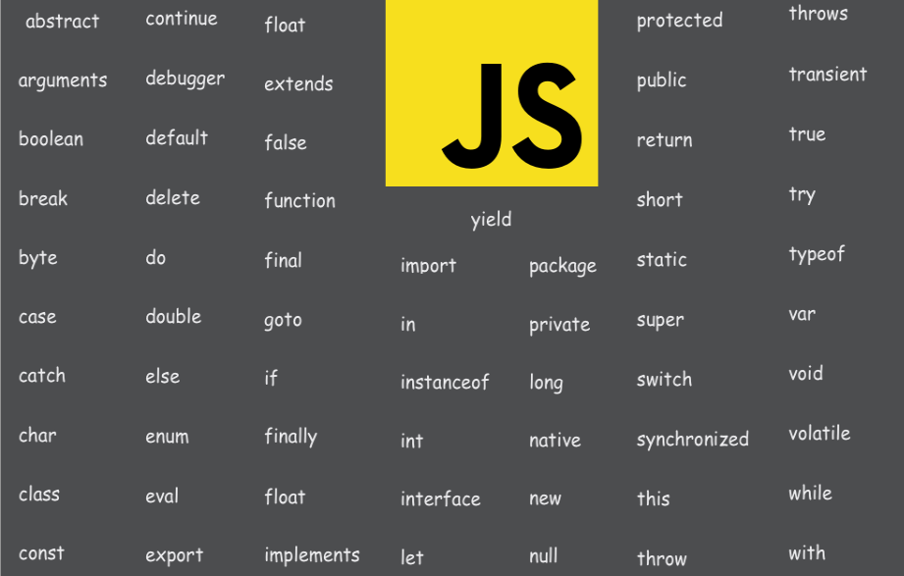

Reserved names
There is a list of reserved words, which cannot be used as variable names because they are used by the language itself.

Slide 6
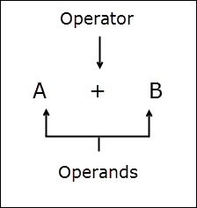



Operators
An operand – is what operators are applied to.
An operator is unary if it has a single operand.
An operator is binary if it has two operands.
An operator is ternary if it has three operands.

Slide 7
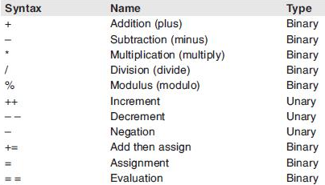
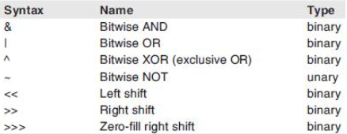
Operators
Mathematical operators
Bitwise operators

Slide 8

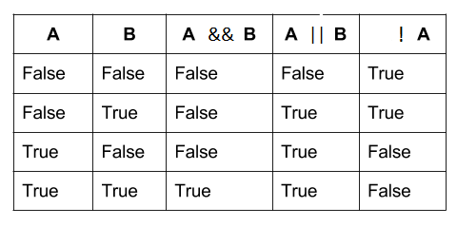
Operators
Logical operators

Slide 9
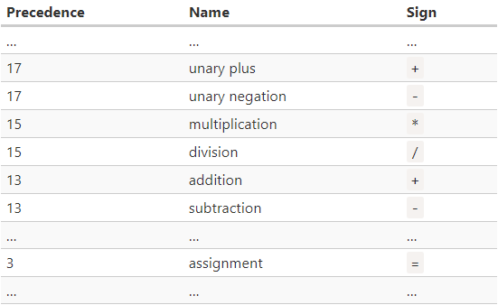
Operator precedence
https://developer.mozilla.org/en-US/docs/Web/JavaScript/Reference/Operators/Operator_Precedence

Slide 10



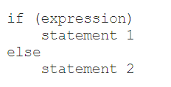
Statements
A statement is an instruction to perform a specific action. Such actions include creating a variable or a function, looping through an array of elements, evaluating code based on a specific condition etc. JavaScript programs are actually a sequence of statements.
Declaration Statements::
Expression Statements:
Conditional Statements:

Slide 11


Statements
Looping statements includes the following statements: while, do/while, for and for/in.
Examples of jump statements includes break, continue, return and throw.
Loops and Jumps :
Function Expressions:
A function expression is part of a variable assignment expression and may or may not contain a name. Since this type of function appears after the assignment operator =, it is evaluated as an expression. Function expressions are typically used to assign a function to a variable. Function expressions are evaluated only when the interpreter reaches the line of code where function expressions are located.

Slide 12
Expressions
Expressions – is any unit of code that can be evaluated to a value is an expression. It`s a set of variables, values combined with operators.
Example: a = b * 2;
This statement has four expressions in it:
2 is a literal value expression.
b is a variable expression.
b * 2 is an arithmetic expression.
a = b * 2 is an assignment expression.

Slide 13
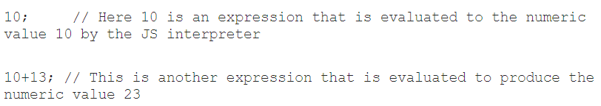

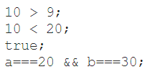
Expressions
Arithmetic Expressions:
String Expressions:
Logical Expressions:

Slide 14
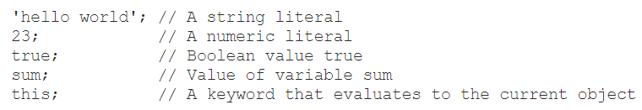


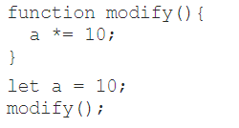
Expressions
Primary Expressions:
Left-hand-side Expressions:
Expressions with side effects:

Slide 15
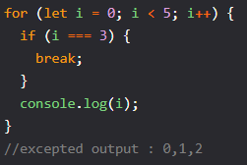
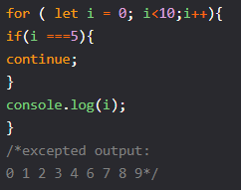
Control Flow
Control flow allows you to conditionally run blocks of code based on a set of rules. By using control flow statements like if...else and switch, you can write functions that make decisions based on certain conditions being met.
Break::
Continue:

Slide 16
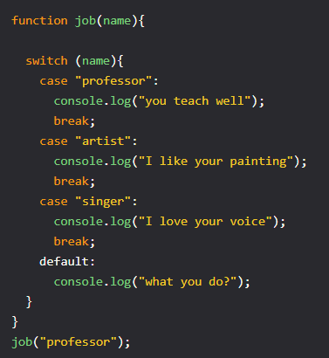
Control Flow
The switch statement lets you create a set of options for the element you want to check.
To use the switch statement you have to divide by cases, being each case, each of the options.
Why the break? We use the break statement because if not, the code will continue and execute the next block.
You can use in the switch case a default “case” where it works like an else statement, i.e if no condition is met that is what the code will execute.

Slide 17


