Slide 1
Data Types and Coercion. Type Conversions
by Yuliia Humeniuk

Slide 2
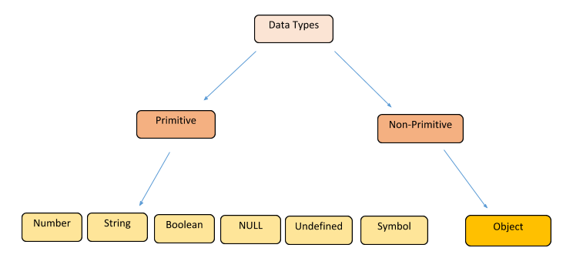
Data Types

Slide 3
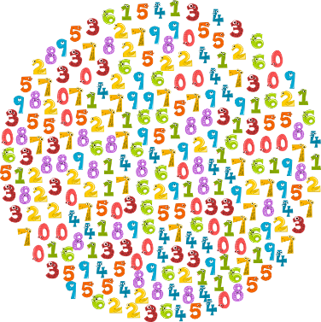



Number
The number type represents both integer and floating point numbers.
Besides regular numbers, there are so-called “special numeric values” which also belong to this data type: Infinity, -Infinity and NaN.
Infinity represents the mathematical Infinity ∞. It is a special value that’s greater than any number.
NaN represents a computational error. It is a result of an incorrect or an undefined mathematical operation.

Slide 4
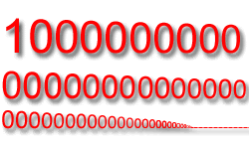
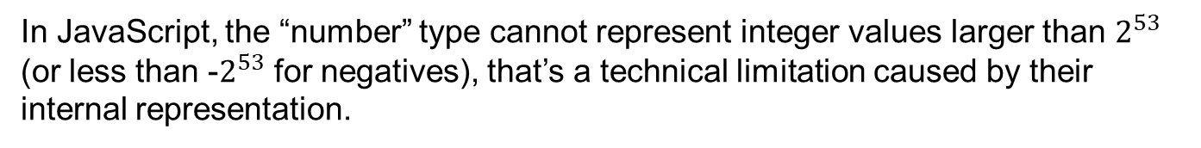
BigInt
In JavaScript, the “number” type cannot represent integer values larger than $2^{53}$ (or less than -$2^{53}$ for negatives), that’s a technical limitation caused by their internal representation.
A BigInt is created by appending n to the end of an integer literal:
*Right now BigInt is supported in Firefox and Chrome, but not in Safari/IE/Edge.

Slide 5
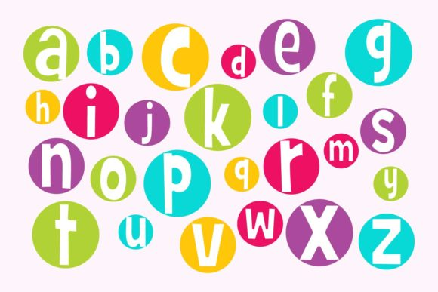

String
A string in JavaScript must be surrounded by quotes.
Backticks are “extended functionality” quotes. They allow us to embed variables and expressions into a string by wrapping them in ${…}

Slide 6


Boolean
The boolean type has only two values: true and false.

Slide 7


The “null” value
The special null value does not belong to any of the types described above.
It forms a separate type of its own which contains only the null value.
In JavaScript, null is not a “reference to a non-existing object” or a “null pointer” like in some other languages.
It’s just a special value which represents “nothing”, “empty” or “value unknown”.

Slide 8

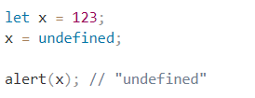

The “undefined” value
The special value undefined also stands apart. It makes a type of its own, just like null.
The meaning of undefined is “value is not assigned”.
If a variable is declared, but not assigned, then its value is undefined.

Slide 9

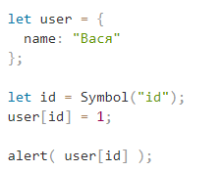
Symbol
The symbol type is used to create unique identifiers for objects.
A value of this type can be created using Symbol():

Slide 10
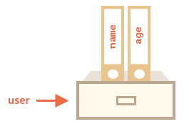

Object
Objects are used to store keyed collections of various data and more complex entities.
An object can be created with figure brackets {…} with an optional list of properties. A property is a “key: value” pair, where key is a string (also called a “property name”), and value can be anything.

Slide 11
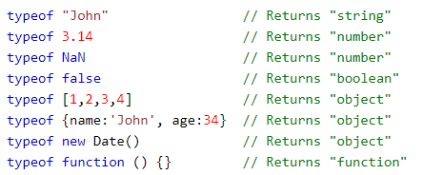
Typeof
You can use the typeof operator to find the data type of a JavaScript variable.
Please observe:
The data type of NaN is number
The data type of an array is object
The data type of a date is object
The data type of null is object

Slide 12


Type conversion
Converting to Strings
The global method String() can convert to strings.
*Method toString() does the same.

Slide 13
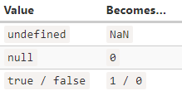



Type conversion
Converting to Numbers
The global method Number() can convert to numbers.

Slide 14



Type conversion
Converting to Booleans
The global method Boolean() can convert to boolean.

Slide 15



Type conversion
Converting to Primitive

Slide 16
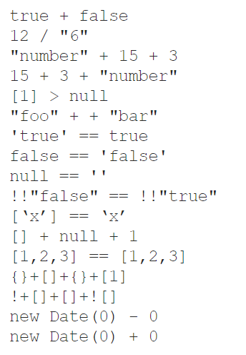
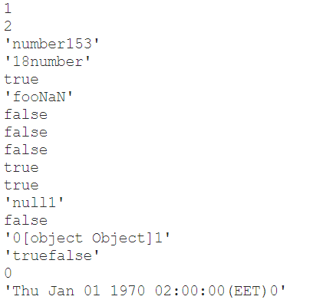
Type coercion
Type coercion is the automatic or implicit conversion of values from one data type to another.

Slide 17

Equality comparisons and sameness
JavaScript provides three different value-comparison operations:
=== - Strict Equality Comparison ("strict equality", "identity", "triple equals")
== - Abstract Equality Comparison ("loose equality", "double equals")
Object.is provides SameValue (new in ES2015).

Slide 18
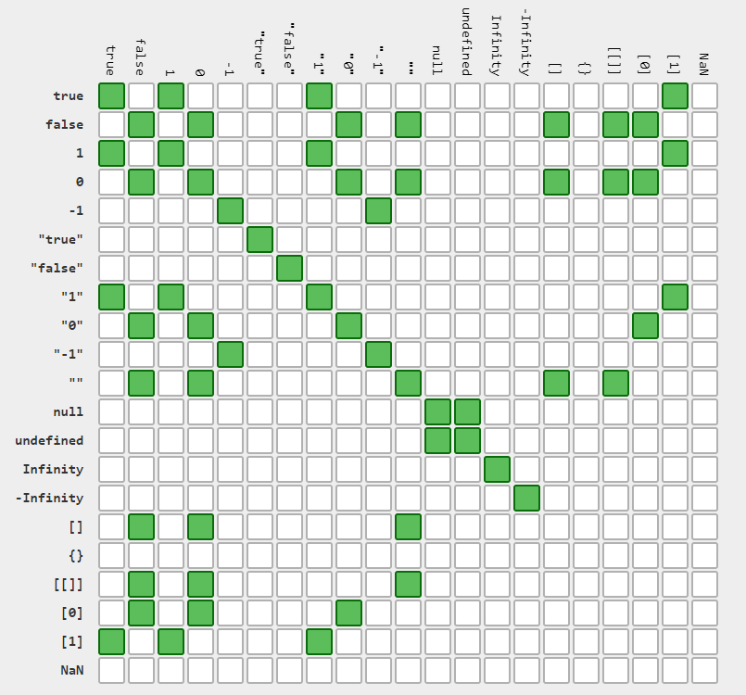


Equality comparisons and sameness
==

Slide 19
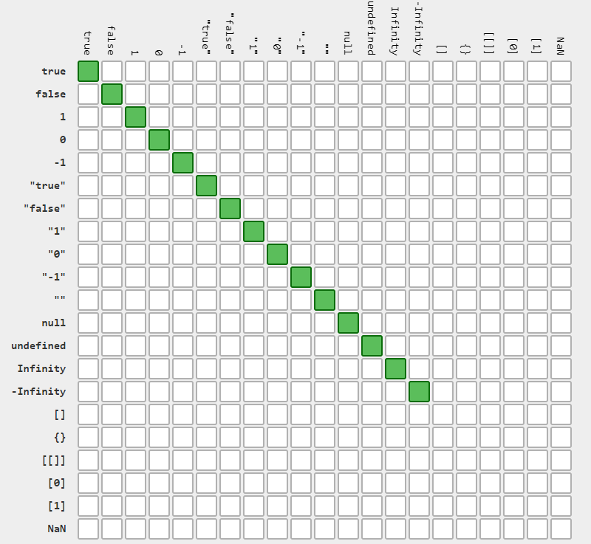
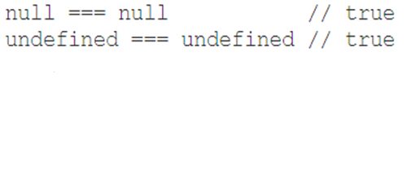
Equality comparisons and sameness
===

Slide 20
References
https://medium.com/@sergeybulavyk/%D0%BF%D1%80%D0%B5%D0%BE%D0%B1%D1%80%D0%B0%D0%B7%D0%BE%D0%B2%D0%B0%D0%BD%D0%B8%D0%B5-%D1%82%D0%B8%D0%BF%D0%BE%D0%B2-%D0%B2-javascript-35a15ddfc333
https://dorey.github.io/JavaScript-Equality-Table/
https://developer.mozilla.org/uk/docs/Web/JavaScript/Reference/Global_Objects/Object/is
https://developer.mozilla.org/en-US/docs/Web/JavaScript/Equality_comparisons_and_sameness

Slide 21


