Slide 1
"When the Floor Speaks, Does the Market Listen?"
Employee Sentiment, Stock Performance, and the Dual-Level Quality Signal
GRA 19701 Master Thesis | 7th Supervision | June 3rd, 2025
Yulin Tian & Ilia Kornietskii Supervisor: Auke Hunneman | BI Norwegian Business School
18,900+
49
11
86
1.9M
Words
References
Figures (main body)
Firms 12 Industries
Reviews Analysed
MSc Data Science for Business | MSc Strategic Marketing Management

Slide 2
The Story We Are Telling
One coherent narrative from question to contribution
ACT 1: The Question
ACT 2: The Surprise
ACT 3: The Contribution
Does employee voice carry information
The answer is YES — but not how
We propose the Dual-Level Model:
that stock markets care about?
you would expect.
Cross-sectional = quality marker
Glassdoor: 1.9M reviews, 86 firms,
Within firms: sentiment peaks PRECEDE
Within-firm = information already priced
12 industries, 7 years (2016–2023)
return underperformance (β = −0.061***)
Employee voice is signal, not noise —
Across firms: positive quality signal
but the market is listening faster
but already priced in by the market
than Glassdoor can report.
“Employee sentiment operates as a structural quality marker, not a shart-term return-generating signal, consistent with an efficient market that has already priced in employee wellbeing.”
This is the thesis statement that runs through all 8 sections.

Slide 3
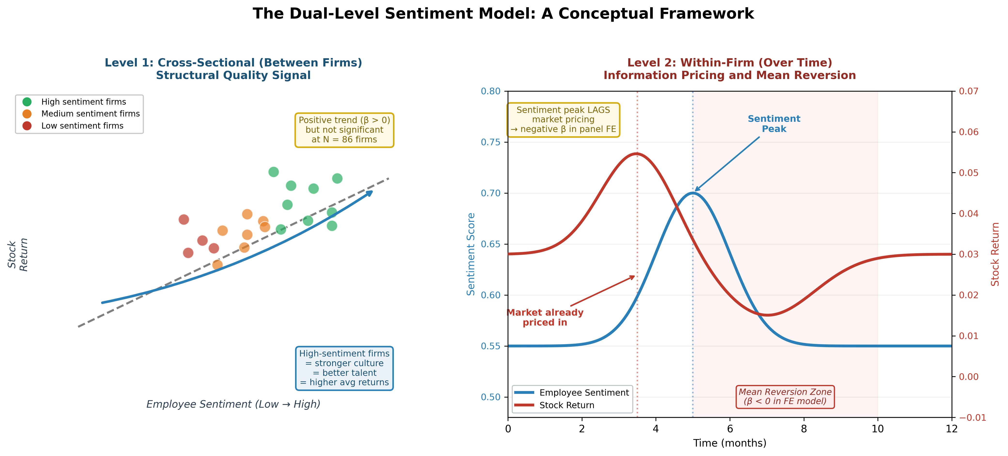
The Dual-Level Sentiment Model
Our original theoretical contribution (Section 2.5)
Figure 1 in the thesis. This framework reconciles the positive cross-sectional and negative within-firm effects into one coherent theory.

Slide 4
Four Hypotheses — Four Dimensions of Employee Voice
Each hypothesis targets a different level of the sentiment–return relationship
Cross-Sectional Quality Premium
H1
Higher sentiment firms → higher average returns
Positive direction, not significant (p = 0.068)
Test: Between estimator, portfolio sort, 3-year OLS
Within-Firm Information Pricing
H2
Sentiment peaks → lower subsequent returns
SUPPORTED: β = −0.061*** (p = 0.001)
Test: Two-Way FE panel regression, horizon analysis
COVID Organisational Resilience
H3
High pre-crisis sentiment → crisis resilience
Suggestive: High ≈ +69% vs Low group (3-yr)
Test: Median split, cumulative return paths, sub-period tests
Topical Content Beyond Scores
H4
Discussion topics vary across industries and firms
SUPPORTED: 11 interpretable topics, strong variation
Test: LDA (K=11), Industry Barometer, divergence analysis
Table 1 and Table 5 in the thesis provide the full hypothesis framework and results.

Slide 5
The Primary Finding: Why the Negative β Is Not Bad News
Section 5.2 — The most important result and its interpretation
What the regression shows:
What it means:
M1 Pooled OLS:
✔ The negative β does NOT mean happy employees hurt stock prices.
✔ It means the market has already priced in employee quality BEFORE the Glassdoor score peaks.
✔ Sentiment peaks are lagging confirmations of good news, not leading indicators of future gains.
✔ The effect strengthens at longer horizons:
1 month: −0.061***
3 months: −0.095*
6 months: −0.153*
→ This rules out noise. It is real mean reversion.
✔ Consistent with the Efficient Market Hypothesis
(Fama, 1970; De Bondt & Thaler, 1985)
β = +0.002 (p = 0.862)
Near zero — opposing effects cancel
M2 Firm FE:
β = −0.047* (p = 0.039)
Within-firm negative effect emerges
M3 Two-Way FE:
β = −0.061*** (p = 0.001)
Primary result — robust and significant
M4 + Text:
β = −0.061** (p = 0.001)
Survives text sentiment control

Slide 6
Thesis Structure: 8 Sections, One Continuous Story
18,900+ words | 49 references | 11 main-body figures | 4 appendices
№
Section
Words
Key Content
1
Introduction
2,000
The puzzle, the gap, four contributions, findings preview
2
Literature Review & Theoretical Framework
3,000
Four literature streams → Dual-Level Sentiment Model
3
Hypotheses
1,200
H1–H4 formally derived from theory (Table 1)
4
Data & Methodology
3,000
Composite index, VADER, panel models M1–M4, LDA (formulas + Table 2–3)
5
Empirical Results
3,400
All hypothesis tests with 9 figures + Tables 4–5
6
Discussion
2,100
Theoretical implications, 3-audience practical implications
7
Limitations & Future Research
1,000
7 limitations including sample size, large-firm bias, language scope, timing lag
8
Conclusion
620
"Employee voice is signal, not noise"
All sections follow APA 7th style. References: 49 sources. Appendices A–D with 34 supplementary figures.

Slide 7
Why This Story Is Potentially Publishable
Four contributions that differentiate our thesis from existing work
Novel Measurement
1
Composite Sentiment Index
First study to synthesise structured ratings, categorical signals, and NLP text sentiment from Glassdoor into a single composite measure. Two-tier architecture (60% core / 40% sub-ratings) with PCA validation.
Counterintuitive Finding
2
Negative Within-Firm β as Market Efficiency
First panel-based evidence that within-firm sentiment peaks PRECEDE return underperformance. We don’t claim sentiment hurts firms — we show the market is faster than Glassdoor. Novel interpretation.
Integrated Two-Strand Design
3
"Feel" + "Say" in One Study
Most studies do sentiment OR topic modelling. We do both and BRIDGE them. The Industry Barometer and Firm Competitor Analysis connect text content to financial outcomes — a methodological template for future research.
Natural Experiment
4
COVID-19 Resilience
Exploiting the pandemic as an exogenous shock, we show high-sentiment firms recovered faster. Economically meaningful even if statistically suggestive. Consistent with Lins et al. (2017) social-capital-as-insurance framework.

Slide 8
Submission Readiness: Status and Next Steps
Where we are and what remains before June 15th
✔ What we have COMPLETED
▶ REMAINING BEFORE SUBMISSION
✔ Full thesis written: 18,900+ words, 8 sections
✔ 49 APA 7th references from published sources
✔ 11 publication-quality figures in main body
✔ 43 supplementary figures in Appendices A–D
✔ 5 tables (hypotheses, data summary, variables, regression, results)
✔ All numerical values verified against notebook outputs
✔ Dual-Level Sentiment Model: original theoretical framework
✔ Topic modelling with Industry Barometer and Firm Analysis
✔ COVID natural experiment as resilience test
✔ Abstract with 8 keywords
✔ Cover page with thesis title
✔ 5 Jupyter notebooks (reproducible, ready for GitHub)
▶ Supervisor feedback on today’s presentation
▶ Final proofreading and formatting check
▶ Push notebooks and data to GitHub ✔
▶ Add GitHub link to Appendix D ✔
▶ Submit by June 15th
TIMELINE
June 3rd
7th Supervision (today)
June 4–8
Incorporate feedback, final edits
June 9–10
Proofreading, GitHub push /Review
June 11–12
Format check, final review
June 15th
SUBMISSION DEADLINE

Slide 9
Hartelijk Dank !!!
voor uw begeleiding, feedback en vertrouwen
Auke Hunneman
Supervisor | BI Norwegian Business School
Yulin Tian & Ilia Kornietskii
MSc Data Science for Business | MSc Strategic Marketing Management
"What employees feel and say matters — not because it predicts next month’s stock return, but because it reveals the quality of the organisation beneath the financial statements."

