Slide 1
Books API Coursework
A RESTful API for Book Information
STUDENT NAME
MODULE DETAILS
SUBMISSION DATE
[Lu Yulin]
XJCO3011 Web Services & Web Data
[2026/4/27]
Notes:
Good morning/afternoon. My name is [Your Name], and today I'll be presenting my coursework project for the XJCO3011 module. The project is a RESTful API for managing book information, built using FastAPI and SQLite. Let's get started.

Slide 2






Problem & Goal
Problem
Lack of a simple, unified API to access and manage structured book data.
Goal
Create a robust, scalable, and easy-to-use RESTful API for book information.
Core Functionality
Enable full CRUD (Create, Read, Update, Delete) operations on a book database.
Advanced Features
RESTful API
Provide powerful filtering, full-text searching, and data statistical analysis capabilities.
BOOK DATA MANAGEMENT
User Experience:Ensure clear API documentation and consistent, meaningful JSON responses.
Notes:
The primary problem I aimed to solve was the lack of a simple, unified API for accessing structured book data. Therefore, my goal was to create a robust and scalable RESTful API that not only allows basic CRUD operations but also provides advanced features like filtering and statistics, while ensuring a good developer experience.

Slide 3




Dataset: Goodreads Books
Data Source
Core Attributes
A public dataset sourced from Kaggle, which was originally scraped from the official Goodreads API, ensuring the authenticity and breadth of the collected information.
Rich book metadata including: Book Title, Author Names, Average User Rating, Total Ratings Count, and Original Publication Date.
Volume & Scale
Preprocessing Workflow
Contains approximately 11,000 unique rows of book data. This sample size provides a solid foundation for analysis across diverse genres and publication years.
• Converted numerical ratings from strings to float types • Handled missing values with context-aware defaults • Removed duplicate entries using ISBN as a unique key • Standardized all date fields to a consistent ISO format
Notes:
The foundation of this project is the Goodreads books dataset from Kaggle, containing about 11,000 book entries. I performed several cleaning steps, including type conversion, handling missing values, and removing duplicates, to ensure the data was reliable and ready for use in the API.

Slide 4



Technology Stack & Rationale
FastAPI Framework
SQLite & SQLAlchemy
Pydantic Validation
WHY WE CHOSE IT
WHY WE CHOSE IT
WHY WE CHOSE IT
A modern, high-performance Python 3.7+ web framework that natively supports asynchronous programming, making it ideal for I/O bound tasks.
SQLite is a lightweight, file-based RDBMS perfect for development. Paired with SQLAlchemy, it provides a powerful abstraction layer over raw SQL.
The de facto data validation library for FastAPI. It enforces type hints at runtime and is used to define strict request/response data models.
KEY BENEFITS
KEY BENEFITS
KEY BENEFITS
Comes with auto-generated Swagger UI for interactive docs; features intuitive dependency injection and near NodeJS/Go performance.
ORM simplifies CRUD operations and ensures database-agnostic code. No server setup required for SQLite, streamlining the development workflow.
Eliminates invalid data at the API boundary; offers automatic data conversion and clear, maintainable schema definitions for the application.
Notes:
For the tech stack, I chose FastAPI for its speed and automatic documentation features. SQLite was the perfect database choice for this coursework due to its simplicity and ease of setup. Finally, Pydantic was used for robust data validation, ensuring the API receives and returns data in the correct format.

Slide 5







System Architecture
HTTP Requests
Client Interaction Entry Point
Modular Structure
Strict division intoroutes/(endpoints),services/(logic),models/(entities), andschemas/(validation) for organized codebase.
API Routes (routes/)
Maps Endpoints & Directs Logic
Separation of Concerns
Clear isolation between HTTP request handling, core business logic execution, and database data access operations.
Service Layer (services/)
Core Business Logic Implementation
Scalability & Maintainability
The layered architecture pattern minimizes code coupling, making the application easy to extend with new features and maintain over time.
🗄️ DB (SQLAlchemy) | 📐 Schemas (Pydantic Validation)
Notes:
The API follows a clean, layered architecture. Incoming requests hit the route handlers, which then call the service layer for business logic. The service layer interacts with the database via SQLAlchemy models. This separation of concerns ensures the application is maintainable and scalable.

Slide 6
Database Model: Book Entity
id/ INT (Integer)
ratings_count/ INT (Integer)
PRIMARY KEY
Total number of user ratings
title/ VARCHAR (255)
publication_date/ DATE
CORE ENTITY
INDEXED
Format: YYYY-MM-DD
books
authors/ VARCHAR (255)
publisher/ VARCHAR (255)
Stores author names separated by commas
Name of the publishing company
Relational Database Schema
average_rating/ FLOAT
isbn/ VARCHAR (20)
INDEXED
International Standard Book Number
Notes:
The core database model is the 'Book' entity. It includes essential fields like title, authors, and average rating. I've also added database indexes on the 'title' and 'average_rating' columns to significantly improve the performance of search and sort operations.

Slide 7


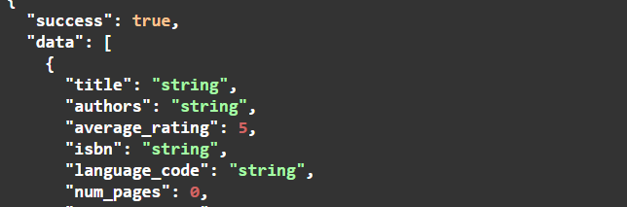


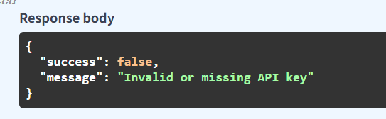

Core API: CRUD Operations
CREATE OPERATION
Unified JSON Response Format
POST /books
Add a new book to the collection. Response: 201 Created
READ (COLLECTION)
✅ SUCCESS (2xx Status)
GET /books
Retrieve paginated list of all books. Response: 200 OK
READ (SINGLE)
GET /books/{id}
Fetch a specific book by its ID. Response: 200 OK
❌ ERROR (4xx / 5xx Status)
UPDATE OPERATION
PUT /books/{id}
Modify an existing book's details. Response: 200 OK
DELETE OPERATION
DELETE /books/{id}
Notes:
The API implements all core CRUD operations. Each endpoint returns a consistent JSON response format, making it easy for clients to handle both successful and error cases. For example, creating a book returns a 201 status code, while a successful update returns 200.

Slide 8

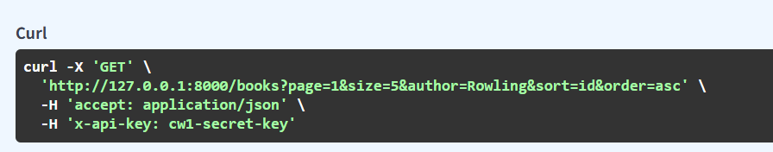

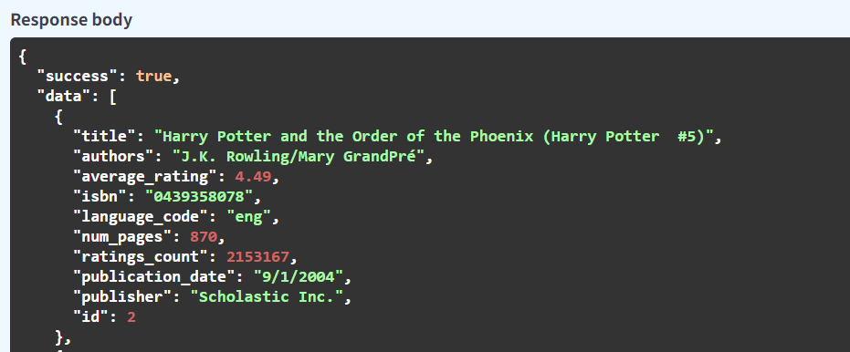

V3 Features: Advanced Querying
Pagination
Example API Request
Use `page` and `size` parameters to limit result sets and navigate through large data volumes.
Filtering
Precisely narrow down results using field-specific filters (e.g., by author, publisher, or publication date).
Standardized JSON Response
Sorting
Control result order with `sort` (field name) and `order` (asc/desc) parameters for optimal presentation.
Unified Response Schema
Standardized list responses include `total`, `page`, and `size` metadata for consistent client-side handling.
Notes:
Building on the core CRUD, version 3 introduced advanced querying capabilities. Users can now paginate results, filter by author, and sort by fields like average rating. The list response is also enriched with metadata like total items and current page number for a better client experience.

Slide 9



V4 Features: Polish & Performance
Full-Text Search
Analytics & Statistics
GET /books?search=harry
GET /stats/average-rating
Enable efficient full-text search capabilities across book titles for quick and relevant content retrieval.
Calculate overall platform insights such as average book ratings to drive data-informed decisions.
API Security Layer
Request Logging
Auth via x-api-key Header
Middleware: Path, Status, Duration
Secure all endpoints with robust API key authentication to ensure only authorized users can access data.
Monitor system health with comprehensive logs capturing every request's path, status code, and response time.
Notes:
Version 4 focused on polishing the API and improving performance. This included adding a search endpoint, statistical endpoints for insights like average rating, API key security to protect the API, and comprehensive logging to monitor usage and performance.

Slide 10





Testing Strategy
Swagger UI
Manual Test Guide
A built-in interactive tool for manual validation of all API endpoints, enabling real-time request/response testing.
Comprehensive documentation of step-by-step test cases for key business scenarios, ensuring reproducibility.
Core Test Cases Coverage
Authentication Failure
Input Validation Errors
Resource Not Found
Full CRUD Lifecycle
Verified 401 Unauthorized response for requests with invalid or missing API keys.
Validated 400 Bad Request handling for malformed JSON payloads and invalid data types.
Tested 404 Not Found responses when accessing endpoints with non-existent book IDs.
End-to-end verification of Create, Read, Update, and Delete data flows.
Notes:
Testing was a crucial part of development. I primarily used the built-in Swagger UI for interactive testing. I also documented a manual test guide covering key scenarios, including authentication failures, validation errors, and the complete CRUD lifecycle to ensure the API's reliability.

Slide 11




Version Control: Iterative Development
V1
MVP Phase
V2
Refinement
V3
Advanced Query
V4
Polish & Scale
Core Foundation
Robustness & Safety
Data Manipulation
Optimization & Audit
Established the basic project structure, defined the initial database schema model, and implemented the core CRUD API endpoints for data manipulation.
Significantly improved API reliability by adding comprehensive error handling logic, standardized HTTP status codes, and strict input validation for all requests.
Implemented essential data management features including result pagination, dynamic filtering capabilities, and multi-criteria sorting to handle large datasets efficiently.
Added full-text search, usage statistics, API key authentication, comprehensive logging, and database indexes for optimal performance and security.
Notes:
The project was developed iteratively, with clear version control. Starting from a basic MVP in V1, I progressively added features in V2, V3, and V4. This approach allowed me to build a solid foundation and incrementally add complexity while maintaining a clean commit history on GitHub.

Slide 12




Deliverables
GitHub Repository
API Documentation
Contains all source code and a detailed README file for reference.
A comprehensive PDF document outlining all endpoints, parameters, and responses.
Technical Report
How to Run Guide
Detailed analysis of the system architecture, technical challenges, and AI model usage.
Step-by-step setup instructions in the README for local execution and testing.
Thank You & Q&A
Notes:
To conclude, the project includes several key deliverables: a public GitHub repository with all code, comprehensive API documentation in PDF, a detailed technical report, and clear instructions on how to run the API. Thank you for your time. I'm now ready to answer any questions.

