Slide 1
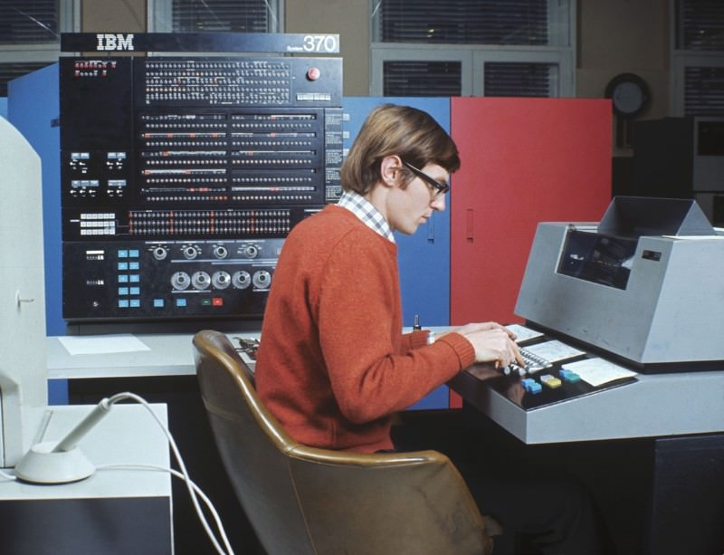
Developing Quantum Programming Software
Jin-Long Huang(黄金龙)
Supervised by Professor Man-Hong Yung(翁文康)
For the Fulfillment of National Training Program of Innovation and
Entrepreneurship for Undergraduates.
(国家级大学生创新创业训练计划)
Southern University of Science and Technology
September 21, 2017

Slide 2
Outline
Quantum Programming Compiler: Quipper
Quantum Computer Architecture
Introduction to Quipper
Elementary Quantum Algorithms in Quipper
Quantum SVM to Recognize Handwritten 6 and 9
Classical SVM
Quantum SVM
Characterization of 6 an 9
Quantum Supremacy: Boson Sampling

Slide 3
Why Quantum Software?
Quantum Algorithms:
Quantum Fourier Transform
Shor’s Algorithm
Eigenvalues Estimation
Grover’s Algorithm
HHL
Quantum SVM
Quantum Reinforcement Learning
…
Experimental Realization:
Superconducting
Ion Trap
NMR
Cavity QED
Optical
Topological
Diamond-based
…
How can we test the performance of quantum algorithms in real situation?
What can we do when we have 100/1000 qubits?
How to design a quantum computer architecture for best performance?
…

Slide 4
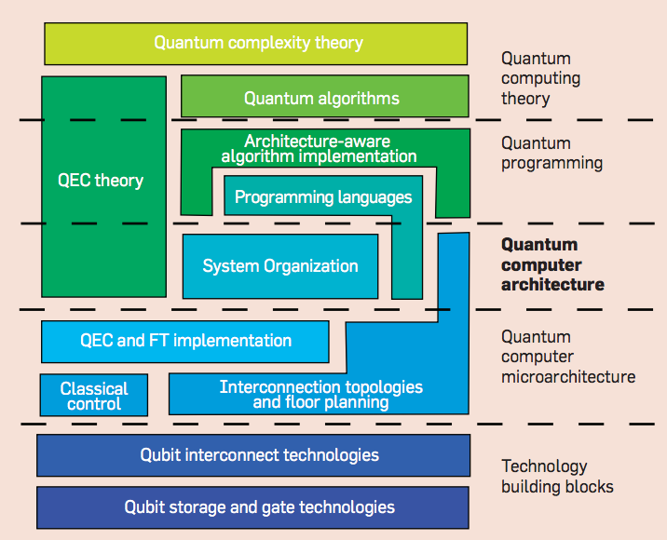
Quantum Computer Architecture
A Blueprint
Van Meter, Rodney, and Clare Horsman. "A blueprint for building a quantum computer." Communications of the ACM 56.10 (2013): 84-93.

Slide 5
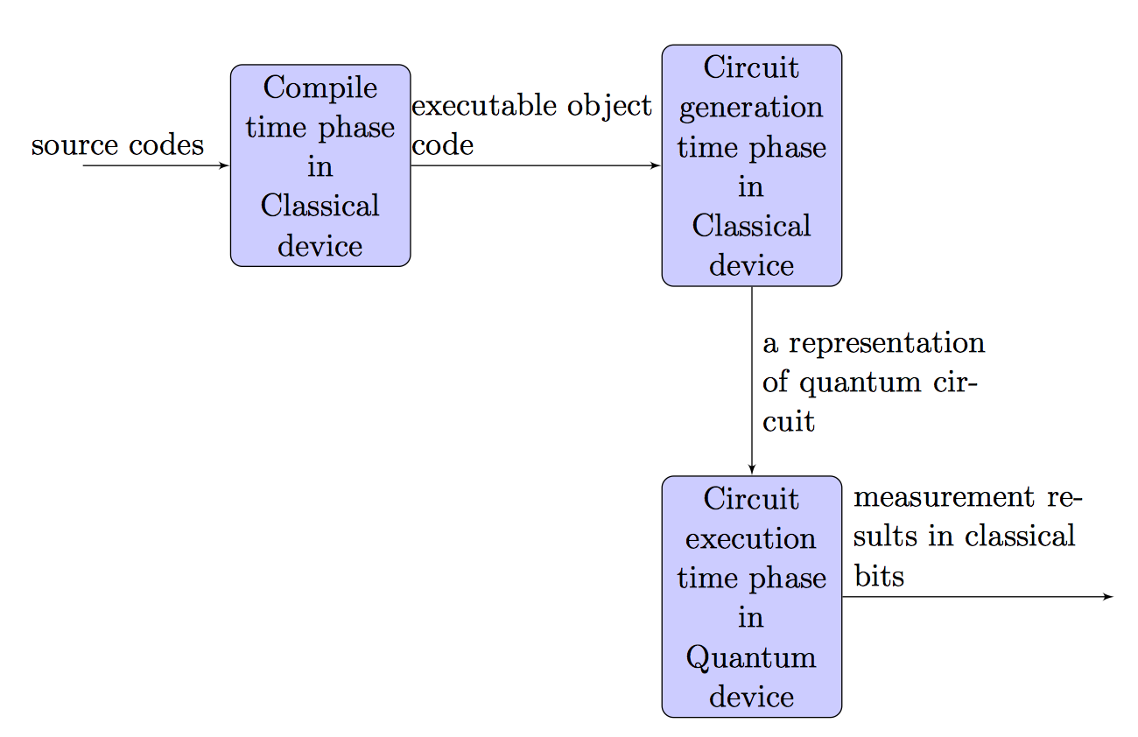
Introduction to Quipper
A unified general-purpose programming framework for quantum computation.
Quantum version of Java — A high-level circuit description language. Module.
Compiled to single qubit gates and two qubits gates. Optimized. Reverse.
Generate quantum circuits and simulate on classical back-ends.
Analysis cost of resource of quantum algorithms.
Embedded on Haskell, a pure functional classical programming language.
Siddiqui, Safat, Mohammed Jahirul Islam, and Omar Shehab. "Five Quantum Algorithms Using Quipper." arXiv preprint arXiv:1406.4481 (2014).

Slide 6
Elementary Quantum Algorithms in Quipper
Hello Quantum World
Entanglement Generation
Deutsch algorithm
Deutsch-Jozsa algorithm
Grover’s Search
Linear Combination of Unitary

Slide 7
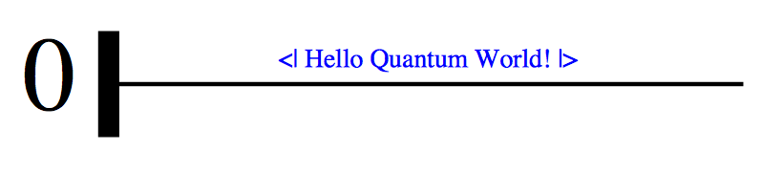
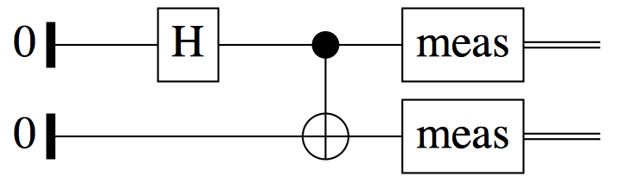
Elementary Quantum Algorithms in Quipper
Hello Quantum World
import Quipper
hello_quantum_world :: Bool -> Circ Qubit
hello_quantum_world var = do
qbit <- qinit var
label (qbit) ("<| Hello Quantum World! |>")
return qbit
main = print_simple Preview (hello_quantum_world False)
Entanglement Generation
➜ myQuipper ./entanglement
(True,True)
(False,False)
(True,True)
(False,False)
(False,False)
(False,False)
(False,False)
(True,True)
(True,True)
(False,False)

Slide 8
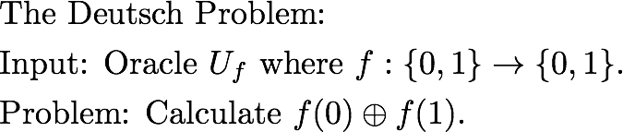
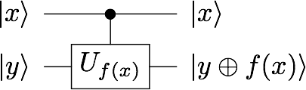
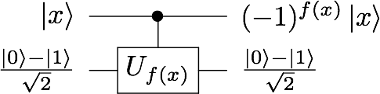

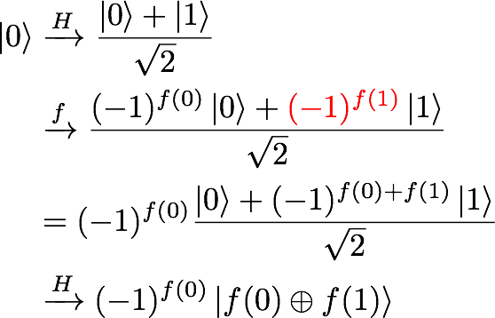
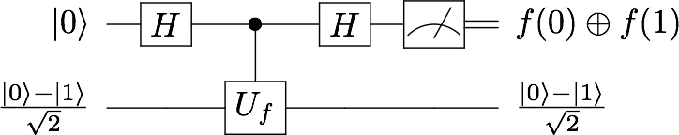
Elementary Quantum Algorithms in Quipper
Classical: 2 queries
Oracle:
Phase Kick-Back:
Deutsch Algorithm:
The first qubit:
Quantum: 1 query

Slide 9
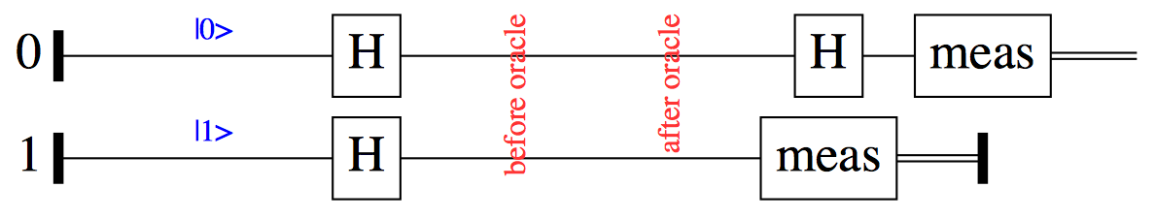
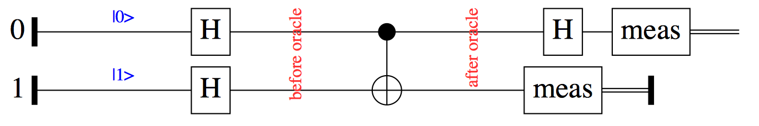
Elementary Quantum Algorithms in Quipper
Deutsch algorithm
-- | initialize oracle function f(x)
constant_oracle_function_1 :: (Qubit, Qubit) -> Circ (Qubit, Qubit)
constant_oracle_function_1 (x, y) = do
-- f(0) = 0; f(1) = 0
return (x, y)
-- | initialize oracle function f(x)
balanced_oracle_function_1 :: (Qubit, Qubit) -> Circ (Qubit, Qubit)
balanced_oracle_function_1 (x, y) = do
-- f(0) = 1; f(1) = 0
qnot_at y `controlled` x
return (x, y)
Constant Oracle
Balanced Oracle
➜ myQuipper ./deutsch
Given oracle is Constant.
Given oracle is Constant.
Given oracle is Balanced.
Given oracle is Balanced.

Slide 10
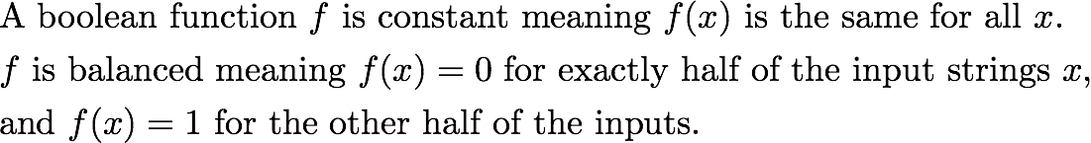
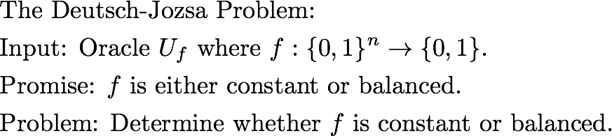
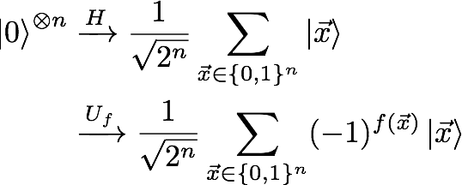
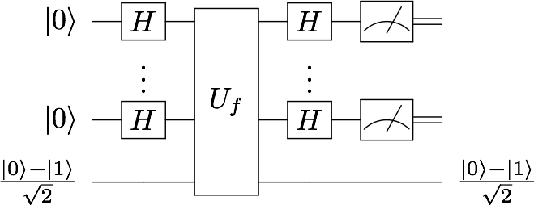
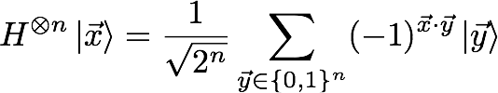
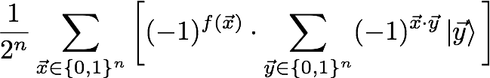
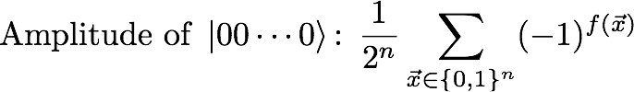


Elementary Quantum Algorithms in Quipper
First n qubits:

Slide 11
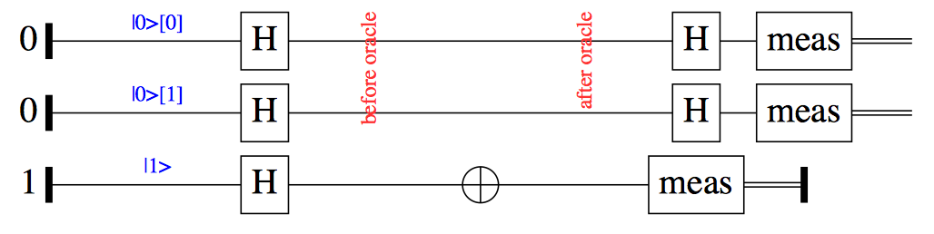
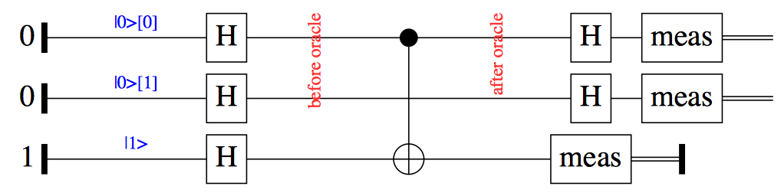
Elementary Quantum Algorithms in Quipper
Deutsch-Jozsa algorithm
Constant Oracle
Balanced Oracle
➜ myQuipper ./deutsch_jozsa
Given oracle is Constant.
Given oracle is Constant.
Given oracle is Balanced.
Given oracle is Balanced.
Given oracle is Balanced.
Given oracle is Balanced.
Given oracle is Balanced.
Given oracle is Balanced.

Slide 12
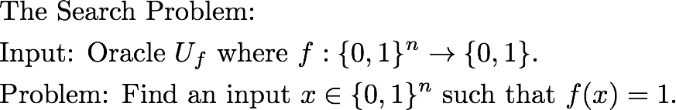
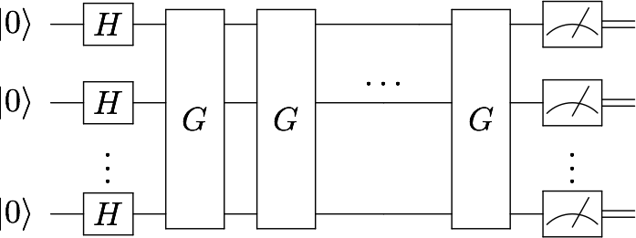
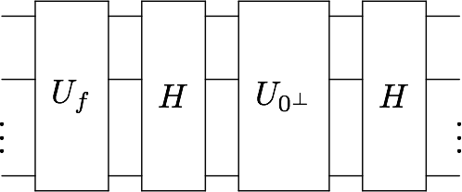
Elementary Quantum Algorithms in Quipper
The Grover Search Circuit:
Where G is the Grover iterator:

Slide 13
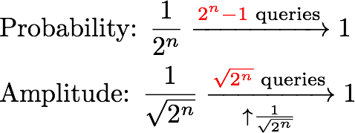
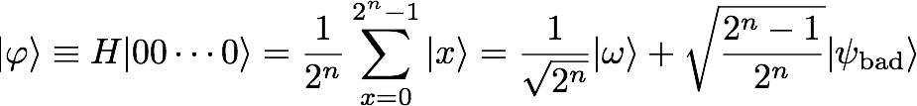
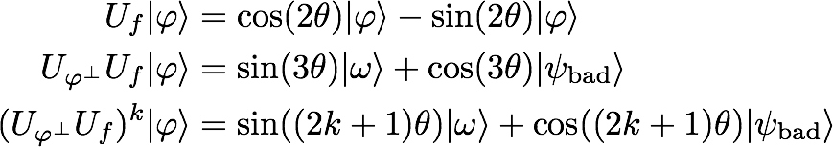

Elementary Quantum Algorithms in Quipper
Grover’s Search

Slide 14
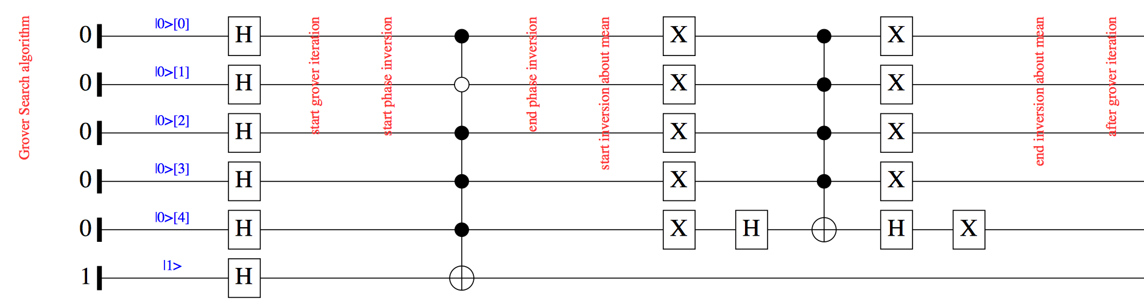
Elementary Quantum Algorithms in Quipper
Grover’s Search
-- | initialize n_qubit_oracle’s function
n_qubit_oracle_function :: ([Qubit],Qubit) -> Circ ([Qubit],Qubit)
n_qubit_oracle_function (controlled_qubit, target_qubit) = do
qnot_at target_qubit `controlled` controlled_qubit .==. [1,0,1,1,1]
return (controlled_qubit, target_qubit)
➜ myQuipper ./grovers_search
[True,False,True,True,True]

Slide 15
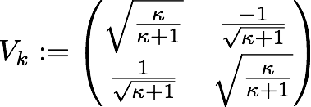
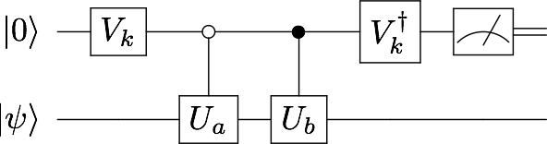
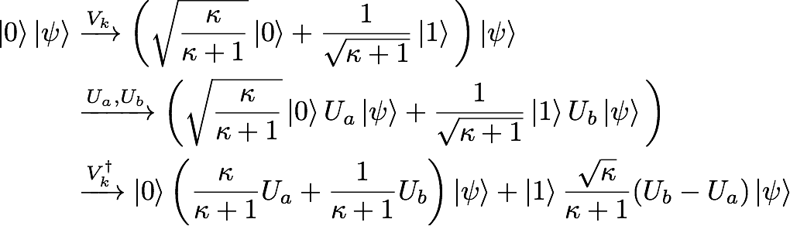

Elementary Quantum Algorithms in Quipper
Linear Combination of Unitary Algorithm
The probability of failure:

Slide 16
Elementary Quantum Algorithms in Quipper
Linear Combination of Unitary Algorithm
-- | define the first Vk gate
linear_combination_circuit :: IO ()
linear_combination_circuit = do
-- get a random number
g1 <- newStdGen
let circ1 = approximate_synthesis_u2 True prec op1 g1
-- call linear_combination_circuit2
linear_combination_circuit2
-- print the circuit for Vk1 in pdf
print_simple Preview circ1
where
prec = 10 * digits
op1 = matrix2x2 (0.9486832980505138, -0.3162277660168379)
(0.3162277660168379, 0.9486832980505138)
Decomposition of Vk gate:
···

Slide 17
Quantum SVM to Recognize Handwritten 6 and 9
Classical SVM
Basic Model
Kernel Function
Least Square SVM
Quantum SVM
Quantum Fourier Transform(QFT)
Eigenvalues Estimation
Controlled-Rotation
SWAP_Test
Non-sparse Matrix Exponentiation
Characterization of 6 an 9

Slide 18
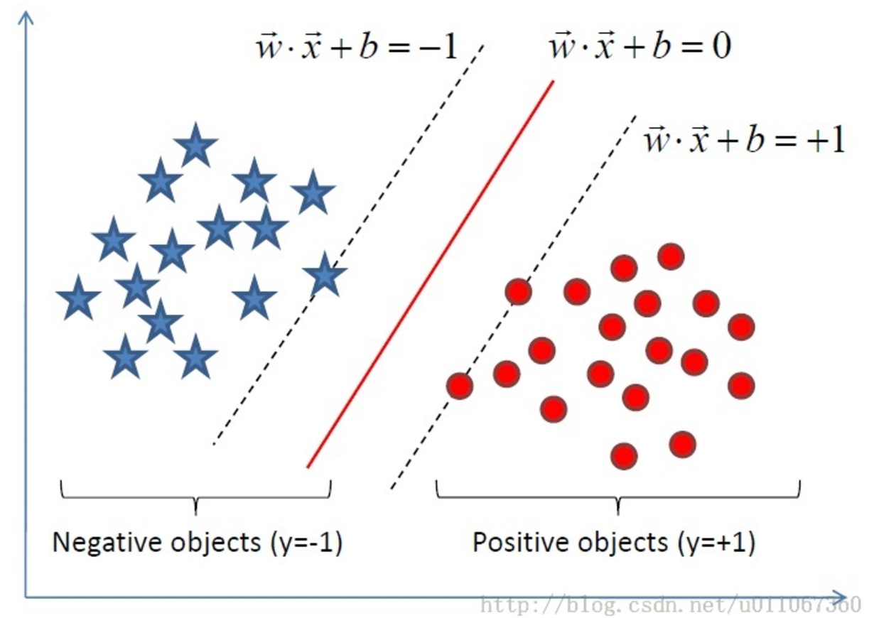

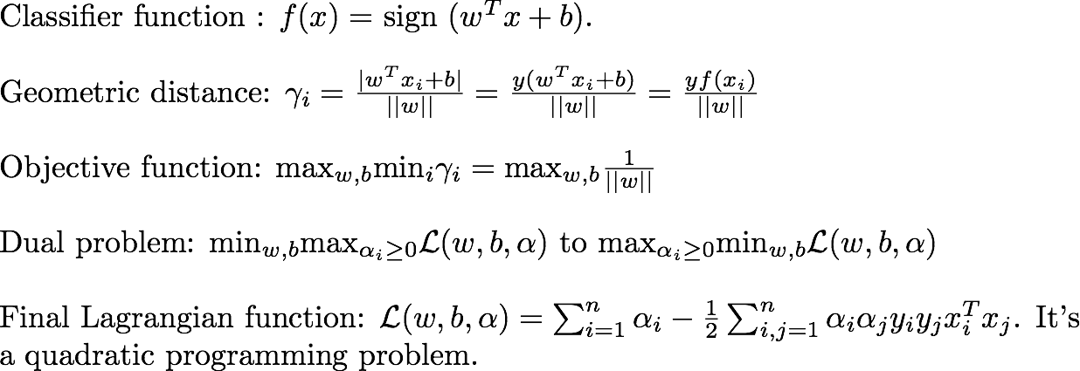
Classical SVM
Basic Model:
Andrew NG, Lecture notes, Support Vector Machines.

Slide 19
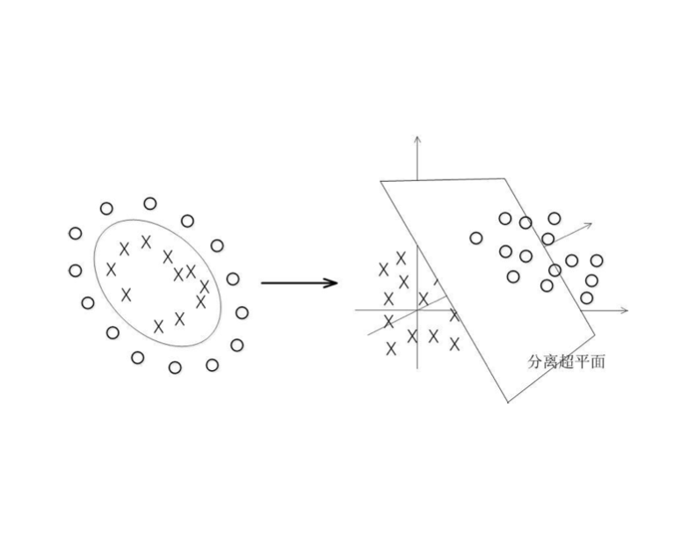
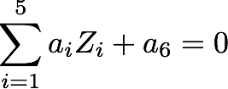
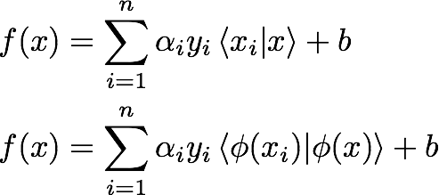
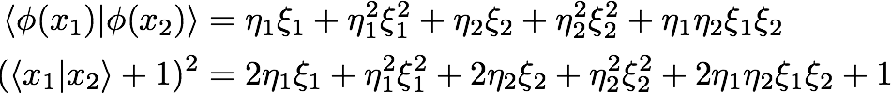

Classical SVM
Kernel:
Objective Function:
Let:
We can see that:
Kernel Function:

Slide 20
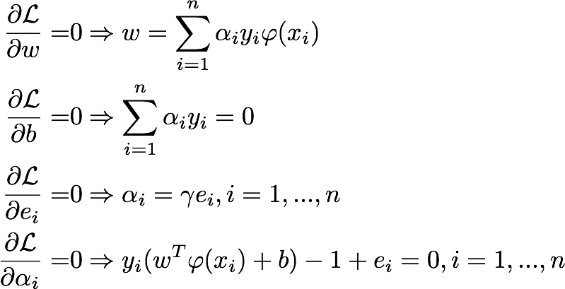

Classical SVM
Least Square SVM:
Constrains:
Which is equivalent to:
Suykens, Johan AK, and Joos Vandewalle. "Least squares support vector machine classifiers." Neural processing letters 9.3 (1999): 293-300.

Slide 21
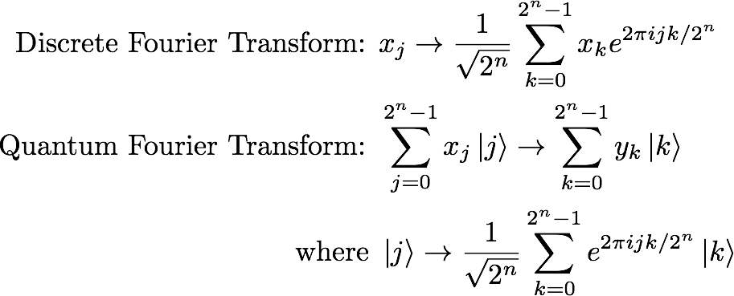


Quantum SVM
Quantum Fourier Transform(QFT):

Slide 22
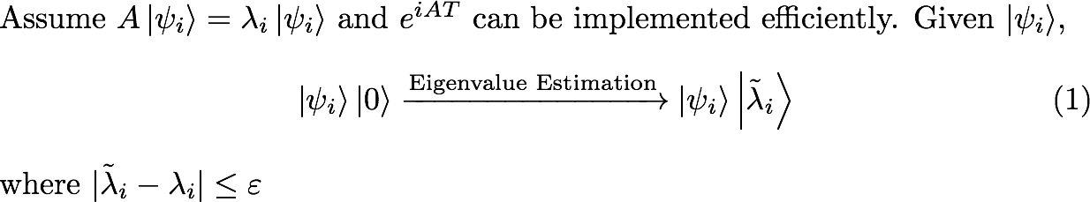
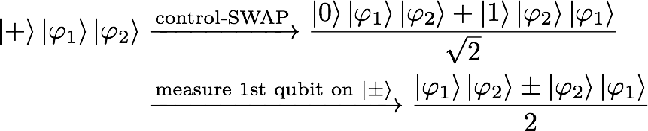

Quantum SVM
Eigenvalues Estimation:
SWAP-test:

Slide 23
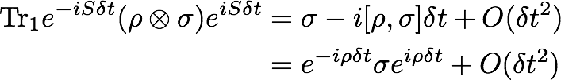

Quantum SVM
Controlled-Rotation:
which can be generalized to
Non-sparse Matrix Exponentiation:

Slide 24
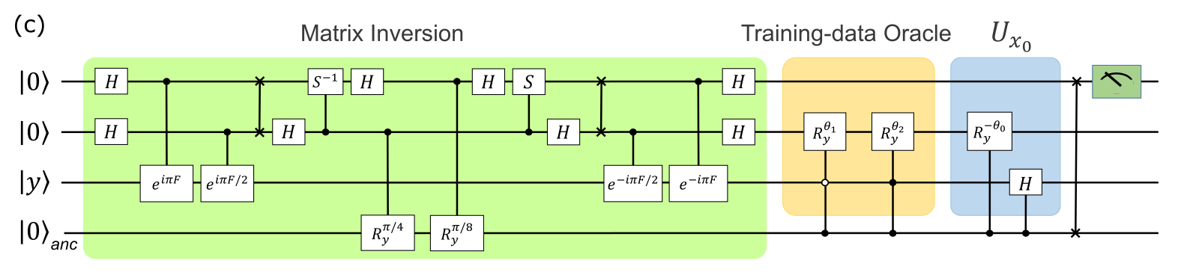


Characterization of 6 an 9
Li, Zhaokai, et al. "Experimental realization of a quantum support vector machine." Physical review letters 114.14 (2015): 140504.

Slide 25
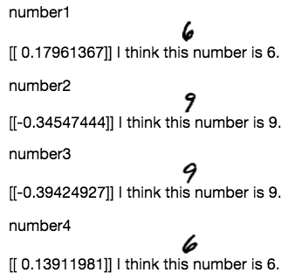
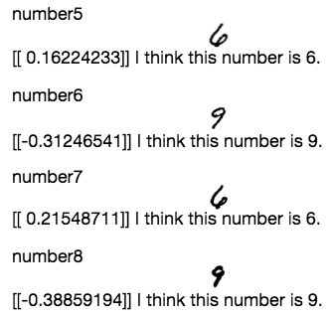
Characterization of 6 an 9
Demonstration of Results:
If the number is positive, the machine recognizes it as 6, otherwise 9.
The first quantum machine learning program targeting computer vision task, at least to our knowledge.
https://github.com/JinlongHuang/quantum-SVM

Slide 26
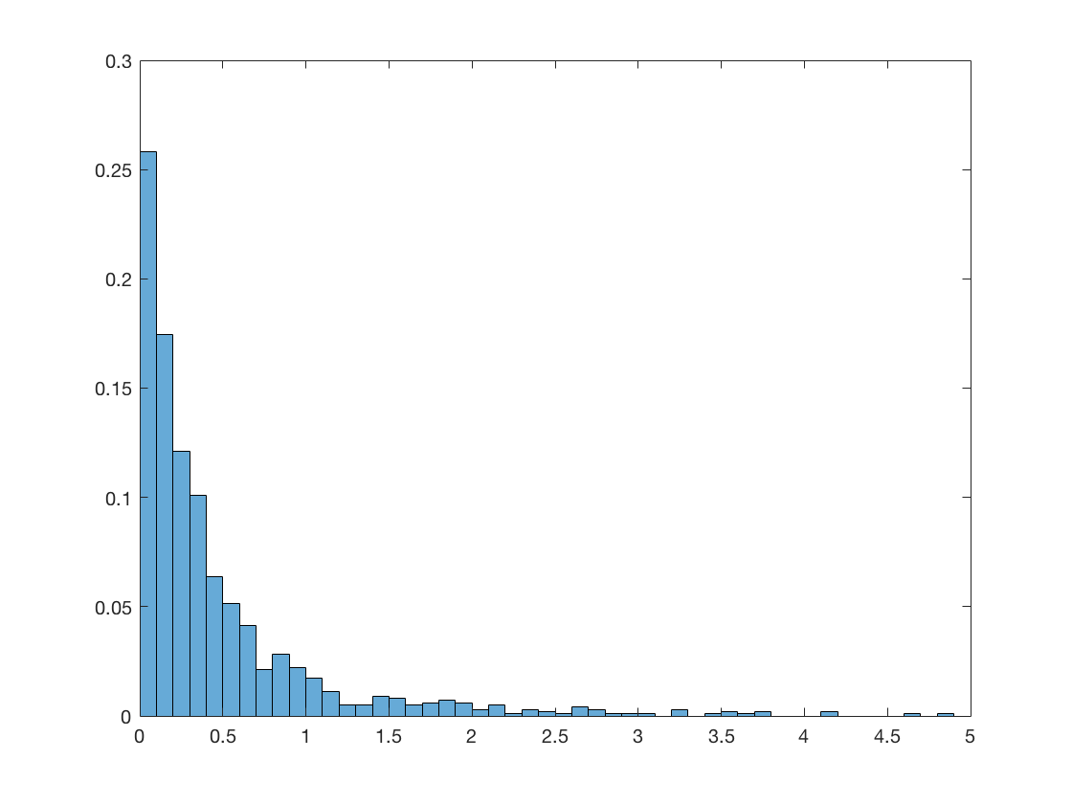
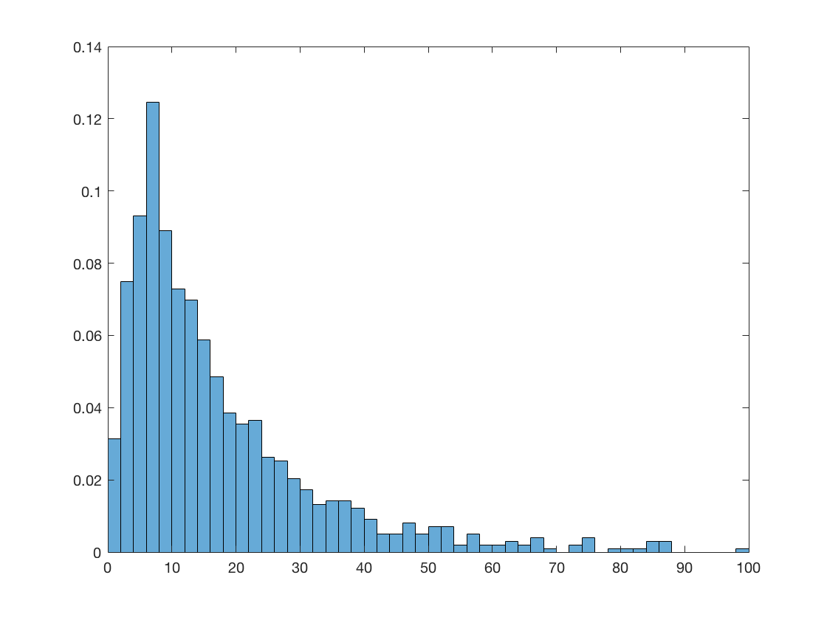
Quantum Supremacy: Boson Sampling
Boson Sampling 16 photons
Glynn’s Algorithm
Gaussian Matrix 20x20
Gurvits’s Algorithm

Slide 27
Thank You.
Q & A?

