Slide 1
GitMe
James Gormley
Yuli Liu
Kirtan Patel

Slide 2
Goal Audience
Provide a user oriented experience for GitHub project management.
GitHub users with multiple accounts
Users of GitHub that owns multiple repositories
Users of GitHub that collaborate on multiple projects (open-source project)
Notes:
The goal for this application is to provide a more user oriented experience for GitHub project management. Currently, GitHub structures their application centered on projects. For example, users have to navigate into a specific repository to view commits, merges, updates for that repo, there is not a easy way for user to view those information about all of their repositories from a more centralized location.
The intended audience for GitMe are users of GitHub, specifically those that owns multiple github accounts and contributes to multiple repositories.

Slide 3
Intended Functionality
News Feed
Comments
Filters
Issues Update
Merges
Pull Requests
Calendar
Personal Velocity/Burndown Chart
Follower and Following list
Handle Multiple GitHub Accounts Concurrently
Notes:
The intended functionality for the application are

Slide 4
Design
Front End: Angular 5
Back End: REST API using Flask
Database: MySQL hosted using AWS

Slide 5
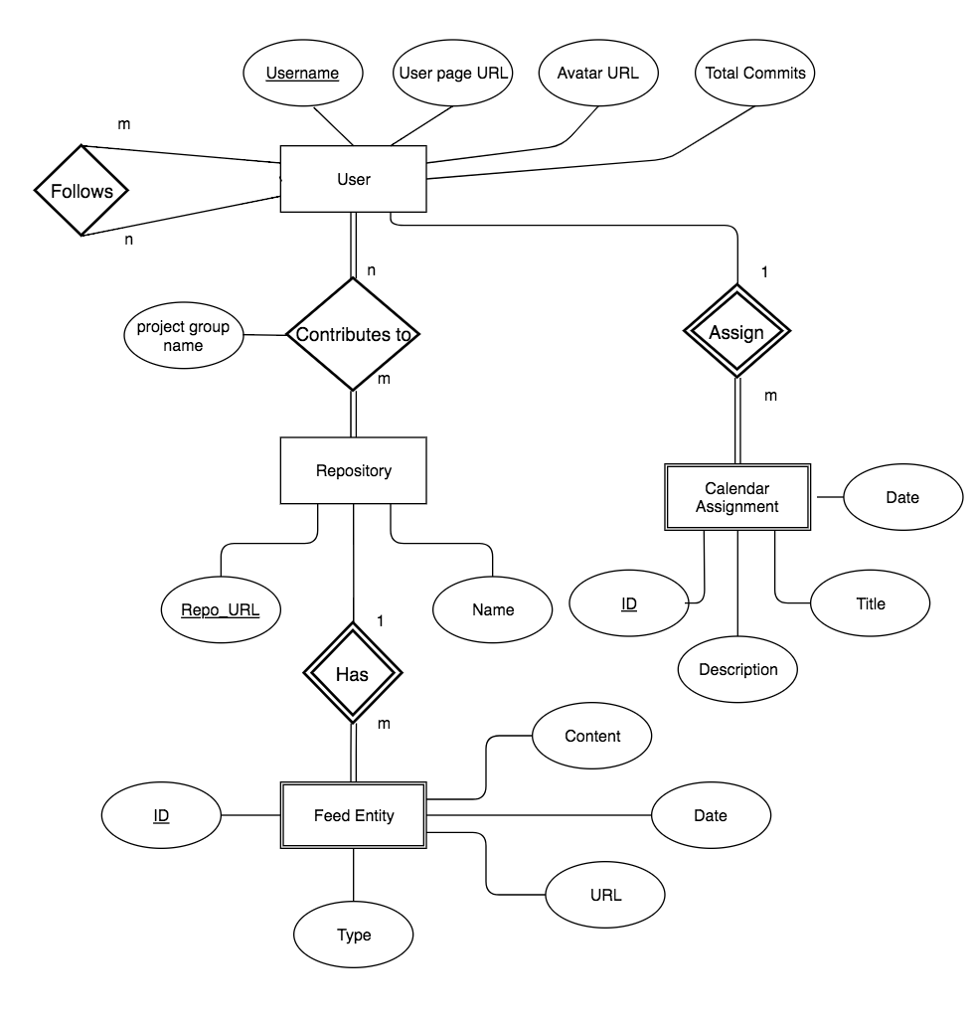
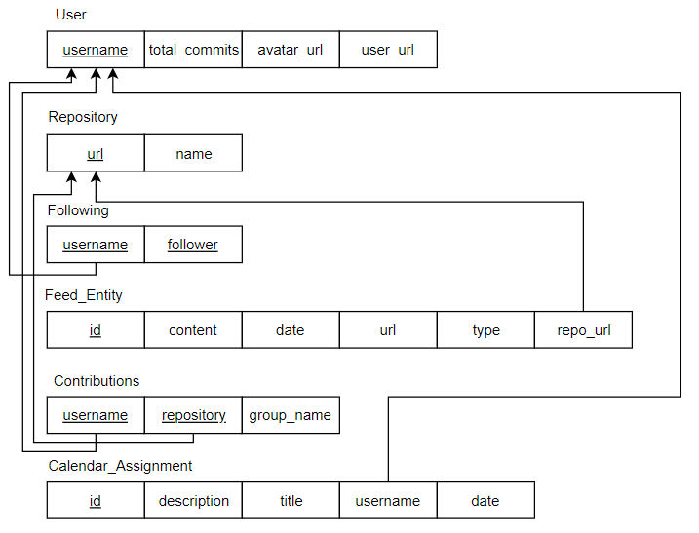
Notes:
Strong Entities: User, Repository
Utilize Calendar Assignments to populate the front End Calendar
Feed Entity populates a user’s feed

Slide 6
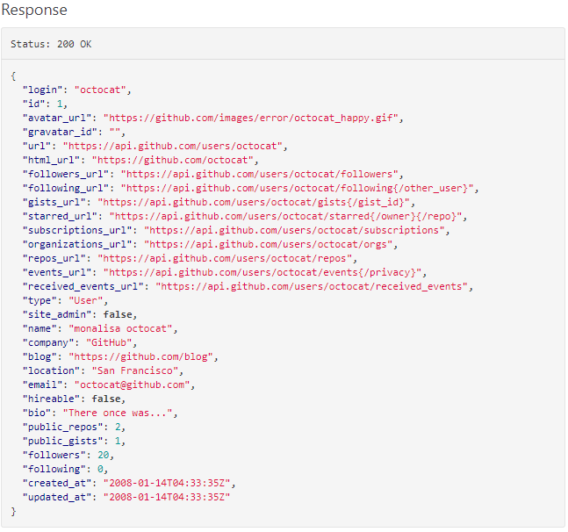
Public Databases
GitHub’s REST API: https://developer.github.com/v3/
Notes:
GitHub has an incredible amount of information. We hardly scratched the surface.

Slide 7
Implemented Functionality
Store GitHub data into GitMe Database
Used Requests library in Python
News Feed:
Comments
Issues Updates
Pull Requests
Calendar
Follows and Following List
Multi-User Access

Slide 8
Not Implemented Functionality
News Feed:
Merges: Not part of GitHub API
Filters: Limit scope of project
Personal Breakdown/Velocity Chart
Requires additional use of ZenHub API

Slide 9
Difficulties
Angular 5
Learning TypeScript
Connecting Front End and Back End
Hierarchy of Components
Establishing an efficient link with GitHub
Requests Limit
Limiting Scope and Time Management

Slide 10
Insights
Utility of Amazon Web Services
Front End is a rewarding
Lots of resources to learn how to use MySQL with Python3

Slide 11
Future Work
Incorporate ZenHub Features:
Burndown Chart
Velocity Chart
Sprint Deadline
Link with GitHub Enterprise
If feature gets added in GitHub API

