Slide 1
F₊ from KsPiPi vs 4Pi and KlPiPi vs 4Pi
11/12/2014 Claire Prouve

Slide 2

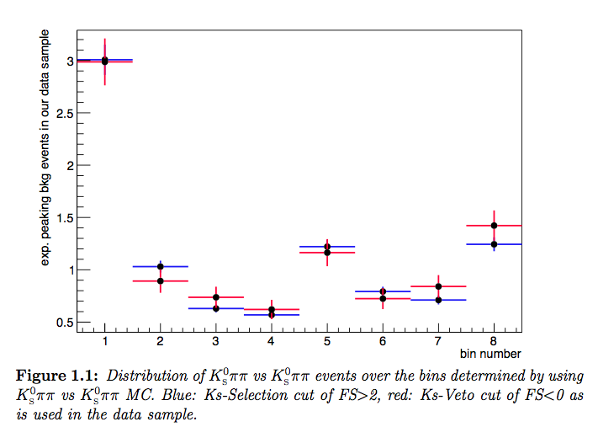
KsPiPi vs 4Pi – peaking bkg
Peaking bkg: KsPiPi vs KsPiPi
total number of peaking bkg events from generic MC: 18.45 ± 1.13
Percentage of peaking bkg events in bin i from data: apply KsPiPi-Selection cut on 4Pi side
BUT: potential bias in distribution due to difference in Ks-Veto and Ks-Selection
KsPiPi vs KsPiPi MC reconstructed as KsPiPi vs 4Pi
Ks-Veto
Ks-Selection
Determine the effect of different cuts using KsPiPi vs KsPiPi signal MC (280000 events)
Weight a_{i}^{peak} accordingly

Slide 3
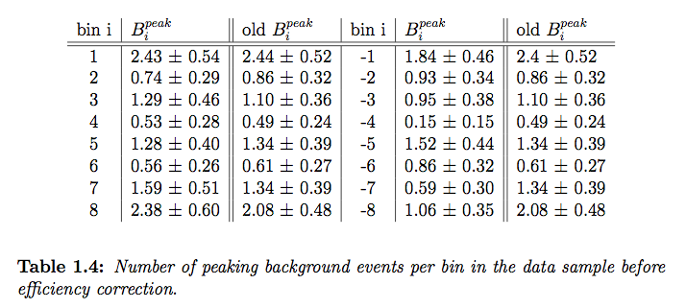
KsPiPi vs 4Pi – peaking bkg
Peaking bkg: KsPiPi vs KsPiPi
total number of peaking bkg events from generic MC: 18.45 ± 1.13
Percentage of peaking bkg events in bin i from data: apply KsPiPi-Selection cut on 4Pi side
BUT: potential bias in distribution due to difference in Ks-Veto and Ks-Selection
All differences within uncertainties anyway….

Slide 4
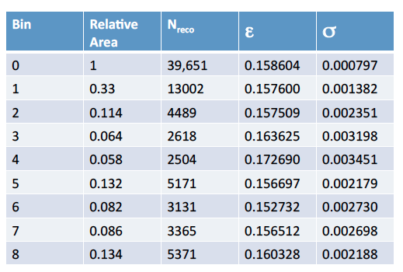
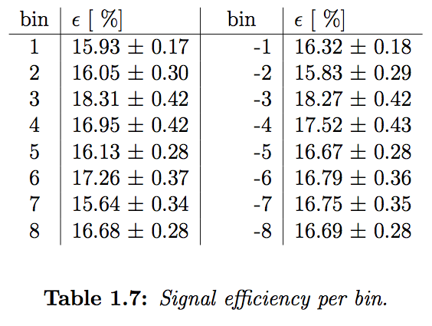
KsPiPi vs 4Pi - efficiency
KsPiPi vs 4Pi signal selection efficiency now determined from KsPiPi vs 4Pi signal MC alone
260k events generated
Efficiencies from K3Pi vs KsPipi - 250k events

Slide 5

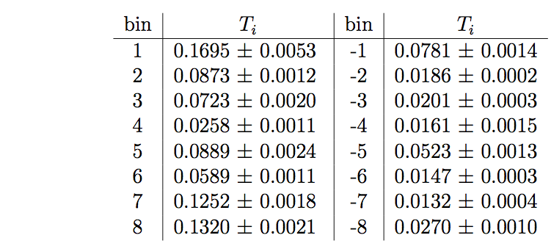
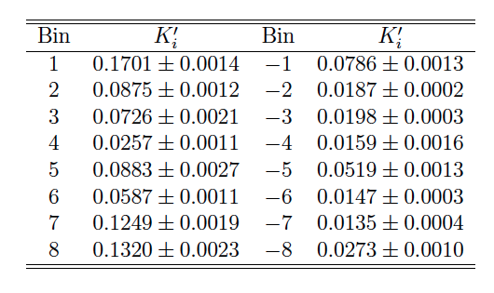
KsPiPi vs 4Pi - T_{i}
T_{i}: fraction yield of flavour tagged KsPiPi events per bin
K’_{i} given by arXiv:1401.1904 contain first order effects of mixing (which are not present at CLEO)
x, y: latest HFAG results (x = (0.63 ± 0.19)%, y = (0.75 ± 0.12)% )
=> fit for T_{i}, using Gaussian constraints on c_{i}, x and y and demanding sum T_{i} =1
New values w/o mixing:
Old values with mixing:

Slide 6
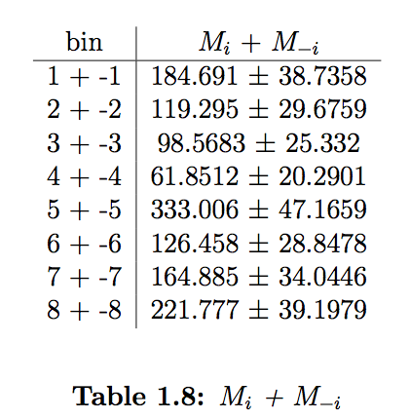
KsPiPi vs 4Pi - M_{i}

Slide 7
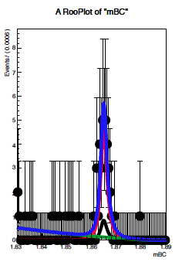
KlPiPi vs 4Pi
Plan for raw signal yield: cut on MissMassSq and fit to M_{bc}(D)
signal shape: fixed from signal MC
peaking bkg shape: same as signal
number of peaking bkg events: …?
Generic MC: after selection
all events
Signal or KsPiPi vs KlPiPi or KsPiPi vs ‘other’
Everything else
What about the ‘everything else’ events that seem to be peaking in M_{bc} too?

Slide 8
F₊
For now: assume only peaking bkg is KsPiPi vs KlPiPi
Raw KlPiPi vs 4Pi yields from fits to M_{bc} in each bin
Signal efficiency from KlPiPi vs 4Pi Signal MC
Fit F₊ for KsPiPi vs 4Pi and KlPiPi vs 4Pi simultaneously (leaving both norm. terms free)
KsPiPi vs 4Pi
Data
Fitresults
KlPiPi vs 4Pi
Data
Fitresults
Chi2/n_dof = 0.627104
F₊ = 0.775 ± 0.056

