Slide 1
MCMC and correlated Pairs
Claire Prouve

Slide 2
DalitzMCMC
MCMC: Markov Chain Monte Carlo
implemented in MINT by Jeremy (Veronika)
tests by Jeremy look good!
super fast but biased for small number of events
-> make huge sample and randomly select events
New: DalitzMCMC now automatically generates a huge sample and randomly selects the
amount you need:
in DalitzMCMC.h:
void FillEventList( DalitzEventList& eventList,
const unsigned int& NEvents, double rejectionFactor = 100 );
-> only every 100th generated event gets put into the eventlist

Slide 3
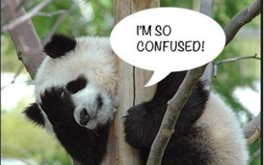
Correlated Pairs
Generation of correlated pairs: this is going on at CLEOc
But we can use the interference in the decay paths to extract some important parameters for our analysis!
Implement a class in MINT that can generate correlated pairs:
use the MCMC method to generate an event with two final states
that follows the PDF corresponding to A(Ψ(3770)-> f1,f2).
f1
D⁰
D⁰
D⁰
D⁰
f2
D^{CP+}
D^{CP-}
D^{CP-}
D^{CP+}
f’1
f’2
Ψ(3770)
Ψ(3770)
Which one is it? I don’t know!
f1/f2: final states accessible both by D⁰ and D⁰ decays
f’1/f’2: final states accessible both by D^{CP+} and D^{CP-} decays
A(Ψ(3770)-> f1,f2) = A(D⁰->f1) • A(D⁰->f2) - A(D⁰->f2) • A(D⁰->f1)
Ψ(3770)
Ψ(3770)
Ψ(3770)
Ψ(3770)

Slide 4
DalitzMCMC_corrPairs
Completely analogue to DalitzMCMC:
DalitzMCMC_corrPairs( const DalitzEventPattern& pat1,
const DalitzEventPattern& pat2, const unsigned int& seed=0 );
void FillEventList( DalitzEventPairList& myPairList,
const unsigned int& NEvents, double rejectionFactor = 100 );
New structure to store (correlated) pairs analogue to DalitzEventList:
class DalitzEventPairList:
public MINT::EventList< std::pair<DalitzEvent, DalitzEvent> >
Same methods, for example:
bool saveAsNtuple(const std::string& fname="DalitzEvents.root",
const bool addSij = true)const;
Note: the PDG information about the D mesons in the tuple is obviously nonsense.
If you want more info about the new classes come and ask me☺

Slide 5
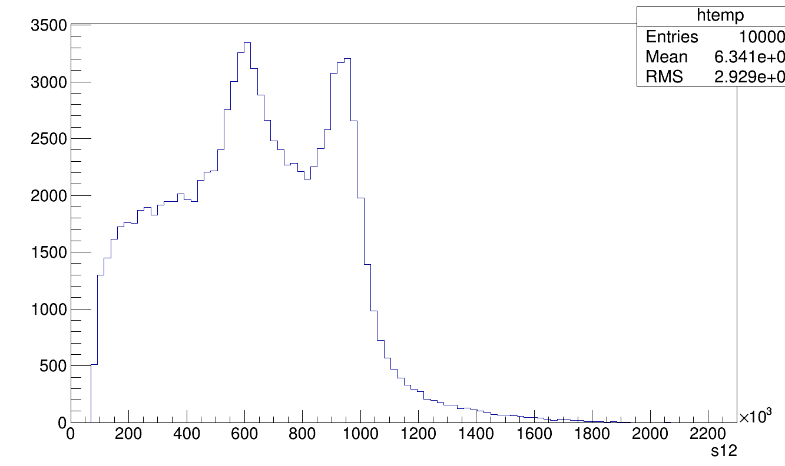
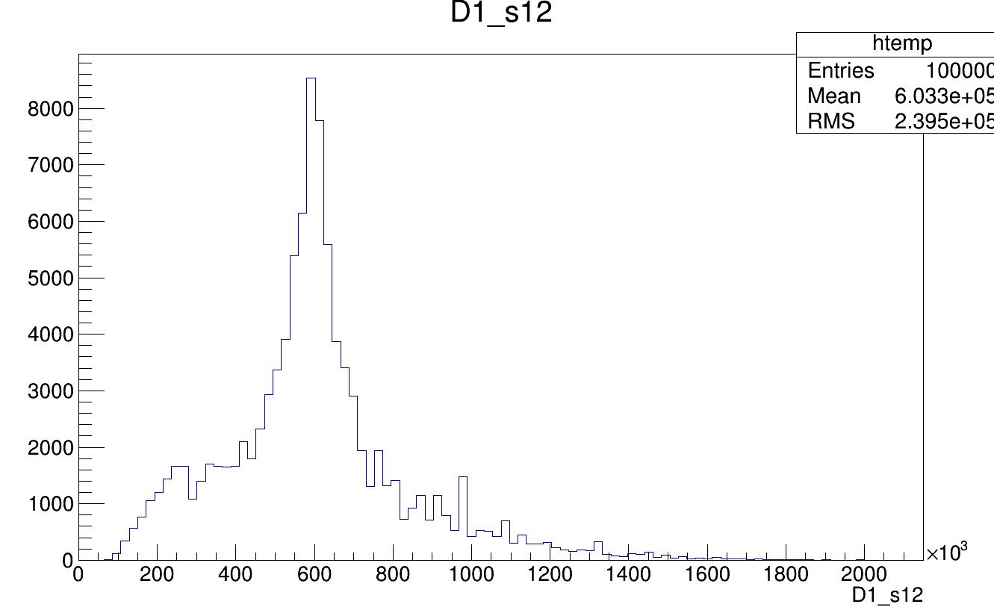
Testing DalitzMCMC_corrPairs
K_{s}PiPi
D^{CP+}
D^{CP-}
D^{CP-}
D^{CP+}
4 Pi
Ψ(3770)
Amplitude for the K_{s}PiPi: D0->rho(770)0(->pi+,pi-),K(S)
Amplitude for the 4Pi: D0[P]->rho(770)0(->pi+,pi-),rho(770)0(->pi+,pi-)
D0->f(0)(980)0(->pi+,pi-),f(0)(980)0(->pi+,pi-)
-> If the correlation thing works, the f(0)(980)0(->pi+,pi-) should be suppressed!
CP even
CP even
CP even
4 Pi
alone
4 Pi
while correlated
Widths of the particles ‘slightly’ modified
No f⁰: Yeay!
ρ⁰
f⁰
ρ⁰
pi+,pi-
pi+,pi-

Slide 6
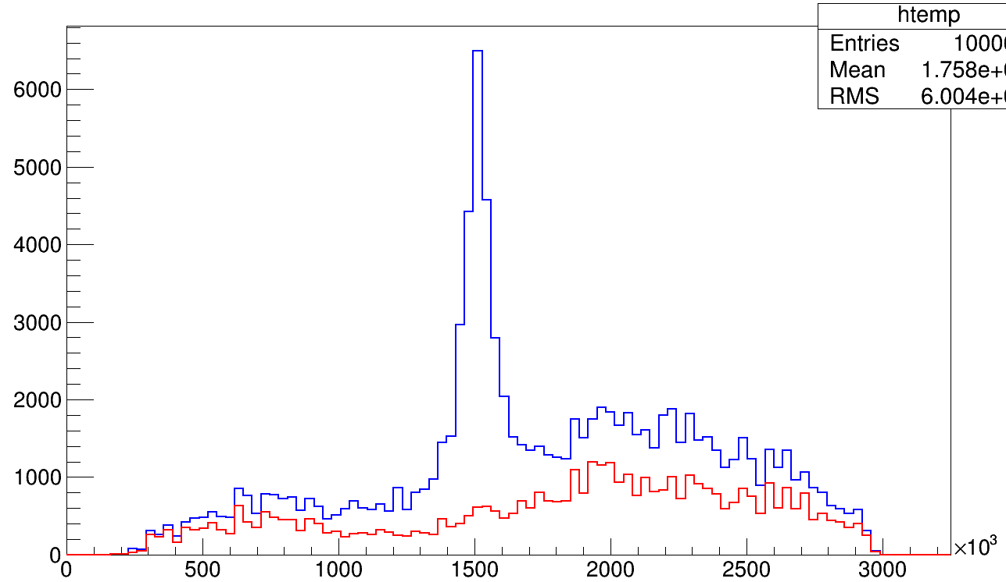
Testing DalitzMCMC_corrPairs
K_{s}PiPi
D⁰
D⁰
D⁰
D⁰
4 Pi
Ψ(3770)
Flavour specific states
Amplitude for the K_{s}π⁺π⁻: D0->K*(892)bar-(->K(S)0,pi-),pi+
Amplitude for the 4π: D0->a(1)(1260)+(->sigma10(->pi+,pi-),pi+),pi-
D0->a(1)(1260)-(->sigma10(->pi+,pi-),pi-),pi+
If we see the K*(892)bar in K_{S}π⁻, the a₁⁺not be seen in π⁺π⁺π⁻
4 Pi
Width of a₁ ‘slightly’ modified
a(1)+
Cut on 0.6GeV < s(K(S)0,pi-) < 1GeV
which makes the K_{S}PiPi come from a D⁰
π⁺π⁺π⁻

Slide 7
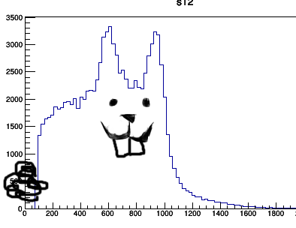
Future MCMC
Pull study to see when MCMC converges/ how reliable it is
Maybe see if we can reproduce the results of the K_{S}PiPi analysis with our DalitzMCMC_corrPairs
Analysiiiiiiiis!!!
New physics?

