Slide 1
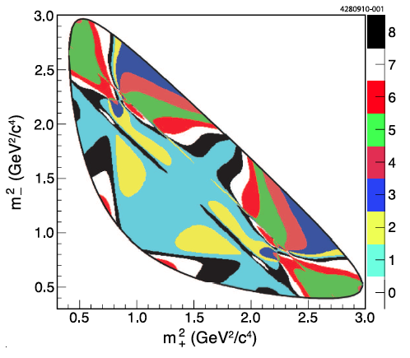
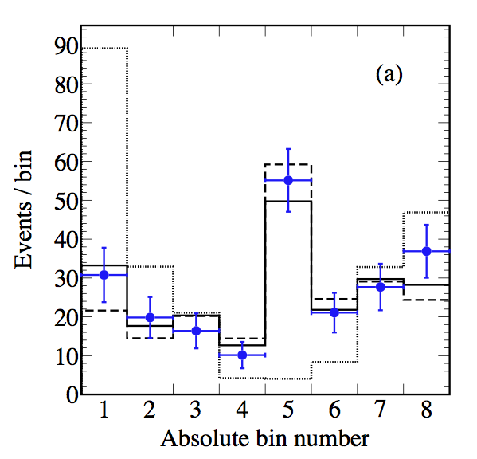
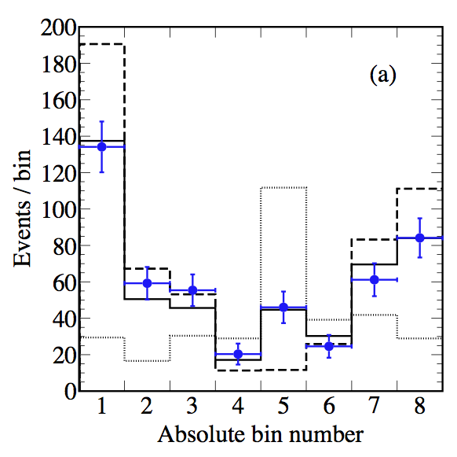

F₊(4π) at CLEO-c
Ultimate goal: model-independent γ measurement at LHCb
F₊(4π) : fractional CP-even content of self conjugated decay D->4π
Using correlated D⁰-meson decays at CLEO-c:
Reconstructing D->4π vs. bins of phase-space of
D⁰->K⁰π⁺π⁻ (strong phase of D⁰->K⁰π⁺π⁻ is known)
D⁰->K⁰π⁺π⁻ phase-space
D⁰->K_{s}π⁺π⁻
D⁰->K_{L}π⁺π⁻
Blue dots: data, solid line: fit result, dotted line F₊=0, dashed line: F₊=1
F₊=0.737 ± 0.049 ± 0.024
Paper published in Physics Letters B
PLB-D-15-00624
amplitude-weighted average of cos(Δδ)

