Slide 1
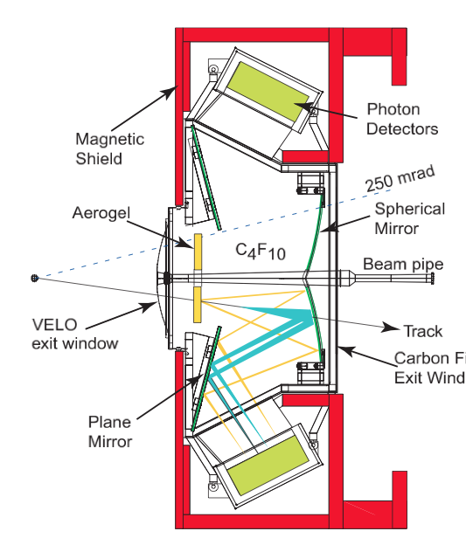
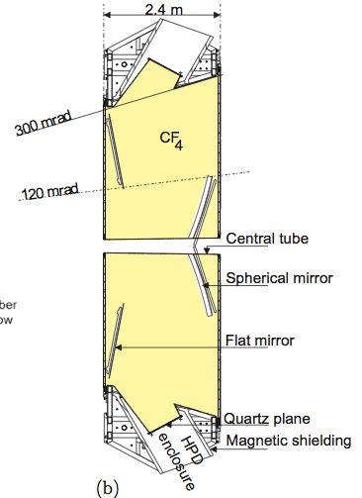
RICH Mirror Alignment
RICH 1:
RICH 2:
4 primary mirrors
16 secondary mirrors
54 primary mirrors
40 secondary mirrors
Photon Detectors
Photon Detectors
Secondary mirrors
Secondary mirrors
Primary mirrors
Primary mirrors
x
x
Misaligned mirrors will affect the PID due to incorrectly predicted Cherenkov angle!

Slide 2
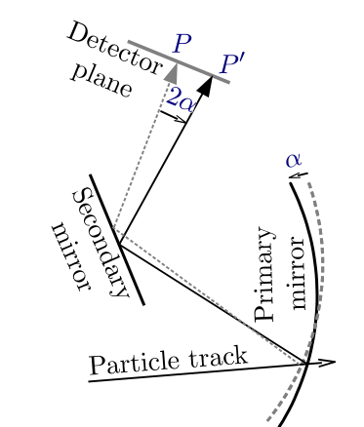
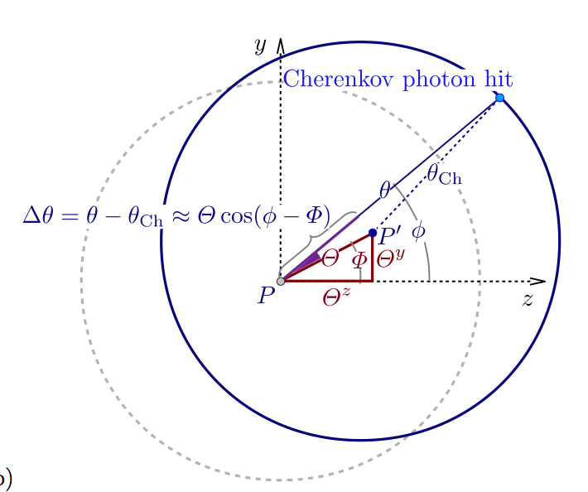
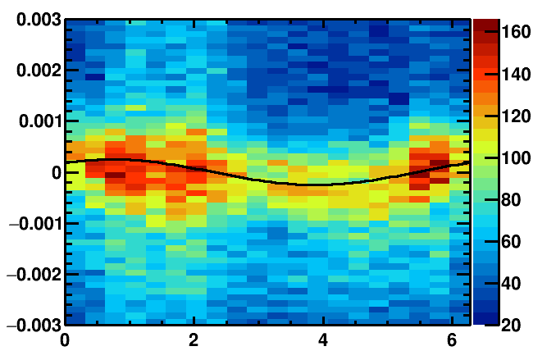
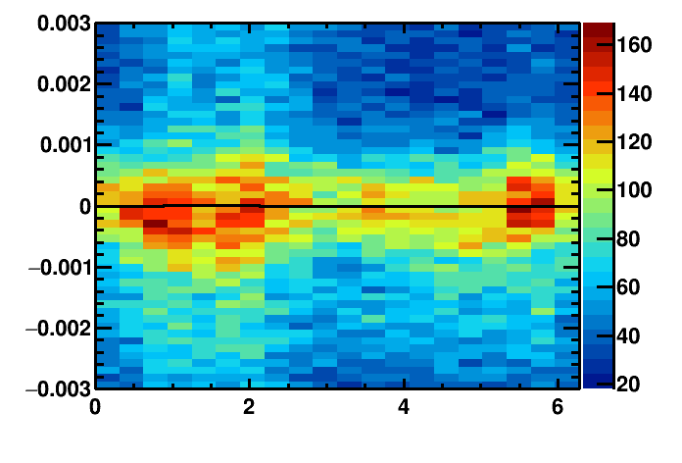
RICH Mirror Alignment
Detector plane
Identify misalignment:
Misalignment
Δθ_{C}(Φ) = θ_{meas.}- θ_{exp.}
Δθ_{C}(Φ) = ρ_{y} cos(Φ) + ρ_{z} sin(Φ)
Proj. Track position
Real track position
Misalignments on detector plane
Misaligned mirror:
Aligned mirror:
Cherenkov angle resolution / rad
Cherenkov angle resolution / rad
azimuthal angle/ rad
azimuthal angle/ rad

Slide 3
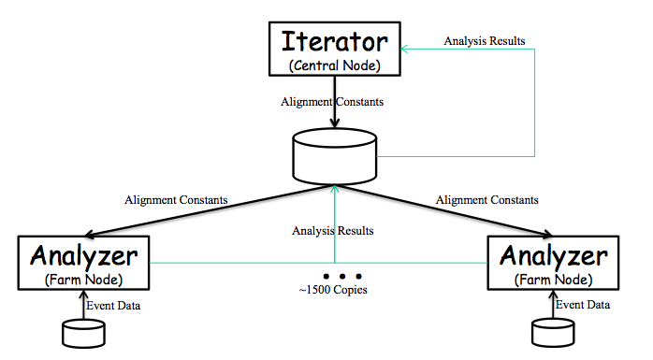
Alignment during Run II
HLT farm nodes (Analysers)
Reconstruct data from HLT1 lines
Make the histograms
Central node (Iterator)
Receives histograms from Analysers
Determines misalignment
produces new database
decides if alignment has converged

Slide 4
RICH Mirror Alignment
RICH1 primary mirrors in y
RICH1 primary mirrors in z
RICH1 secondary mirrors in y
RICH1 secondary mirrors in z
DOWN
UP
DOWN
DOWN
UP
DOWN

