Slide 1
F₊(D->4Pi) from KsPiPi vs 4Pi and KlPiPi vs 4Pi
16/02/2014 Claire Prouve, Chris Thomas, Guy Wilkinson, Sneha Malde

Slide 2
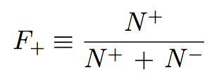
What is F₊(D->4Pi) ?
F₊ is the CP-even fraction of the D->4Pi decay:
F₊(D->K⁺K⁻) = 1 CP even
F₊(D->K_{s} Pi⁰) = 0 CP odd
F₊(D->2Pi⁺2Pi⁻) = [0,1] CP mixture
Measure F+ using the quantum correlated D⁰/D⁰ decays at CLEO:
CLEO-c reminder: ee -> Psi(3770) -> D⁰D⁰ / D⁻D⁺
Straight forward measurement of F₊:
1. count 4Pi vs. CP even/ CP odd eigenstates ==> M⁺ / M⁻
2. count the total number of CP even/ CP odd decays in sample ==> S⁺ / S⁻
3.
N⁺ = M⁺ /S⁺ ==>
Ψ(3770)
2Pi⁺2Pi⁻
D₁
D₂
CP -ES
Ψ(3770)
Don’t care
D₁
D₂
CP -ES

Slide 3

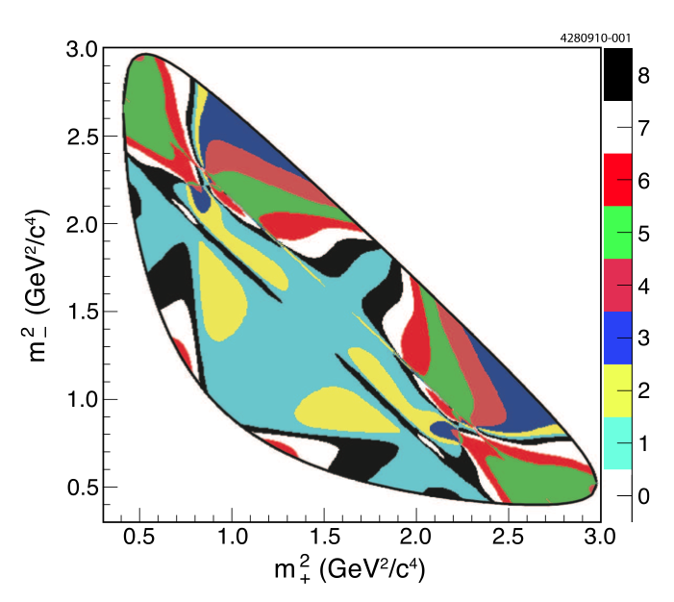
Measuring F₊ with K⁰PiPi
F₊ is related to the strong phase difference in the D-decay:
We know the binned strong phase difference of D->K_{S}PIPi and D->K_{L}PiPi!
(arXiv:1010.2817)
Here is how to get F₊(4Pi):
Amplitude weighted cos of strong phase difference
M_{i}: number of events in bin i
T_{i}: relative number of events in bin i
Flavour tag
Ψ(3770)
Ψ(3770)
D₂
4Pi
D₂
D₁
D₁
^{arXiv:1210.939}
Select K⁰PiPi vs 4Pi events and count how many signal events there are in each bin!
(and then fit the data with the above formula for F₊)

Slide 4
K_{s}PiPi vs 4Pi
Fairly boring selection (CLEO is just so clean)
Fitting the final state particles to the D Mass
Rejecting K_{S}PiPi in the 4Pi side using the flight distance significance of a possible Ks formed of two opposite sign pions
cut of KS_FS<0:
Signal efficiency: 85.1%
bkg efficiency: 9.6%
KsPiPi vs 4Pi
KsPiPi vs KsPiPi reco.
as KsPiPi vs 4Pi
Getting the signal yield:
Signal yield = raw event yield
– peaking bkg yield – flat bkg yield

Slide 5

K_{S}PiPi vs 4Pi – peaking bkg
Peaking bkg: K_{S}PiPi vs K_{S}PiPi
total number of peaking bkg events from generic MC: 18.45 ± 1.13
distribution of peaking bkg events over bins from data:
apply K_{S}PiPi-Selection cut on 4Pi side to get a K_{S}PiPi vs K_{S}PiPi data sample
Remove bias due to K_{S}-Selection instead of K_{S}-Veto with K_{S}PiPi vs K_{S}PiPi Signal MC
with bias removal
w/o bias removal

Slide 6

K_{S}PiPi vs 4Pi – flat bkg
Total number of bkg events determined extrapolating from the sidebands in data:
11.64 ± 2.90 flat bkg events in the signal region
Distribute them ‘flatly’ across the bins
= proportional to the are of the bin
S
A
D
C
B
A,B: one D correctly id-ed
C: continuum bkg
D: pure combinatoric

Slide 7

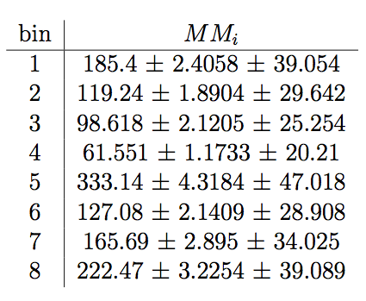
K_{S}PiPi vs 4Pi – signal yields
Signal
peaking bkg
flat bkg
Efficiency corrected signal yields:
stat errors only, (first MC, second data)

Slide 8
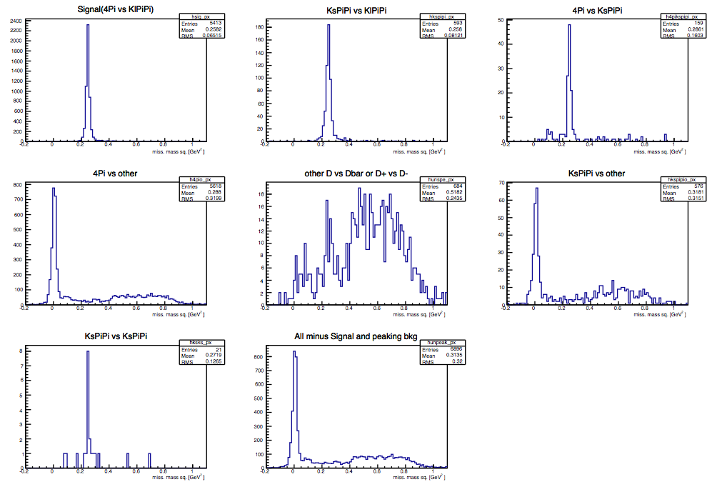
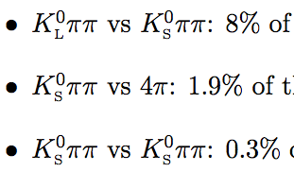
K_{L}PiPi vs 4Pi – peaking bkg
Same strategy as for K_{L}PiPi vs 4Pi, but more tricky due to more and different bkg.
Peaking Bkg:
Generic MC:
Reconstruct K_{L}PiPi vs 4Pi and see what we get ➔
Peaking in SW:
Signal window

Slide 9
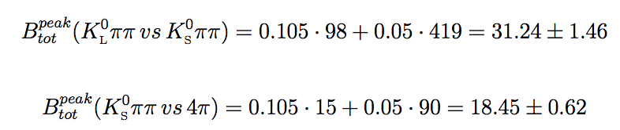
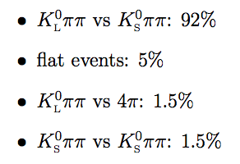
K_{L}PiPi vs 4Pi – peaking bkg
1. Scale the total number of peaking bkg events from generic MC:
2. Get K_{L}PiPi vs K_{S}PiPi distribution over bin using data with K_{S}-Selection on the 4Pi side:
generic MC tells us that the data sample with K_{S}-Selection contains:
Subtract the flat distribution from the data to get the peaking bkg
Remove the bias introduced by the K_{S}-Selection
Put a systematic on it later
3. Get K_{S}PiPi vs 4Pi distribution over bin using data from KsPiPi vs 4Pi analysis :
➔ Take results from K_{S}PiPi vs 4Pi and reweight according to the bin-dependent efficiency in K_{L}PiPi vs 4Pi
The efficiency for reconstructing and selecting K_{S}PiPi vs 4Pi events as K_{L}PiPi vs 4Pi events is taken to be the same as that for genuine K_{L}PiPi vs 4Pi events - under the assumption the K_{S} is ’lost’ which should result in the same kinematics of the two decays.

Slide 10

K_{L}PiPi vs 4Pi – flat+cont bkg
Since for K_{L}PiPi vs 4Pi only 4 pions are reconstructed, the amount of continuum bkg is considerable.
Use the Powell method to determine the total number of flat and cont. bkg event
Divide the MissMassSq region into lower sideband, signal region, upper sideband
Assume that the ratio of events between these regions is correctly modeled by MC:
for example N_{sig}^{KLPiPivs4Pi} = MC_{sig}^{KLPiPivs4Pi} /MC_{LU}^{KLPiPivs4Pi} N_{LU}^{KLPiPvs4Pi}
3 equations with 3 unknowns:
Solve and get:
B^{flat} = 28.42 ± 10.80 ± 6.80
B^{cont} = 37.15 ± 10.85 ± 9.45
Distribute ‘flatly’ over bins, i.e. according to bin area.
Continuum bkg
Flat bkg
Raw data yields
Signal yields
Peaking bkg
Signal
peaking bkg
flat bkg
cont bkg

Slide 11
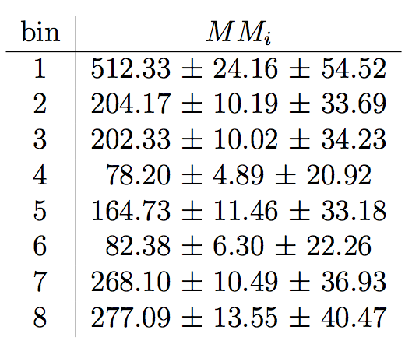
K_{L}PiPi vs 4Pi – signal yield
Preliminary: we are still fiddling around with some yields here…
Signal
peaking bkg
flat bkg
cont bkg
Efficiency corrected signal yields:
stat errors only, (first MC, second data)

Slide 12
F₊ - from K_{S}PiPi vs 4Pi
Reminder:
In the Fit: Gaussian constrain all input parameters, take into account correlation between c_{i}, fit for F₊ and h
Just measured
External input
Want this
Thanks to Jeremy’s tutorial
Data
Fitresults
F₊ = 0.830 ± 0.071
Chi2/ndof = 0.7

Slide 13
F₊ - from K_{L}PiPi vs 4Pi
Reminder:
In the Fit: Gaussian constrain all input parameters, take into account correlation between c_{i}, fit for F₊ and h
Just measured
External input
Want this
Data
Fitresults
F₊ = 0.678 ± 0.069
Chi2/ndof = 0.62

Slide 14
F₊ from simultaneous fit
Data
Fitresults
Data
Fitresults
F₊ = 0.753 ± 0.052
Chi2/ndof = 0.77
K_{S}PiPi vs 4Pi:
F₊ = 0.830 ± 0.071
Chi2/ndof = 0.7
K_{L}PiPi vs 4Pi:
F₊ = 0.678 ± 0.069
Chi2/ndof = 0.62
As I said: more fiddeling has to be done on the K_{L}PiPi part…

Slide 15
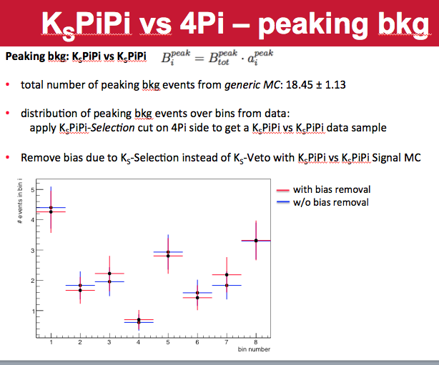
Question 1
When distributing the total number of flat bkg events over the bins no error on the area of the bin is assumed.
The error on the bkg yield per bin is smaller than sqrt(N_{i})
Is that a problem? How to fix it?
For the distribution of peaking bkg I only take the error from
distribution in data (multinomial error)
rescaling from MC (ratio of two efficiencies)
➔ Does that not introduce the same problem as above?

Slide 16
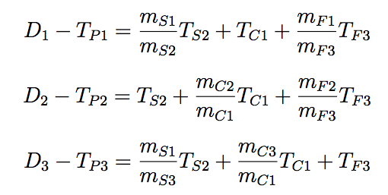
Question 2
K_{L}PiPi vs 4Pi – error on signal yields
Done using a toy study:
1. in the Powell method Poisson/Gauss vary all inputs (MC and data independently)
2. Still from within the toy study calculate the flat bkg, cont bkg yields per bin
3. Subtract from data yield per bin to get signal yields per bin
The data yield is needed twice: in step 1 and in step 2:
I generate the data yields for each bin (which I am going to use in step 2), and use the sum as input for step 1. ➔ I am using the same data yield in the entire toy. Is that correct?

Slide 17
Summary
Calculated the K_{S}PiPi vs 4Pi signal yield per bin
Almost finished calculating the K_{L}PiPi vs 4Pi signal yield per bin
Fitter is fully setup and functional
Still to do:
Some kinks to iron out in the K_{L}PiPI vs 4Pi part
Generate more K_{L}PiPi vs 4Pi signal MC for the efficiency correction
Calculate ALL the systematics

Slide 18

Backup
Binned strong phase difference
Amplitude of D going to point x,y in the Dalitz Plot

Slide 19
Backup
Powell method:

