Slide 1
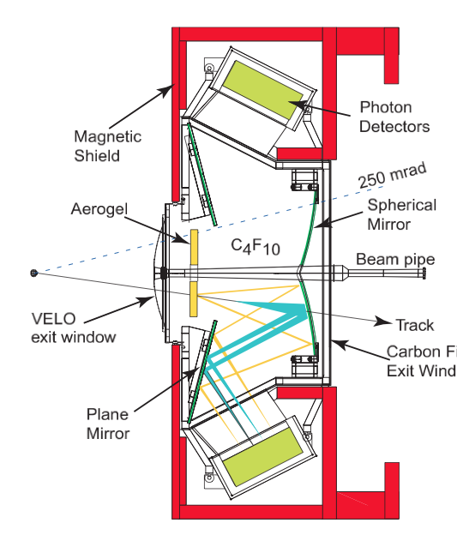
Real-time alignment of the LHCb RICH detectors
Ring Imaging Cherenkov detector:
Run I: offline alignment after data-taking, twice a year (?) => reprocessing of data
Run II: real-time alignment every fill!!!
Detector plane
Secondary mirrors
NEW!
Primary mirrors
L0 Trigger
HLT1
buffer
Offline
HLT2
Calib.
Implementation on HLT farm:
If mirrors are misaligned, the Cherenkov angle is reconstructed incorrectly => bad PID ☹
Alignment Procedure: data driven, iterative
~1800 farm nodes used for event reconstruction
Central node evaluates results from reconstruction and calculates new alignment constants
Everything steered by a Finite State Machine
Super fast! :D
Central Node
Results
Current alignment
Reconstruct selected
events
Alignment Constants
Alignment Constants
Alignment Constants
Amend alignment constants
Has the alignment changed?
Results
Farm Node
…
Farm Node
Farm Node
Event Data
~1800 Nodes
Event Data

