Slide 1
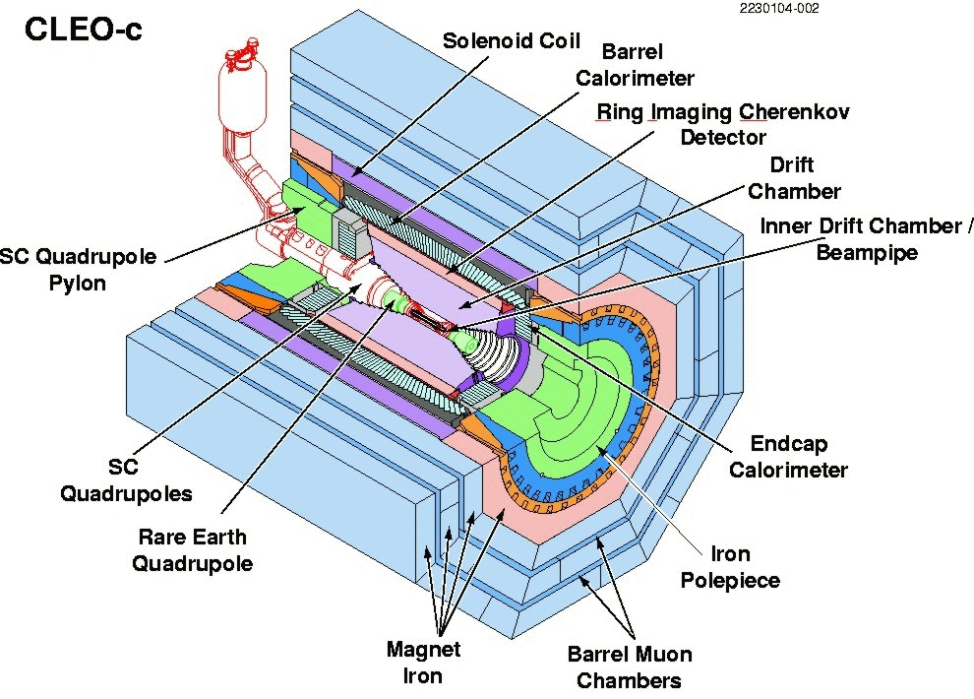


F₊(4Pi) at CLEO-c
Ultimate goal: model-independent y measurement at LHCb
CLEO-c at Cornell Electron Storage Ring (CESR):
e⁺e⁻ collisions at the Ψ(3770) resonance
Ψ(3770) decays into correlated D meson pair:
(correlation conserved even during meson oscillation!)
Ψ(3770)
Ψ(3770)
D⁰
D⁰
D_{CP}⁺
D_{CP}⁻
F+: CP even fraction of D->4Pi
N+(-)= M+(-)/S+(-)
S+(-): number of single-tagged CP even (odd) candidates
M+(-): number of CP even (odd) 4Pi candidates
=> F+ can be measured by evaluating the yields of 4PI events against CP-tags (Chris Thomas from Oxford is doing this part)
amplitude-weighted average of cos(Δδ)

Slide 2
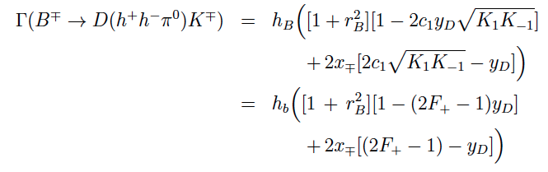

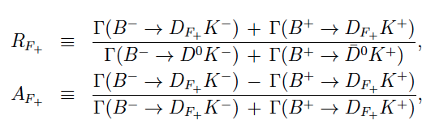

Gamma with F₊(4Pi)
R_F+ : partial widths ratio
A_F+ : CP-Asymmetry
amplitude-weighted average of cos(Δδ)

Slide 3
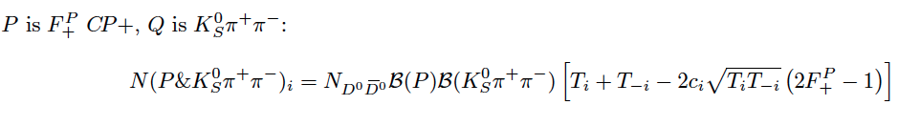
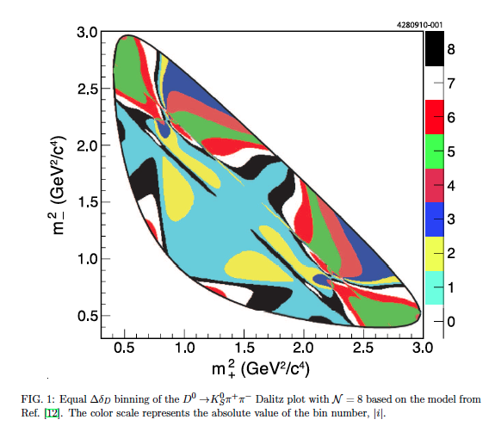
F₊(4Pi) at CLEO-c using KsPiPi
This is what I have been doing!
P = 4Pi here
Number of 4Pi vs KsPiPi events in the i-th bin of the KsPiPi phasespace
Fractional flavour tagged KsPiPi events in bin i
(already measured)
Amplitude weighted cos of the strong phase of D->KsPiPi in bin i
(already measured)
Total number of DD events in data-sample
Selected 4Pi vs KsPiPi events in the KsPiPi phasespace, events color-coded by bin
amplitude-weighted average of cos(Δδ)

Slide 4
F₊(4Pi) at CLEO-c using KsPiPi
On the selected sample I did some bkg substraction (bkg very very low, MC and data driven) and efficiency correction (using signal MC)
Summation over bins i and –i because they yields the same values
Then fitted for F
c_{i}, T_{i} were measured before and were therefore Gaussian constraint in the fit with sigma being their uncertainty, correlation between c_{i}’s taken into account
Red dots: ‘data’
Blue dots: fit values
F₊ = 0.84 +/-0.07
(which is in agreement with the current results on the CP-tagged events)
Next: same with KlPiPi instead of KsPiPi
Same eq. as on slide 2 but with +2*c_{i} *sqrt(….)
(c_{i} are the same as for KsPiPi in that case)
Events are selected but the bkg-substraction way more difficult => this is what we are working on right now
amplitude-weighted average of cos(Δδ)

