Slide 1



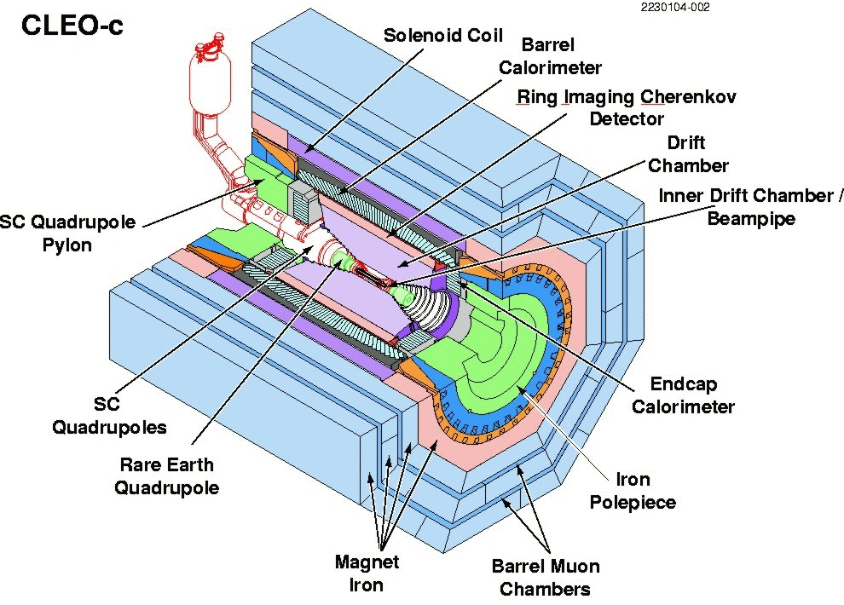
c_{i} and s_{i} at CLEO-c
Ultimate goal: model-independent y measurement at LHCb
Decay width in bins of D phase space:
with amplitude-weighted
average of
cos(Δδ)/sin(Δδ) in bin i
CLEO-c at Cornell Electron Storage Ring (CESR):
e⁺e⁻ collisions at the Ψ(3770) resonance
Ψ(3770) decays into correlated D meson pair:
(correlation conserved even during meson oscillation!)
Ψ(3770)
Ψ(3770)
D⁰
D⁰
D_{CP}⁺
D_{CP}⁻
amplitude-weighted average of cos(Δδ)

Slide 2
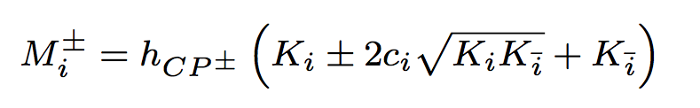
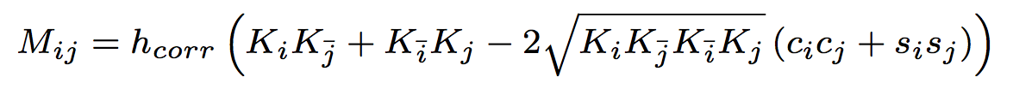
c_{i} and s_{i} at CLEO-c
Use D π⁺ π⁺ π⁻ π⁻ decays due to symmetry in the final state
(increase statistics by ‘folding’ the Dalitz-Space)
Measure c_{i} by:
reconstruct D 4π vs. CP specific final state (CP tag)
reconstruct D 4π vs. flavor specific final state (flavor tag)
compare yields in each bin to get model independent c_{i}
CP tagged D-> 4Pi
#of events in bin i: M±_{i}
(simulation)
Measure s_{i} by:
reconstruct Ψ(3770) (DD) (4π)(4π’) and use interference effects between both possible decay paths
extract event yields from both Dalitz plots
Compare to M±_{I} and : K_{i} to get model independent s_{i}
OR: use Ψ(3770) (DD) (4π)(K_{s}ππ) to add statistics
c_{i} and s_{i} known for K_{s}ππ
and just use formula above ;)
flavour tagged D-> 4Pi
#of events in bin i: K_{i}
(simulation)
amplitude-weighted average of cos(Δδ)

