Slide 1
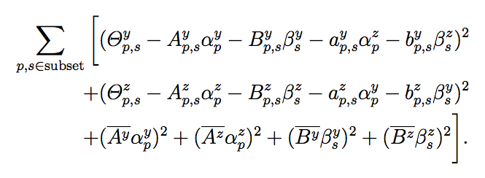

Current regularized least square method in the RICH mirror alignment:
“Normal” least square
Regularization term
Mirror tilts
(major) magnification coefficients
(translate the mirror tilt into effect seen on the detector plane)
Tikhonov regularization/ ridge regression:
In many cases, this matrix is chosen as a multiple of the identity matrix, giving preference to solutions with smaller norms; this is known as L2 regularization.

