Slide 1
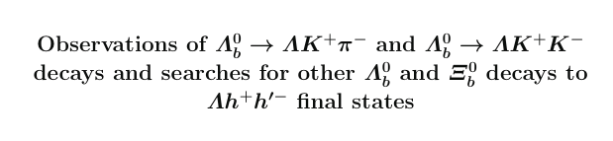
MCMC and correlated Pairs

Slide 2
Motivation
Λ_{b} and Ξ_{b} have been discovered but not many decays modes have been studied – especially charmless ones.
Decays can offer insight into harmonization mechanisms
CP violation has been observed in charmless B-decays ➔ look for CP violation in charmless Λ_{b} decays
Looked for Λ_{b} and Ξ_{b} to ΛK⁺K⁻, Λπ⁺π⁻, ΛK±π± with Λ_{b} to Λ_{C} (-> Λπ⁺) π⁻ as control and normalization channel
Measure phasespace integrated CP violation for Λ_{b} to ΛK⁺K⁻ and ΛK±π±
Analyses done for 2011, 2012a, 2012b independently as well as for long and downstream reconstruction of Λ➔pπ⁻

Slide 3
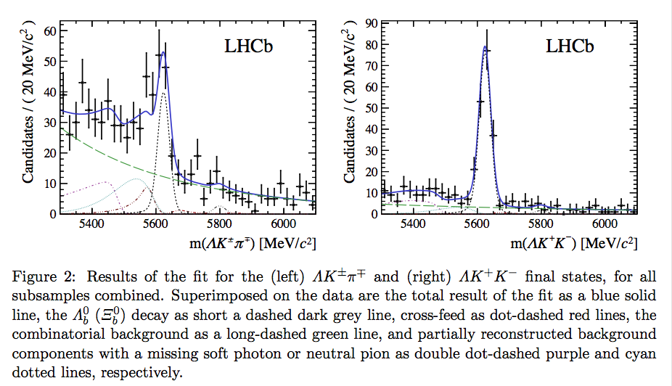
Signal observation
Signal: double Crystal ball
Cross-feed bkg: double Crystal ball
Combinatorial bkg: exponential Partially reconstructed bkg:
ARGUS convolved with Gaussian

Slide 4
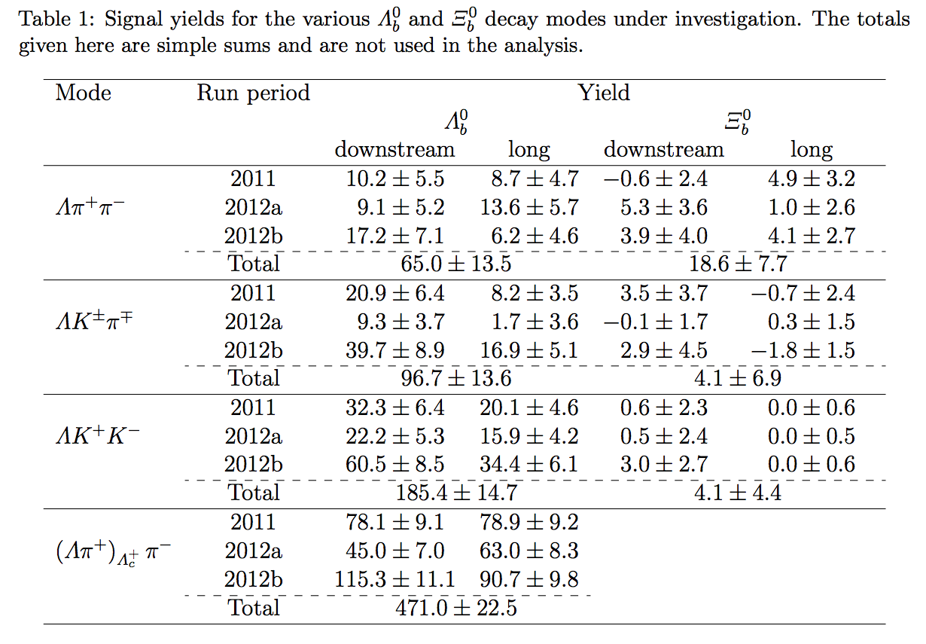
Signal observation
5.2σ
8.5σ
20.5σ

Slide 5

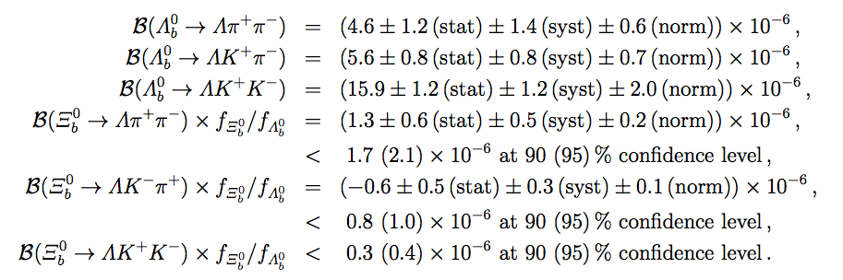
Branching ratios (limits)
Branching ratios determined using the normalization channel:
Theoretical predictions: 10⁻⁹ – 10⁻⁷

Slide 6



CP - Asymmetry
Bkg subtracted and efficiency corrected signal yields
Use control channel to get production and detection asymmetry since no CP-asymmetry is expected : A^{raw}_{CP}(control) = A_{P} + A_{D}
Smaller than 3σ ☹

Slide 7
Comments
Efficiencies for selection not listed.
Selection efficiency modeled in 5 variables: 2 Dalitz-masses, 3 helicities ➔ the information about the last three should be in the contained in the first two + this assumes that individual track- p_{T} and η are correctly modeled in the MC
Cross-feed bkg modeled by double CB: shape determined with the help of “high statistics control sample” ➔ Need specifying and reference
Partially reconstructed bkg modeled by ARGUS convolved with Gaussian: What does this model?
Partially reconstructed bkg for control channel modeled by non-parametric density estimate: Why and from where?
Ξ_{b} ➔ ΛK⁺K⁻ has very few events in signal region and therefor the signal yield is constrained to be non-negative: Lower fit-error is biased!
Fit model and stability is validated with ‘pseudoexperiments’: more details
Dalitz-plot distributions of Λ_{b}➔ΛK⁺K⁻ and Λ_{b}➔ΛK±π± are obtained using the sPlot technique: Λ_{b} mass is correlated with position on Dalitz-Plot so maybe shouldn’t be used?

